Slide 1
Creating Community and Belongingness within Online Learning Platforms
Dr. Rebecca Rivera

Slide 2
What is Community?
Within our classrooms, we:
  Build and maintain a collective sense of purpose and a shared responsibility for learning.
  Create shared norms and build relationships
  Craft meaningful and interactive learning activities

Slide 3

What is Belongingness?
Students feel accepted, valued, and respected as a
legitimate part of the learning process.
Student identities are reflected within the course.
Students are able to identify with the curriculum and
interactive learning.
Students feel safe to learn, take risks, and ask for help.

Slide 4
Why is this Important?
When students do not feel they belong or are disconnected from the instructor and their peers, they are more likely to disengage.
Dr. Rebecca Glazer (2021), in her book, “Connecting in the Online Classroom.” argues that there is an online retention crisis within online courses.
She states that students report that a major reason they drop online courses is due to the lack of connection they feel within the course.

Slide 5
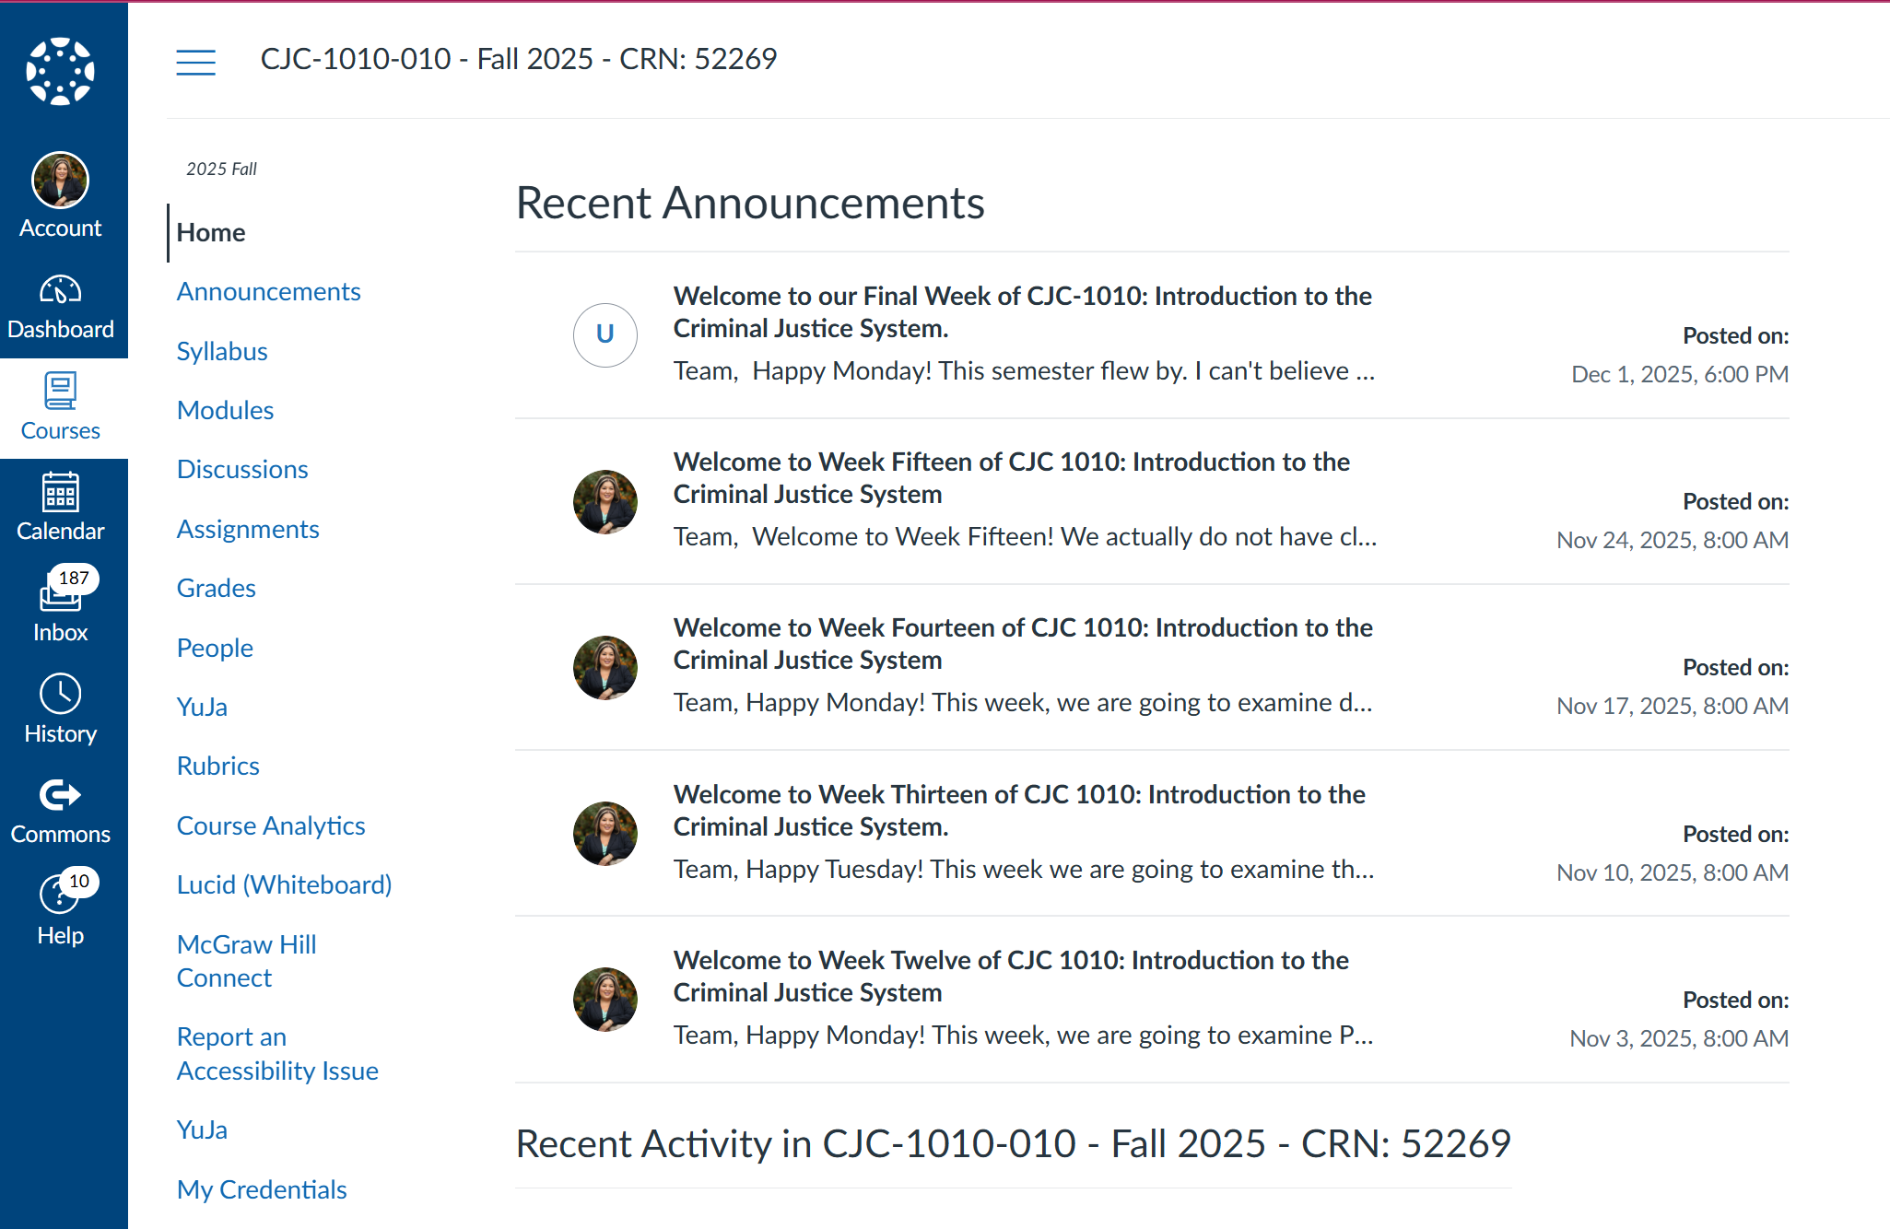
How do We Create Community and Belongingness online? (1 of 3)
Establish a weekly routine of posting weekly announcements so that students know:
-how to navigate the course
-the weekly agenda
-weekly topic
-assignments due that week
Our language should be intentional, inclusive, and welcoming.

Slide 6
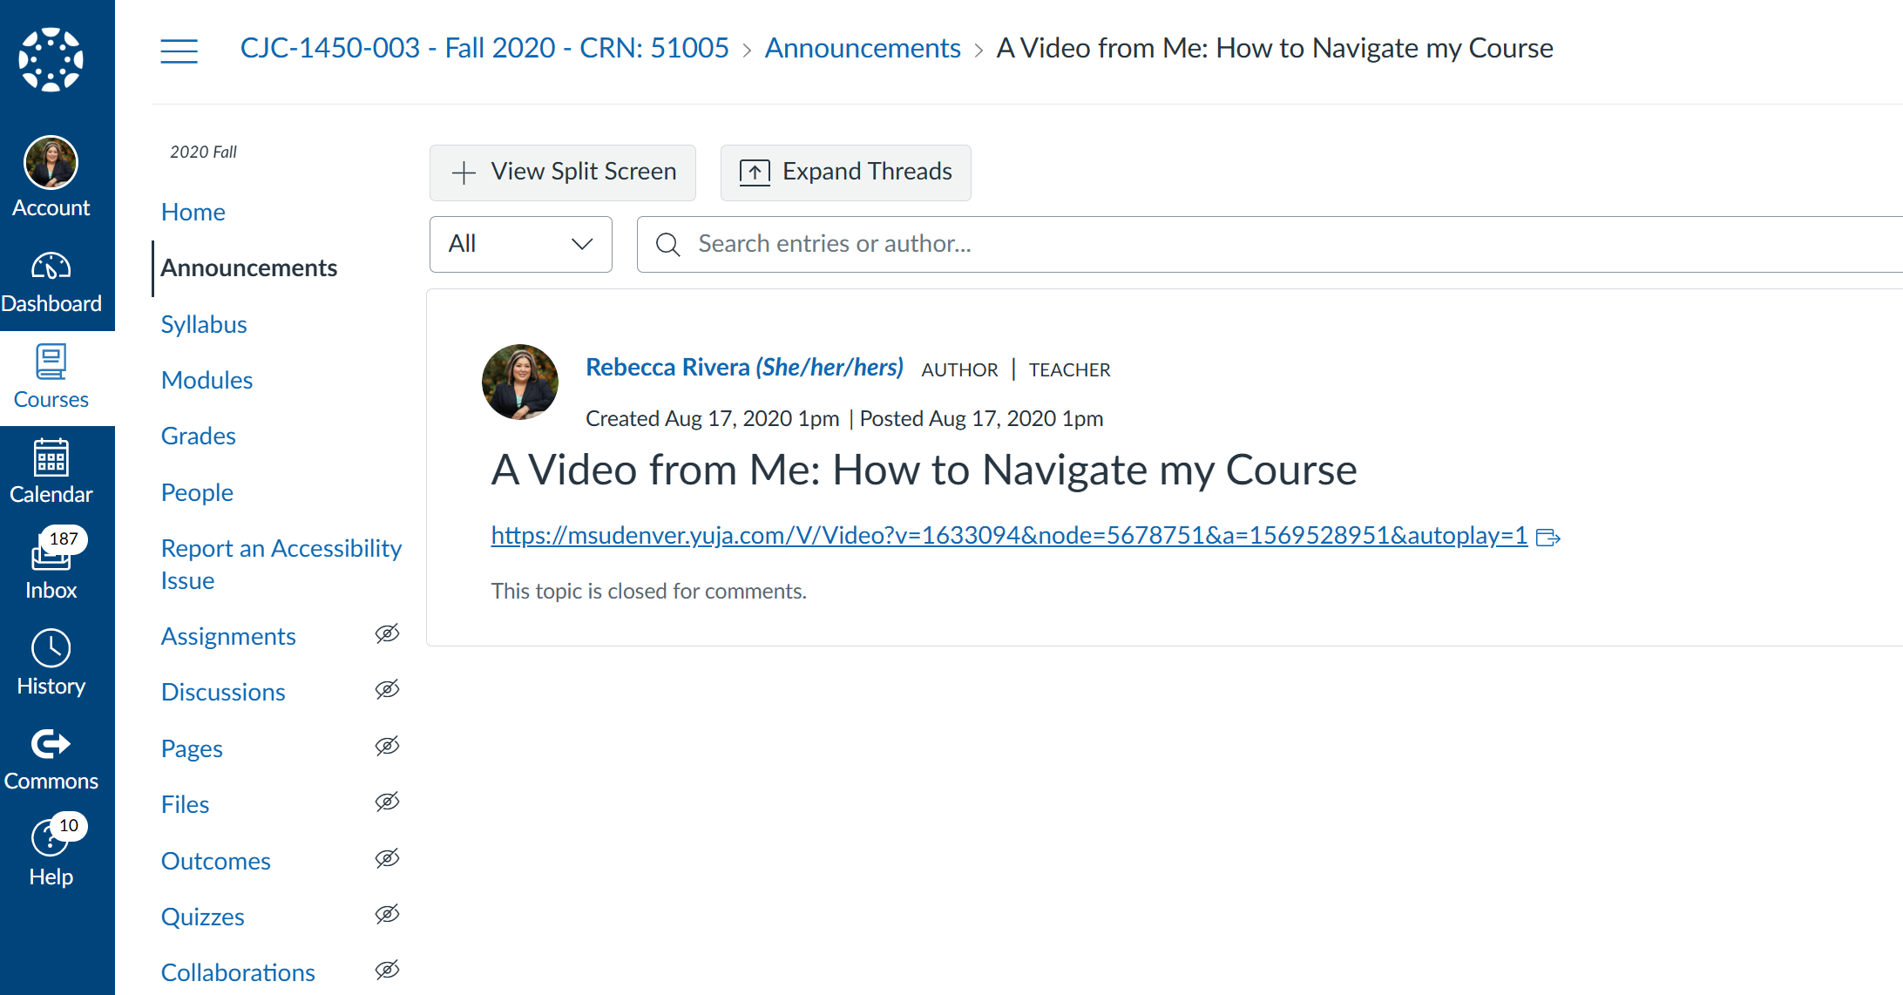
How do We Create Community and Belongingness online? (2 of 3)
Add videos to create a human connection with your students.
-They see you and hear your voice.
-They get to see your personality.
Weekly messages, to include videos builds rapport between the instructor and the student (Glazier, 2021).

Slide 7
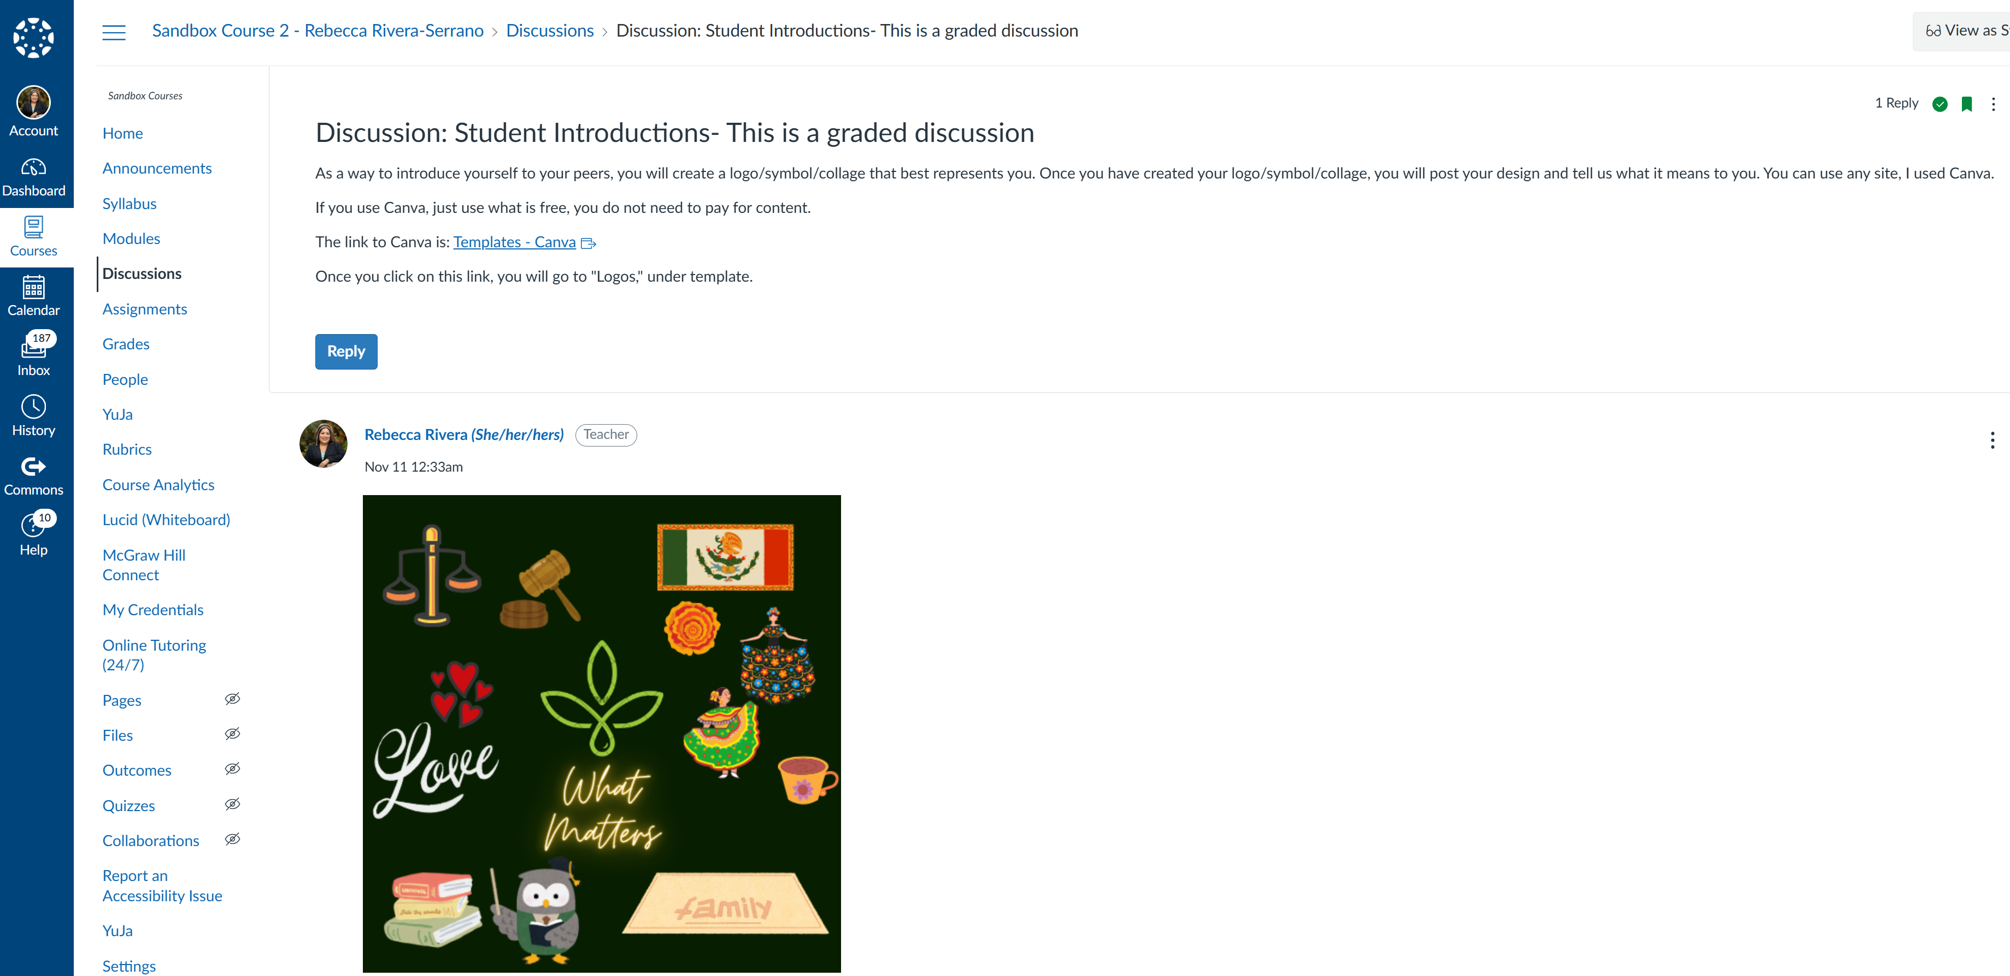
How do We Create Community and Belongingness online? (3 of 3)
Create activities within the
the course that invites students
to introduce themselves and
what matters to them.
As an example, have students
create a Canva design or logo
that represents them and has
them explain why.
Or have them create a video
introducing themselves.

Slide 8
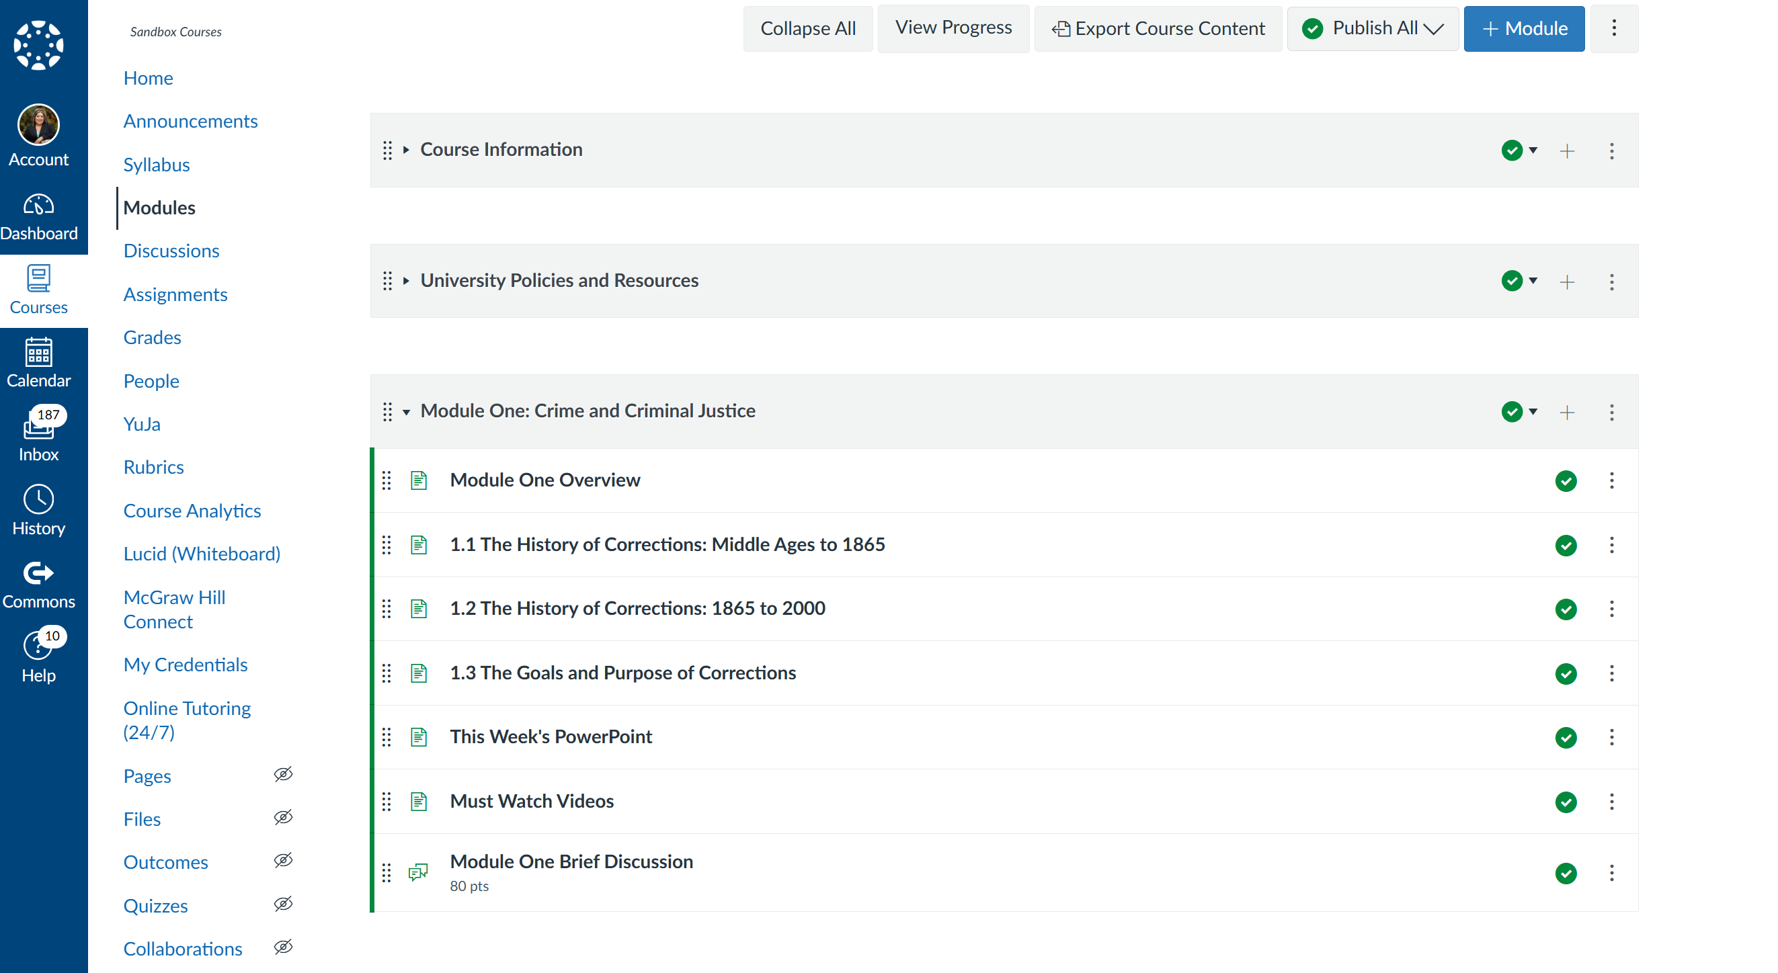
How do We Create Community and Belongingness online?
Create routine and consistency.
This creates safety.
Each module is designed the same
so students learn what to expect
and how to navigate the course.
Create weekly discussions so that
students are engaging with each
other.

Slide 9
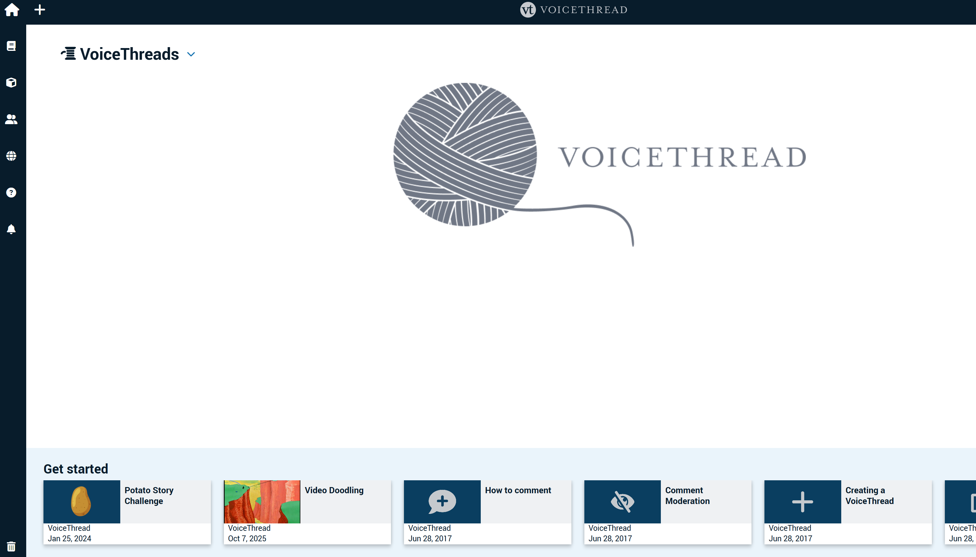

Interactive Presentations and Discussions

Slide 10
Additional Suggestions to Create Community and Belonging
Dr. Glazier (2021 recommends the following:
  Letting students know we are on their side.
  Offering constructive and timely feedback.
  Check in with students who are falling behind.
  Use students’ names in comments, discussions, and feedback.
  Make sure your course is accessible.

