Slide 1

Ai vs Ai
Artificial Intelligence Detectors
Joe Mahoney | December 9, 2025
Notes:
Struggled finding a topic, and Ai is kind of tired. But, the misuse of Ai was a lot of hallway conversation in my department recently due to a our Spring schedule having a few more online courses that more of the faculty teach. So, here we go. I also break convention and use Ai vs AI because it looks like AL to me & I think of Alf from the old, old sitcom and that freaks me out….it is a whole thing.

Slide 2

Contents
Who’s using Ai at MSUD and how?
50,000-foot look at Ai detectors
Do they work?
Alternatives & strategies for mitigating inappropriate Ai use in class
CTLD Resources
References cited

Slide 3

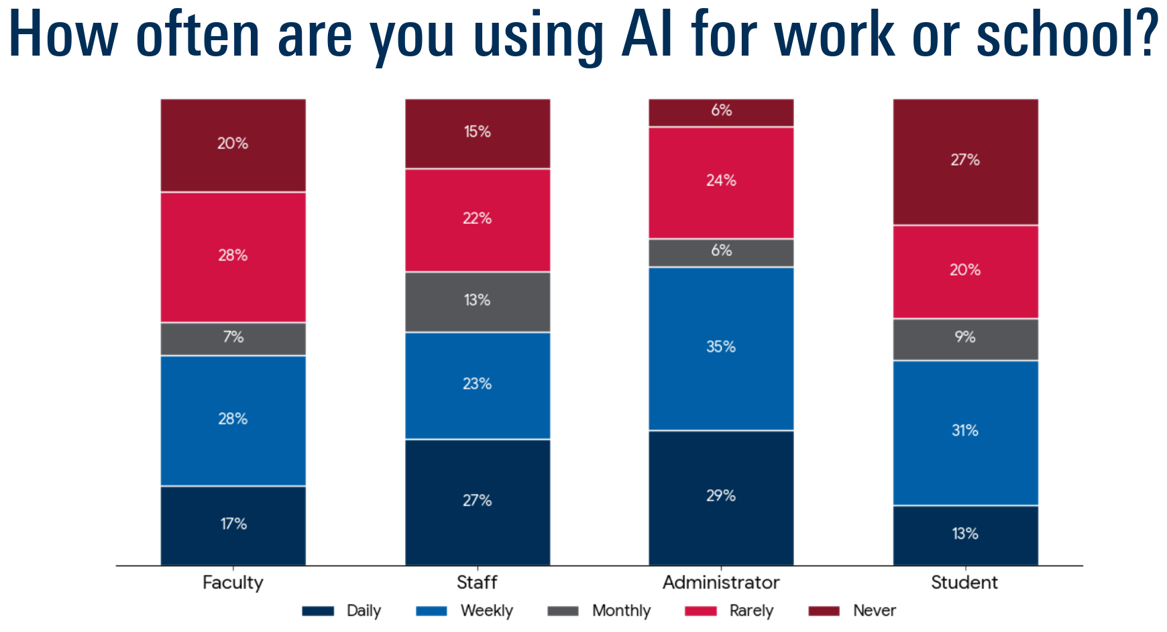
Who’s using Ai at MSUD and how?
Of note: 47% of students and 48% of faculty respondents rarely or never use AI at work or school.
Text description of graph on slide 17.
Survey presented to Faculty Senate on Dec. 4, 2025, by Sam Jay, Executive Director of Online Learning of 1,953 MSU Denver students (83% degree-seeking undergraduates).

Slide 4

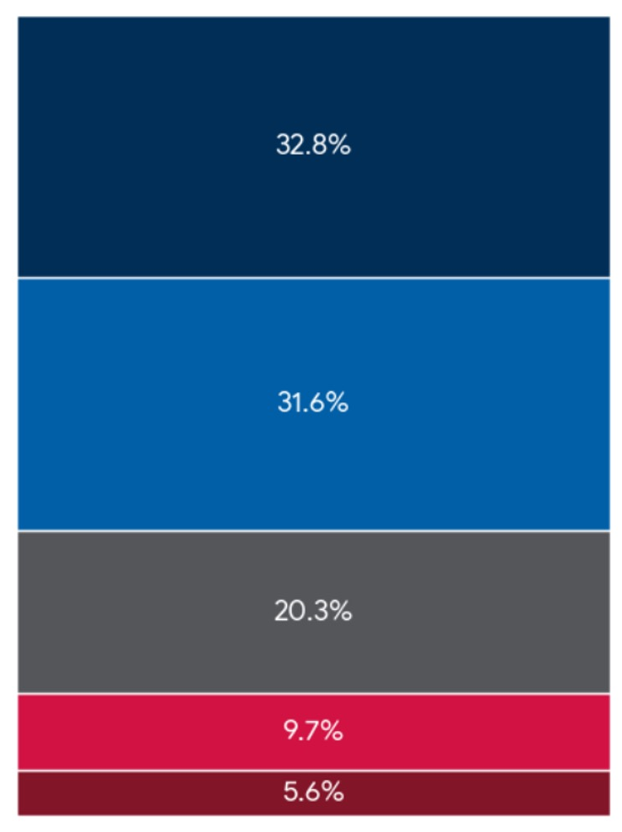
MSU Denver Students on AI
32.8% Strongly Agree
64% of students (total) using it agree or strongly agree that: “Learning to use AI effectively is essential for my future/professional success.”
31.6% Agree
20.3% Neutral
9.7% Disagree
5.6% Strongly Disagree
Source: Sam Jay, Executive Director of Online Learning, MSU Denver; Survey of 1,953 students (83% degree-seeking undergraduates).
Notes:
672

Slide 5
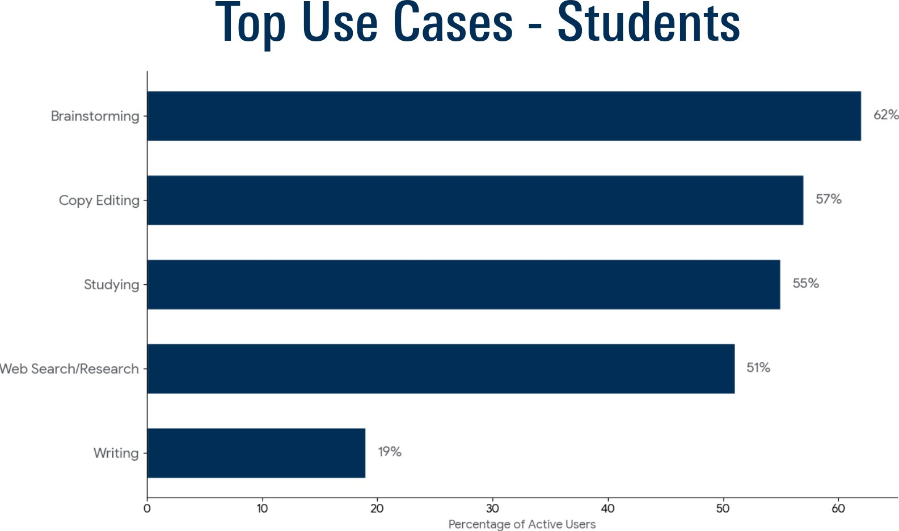
Top Use Cases - Students
Top Use Cases - Students
  (Per class of 25)
Brainstorming
  62% (8)
Copy Editing
  57% (7)
  Studying
  55% (6)
  Web Search/ Research
  51% (6)
  Writing
  19% (3)
  Percentage of Active Users
Survey presented to Faculty Senate on Dec. 4, 2025, by Sam Jay, Executive Director of Online Learning of 1,953 MSU Denver students (83% degree-seeking undergraduates).
Notes:
52% of 25 (avg class) is 13, then 19% of 13 = 2-1/2 using it for writing;

Slide 6

Two main Ai Detectors’ metrics:
“The text itself is not originally written by AI. It is the main body of the 1787 U.S. Constitution, drafted by the delegates to the Constitutional Convention in Philadelphia and ratified in the late 18th century by human authors.”
- ChatGPT v.5.1 Thinking (Dec. 7, 2025)
and Gemini 3 Thinking agreed.
Perplexity : How close is the writing to an LLM’s training data?
The closer text resembles training data, the lower the perplexity, more likely it is Ai text.
Burstiness : Evaluates the variability in sentence length and structure throughout a text.”
Low burstiness score = High Ai likelihood
“If you feed America’s most important legal document—the US Constitution—into a tool designed to detect text written by AI models like ChatGPT, it will tell you that the document was almost certainly written by AI. ” (Edwards, 2023).
Ai no longer identifies it as Ai.
Notes:
“Viral moment” way back in the ai innocet days 2023 some detectors said the Constitution was AI because it found it in its training data? /But, not any more.

Slide 7
Ai vs. Ai: Opinions and research on detector reliability (1 of 4)
“Ai-output detectors exhibit moderate to high success in distinguishing AI-generated texts, but false positives pose risks to researchers” (Erol et al., 2025).
Antonio Prohías/ EC Publications, MAD Magazine

Slide 8
Ai vs. Ai: Opinions and research on detector reliability (2 of 4)
“While models like ChatGPT enhance content creation and efficiency, they raise ethical concerns, particularly in fields demanding trust and precision.”
(Erol et al., 2025)
Notes:
Goes back to the “perplexity” and “burstiness” — some precise writing (such as what can be found in some disciplines) looks a lot like training data.

Slide 9
Ai vs. Ai: Opinions and research on detector reliability (3 of 4)
“AI writing is undetectable and likely to remain so, AI detectors have high false positive rates, and they should not be used as a result.”
- Ethan Mollick, Associate Professor of Management, University of Pennsylvania, Co-Director, Generative AI Labs at Wharton
Notes:
Range of opinions on detectors’ value

Slide 10
Ai vs. Ai: Opinions and research on detector reliability (4 of 4)
“I think they (ai detectors) are mostly snake oil.”
- AI researcher Simon Willison
Notes:
Goes back to the “perplexity” and “burstiness” — some precise writing (such as what can be found in some disciplines) looks a lot like training data.

Slide 11

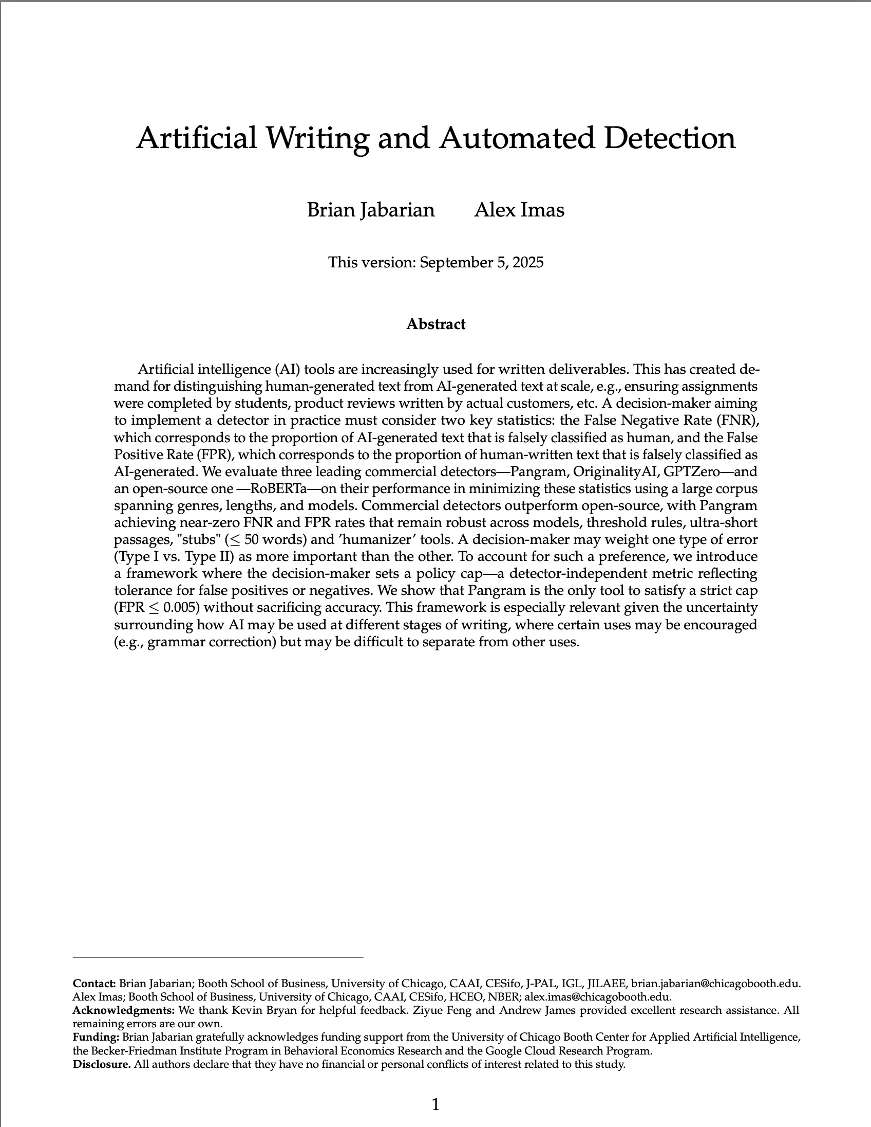
Detector success:
“Pangram achieved near-zero False Negative Rate and False Positive Rate rates that remain robust across models, threshold rules, ultra-short passages, 'stubs' (≤ 50 words),and 'humanizer' tools.”
(Jabarian & Imas,2025)

Slide 12
Response?
“Timed, hand-written exams may present a distracting challenge for most students, since few today are accustomed to composing and writing by hand” (Tai et al., 2022).
“Thoughtfully designed assignments can reduce the temptation to misuse AI by sparking students’ intrinsic motivation.” (“AI Detectors Don’t Work,” n.d.).
“[A]n in-class writing assignment or oral exam is the 100-meter dash to the long-form essay's marathon.”
- Josh Brake, Engineering Professor at Harvey Mudd College

Slide 13

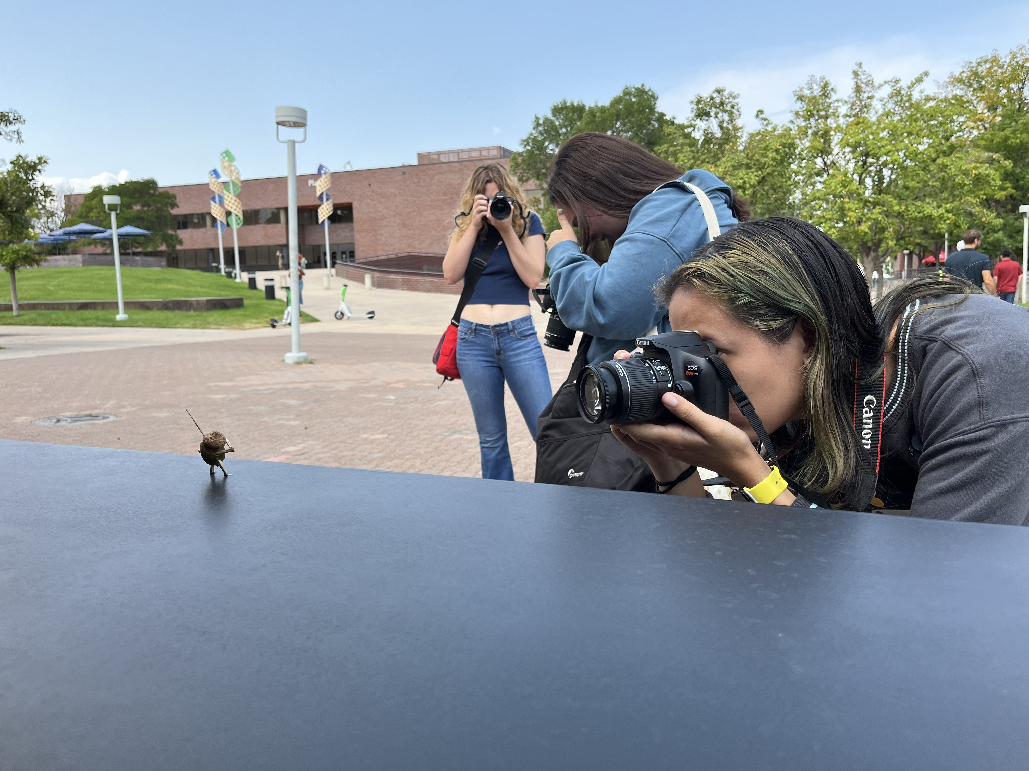
Summary
Generally, the inappropriate use of Ai by some students is unavoidable, but the impact of the use can be minimized.
Risks of detectors > the “rewards. (Although some, Pangram, are better than others.)
Design coursework with multiple layers of opportunities for students to demonstrate subject-matter competency.
Photojournalism I (JMP2600) field exercise.
Involve students in AI use policies and discuss the pros & cons of AI use vs. learning.
Notes:
1) This is easier in some courses (photojournalism) than other (reporting).
2) Risks of AiD > the “rewards”
3) Again, this can be situational and I don’t have much to offer for async-online courses.
4) Just finished ACUE a few days (?) ago, introduced to me the “reciprocal interview” technique, so I’m looking at that as a way to get students on board.

Slide 14
CTLD Resources:
Start a Conversation About Generative AI
Consider Academic Integrity with AI
Where Can I Find a Syllabus Statement Regarding Generative AI? “ on CTLD site.
Using Generative AI to Enhance Student Learning Resources and Prompt Examples

Slide 15
References:
AI detectors don’t work. Here’s what to do instead. (n.d.). MIT Sloan Teaching & Learning Technologies. MIT Sloan School of Management. https://mitsloanedtech.mit.edu/ai/teach/ai-detectors-dont-work/
Brake, J. (2024, July 3). Blue books and oral exams are not the answer. Substack. https://joshbrake.substack.com/p/blue-books-and-oral-exams-are-not-the-answer
Edwards, B. (2023, July 14). Why AI detectors think the US Constitution was written by AI. Ars Technica. https://arstechnica.com/information-technology/2023/07/why-ai-detectors-think-the-us-constitution-was-written-by-ai/
Erol G, Ergen A, Gülşen Erol B, Kaya Ergen Ş, Bora TS, Çölgeçen AD, Araz B, Şahin C, Bostancı G, Kılıç İ, Macit ZB, Sevgi UT, Güngör A. Can we trust academic AI detective? Accuracy and limitations of AI-output detectors. Acta Neurochir (Wien). 2025 Aug 7;167(1):214. doi: 10.1007/s00701-025-06622-4. PMID: 40773066; PMCID: PMC12331776.
Jabarian, Brian and Imas, Alex, Artificial Writing and Automated Detection (August 26, 2025). Available at SSRN: https://ssrn.com/abstract=5407424 or http://dx.doi.org/10.2139/ssrn.5407424

Slide 16
Contact Joe Mahoney
Joe Mahoney
jmahon12@msudenver.edu
Assistant Professor of Journalism
Department of Journalism and Media Production
December 2025

Slide 17
Slide 3: Bar Graph “Who’s Using AI at MSU Denver?
Bar graph is titled “How often are you using AI for work or school?” The data from the bar graph is presented in the table below.
 | Daily | Weekly | Monthly | Rarely | Never
Faculty | 17% | 28% | 7% | 28% | 20%
Staff | 27% | 23% | 13% | 22% | 15%
Administrator | 29% | 35% | 6% | 24% | 6%
Student | 13% | 31% | 9% | 20% | 27%
Two percentages are circled: Faculty, weekly use 28%, and Student, weekly use 31%.
Return to slide 3.

