Slide 1
Faculty Success
Reviews, Promotion and Tenure
Reviewer Essential Skills Training

Slide 2
Reviews, Promotion and Tenure (RPT/Workflow)
RPT is used to fully digitize your processes for annual review and promotion & tenure and get rid of the binders filling your provost’s office.
RPT empowers you to track progress and provide guidance to your stakeholders to ensure completion of critical campus processes from one central location.

Slide 3
Essential Skills for Reviewers

Slide 4
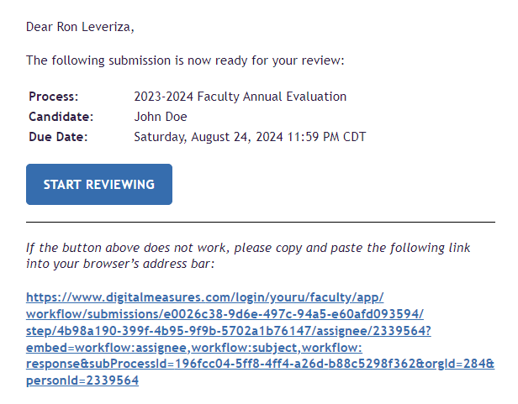
Sample Email Notification for Reviewers

Slide 5
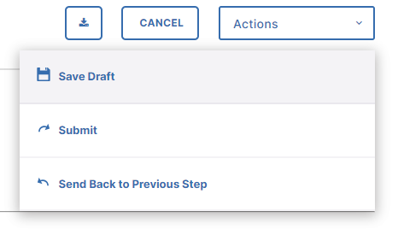
Submitting Your Form and Other Actions for Reviewers
Reviewers will have additional Actions to choose from. If you are a reviewer on a step, you can Send Back to the Previous Step. You will be able to write a note and set a deadline for the step to be completed and rerouted to you.

Slide 6
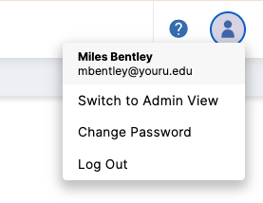
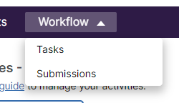
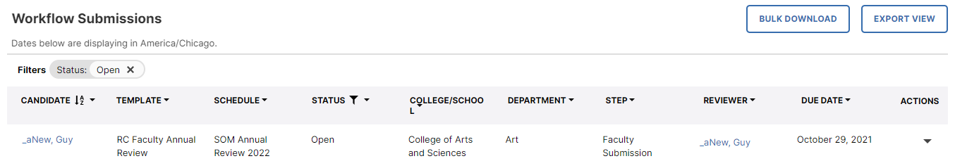
Permissions: Submission Monitoring and Unit Administration
Some campus leaders will have permission to view or delegate over submissions of their particular group (college, department, etc.) This is determined by your Workflow administrator.
If you are given permission to Submissions, you will access the Submissions table by navigating to the Admin view in Faculty Success, clicking on the Workflow tab, and then Submissions. You will also notice an additional option, Tasks, and that takes you to your Workflow Tasks screen where you will access your Inbox and History.

Slide 7
Committee Steps

Slide 8
Contributing to a Committee Step
You may have a review process that includes committees. Committees are comprised of a Chair and Members.
Committee member forms can be configured so that are anonymous or visible to other committee members. The Committee Chair also contributes as a committee member.
All committee members will be able to view the Chair’s form, even in draft phase, whether the step is set to be anonymous or not.

Slide 9
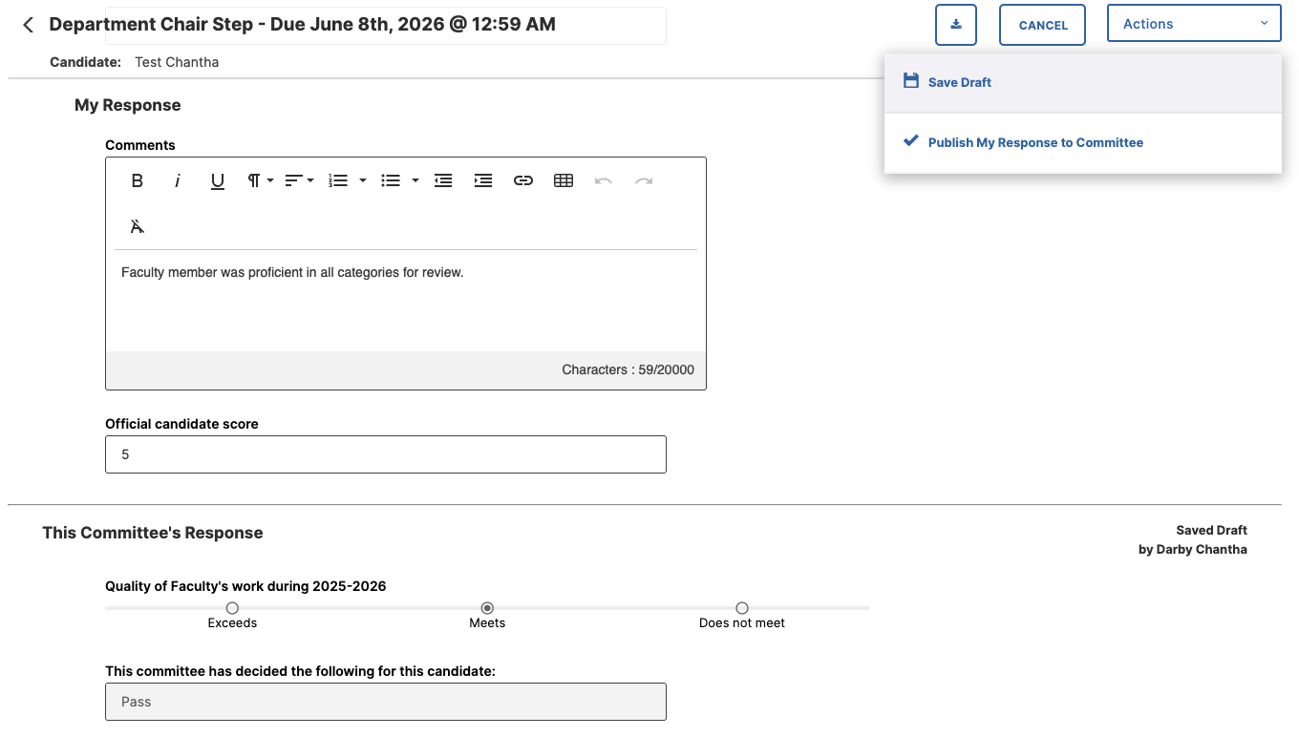
Contributing as a Committee Member
When a committee member opens their workflow form, the form will show all prior step responses that are visible to them, and they can use this information as part of their review process.
Your submission portion will be towards the bottom under “My Response”. You will fill out their form and click “Publish My Response to Committee”.

Slide 10
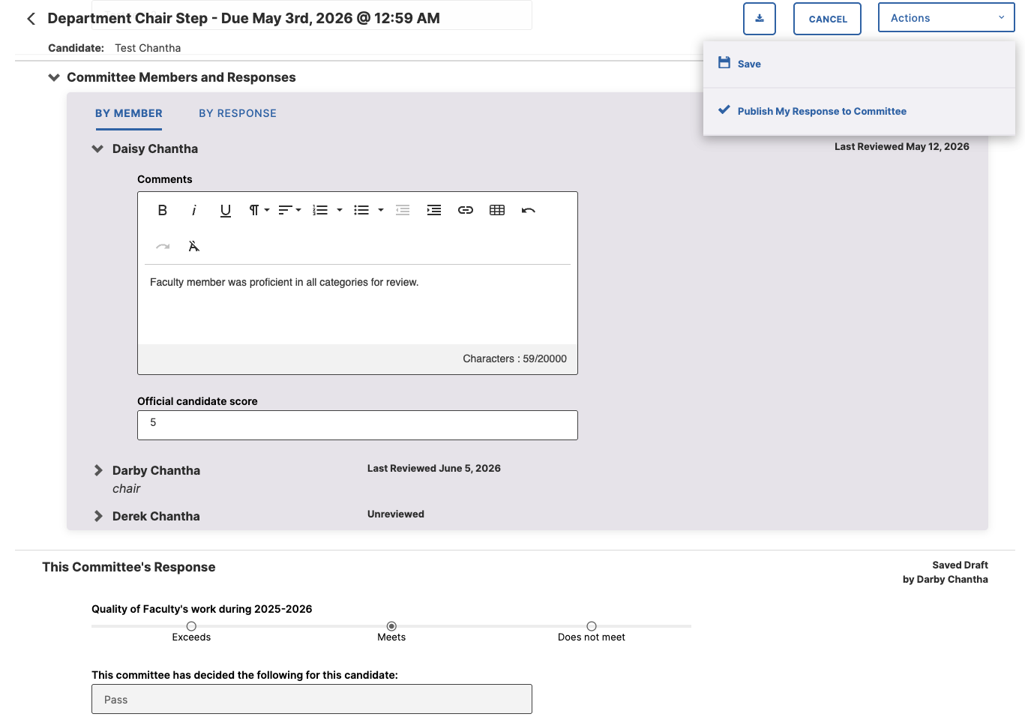
Committee Member View After Published Response

Slide 11
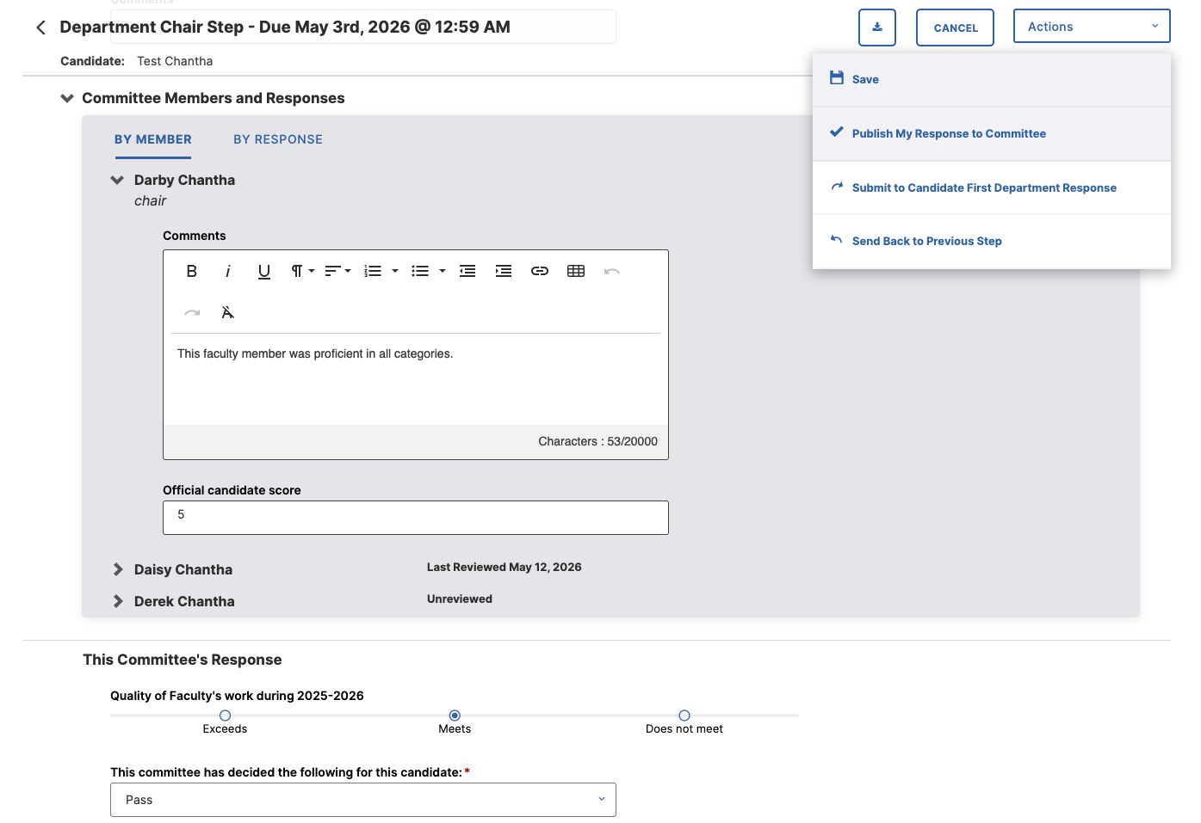
Chair Contributing as a Committee Member
The committee chair will complete both the committee member form and the committee chair form.
The committee chair form is the one that will get moved forward in the process. The Chair will first complete the member form. When they are finished, they will click “Publish My Response to Committee”.

Slide 12
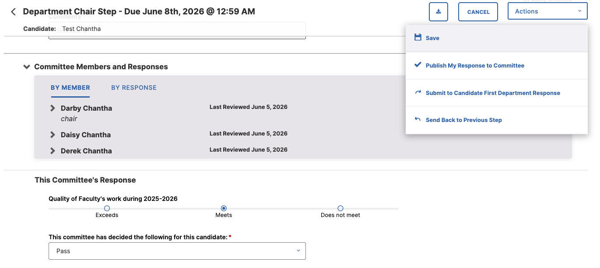
Chair Contributing as the Chair and Submitting to Next Step
When all committee members have responded, the Department Chair can now complete the Chair form for submission. When completed, they will click “Submit to XYZ” under Actions to send to the next step.

