Slide 1
Faculty Success
Reviews, Promotion and Tenure
Faculty & Staff Essential Skills Training

Slide 2
Reviews, Promotion and Tenure (RPT/Workflow)
RPT is used to fully digitize your processes for annual review and promotion & tenure and get rid of the binders filling your provost’s office.
RPT empowers you to track progress and provide guidance to your stakeholders to ensure completion of critical campus processes from one central location.

Slide 3
Reviews, Promotion and Tenure
Campus Expectations of Faculty
Faculty are expected to log into Faculty Accomplishments Reviews, Promotion and Tenure using the URL provided or via the email they received to submit their Annual Review prior to the faculty review due date (see Procedural Calendar)

Slide 4
Essential Skills and
System Interface

Slide 5
Essential Skills
  Logging into Faculty Success
  Accessing Workflow and your submission
  Completing your submission and contributing to a review process
  Action options available to you
  Monitoring the progress of your submission
Notes:
Please provide your expectations for your End Users. We’ve provided a few examples for you.

Slide 6
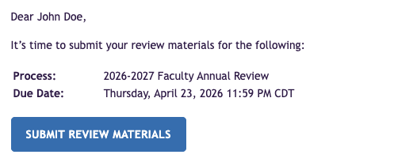
Accessing Reviews
When the Workflow process launches, tasks are created and await the attention of the faculty candidates who will submit their materials in the system. Faculty can access these tasks two ways:
Through the email that was generated when the process launched. The template controls whether this email notification is sent. This is an example of what the email could look like:
By logging into Faculty Success directly. When a process launches, users will be able to click the Reviews utility and review their Inbox for any available tasks, or quick select from their Tasks & To-Dos on the Home page.

Slide 7
Types of Email Notifications
RPT email notifications are configured by your campus Workflow administrators. They determine which ones get sent out and the frequency of the emails.
Initial email invitation for Faculty
Initial email invitation for Reviewers
Reminder emails
Final Reminder emails (one day before due date)
Overdue alert emails

Slide 8
Completing a Form
The submission forms available to faculty and reviewers are customized for each specific process and step by the Reviews, Promotion and Tenure (RPT) Administrator.
Certain fields may be set as required. This is a configuration choice made when the form was created.
When reviewing and contributing to a form, you will have different types of fields to complete. Options include:
File Upload
Rating Scale
Text box
Dropdown menu
Prior Submissions
Report (generated from Faculty Success)

Slide 9
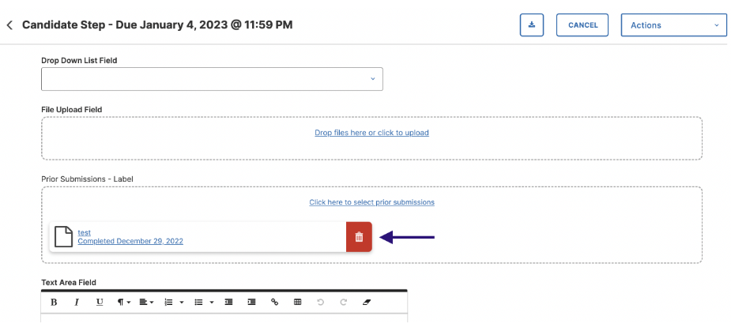
Example of Field Types on a Form

Slide 10
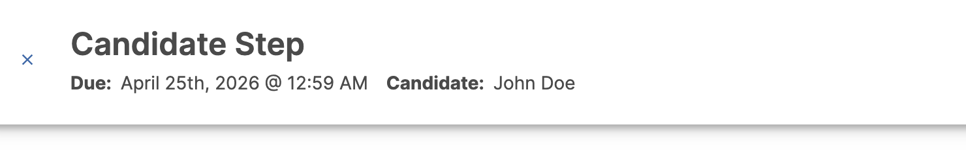
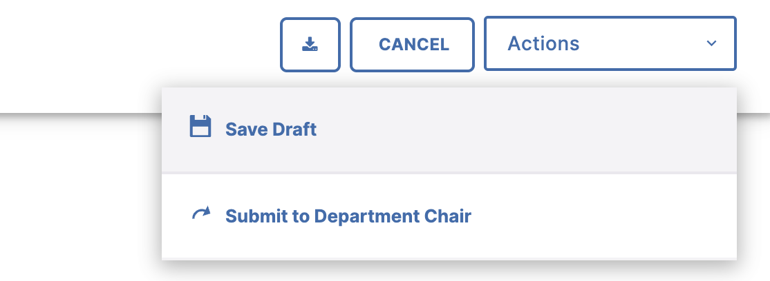
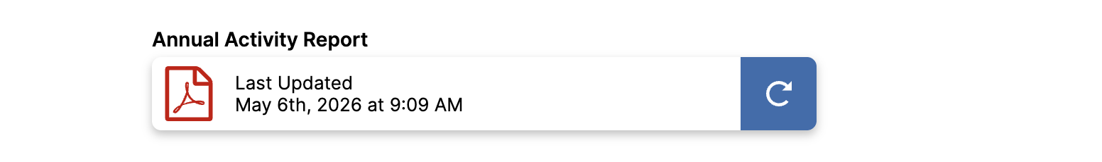
Reports Within Workflow Forms
A Workflow form may have been configured to automatically include a custom report from Faculty Success, populated with data from the My Profile/Manage Activities utility. This report is generated when the process launches. Faculty can preview the report. If they notice any issues in the report or realize that additional activities need to be entered into the database, they can:
1. Save a draft of their progress on the form by accessing the Actions menu in the top right and selecting Save Draft.
2. Navigate to My Profile/Manage Activities.
3. Correct or revise the appropriate data.
4. Return to the Workflow task and refresh the report, so the updates are reflected in the report.

Slide 11
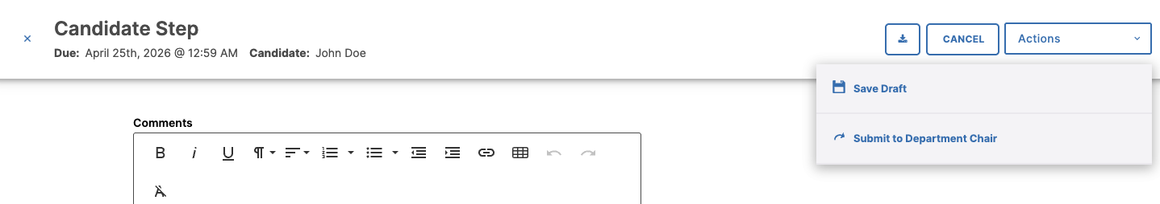
Submitting a Step and Other Actions
Once a candidate’s submission is complete and ready for review, they can simply click the Submit option on the Actions menu to move the materials to the next step in the process. At this point, the submission materials are locked (including any reports that have been attached), even if changes are made through the My Profile/Manage Activities module.
You can Save Draft to return to your form at another time. Sometimes, other submission actions may be available.

Slide 12
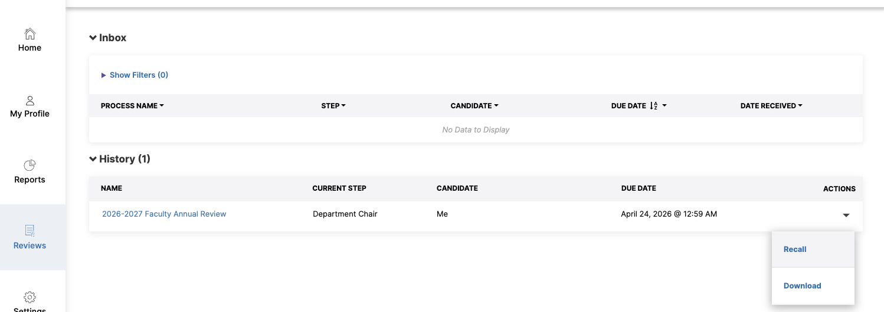
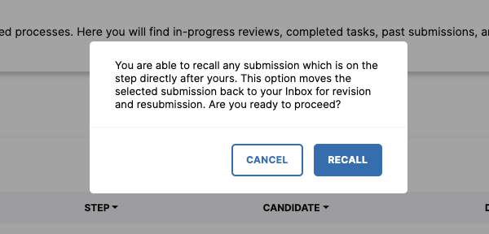
Recalling a Step
If a candidate advances a submission to the next step, they can recall the submission from that step to:
Correct factual or typographical errors
Add a critical piece of information that was missed
Further review a submission that was prematurely advanced
Click the arrow under Actions.
Click Recall.
Note: Once the next step has begun, the recall option is no longer available.

Slide 13
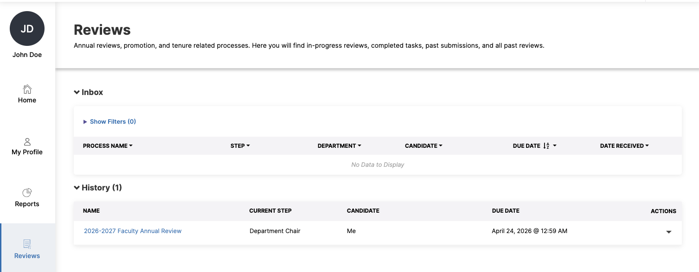
Accessing History (Monitoring Your Submission)
After a candidate has advanced the process to the next step, they will see the task move from the Inbox to the History section in RPT. There, they can see where in the process the submission stands as it advances through each future step, and, depending on the form visibility settings, review the content of the submission and the fields completed by reviewers.
The historical record will remain available to the candidate for future reference.
To access History:
Log into Faculty Success.
Click Workflow.
Locate the History section.

Slide 14
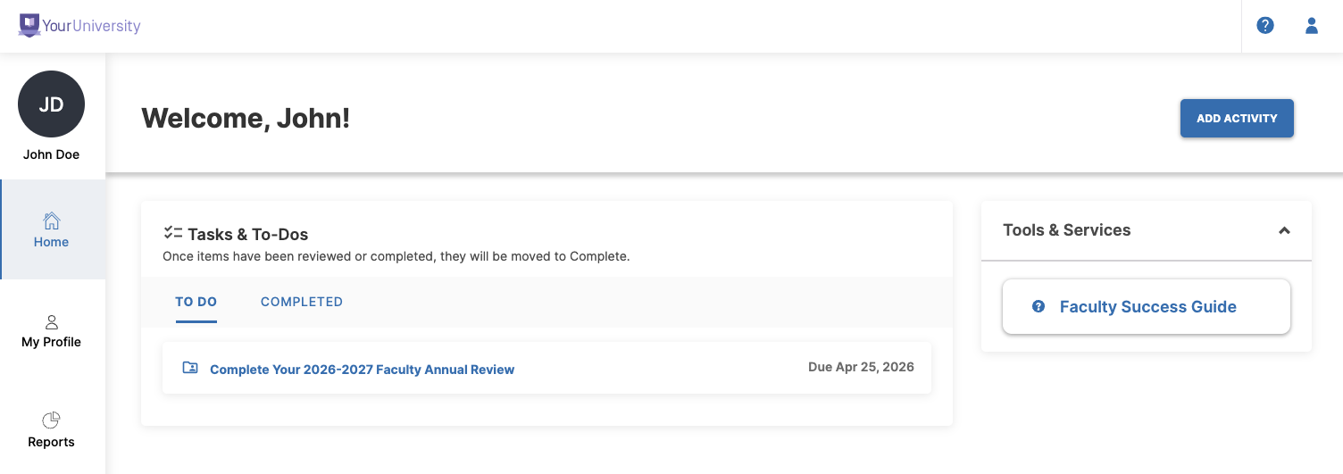
Help Tools
If you need help with adding activities, access the Faculty Essentials toolkit in the Watermark Help Center via the “Tools & Services” box on your Home page.
Click ? in the top right corner of your account to access additional help resources.

