Slide 1
MSU Denver Board of Trustees Finance and Audit Committee June Meeting
June 11, 2026
Agenda Item III.A Approval of Proposed FY27 MSU Denver E&G Budget and Tuition and Fees
Andrew Rauch, Executive Budget Director

Slide 2
Agenda and Purpose: Continued Movement Toward Modernizing MSU’s Budget
FY27 Development Context: What is Working at MSU
  The Flywheel is driving success despite State Budget Constraints
Revenue Drivers and Available FY27 Revenue
  Understand the tension between increasing revenue and investing in strategic opportunities
Reviewing FY27 Strategic Investment Opportunities
  Opportunities to invest in our people
  Examples of Flywheel-aligned investments in FY27
Recommendation of FY27 Budget for Approval
  Providing a wholistic picture of the FY27 Budget Recommendations
Update on Capital Planning and Investment
2

Slide 3
FY27 Development Process: Wins and Successes
Campus-Wide Collaboration: the University Planning and Budget Advisory Committee, Campus Leaders, Shared Governance, and engagement with budget experts across the university
Thoughtful navigation of a difficult budget context: Colorado’s fiscal uncertainty presented a challenge that was successfully navigated
Normalizing a comprehensive general fund budget structure by incorporating and highlighting the strength of MSU’s graduate programs
Restoration of the FY26 mid-year cut from the State due to strong engagement with the General Assembly
Flywheel investments are yielding results: MSU is seeing the benefits from past investments in proven strategies
3

Slide 4
Understanding the FY27 Development Context

Slide 5
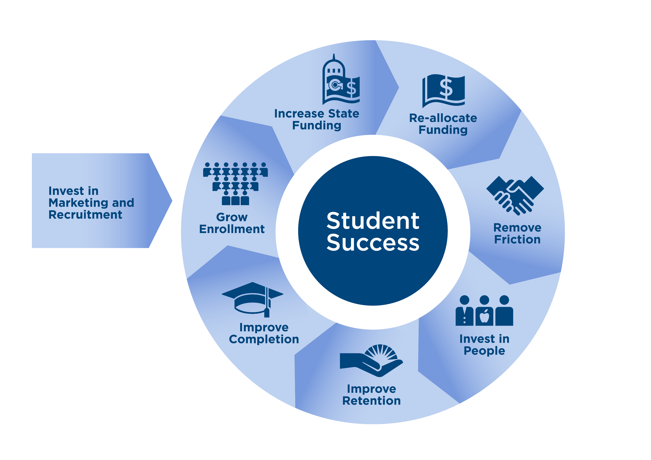
The MSU Denver Flywheel Strengthens the Institution Through Linking Work to Student Success
The state funding landscape is challenging, but flywheel investments strengthen MSU’s position within the State’s funding model
Branches identified $2.4M in spending efficiencies to redeploy across MSU in FY27
Proposed and recommended investments in marketing and student-facing programs that support retention and completion drive MSU’s success
A proposed 2% ATB generated through redistributions and new revenue allows MSU to invest in its people when Colorado is not doing an Across-the-Board
MSU set record retention from Fall 24 to Fall 25 at 69%, with a 2030 goal of 80%
5

Slide 6
FY26 Budget Is Trending Under by a Thin Margin Reflecting Strong Budget Management
Branch | Budget | Actuals Through April | Projection | Difference | Percent Under/Over
President's Office | 2,706,159 | 1,985,761 | 2,537,323 | 168,836 | 6.24%
Provost/Academic Affairs | 121,979,926 | 110,629,234 | 121,472,275 | 507,651 | 0.42%
Administration | 34,575,740 | 27,701,740 | 34,823,768 | -248,028 | -0.72%
University Advancement | 4,831,348 | 3,882,759 | 4,928,116 | -96,768 | -2.00%
Enrollment and Student Affairs | 18,543,041 | 15,413,705 | 18,632,731 | -89,690 | -0.48%
Diversity | 1,512,845 | 1,044,380 | 1,415,285 | 97,560 | 6.45%
General Counsel | 2,188,979 | 1,096,805 | 1,676,927 | 512,052 | 23.39%
Strategy and External Affairs | 3,612,744 | 2,464,091 | 3,336,056 | 276,688 | 7.66%
University Communication and Marketing | 5,309,627 | 4,325,391 | 5,299,037 | 10,590 | 0.20%
Athletics | 3,870,337 | 3,009,734 | 3,774,674 | 95,663 | 2.47%
Campus-Wide | 23,803,006 | 19,412,310 | 23,748,607 | 54,399 | 0.23%
Total | 222,933,752 | 190,965,910 | 221,644,799 | 1,288,953 | 0.58%
6

Slide 7
Increased Tuition Revenue and Strong Investment Returns, Allowed MSU to Offset the Mid-Year State Cut Without an Impact
Revenue Category​ | Budgeted Amount​ | Estimated Changes​ | Forecasted​
Tuition and Fees​ | $123,186,976 ​ | $1,114,715 ​ | $124,301,691 ​
State Funding​ | $90,244,146 ​ | ($880,903)​ | $89,363,243 ​
Other Operating Including: ICR, Interest Income, and Misc Revenue Categories​ | $9,502,630 ​ | $1,865,227 | $11,367,857​
Total​ | $222,933,752 ​ | $2,099,039​ | $225,032,791 ​
7

Slide 8
MSU Denver is on Target to Meet Its Reserve Requirement in FY27 With Proposed Budget
8

Slide 9
FY27 Development Underscores the Tension Between Investments, Competitiveness and Revenue
Compensation
Competitiveness
Maximize Available Revenue
Minimizing Reductions
Minimize Tuition Increases
9

Slide 10
Revenue Drivers: State Funding and Tuition

Slide 11
Where the Money Comes From in FY26: State Funding is Critical
11

Slide 12
Colorado’s Constrained Budget Context Ripples into MSU’s Funding in FY27
About 40% of MSU’s revenue comes from the State
For FY27, Colorado reinstated the funding that was cut mid-year in FY26
  This resulted in about $800K being restored to MSU’s budget
The State’s constrained budget is evident over the last three years
  State appropriations to MSU Denver have decreased from $9M in FY25 to flat funding in FY27
The Constraint is likely to continue requiring MSU to make investments linked to the Flywheel
12

Slide 13
Maintaining Affordability and Competitiveness through 3.5% Undergraduate Tuition Increase
Undergraduate tuition recommendations are:
  3.5% for new Resident students
  3.5% for new Non-Resident students
Approximately 72% of current students are covered by the tuition lock
  These students will not see a tuition increase
  Tuition rate increases will impact an estimated 28% of students who are not on a lock
Undergraduate enrollment is assumed flat
13

Slide 14
Undergraduate Tuition and Fee Increases over the last decade have helped MSU Reinvest in Itself
 | 2015-16 Tuition and Fees | 2025-26 Tuition and Fees | Rate Increase
MSU | $6,420 | $11,450 | 78.4%
Average Tuition of Comparable 4 Years* | $10,403 | $14,963 | 43.8%
% of Average Tuition | 62% | 77%
*Fort Lewis, Adams State, and Western are committed from comparisons due to different economic and demographic drivers
MSU Costs and Investments
  Denver Inflation increased by 35.1% over 10 years
  MSU increased compensation by about 2.4% annually over ten years
  MSU made structural investments to bolster enrollment and retention
  MSU intentionally invested in Advancement, Government Relations, Marketing, new Enterprise Resource and Student Information Systems, Classroom Capital Investments, and compensation
14

Slide 15
Building a Comprehensive View of MSU’s General Fund Means Incorporating and Normalizing Conversations Around MSU’s Successful Graduate Programs
When MSU became a University, Graduate Programs were held as auxiliaries outside of the General Fund
Our Graduate Programs have demonstrated strong student outcomes and effective financial stewardship
In FY27, these programs will be incorporated into the General Fund to improve transparency and increase ability to effectively manage budgets
15

Slide 16
Maintain Affordable Graduate Tuition through Average Resident Increases of 1% and Average Non-Resident Increases of 2%
Graduate Programs Revised Tuition Rates | Resident |  |  |  | Non-Resident
 | FY26 | FY27 | $ Change | % Change | FY26 | FY27 | $ Change | % Change
Accountancy | $520 | $520 | $0 | 0% | $570 | $570 | $0.00 | 0%
Business Administration | $500 | $500 | $0 | 0% | $525 | $525 | $0.00 | 0%
Teaching (MAT) | $398 | $410 | $12 | 3% | $550 | $578 | $27.50 | 5%
Education | $398 | $410 | $12 | 3% | $550 | $578 | $27.50 | 5%
Social Work | $536 | $555 | $19 | 3.5% | $735 | $772 | $36.80 | 5%
Health Administration | $551 | $571 | $19 | 3.5% | $578 | $607 | $28.90 | 5%
Dietetic Internship Program | $600 | $600 | $0 | 0% | $709 | $709 | $0.00 | 0%
Human Nutrition and Dietetics | $600 | $600 | $0 | 0% | $700 | $700 | $0.00 | 0%
GR International Board-Certified Lactation Certificate | $550 | $569 | $19 | 3.5% | $600 | $630 | $30.00 | 5%
Cybersecurity | $550 | $569 | $19 | 3.5% | $725 | $761 | $36.30 | 5%
Clinical Behavioral Health | $585 | $591 | $6 | 1% | $700 | $707 | $7.00 | 1%
Speech Language Pathology | $615 | $615 | $0 | 0% | $750 | $750 | $0.00 | 0%
16

Slide 17
FY27 Budget Development Started with Branches evaluating costs and identifying efficiencies
Branch | Identified Funding for Redistribution Based on Efficiencies
President’s Office | $50K (2%)
Strategy and External Affairs | $105K (3%)
Diversity and Inclusion | $17,500K (2%)
General Counsel | $100K (4.5%)
Advancement | $25K (.5%)
Communications and Marketing | $123K (2.3%)
Administration | $1.1M (3.1%)
Enrollment and Student Affairs | $386K (2%)
Academic Affairs: The Office of Academic Affairs | $400K (3.4%)
Athletics | $115K (3%)
Campus Wide | Potential Savings via Energy Performance Audit Long-Term Impacts
Total | $2.4M from Branches (2.8%)
17

Slide 18
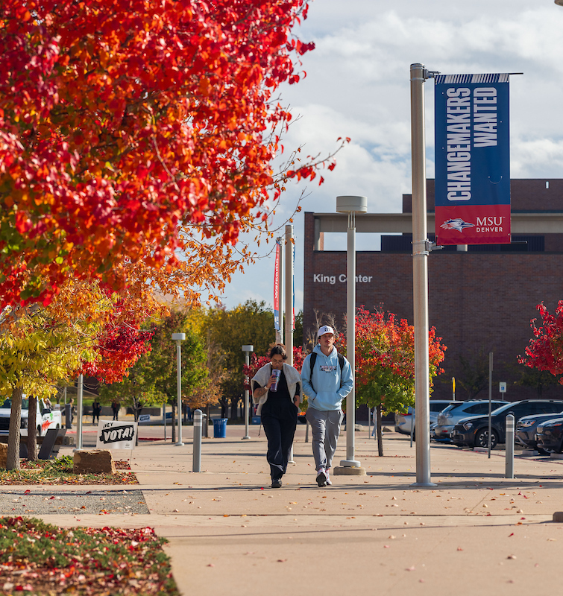
Student Fees Require Approval from the Board, but Are Earmarked for Specific Purposes
Mandatory Fees: Paid by each student
  Support key auxiliaries like Debt Service, Health Center, Student Technology, and Student Support and Academic Programming
  Can be raised by 5% annually under adopted Fee Plan
Program Fees: Support Specific Academic Programs
  Recommended after review by Student Fee Review Panel
Matriculation Fee: supports student orientation and commencement
Auraria and CU Denver Pass-Thru Fees: Increase by Inflation or through student referendum
18

Slide 19
Fee Increases: Average Mandatory Fee Increase is 1.7%, about $6/credit hour. Program Fees increasing in alignment with policy.
Program Fee Rates | FY26 Rate | FY27 Rate | Change
Health Care Management (HCM) Fee | $1.00 | $1.71 | $0.71
School of Education (SOE) Teacher's Ed Fee | $3.00 | $5.39 | $2.39
Hotel Management (HTL) Fee | $6.00 | $9.31 | $3.31
Restaurant Management (RST) Fee | $40.00 | $46.31 | $6.31
Mandatory Fee Rates | FY26 | FY27 Rate | Change
Student Affairs Fee | $60.40 | $63.40 | $3.00
Intercollegiate Athletics Fee | $52.70 | $52.70 | $0.00
Health & Wellbeing Fee (Combines Health & Wellness fee, Campus Recreation fee, and Phoenix Center Pass Through fee) | $158.77 | $158.50 | ($.27)
Metro Bond Fee | $30.70 | $32.20 | $1.50
Student Technology Fee | $9.60 | $10.10 | $0.50
Auraria Facilities Bond Pass Through Fee | $54.70 | $56.00 | $1.30
Auraria Clean Energy Pass Through Fee | $10.86 | $11.10 | $0.24
Matriculation Fee | FY26 | FY27 Rate | Change
Graduate Matriculation Fee | $125 | $150 | $25
Streamlining fee charges for transparency, more effective billing and efficiencies by combining Health and Wellness, Campus Recreation, and Phoenix Center fees
  Phoenix Center Fee was increased from $3.77 to $10 via student referendum
MSU Athletics Fee and Health and Wellbeing Fee will be more effectively assessed in FY27 across the student body
Inflationary pressure has increased demand on program fees, so the increases support a minor catch-up in alignment with Board Policy
Aligning graduate matriculation fee with undergraduate matriculation fee at $150
  Students only pay this fee once in their time at MSU
19

Slide 20
FY27 Available Revenue is tied to Tuition, Identified Redistributions linked to Efficiencies, and Benefits from Past Investments
Understanding Available Resources for FY27, the Revenue Part of the Math problem
  Available Tuition: $2.3M linked to Undergraduate and Graduate Increases
  Branches identified more efficient spending, freeing up $2.4M to redeploy across MSU in FY27
  Restoration of State Funding at $800K
  $2.3M in structural revenue linked to bolstered enrollment, increased investment income, and lower bad debt
  Pursuant to Board Policy, the Underspending in FY26 goes to reserves, helping MSU meet its target balance
Total is an Approximate $7.8M
20

Slide 21
Strategic Investment in the FY27 Budget

Slide 22
Compensation Recommendation: 2% and Maintain 75% Share on Health Insurance
Investing in our people helps MSU meet its Strategic Plan Goal of being Colorado’s most desired place to work
2% Across the Board for Faculty and Staff totaling about $3.1M
Maintaining our 75/25 insurance premium split helps keep a strong benefits package without passing costs to families totaling about $1M
Overall compensation investment is about $4.1M
Available Revenue after compensation is $3.7M {$7.8M - $4.1M = $3.7M}
22

Slide 23
MSU’s Historical Compensation Has Helped Maintain Competitiveness
 | FY17 | FY18 | FY19 | FY20 | FY21 | FY22 | FY23 | FY24 | FY25 | FY26 | FY27 Proposed
Classified | 0.0% | 2.5% | 3.0% | 3.0% | 0.0% | 3.0% | 3.0% | 5.0% | 3.0% | 2.5% | 1%
Faculty and Staff | 2.0% | 1.0% | Maintain CUPA | 3.0% | 0.0% | 1.75% + $2000 Stipend | 3% | 4% + $800 Stipend (one time) | 2% +$820 Flat (base building) | 2.5% | 2%
Inflation | 2.8% | 3.4% | 2.7% | 1.9% | 1.9% | 3.4% | 8.0% | 5.2% | 2.3% | 2.3% | NA
23

Slide 24
Mandatory Costs: $2.8M in Contractual and Statutory Costs
Contractual Costs: Utilities, Audit Contract, Cashnet Contract, Advancement Software, Workday License, IT Security and Device contracts, and insurance: $1.6M
Statutory Costs: Access Center Compliance with ADA, Financial Aid matching for state foster youth and homeless youth scholarships: $500K
Compensation: Classified Employee Step and Range Increases and Faculty Contract Increases: $700K
Remaining available revenue after Mandatory Costs: $.9M {$3.7M -$2.8M = $.9M}
24

Slide 25
Flywheel Aligned Investments of $.9M Drive Student Success, Enrollment, and Revenue
Examples of Flywheel-Aligned Budget Investments include: Marketing, the Teaching Assistants Program, and Moving Payment Plans in house
Investing in University Marketing is a strong example of an investment that drives enrollment
For example, hiring a person in the Bursar’s Office to support payment plans eliminates friction for students and brings an estimated $200K in revenue annually
The Teaching Assistant Program is an excellent example of a program demonstrated retention benefits and drives student success
25

Slide 26
Solving the FY27 Math Problem
MSU’s Revenue Includes
  Projected Tuition Revenue based on rate increases: $2.3M
  Efficiency-based Redistributions for University Branches: $2.4M
  Reinstatement of state funds: $.8M
  Structural revenue generated from investments and the Flywheel $2.3M
  Total Revenue is about $7.8M
MSU Denver Costs Include:
  Mandatory Costs as outlined are $2.8M
  Investing in our people via an Across-the-Board and maintaining insurance premiums is $4.1M
  Strategic investments in branch requests: $.9M
  Total Costs are about $7.8M
26

Slide 27
Board Approval

Slide 28
Request to Approve an FY27 Budget of $245M
Branch | FY26 Base Budget | Efficiencies | FY27 Mandatory Cost | FY27 New Spending | FY 27 Allocation
Academic Affairs | $16,488,918 | $(400,000) | $14,869 |  | $16,103,787
Schools and Colleges | $121,695,339 |  |  |  | $121,695,339
Administration | $35,108,473 | $(1,095,664) | $1,101,860 | $ 39,500 | $35,154,169
Athletics | $3,870,666 | $(115,000) |  |  | $3,755,666
Campus-wide | $23,674,226 |  | $736,134 |  | $24,410,360
Diversity | $1,514,061 | $(17,500) |  | $231,000 | $1,727,561
General Counsel | $2,188,979 | $(100,000) |  |  | $2,088,979
President's Office | $2,655,633 | $(50,000) |  |  | $2,605,633
Strategy and External Affiars | $3,487,857 | $(105,000) |  |  | $3,382,857
Enrollment and Student Affairs | $18,836,018 | $(385,988) | $245,000 |  | $18,695,030
UCM | $5,310,028 | $(133,200) |  | $475,000 | $5,651,828
University Advancement | $4,835,041 | $(25,000) | $20,721 | $160,000 | $4,990,762
Compensation Increases |  |  | $700,000 | $4,003,257 | $4,703,257
Total | $ 239,665,239 | $(2,427,352) | $2,818,584 | $4,908,757 | $244,965,228
28

Slide 29
Board Approval: Seeking a Yes Vote on the FY27 Budget
Seek Approval for Recommended FY27 Tuition and Fee Increases
Seek Approval for Recommended FY27 General Fund Budget of $245M
29

Slide 30
Update on Capital Planning and Investment

Slide 31
MSU is Planning for a New Era of Asset Ownership
Student Housing, the PE and Events Center, and the Day Health Institute are expanding MSU’s footprint on the campus
These strategic investments directly support students, learning outcomes, and generate revenue
Facilities, Finance, and Operations are working together to evaluate available funds to support the on-going operations of these buildings in alignment with program plans
31

Slide 32
Thank You! Questions?

Slide 33
Appendix

Slide 34
Where Does the Money Go

Slide 35
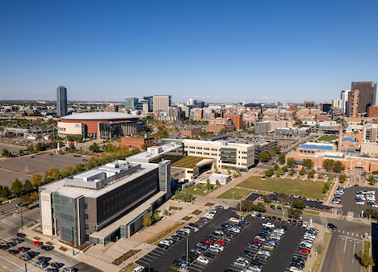
Main Sources of Expenditures
Between 70% and 75% of the University’s Budget is tied to personnel annually
  This is Salary and Benefits
Remaining 25% to 30% is operating
35

Slide 36
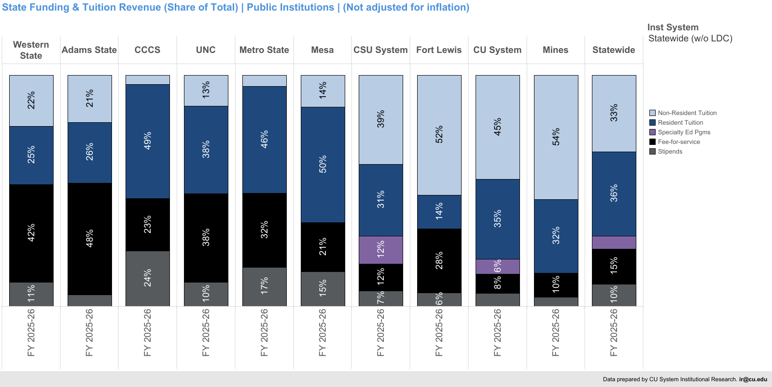
MSU Denver is More Reliant on Resident Tuition than Other Colorado Institutions
36

Slide 37
Resident UG Tuition Comparison: Forecasting for FY27 Based on Available Data
Institution | Resident Tuition (30 credits) | Projected Increase Based on Rate Increase | Rate Increase | Difference
Adams State | $6,264 | $6,483 | 3.50% | $219
Western State | $7,476 | $7,738 | 3.50% | $262
Fort Lewis | $8,040 | $8,321 | 3.50% | $281
CSU Pueblo* | $9,155 | $9,475 | 3.50% | $320
Northern Colorado** | $9,365 | $9,740 | 4.00% | $375
MSU Denver | $9,456 | $9,787 | 3.50% | $331
Colorado Mesa | $9,766 | $10,108 | 3.50% | $342
CSU Fort Collins* | $10,980 | $11,364 | 3.50% | $384
CU Colorado Springs* | $11,070 | $11,460 | 3.50% | $390
CU Denver* | $12,090 | $12,510 | 3.50% | $420
CU Boulder* | $13,566 | $13,973 | 3.00% | $407
Colorado School of Mines | $19,500 | $20,183 | 3.50% | $683
*Rates have been presented to their board
Resident rate cap is 4% in Long Bill
37

Slide 38
Non-Resident UG Tuition Comparison: Forecasting for FY27 Based on Available Data
Institution | Non-Resident Tuition (30 Credits) | Projected Increase Based on Rate Increase | Rate Increase | Difference
Adams State | $18,696 | $19,631 | 5% | $935
CSU Pueblo* | $19,749 | $20,539 | 4% | $790
Fort Lewis | $20,016 | $21,017 | 5% | $1,001
Western State | $20,928 | $21,974 | 5% | $1,046
Northern Colorado | $25,091 | $26,346 | 5% | $1,255
Colorado Mesa | $26,619 | $27,950 | 5% | $1,331
CU Denver* | $28,710 | $29,571 | 3% | $861
MSU Denver | $29,700 | $30,740 | 3.5% | $1,040
CSU Fort Collins* | $33,589 | $34,933 | 4% | $1,344
CU Colorado Springs* | $36,270 | $37,358 | 3% | $1,088
CU Boulder* | $43,708 | $45,019 | 3% | $1,311
Colorado School of Mines | $44,130 | $46,337 | 5% | $2,207
*Rates have been presented to their board
38

Slide 39
Impact to Students: Financial Aid and the Tuition Lock Help MSU Denver Maintain Affordability for Students
SAI Band | Head-count | Avg. Federal and State Grants (FT) | Avg. Institutional Aid (grants, scholarships, foundation) | Avg. Other Grants or Scholarships (External) (FT) | Avg. Out of Pocket (FT) | Estimated 3.5% Tuition Increase Impact Assuming Proportional Increases (FT – if outside lock)
0 or Less | 3,844 | $6,427 | $634 | $359 | $179 | $6
1 to 5,000 | 787 | $3,508 | $707 | $337 | $1,210 | $43
5,001 to 10,000 | 701 | $470 | $1,490 | $383 | $3,126 | $109
10,001 + | 2,001 | $80 | $606 | $193 | $4,485 | $157
39

Slide 40
Flywheel Aligned Branch Requests of $.9M Drive Student Success, Enrollment, and Revenue
Recommended .5 FTE and $40K in Bursar Office will convert payment plan administration in house increasing revenue by $200K
Investment of $231K in Undergraduate Teaching Assistant Program with strong retention and ROI
A $475K investment in marketing to help build an out of state strategy and bolster recruitment
$160K for University Events Position to support future revenue generation
40

