Slide 1
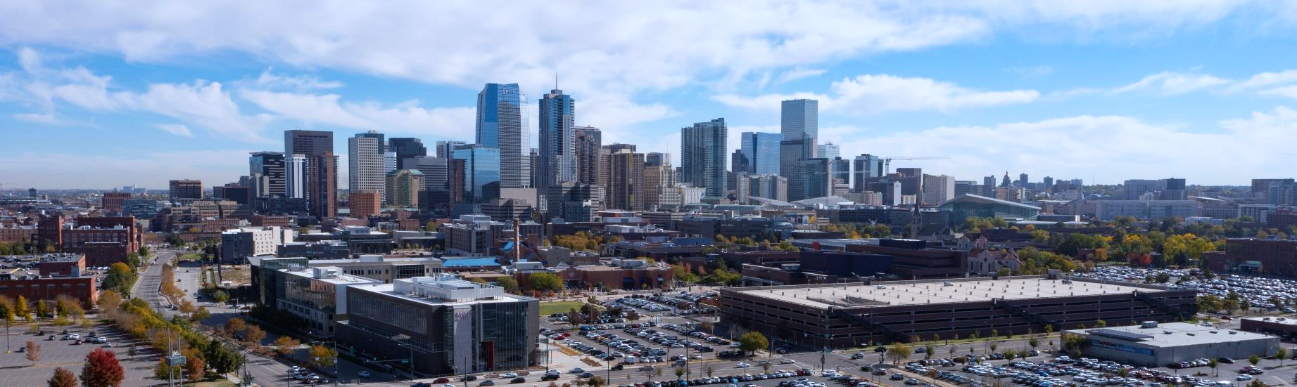

MSU Denver College of Business New Students Pre-Orientation Slides

Slide 2
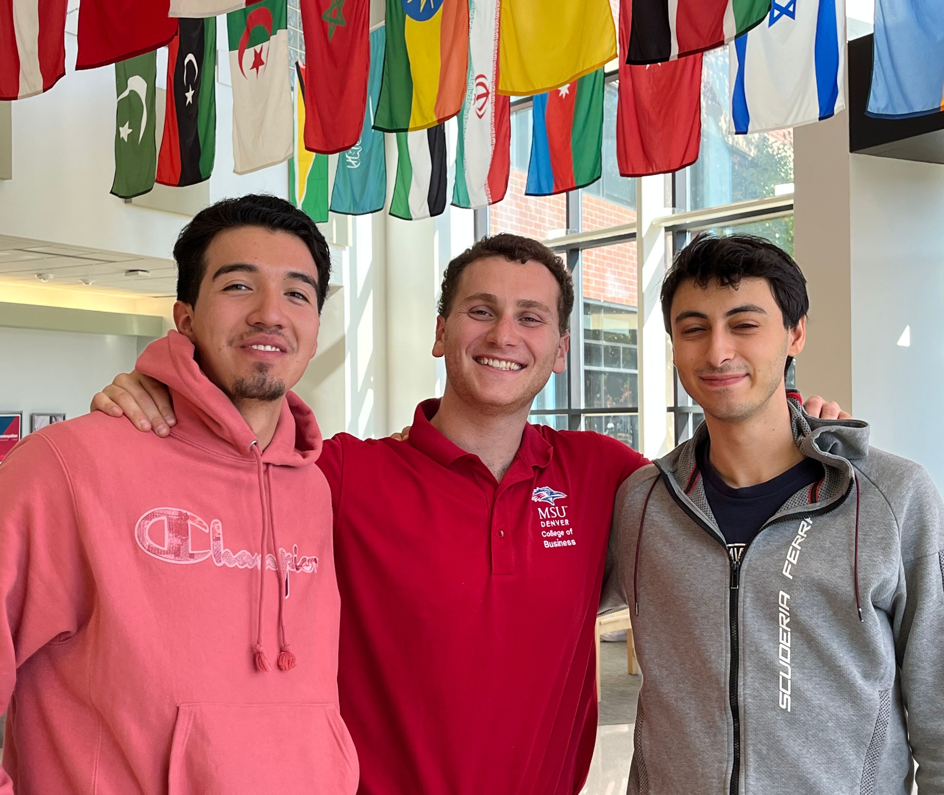
These slides will familiarize you with important policies and information regarding your academic program. You are responsible for knowing and understanding this information.
Notes:
Please review the following slides as they will help you be Road Runner Ready!

Slide 3


Welcome to the College of Business (CBUS)
We are….
Located in vibrant downtown Denver
AACSB accredited – a distinction earned by only 6% Business Schools worldwide
Ranked in the 10% of universities for CollegeNet’s Social Mobility Index
Have among the lowest tuition & fees of Colorado’s 4-year universities
Focused on providing quality education for our future business leaders
You’ve made an excellent choice!

Slide 4

You need to be Rowdy Ready by…
Completing all Admissions steps
Taking secondary placement exams (if needed) before registration
Understanding University & CBUS Policies, Dates, & Deadlines
Being prepared for your first Advising Appointment or Registration Session

Slide 5
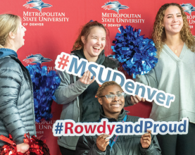
Admissions Steps
You must complete all Admissions Checklist items
This includes submitting the following:
Official transcripts from each institution attended
AP, IB, CLEP, or DANTES/DSST Test Scores
Your final High School or GED transcript (if not transferring in 24+ credits)
Your Immunization Records (or alternative documentation)
Military/Vets: military service records (DD214, JST or CCAF Transcript)
Find your checklist (Transfer / New Student / Readmit / Int’l Student / Military) on the Admissions Website
Instructions for submitting official transcripts, test scores, and documents are on our SEND IT webpage.
For Immunization Requirements, see the Auraria Health Center

Slide 6

Concurrent Enrollment (CE) Transcripts
If you took a Concurrent Enrollment class in High School (this is a college course you took while in High School), you must send MSU Denver Admissions an official transcript from the College or University you took your CE class through
High School transcripts will not get you college credit
If you aren’t sure which college you took your CE class through, contact your High School, then order your official college transcript

Slide 7

What happens if I don’t complete my Admissions Steps in a timely manner?
You will have Registration Holds put on your account preventing you from adding future classes
You increase your chances of registering for classes you don’t need or accidentally repeating a class
You may not be able to register for classes without making an advising appointment

Slide 8


English and Math Placement
You may need to take placement tests for English & Math
Most Business classes require English, an Oral Communication, and a College Math class as prerequisites
If you do not take your placement tests/prerequisites in a timely manner, you will run out of classes to take that count towards your degree
A prerequisite is a requirement, condition, or course that must be fulfilled or completed before another can take place. For example, taking a beginner class before an advanced one. Because we are AACSB accredited, we will not waive prerequisites in any circumstances.

Slide 9

How do I know if I need to take English and Math Placement Tests?
See our CBUS Advising Website General Requirements
Transfer Students:
If you completed equivalents to ENG 1010 or ENG 1020, you do not need to take the English Placement Survey
If you completed College Algebra (MTH 1110), Finite Math (MTH 1310), Pre-Calculus (MTH 1400), Business Calculus (MTH 1320), or Calculus (MTH 1410), you do not need to take the Math placement test
You can check if courses transfer in as equivalents via Transferology

Slide 10
If you do not know for certain if you are transferring in ENG 1010 or ENG 1020 or have the test scores to take ENG 1010, take the English Placement Survey now
The Survey takes less than a minute, there’s no pass/fail, and it is free!
You will be emailed your recommended English Class. This is only a recommendation—you can talk to an Academic Advisor about your options.

Slide 11

Policies, Dates, and Deadlines
You are responsible for knowing and following University policies and deadlines
We’ve built a handout outlining policies & deadlines and how to find them - Rowdy Ready Semester Checklist
We will highlight a few here:
Our Mandatory Class Participation Policy
The 100% and 50% Refund Dates
Financial Responsibility
Live Proctoring for some Business classes

Slide 12
Mandatory Class Participation
You must participate in your classes
If you do not participate, you could be reported to the Registrar’s Office and dropped after the first 2 weeks
If you are dropped, you will be issued a 50% refund for the class and will not be allowed back in
You could lose Financial Aid, Scholarships & Grants, and/or Military Benefits
Each instructor determines what constitutes participation so read your syllabi, attend your classes, and turn in all assignments and quizzes the first 2 weeks of classes so you don’t get dropped!

Slide 13
100% Refund Deadline
100% Refund Deadline is the date you must drop your class by to receive a full refund of tuition & fees
If you drop a class after this date, you will receive a 50% refund up until the 50% refund deadline
The 100% Refund Date is also the last day to self-register for most classes
After this date and up until the 50% Refund Deadline, you will need instructor permission to add classes
The 100% Refund Date is typically (but not always) the first Monday after classes begin for full semester classes

Slide 14
50% Refund Deadline
The 50% Refund Deadline is the date you must drop your class by to receive a 50% refund
If you drop your class after this date, you will not receive a refund
The 50% Refund date (called Census) is the last day to add full semester classes with instructor permission
Financial Aid WILL NOT cover classes added after Census
If you want to add full semester classes after this date, you need to submit a late enrollment form
The 50% refund date is usually (but not always) two weeks after classes begin

Slide 15
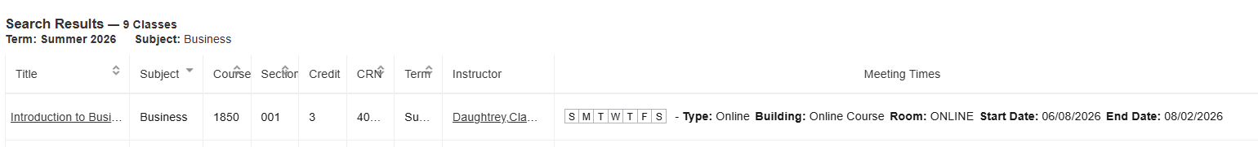
Full Term and Part Term Classes
MSU Denver offers full-term and part-term (including Maymester and Winterim) classes
A Full-Term class runs the full 16 weeks in the Fall and Spring or the full 8-weeks in Summer
A Part-Term class does not run the full semester and will have different start/end and refund dates
Many Business Fall & Spring classes are Part-Term, 14-week classes
(Veterans--talk to the VA Office about the impact to your benefits)
The class schedule will show you course dates

Slide 16
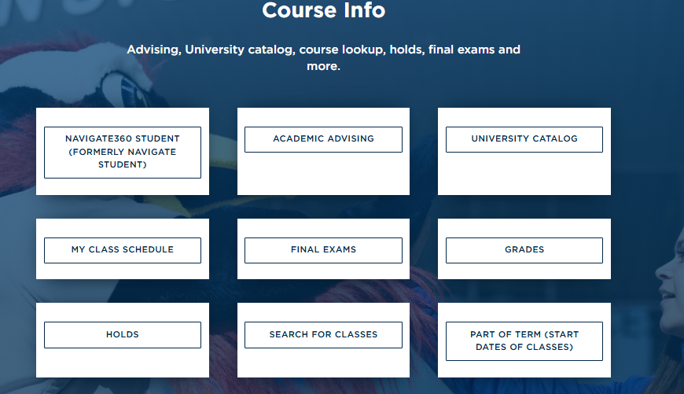
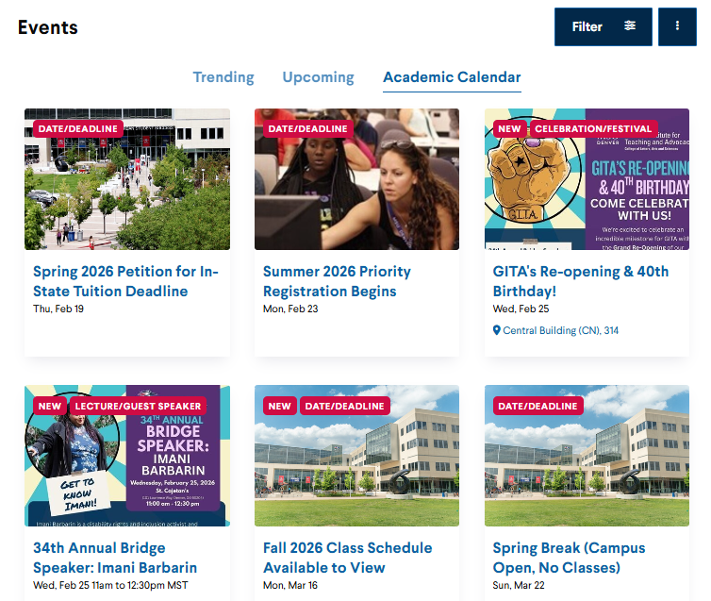
Refund Deadlines
My Class Schedule, which is available on Student Hub, under the Course Info Section, will have the refund dates for your classes (full-term or part-term)
Refund dates are posted on the Academic Calendar for full term classes only.

Slide 17

Financial Responsibility Reminders
If you register for classes, you owe tuition & fees whether you attend them or not
For a full refund, you must drop classes by the 100% Refund Date
You are responsible for paying your tuition & fees, books, etc., even if your Financial Aid award isn’t enough to cover your bill
Consider signing up for a Payment Plan if needed
Learn about your Financial Responsibility requirements

Slide 18

How can I keep my education costs down?
Take advantage of university & community resources and resources (Auraria Library, Rowdy’s Corner, etc.)
Apply for Scholarships and Work Study
Explore Alternative Credit Opportunities
We accept AP, IB, CLEP, DSST credits, some 3rd Party Self-Paced courses, some licenses, Military Service, and portfolio assessment
Learn which Business Requirements you can meet with Alternative Credit on our webpage
For example, students who speak Spanish, French, or German fluently can take a CLEP exam and potentially save thousands in tuition & fees
Review these and other Money Saving Tips on our checklist
Money Saving Tips Checklist

Slide 19

Additional Advice
File your FASFA / CASFA Application Early!
Regularly check your application status and make sure you are not missing required paperwork
Remember you need to accept your award
If you need help, you can get support from:
Financial Aid Office – Financial Aid Questions
Education Opportunity Center – help filing FASFA
Immigrant Support Office – help filing CASFA

Slide 20
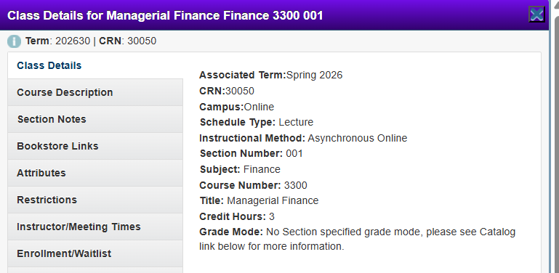
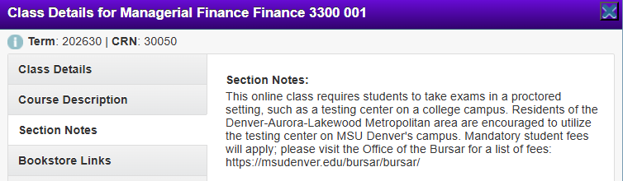
Live Proctoring for Exams
The Course Section Notes in the Class Schedule will let you know if the class requires live proctoring
Some Business classes require live proctoring for exams, even for online (asynchronous) classes
This means you must take your exams on the Auraria Campus or an approved Alternate Testing Center (for example, a local Community College or military base)
This helps us maintain the Academic Integrity of our programs (an AACSB requirement)

Slide 21
Let’s Talk Academic Advising

Slide 22

We have two types of Business Advisors
Faculty and Professional Academic Advisors
Faculty Advisors are your Professors and experts in their respective fields. They can help you with…
Career Advice
Jobs & Internship Information
Graduate School Inquiries
Selecting upper division Major Courses and Electives
Picking Certificates, Concentrations, Minors, and Majors
Student Support Resources

Slide 23
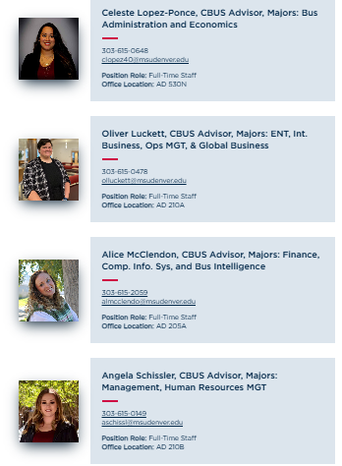
Professional Academic Advisors
Assigned by Major and can help you with….
Unofficial transfer evaluations and transfer questions
Academic Standing (Recovery/Notice)
Questions about policies and procedures (Fresh Start, Late Enrollment, etc.,)
Academic Plans (Financial Aid Appeals)
Declaring Majors / Minors / Concentrations / Certificates
Student Support Resources and referrals
Assist with Instructor Problems
And much more!
See a Professional Academic Advisor if you need help with anything other than what is specifically on the Faculty Advisor list

Slide 24
Faculty & Professional Academic Advisors…
Are Not Financial Aid Counselors or Bursar’s Staff
Financial Aid Questions need to be directed to the Office of Financial Aid and Scholarships
Tuition and fees questions should be directed to the Bursar’s Office
Do Not have unlimited Cosmic Power
While we are here to help make your academic journey smoother, you are responsible for registration, FASFA/CASFA applications, filling out relevant forms, etc.,
We must operate within existing university policies, guidelines, & deadlines
We are available during university business hours, not 24/7
Because of privacy laws, academic & faculty advisors do not have access to some records including financial or billing info—this is why we can’t help you with these questions

Slide 25
How do I contact an Advisor?
Professional Academic Advisors are assigned by Major and current assignments are on our CBUS Advising Webpage
You can make advising appointments with them through Navigate360. This is the preferred method for reaching your academic advisor
You can also email your advisor
If you email, please email from your MSU Denver student account and include your Student ID so we can verify your identity
Include a short summary of what you need assistance with
Please do not Teams chat us or call us unless directed by your advisor (this lets us prioritize support to students)
Learn more about our Advising and Expectations for students
For Faculty Advising, see the CBUS Faculty and Staff Directory for contact information

Slide 26


Teams Appointments
For Teams appointments, we do not send separate meeting links
You must be logged into Teams with your MSU Denver email account and answer the call at the scheduled time
You can find instructions for accessing Teams on the ITS website
If you are unable to use Teams, please email your advisor with a phone number prior to your appointment
We do not use Zoom as this platform is not supported by our ITS Department

Slide 27
Final Section: Preparing for your first Academic Advising Appointment or Registration Session

Slide 28
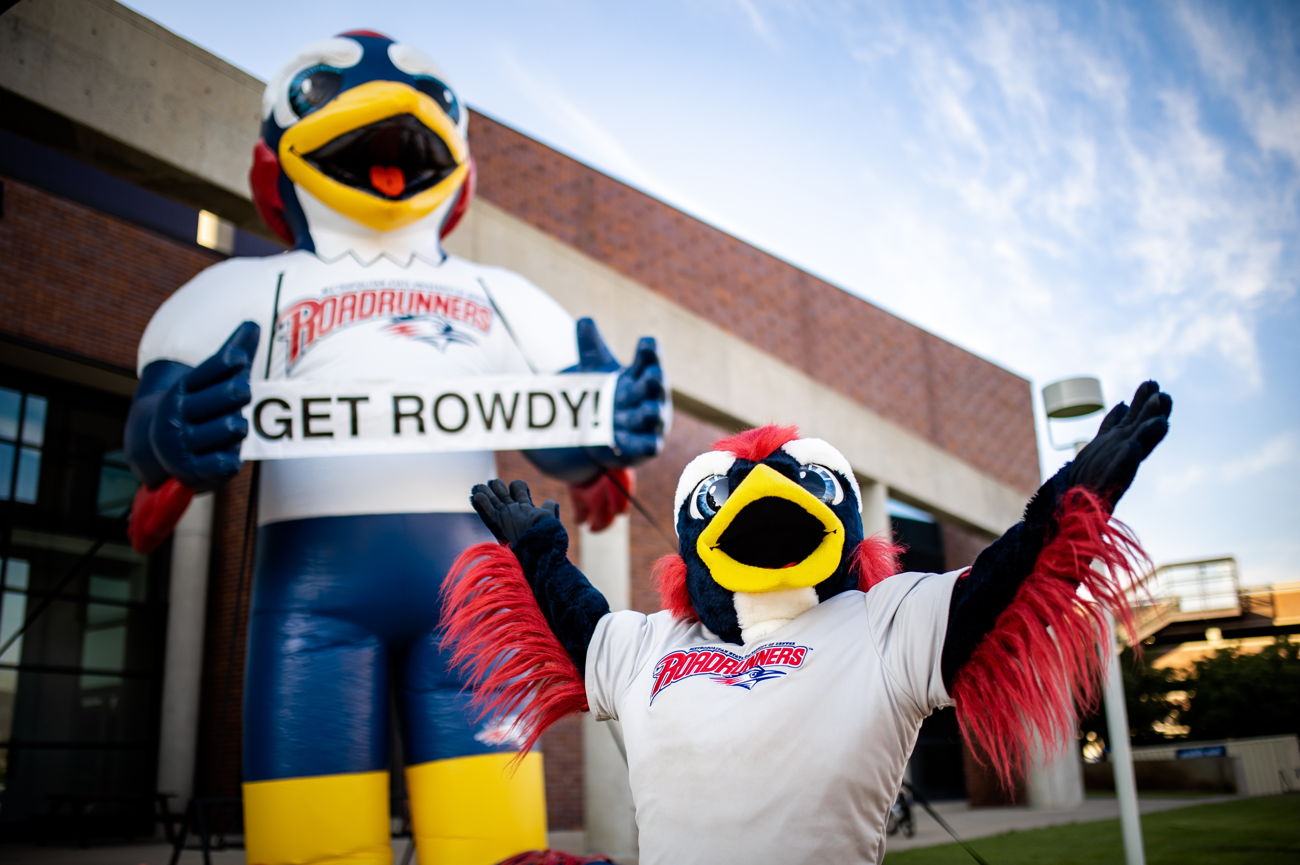
We recommend signing up for the earliest possible registration session or advising appointment
It is important for you to register as early as possible
Early Birds get the worm better class choices!

Slide 29
Preparing for your First Appointment or Registration Session
You need to have these available
Unofficial copies of college transcripts
We need your college transcript for Concurrent Enrollment courses (not your High School Transcript)
International Students we need a copy of your NACES transcript (we will not be able to assist you without one)
Your ACT or SAT Score Report
Only if you meet English / Math score minimums and are not transferring in ENG 1010 or ENG 1020 and the appropriate Math class and your SAT or ACT scores are less than 5 years old
AP / IB / CLEP / DSST Scores

Slide 30
Additionally, we highly recommend completing the following before your appointment
The English Placement Survey
The appropriate Math Assessment (if needed)
Our Course Selection Guide for First Time Students (this will help you pick classes and your schedule)
Reviewing our CBUS Advising Website, including Student Expectations
We will not provide course overrides without proof you have completed prerequisites
If you submitted official scores and transcripts two weeks prior to your registration/appt, you do not need to bring copies with you

Slide 31
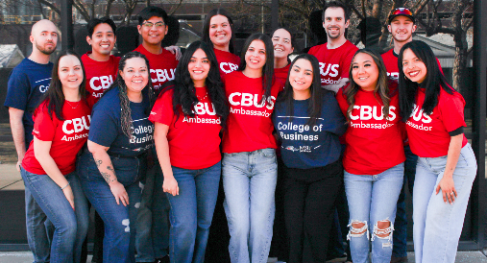
Transfer Students
Please submit official transcripts to MSU Denver Admissions as soon as possible
Official transcript reviews by the Transfer Office can take weeks
Failure to send your transcripts in a timely manner may result in you accidentally taking classes you don’t need
If you took AP, IB, or CLEP tests, you must also send MSU Denver your official test scores to receive academic credit
Your classes (particularly if they are from out of state) may need further review by an Academic Department Chair
You may be required to submit a class syllabus
Your academic advisor will help you review your transcript and instruct you on submitting courses for additional review
If you have questions, please see the Transfer Toolkit

Slide 32

International Transfer Students
CBUS Advisors will not do unofficial transfer evaluations without a NACES approved transcript translated into English
Even with a NACES transcript, we will not be able to provide course overrides until we can verify you meet class prerequisites
This might require you submitting copies of your course syllabi for review
Please submit your NACES transcript early and do not make an advising appointment until you have at least an unofficial copy of it

Slide 33
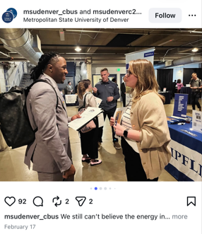
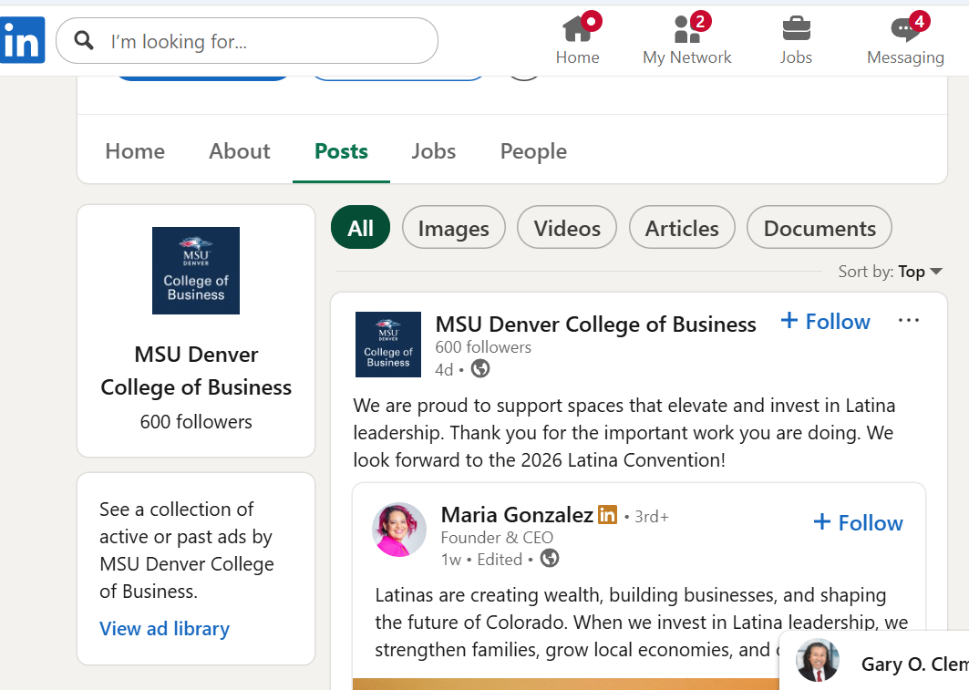
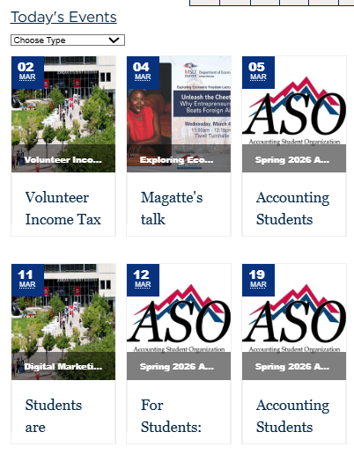
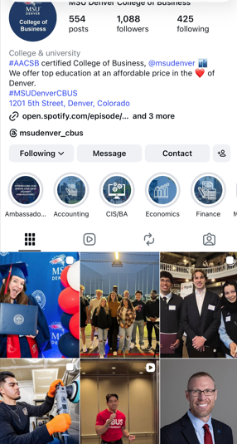
Email / Social Media
Check your MSU Denver email on a regular basis
This is the primary method of contact with the University, including Financial Aid and your Professors
You could miss important info like class cancellation notices, reminders about deadlines and career events, missing assignments, FASFA award notifications, etc.
We also recommend following the College on Social Media as we also post reminders and notices about upcoming events
CBUS Events
LinkedIn
Instagram

Slide 34

Thank you for your attention. We look forward to seeing you soon!
Go Road Runners!

