Slide 1
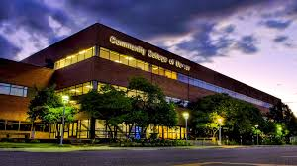
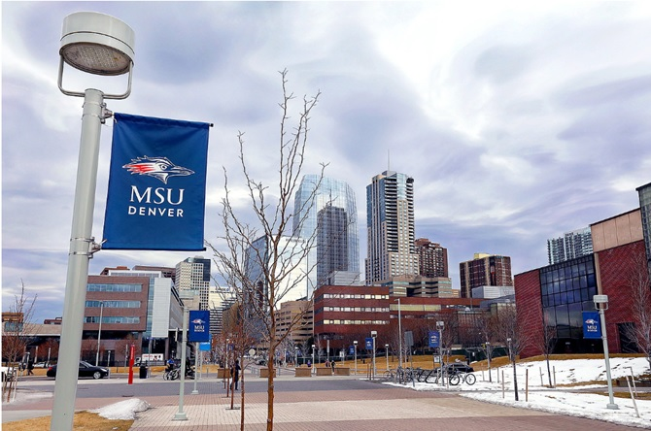
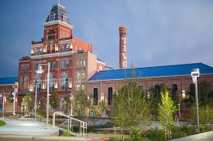
CCD & MSU Denver Summit
February 24, 2026

Slide 2
Agenda
Welcome Activity & Introductions-15 min
Purpose/Summit Outcomes-5 min
Defining Current Interinstitutional CCD/MSU Denver program-5 min
Small Group Discussion-20 min
Break-5 min
Student Data & Case Study-10 min
Benefits and Barriers-10 min
Future visioning & opportunities-30 min
Wrap up & next steps-5 min
Notes:
ANGIE

Slide 3
Welcome Activity & Introductions
Raise Your Hand & Why You’re Here
Introductions
Name, title, what is your role in the transfer process?
Notes:
ANGIE
Add welcome activity questions
Introductions: Name, title, what is your role in the transfer process?

Slide 4
Problem Statement & Purpose
While both campuses share a vision of seamless student movement, there needs to be a clearly defined interinstitutional process that enables students to enroll in courses across campuses in a way that is sustainable & scalable.
The purpose is to provide a robust, easy interinsitutional enrollment process for students, increasing completion rates, and credit loads for students at each institution.
Notes:
ANGIE-how do we find momentum post-summitt

Slide 5
Outcomes
Knowledge of current Interinstitutional student program
Identify opportunities to increase participation by students & improve process
Brainstorm a future vision for a seamless & sustainable Interinstitutional program
Define next steps
Notes:
CONNIE

Slide 6
CCD & MSU Denver Interinstitutional Program
Allows MSU Denver & CCD students to take courses at the other school.
Student has a “home school” and “host school”.
Student pays tuition at home school, course fees at host school.
MSU Denver student submits the request form and application at CCD.
CCD student submits the request form to enroll at CCD (no app req’d).
Credits enrolled from both schools count towards financial aid eligibility.
Both institutions set enrollment deadlines each term for this program.
No tuition is exchanged & COF is reimbursed by host school.
Courses are officially transcribed on both academic records.
Host school reports official enrollment for FTE.
Courses must be approved at home school and apply towards degree.
Notes:
CONNIE
We should leave space for people to ask questions.

Slide 7
Student Data
MSU taking CCD (5-10 each fall/spring term)
CCD taking MSU (10-20 each fall/spring term)
Summer enrollment small for both
2016-2026
167 unique students
96 have a Bachelors
49 CCD graduates
14 of these have graduated from MSU
80 have Bachelors from MSU
Source: National Student Clearinghouse/CCD IR
Notes:
ANGIE
Still validating data, at-a-glance
Last 10 years

Slide 8
Small Group Discussion Topic:
How do students at CCD or MSU Denver hear about this program?
Would you know how to refer a student for the program and explain the process?
What are the barriers or benefits that you have heard about or directly experienced with a student?
Notes:
CONNIE
Have each group report out

Slide 9

Break (5 minutes)

Slide 10
Case Study: CCD & MSU Denver Nutrition Pathway
CCD offers an AS in Nutrition that articulates into the BS in Nutrition at MSU Denver.
Student also can pursue a Nutrition Master’s degree at MSU Denver.
The articulation agreement with MSU Denver incorporates 1-2 courses in this program while at CCD.
Data on this program as of September 2025:
29 students identified in the Inter-Institutional Program with CCD who are now pursuing NUT degrees
16/29 students are still currently registered (15 UG; 1 GR)
5 UG Degrees have been awarded
1 UG Degree pending award
2 GR Degrees have been awarded
Exposes students to MSU Denver course prior to graduation.
Collaboration and intentional curriculum design between both Nutrition Chairs.
Notes:
CONNIE

Slide 11
Current Program Benefits
Keeps tuition cost down for CCD students (access).
Students never have to transfer any coursework between schools.
CCD students do not have to be formally accepted at MSU Denver for this program.
Financial Aid is administered by one college.
Allows students to have more course flexibility (if the course time is not available at home school).
Others?
Notes:
CONNIE

Slide 12
Current Barriers
Challenging student experience.
Extremely manual on staff end for small % of students.
MSU Denver students cannot take online courses at CCD.
CCD students must obtain prereq overrides (resolution in progress).
Process can be confusing to advisors, staff, and faculty.
Others?
Notes:
CONNIE

Slide 13

How can we transform cross-registration at MSU Denver & CCD?
Task: Brainstorm with your group and design a seamless and sustainable program
Consider:
How will this benefit students & transfer?
Who needs to be involved to operationalize this vision (what functional areas)?
How might T&F and/or Fin Aid be leveraged differently?
What is the governance structure or policy approvals required to institutionalize this work?
What needs to be in place to find forward momentum post-Summit?
How does this impact resource (staffing)?
How do we promote/comm this opportunity with students?
What are the incentives for faculty & staff to invest in this program?
Notes:
EACH TEAM TO REPORT OUT:
DIFFERENT FUNCTIONAL AREAS ON EACH TEAM
How can technology be leveraged?
How does this impact transfer to MSU Denver from CCD?
How could this program be better marketed to students?
What would this mean for student success & retention?
How does and can this program promote transfer?

Slide 14

Next Steps
Notes:
ANGIE –GATHER INFORMATION

Slide 15
Thank you!

