Slide 1
MSU Denver FY26 Proposed Budget
MSU Denver Board of Trustees: Finance Committee Meeting
June 12, 2025

Slide 2
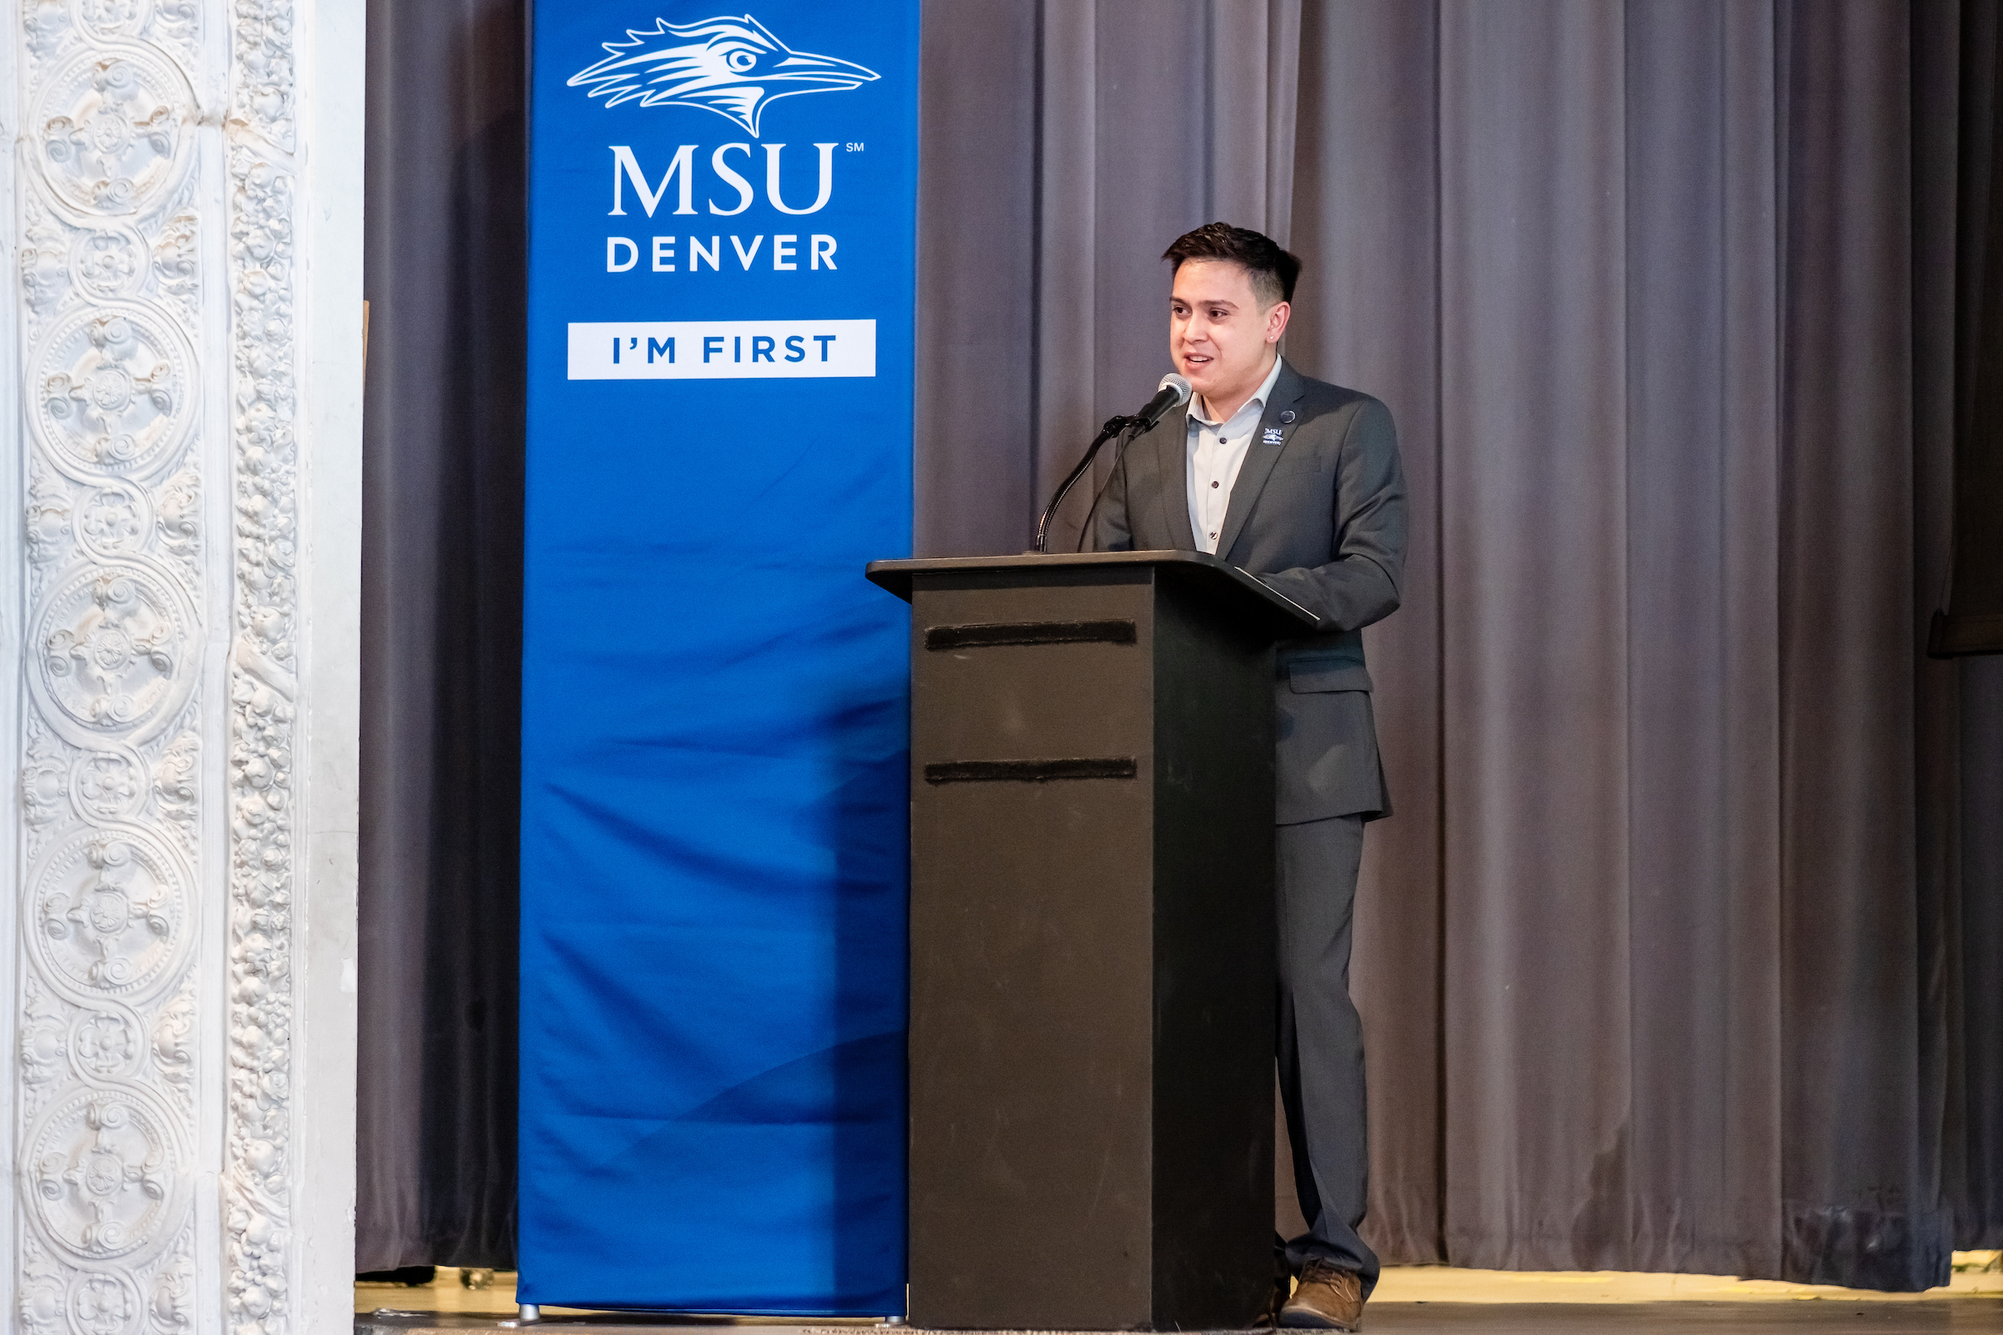
Agenda Overview
Budget Priorities
Revenue Drivers
Expenditures and Strategic Alignment
Board Approval
Notes:
Jim – 5 minutes

Slide 3
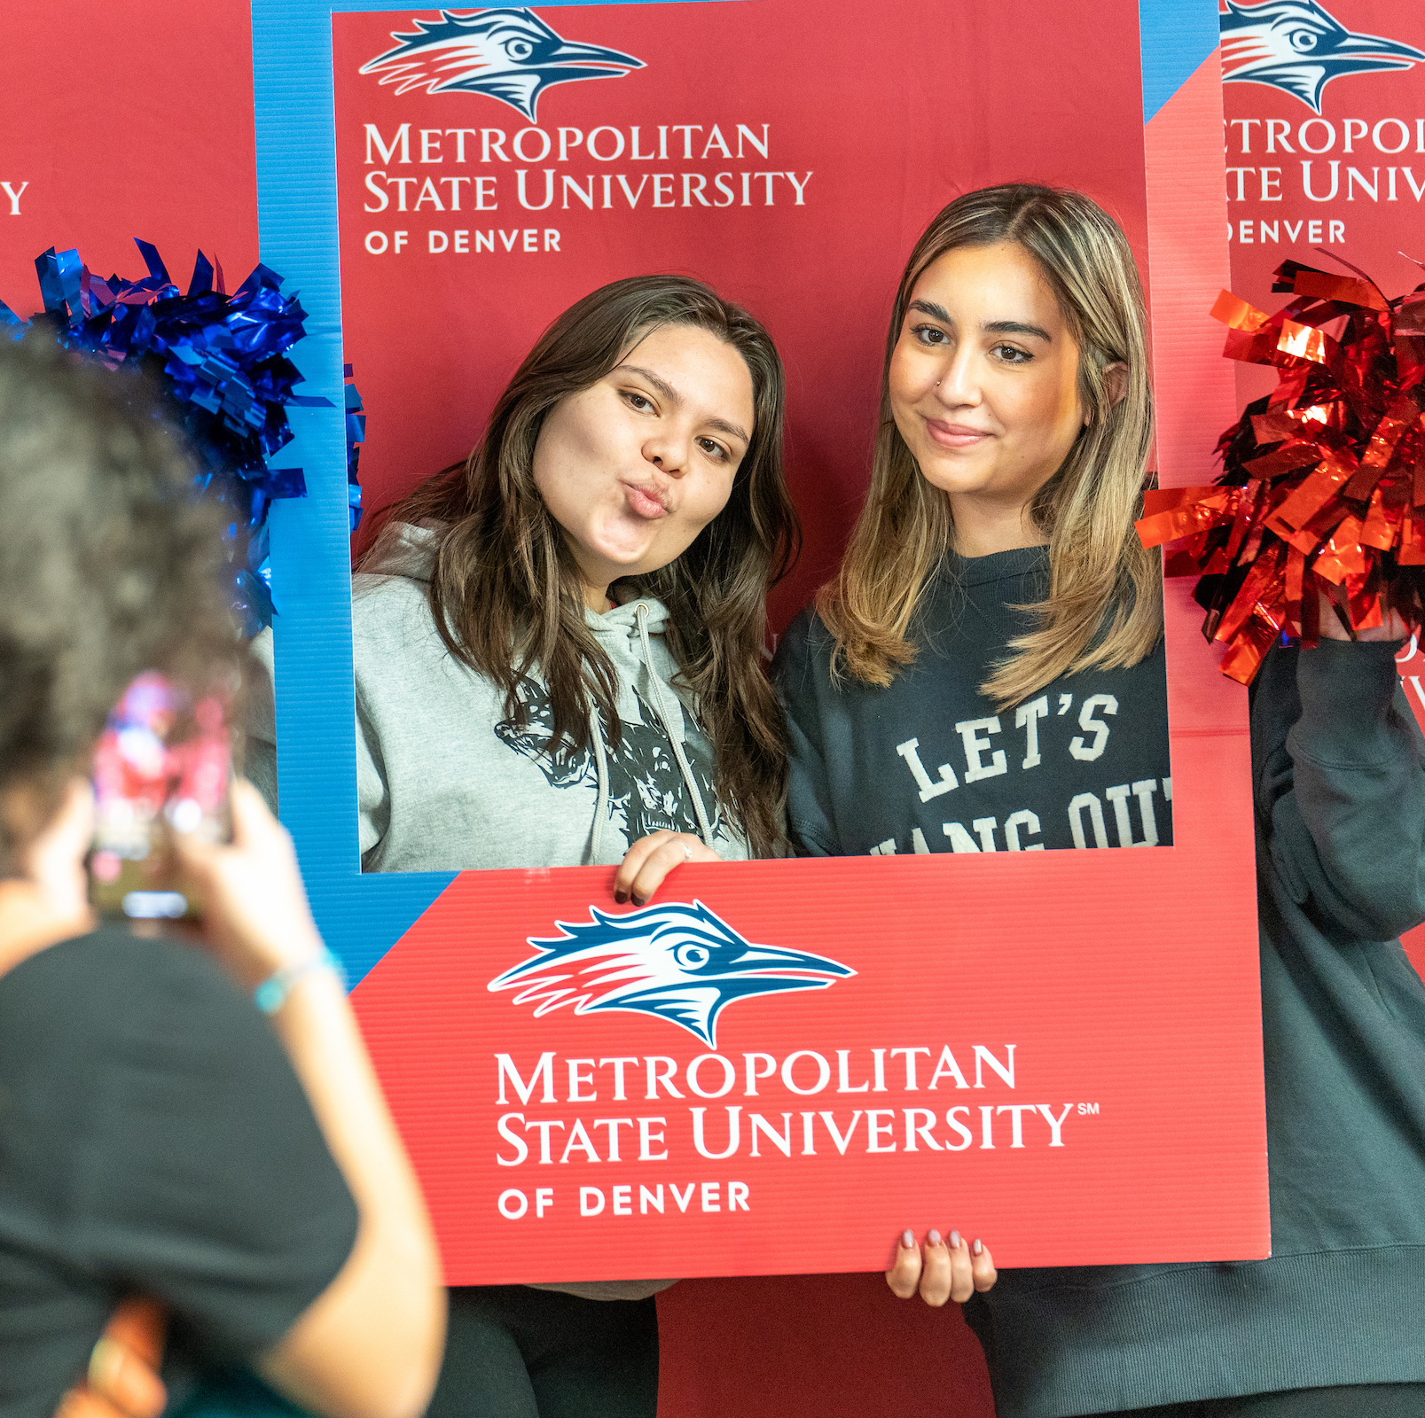
Seeking Approval for FY26 Budget
General Fund Budget: $222.9M
Resident and Non-Resident Tuition Increases: 3.5%
Fee Increases:
Mandatory Fees
Program Fees
Matriculation Fee

Slide 4
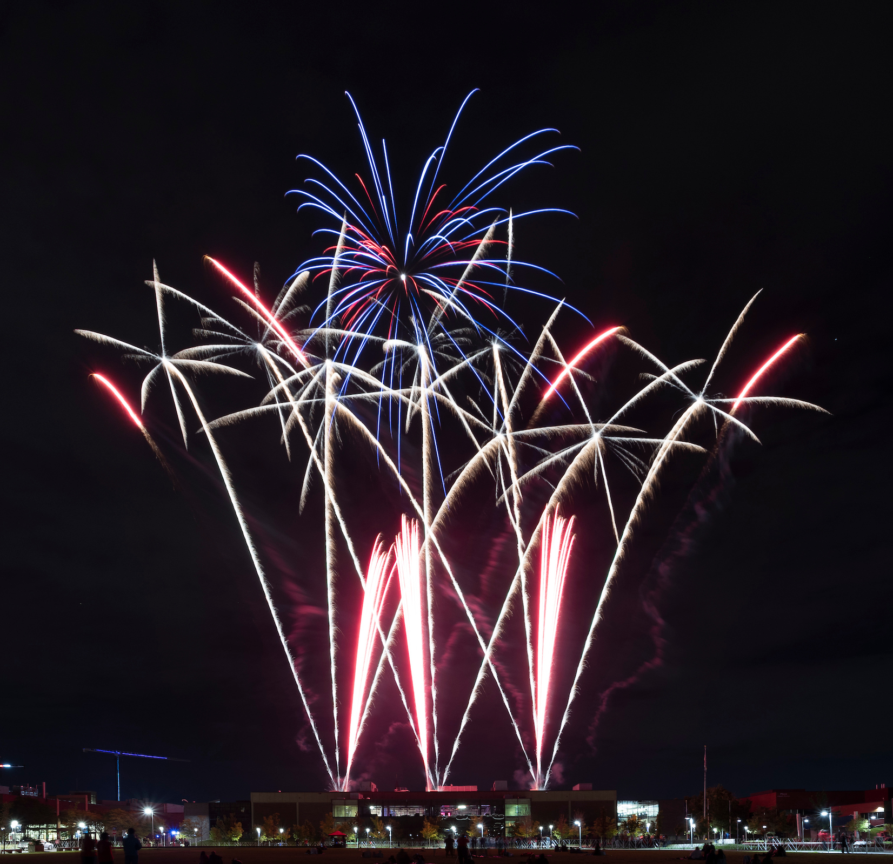
FY26 Budget Development: Big Wins
Engagement in the process: UPBAC, Campus Leaders, and Budget Team
Systems Transparency: Workday provides a better understanding of budget to actuals
Understanding Trends: Better evaluation of University Underspend and reversal of past budget contra
Program evaluation: Used ROI to analyze Tennis program
Contracts Management: Budget savings identified through contract reductions
Walking our way to ERM Success

Slide 5
President Davidson’s Budget Charge
Student Retention and Completion
Continuing our commitment to our people
70% of budget linked to our talented people; so this valuable investment must be protected
Removing friction and increasing organizational efficiency
Strengthen sustainability through strategic reserves
Strategically expand our recruitment

Slide 6
FY 26 Revenue Drivers

Slide 7
FY25 Tuition and Fees Landscape MSU Compared to Colorado Peers (30 Credits)

Slide 8
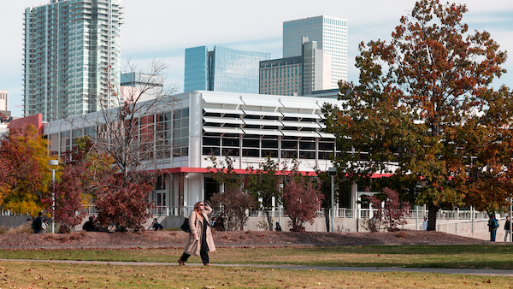
Data assessment points to using Flat enrollment growth as conservative estimate for budget build
Increased Recruitment:
Applicants up 23%
Admits up 25%
Fall 24 to Fall 25 Comparison:
Full Year FTE Trends up .47%
Headcount Trends up .22%

Slide 9
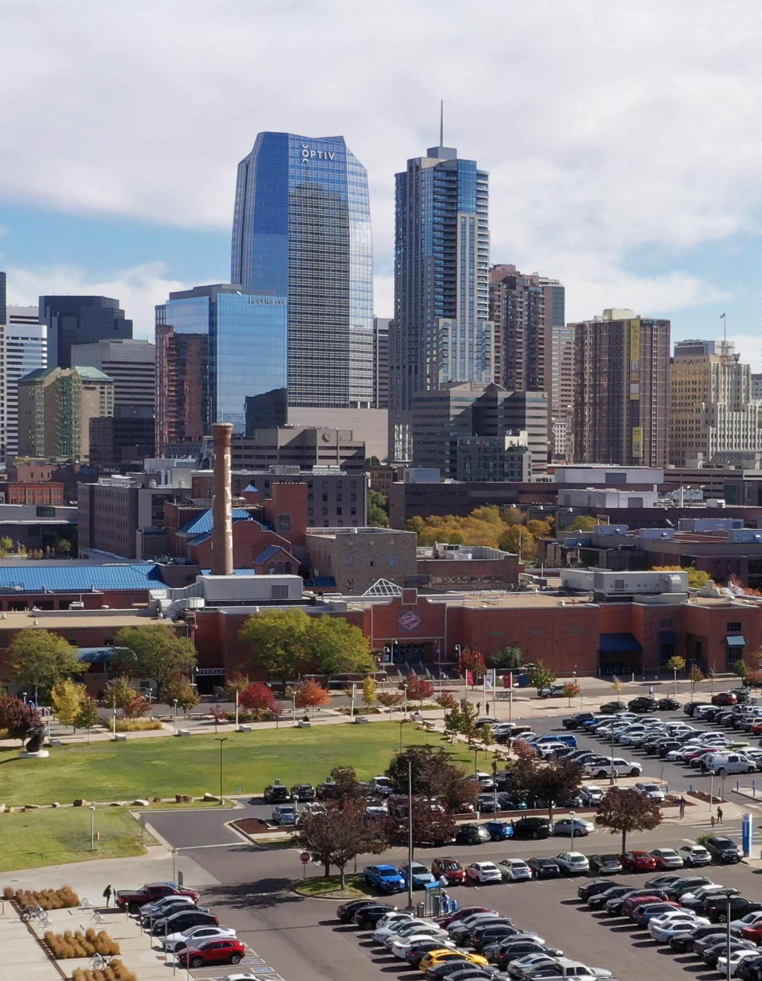
State Funding and Tuition
Changing State Environment:
$31.7M for Higher Education Operating
$3.3M for MSU Denver
Tuition Rate Caps:
3.5% for Resident and Non-Resident Students
Rates only applied to new students due to Tuition Lock
Generates $1.3M in Revenue

Slide 10
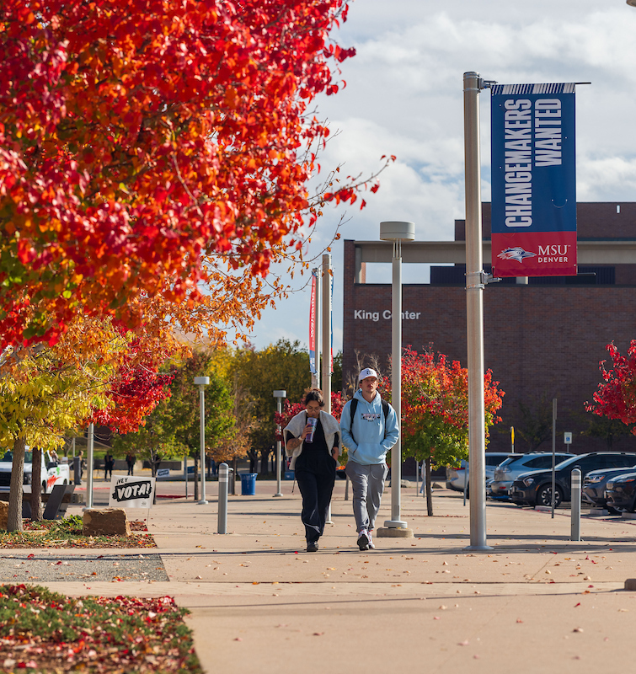
Fees: Four Types Supporting Students
Mandatory Fees: Paid by each student
Support key auxiliaries like Debt Service, Health Center, Student Technology, and Student Support and Academic Programming
Can be raised by 5% annually under adopted Fee Plan
Program Fees: Support Specific Academic Programs
Recommended after review by Student Fee Review Panel
Matriculation Fee: supports student orientation and commencement
Recommended after Student Fee Review Panel
Auraria Pass-Thru Fees: Set by AHEC at inflation

Slide 11
Expenditures and Strategic Alignment

Slide 12
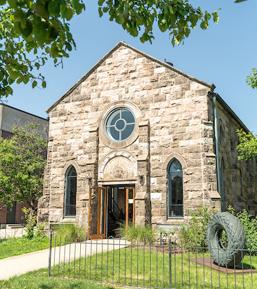
FY26 Budget: The Math Problem
MSU Denver Base Needs
Compensation increase of 2.5%: $3.7 M
Mandatory costs: $4.2 M
Total Base Cost Increase: $7.9 M
FY 26 Revenue
Increased state funding: $3.3 M
Tuition increase at 3.5%: $1.3 M
Total Possible Revenue Increase: $4.6M
Projected MSU Denver Budget Gap: $3.3 M

Slide 13
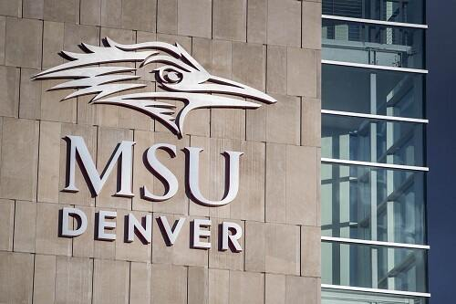
FY26 The Dollars: Identified Savings for Redistribution
President’s Office: $45,000
Office of Diversity: $30,000
Marketing and Communications: $45,000
General Counsel: $50,000
Strategy: $50,000
Athletics: $72,000
Advancement: $50,000
Administration: $974,900
Academic Affairs: $1,750,000
Campus Wide: $500,000
Government Relations: $5,000
Student Affairs: $292,000
Total: $3,863,900

Slide 14
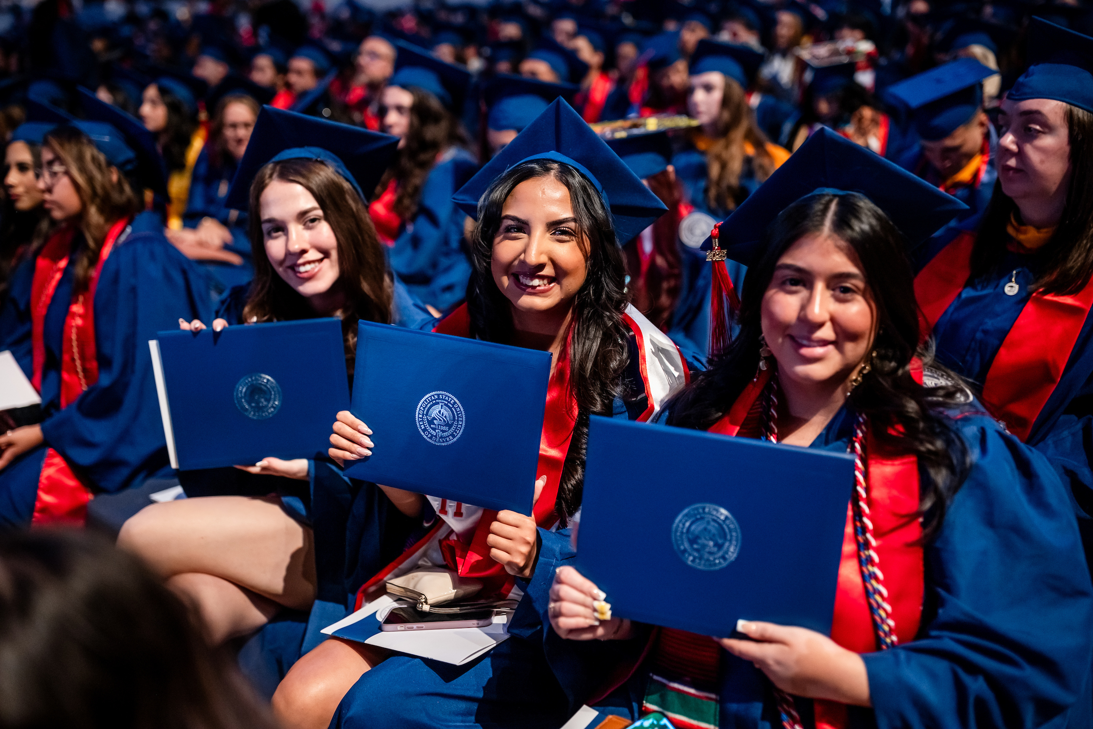
Strategic Budget Savings: Protecting Student Supports
Savings focused on unutilized or underutilized resources
Areas Protected from Budget Reductions
Student financial aid
Academic support for growing programs
Instruction for growing programs
Advising Services
Direct Student Supports

Slide 15
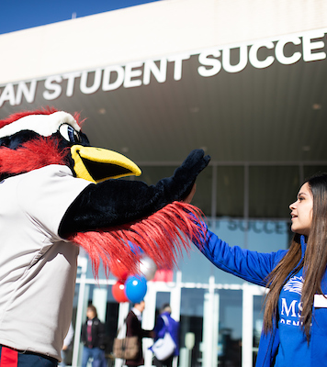
FY26 Recommended Increases
Mandatory Costs:
$4.2M to support and maintain campus operations
Direct Student Investments:
$100K for Athletics Scholarships
$100K for Student Hourly in Writing Center and Tutoring Center
Investing in Ourselves:
$250K for marketing support for statewide engagement
$126K for technology security investments
$27,500 for mission aligned investment in ODI staff

Slide 16
FY26 Compensation: People do the Work
Planning a 2.5% ($3.7 million) increase in salaries
Following State Increase
FY26 Classified increase was 2.5%
Tracking with inflation
Maintain competitiveness
Reducing investment has a compounding effect

Slide 17
Historical Comp Increases: Catching up on Competitiveness
 | FY17 | FY18 | FY19 | FY20 | FY21 | FY22 | FY23 | FY24 | FY25
Classified | 0.0% | 2.5% | 3.0% | 3.0% | 0.0% | 3.0% | 3.0% | 5.0% | 3.0%
Faculty and Staff | 2.0% | 1.0% | Maintain CUPA | 3.0% | 0.0% | 1.75% + $2000 Stipend | 3% | 4% + $800 Stipend (one time) | 2% +$820 Flat (base building)

Slide 18
Enterprise Risk Management: Moving Forward to next Phase with Existing Resources
Building out ERM Approach: Aligning Existing Resources
Utilize the resources provided for the Baker Tilly Contract to expand MSU’s ERM reach
Partnering with Risk Assurance and Advisory Center in the College of Business
Capitalize on expertise in Administration and Finance with new Chief Operating Officer

Slide 19
Building our Reserves: FY25 estimated 13.5% trending toward 15%

Slide 20
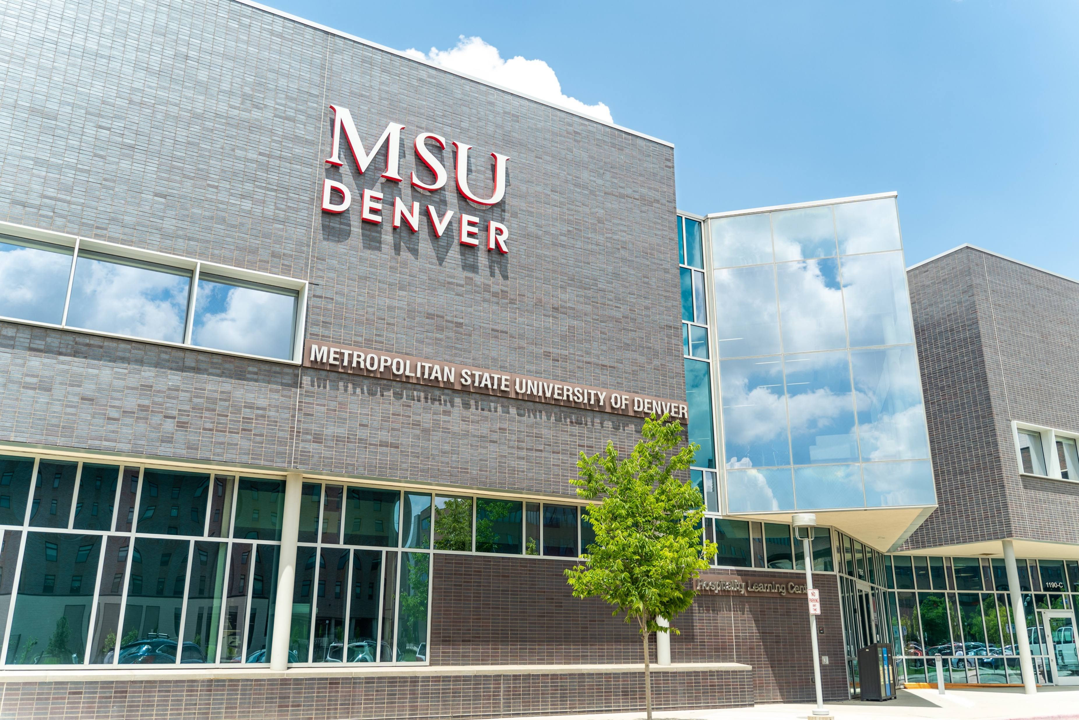
Capital Budgeting: Building the Approach
New capital assets (student housing and Day Health Institute Tower) coming online in 2027
Building in programmatic costs for student housing
Continuing to hone program costs and revenue impacts for increased enrollment
Developing a set-aside for operations and maintenance using existing resources from Bond Fee

Slide 21
FY26 Budget Approval

Slide 22
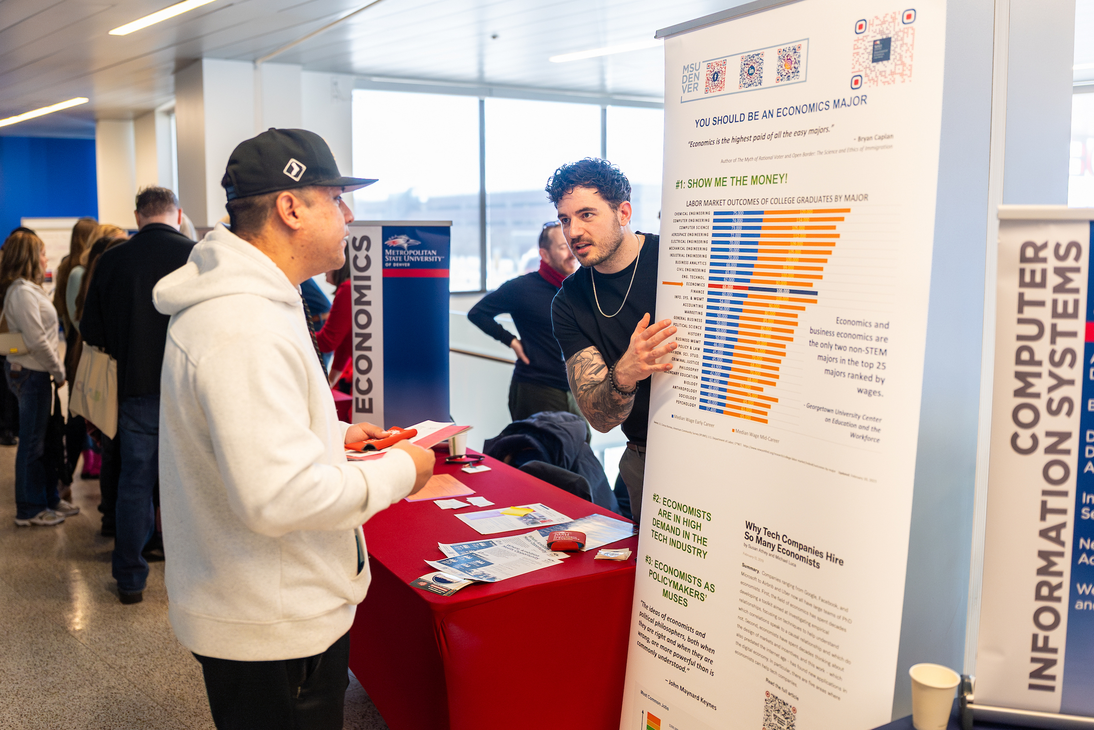
Board Approval
The Board of Trustees is requested to approve the following:
The Education and General Budget of $222.9M
Resident tuition increase of 3.5%
Non-resident tuition increase of 3.5%
Mandatory fee increases of 5%
Three program fee increases and one program fee decrease
Matriculation fee increase of $50

Slide 23
FY26 Budget Allocations
Branch | FY25 Base | New Funding | Mandatory Costs | Budget Savings and Adjustments | Total BoT
Academic Affairs | $120,677 | $100 | $15 | ($1,750) | $119,117
AFF | $33,585 | $126 | $1,245 | ($975) | $33,981
Athletics | $3,648 | $100 | $0 | ($72) | $3,676
Campus-wide | $32,748 | $0 | $1,785 | ($11,123) | $23,411
Diversity | $1,477 | $28 | $0 | ($30) | $1,475
General Counsel | $2,221 | $0 | $0 | ($50) | $2,171
Government Relations | $915 | $0 | $0 | ($5) | $910
President's Office | $2,433 | $0 | $0 | ($45) | $2,388
Strategy | $2,709 | $0 | $0 | ($50) | $2,659
Student Affairs | $18,611 | $0 | $10 | ($292) | $18,329
UCM | $5,015 | $250 | $0 | ($45) | $5,145
University Advancement | $4,520 | $175 | $13 | ($50) | $4,657
Compensation Increases |  | $3,750 | $1,265 |  | $5,015
Total Expenditures (in 000s) | $228,560 | $4,529 | $4,333 | ($14,487) | $222,934

Slide 24
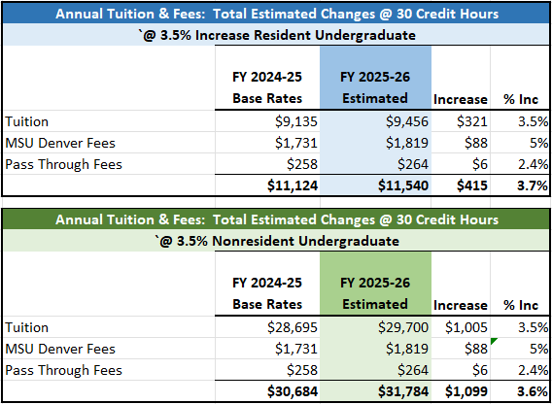
Impact to Students
Impact to resident students: $415 per FTE
Impact to non-resident students: $1,099 per FTE
Still competitive and comparable

Slide 25
FY26 Matriculation Fee: Maintaining Services and Competitiveness
One-time fee assessed when a student matriculates
Supports orientation and commencement
Fee has not been increased in five years while costs have grown
Fiscal Year | Inflation Adjusted Rate | Current Rate | Difference
FY20 | $101.95 | $100 | ($1.95)
FY21 | $105.56 | $100 | ($5.56)
FY22 | $114.01 | $100 | ($14.01)
FY23 | $119.97 | $100 | ($19.97)
FY24 | $122.69 | $100 | ($22.69)
FY25 | $126.37 | $100 | ($26.37)

Slide 26
Thank You!

Slide 27
Appendix

Slide 28
MSU Denver FY25 Total Budget: $292M Including Auxiliaries

Slide 31
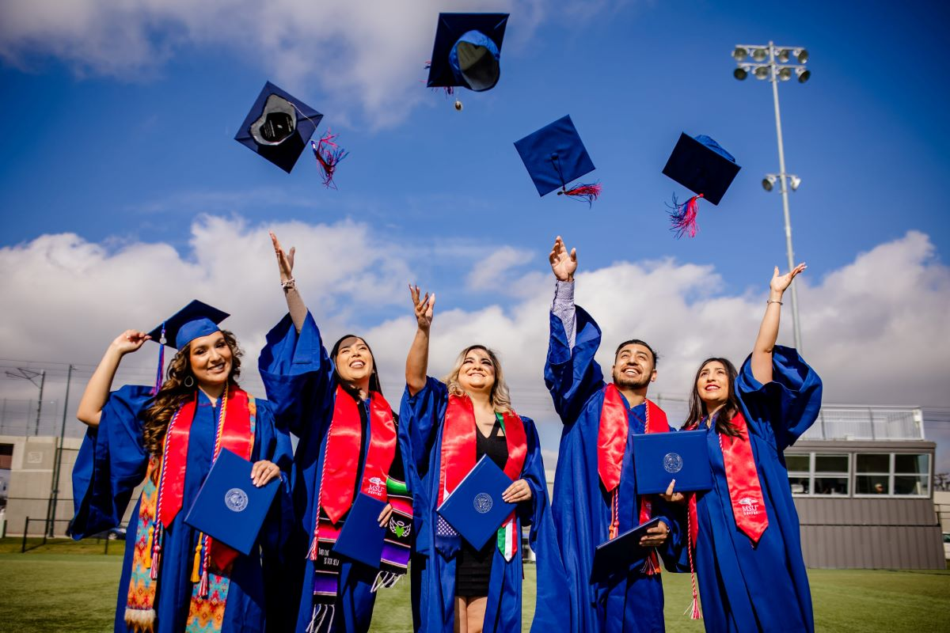
Approximately 64% of tuition and fees are covered by grants and scholarships.
Federal Aid:
$41.8M
State Aid:
$32.3M
Institutional Aid:
TOTAL:
Scholarships (MSUDF, Corporate, Tribal, etc):
$13.4M
$8.7M
$96.2M aid $150.9M tuition/fees

Slide 32
Tuition and Affordability
Roadrunner Promise: Students making less than $60K pay no tuition and mandatory fees
Nearly 40% of MSU Denver Students are Pell-Eligible
According to 2023-24 Data, about 50% of students had reported income below $40,000
Based on available data, average loan debt and share of students with loans have both decreased

Slide 33
MSU Denver Ten Year Tuition History
The 15 Credit Hour Rate Increase for FY 19-20 and FY21-22 reflect the two-part effort to close the tuition window.

Slide 34
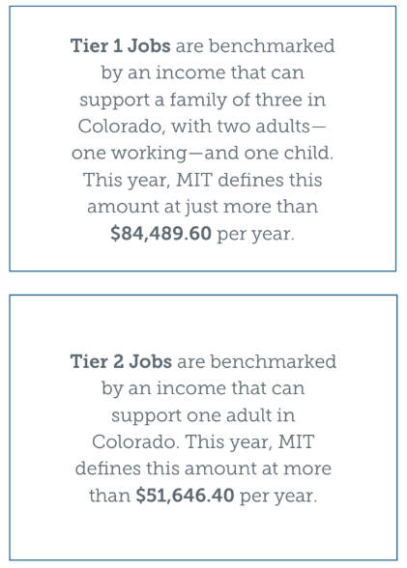
Strong Compensation is Our Most Strategic Investment
Key Results from Salary.com Compensation Equity Study
No equity issues identified
Competitive compensation
Median Salaries:
Faculty at $95,356 (qualifies as Tier 1 Job)
Staff: $70,690 (qualifies as Tier 2 Job)

Slide 35
If Enrollment Changes MSU Will Enact a Waterfall of Priorities
Increased Enrollment Waterfall Subject to Available Revenue
Add Enterprise Risk Management position funding requested by the Administration Branch.
Increase support for UCM to support marketing
Additional student hourly support for Undergraduate Studies
Move money to reserves and support University fiscal stability
Athletics scholarships
Further compensation adjustments
Reduced Enrollment Waterfall (1% Down)
Reduce student hourly for Undergraduate Studies
Reduce Marketing support for UCM
Reduce Athletics Scholarships
Do not move Advancement positions
Pull back ODI Salary increases
Halt Email and Account Security Enhancements
Identify additional savings from branches

Slide 36
FY26 Hotel Budget: Informational Update
FY26 Hotel Budget is on course and on speed
Occupancy remains strong
Benchmarking against industry standard for key metrics
Continued strong revenue projections
Evaluating circumstances that would impact the budget
Budget is Approved by Vice President of Administration and Finance

