Slide 1

ADVISING
SYSTEMS

Slide 2

We support advising teams across campus!
  We are part of Undergraduate Studies in Academic Affairs
  Along with leadership in colleges, schools, and programs, we help manage MSU Denver’s undergraduate advising structure.
  We don’t supervise advisors/leads or directly advise students outside of those on Academic Standing.
  We keep advisors informed and connected.
  We develop and implement strategy, training, and development, and manage Navigate360.

Slide 3
WHAT WE DO
1
2
3
Advising Strategy, Training, and Development
Early Alerts and Academic Standing
Navigate360 Management

Slide 4

OUR ROLES
Stephanie Allen- Director
Kimberly Williams - Associate Director, Intervention Services
Brandy Swanson - Coordinator for Training and Development
Patrick Wise - Advising Coordinator, Intervention Services
Heather Collins - Coordinator for Technology and Support
Michele Short - Academic Recovery Advisor and Advising Trainer
Student Staff

Slide 5
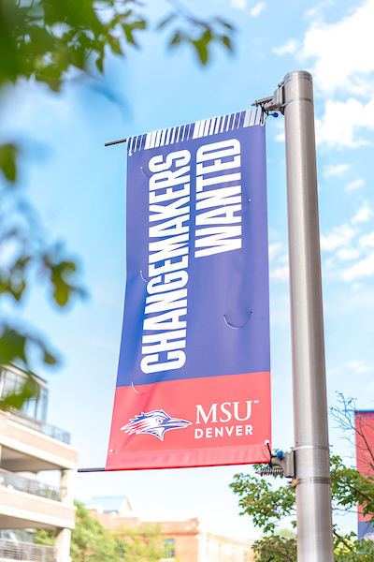

STRATEGY, TRAINING, AND DEVELOPMENT
  New Advisor Onboarding
  University-wide Advising Initiatives
  Provide input on policies and procedures
  Professional Development opportunities and ongoing training
  Collaboration, leadership, and communication to help fulfill goals of the University

Slide 6
EARLY ALERTS AND
ACADEMIC STANDING
  Create, send, and manage Early Alert campaigns to faculty
  Support students on Academic Notice (formerly Warning), Academic Recovery (formerly Probation), and Academic Suspension
  Registration encumbrances: impact students on Academic Recovery (AR) and Suspension (AS). AR students can have it lifted by an advisor or Advising Systems staff. AS students have it lifted by Advising Systems staff only and requires an approved appeal

Slide 7
NAVIGATE 360 MANAGEMENT
  Provide/collaborate training for faculty & staff on Navigate360
  Troubleshoot Issues
  Behind-the-scenes configurations
  Launch new features
  Leverage tech to support student success

Slide 8
OTHER SUPPORT
  Schedule appointments for Student Intervention Services Staff (Students on warning or recovery status may also meet with their professional academic advisor.)
  Help direct students to appropriate advisors, resources, or offices. Note: Referring students first to their academic department, academic advisor, or appropriate office is a great way to beat the Roadrunner Runaround!
  Appointment scheduling for students is available online or via the advising area/advisor. We do not schedule advising appointments.

Slide 9


RESOURCES
FOUND ON THE ADVISING WEBSITE:
ADVISOR LIST
ADVISING RESOURCES FOR STUDENTS ON WEB
TUTORIALS
FAQS
msudenver.edu/advising

Slide 10
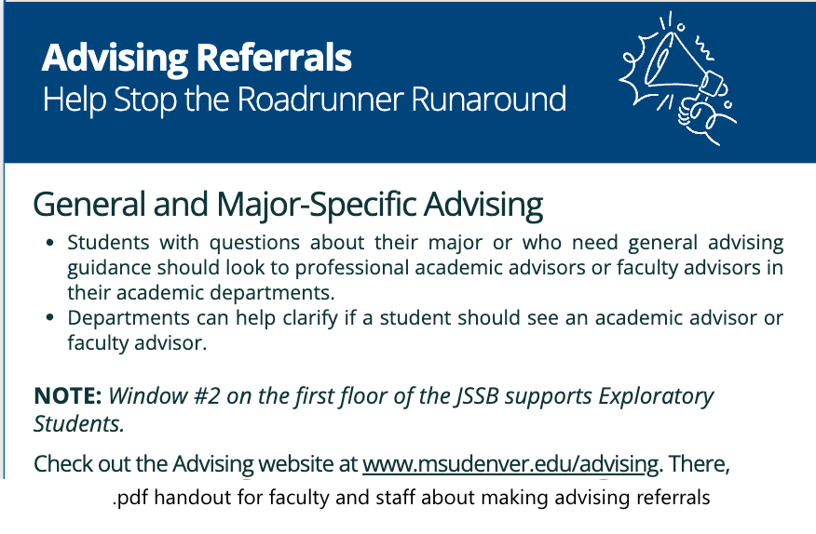
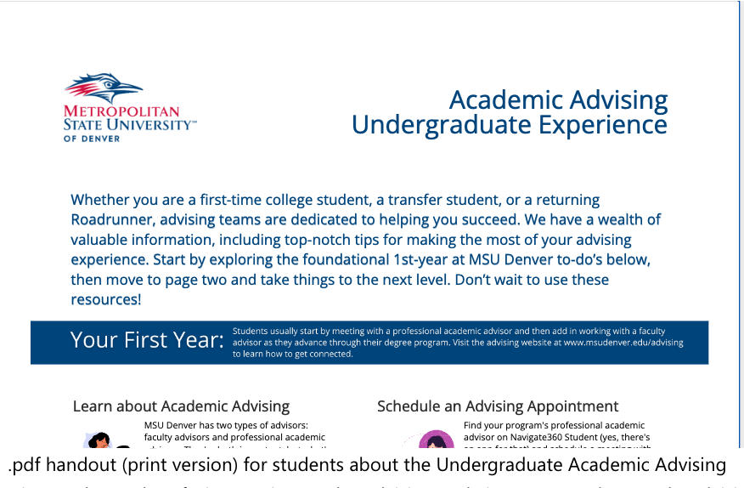
MAKING REFERRALS
ADVISING EXPERIENCE

Slide 11
THANK
YOU
We couldn’t do what we do...without you!
Advising Systems
advisingsystems@msudenver.edu
303-605-5650
Student Intervention Services
sis@msudenver.edu
303-605-5644
www.msudenver.edu/advising

