Slide 2
A journey… Nairobi, Kenya

Slide 3
Trauma bonding during education….
Dr Wanja Ogongi, Associate Professor,
Millersville University
Social & Community Development
International Social Work Education
Issues affecting the African Diaspora in the U.S.
Deborah Ongeri
Gracieh Msafiri, Rhythm of Africa Safari

Slide 4
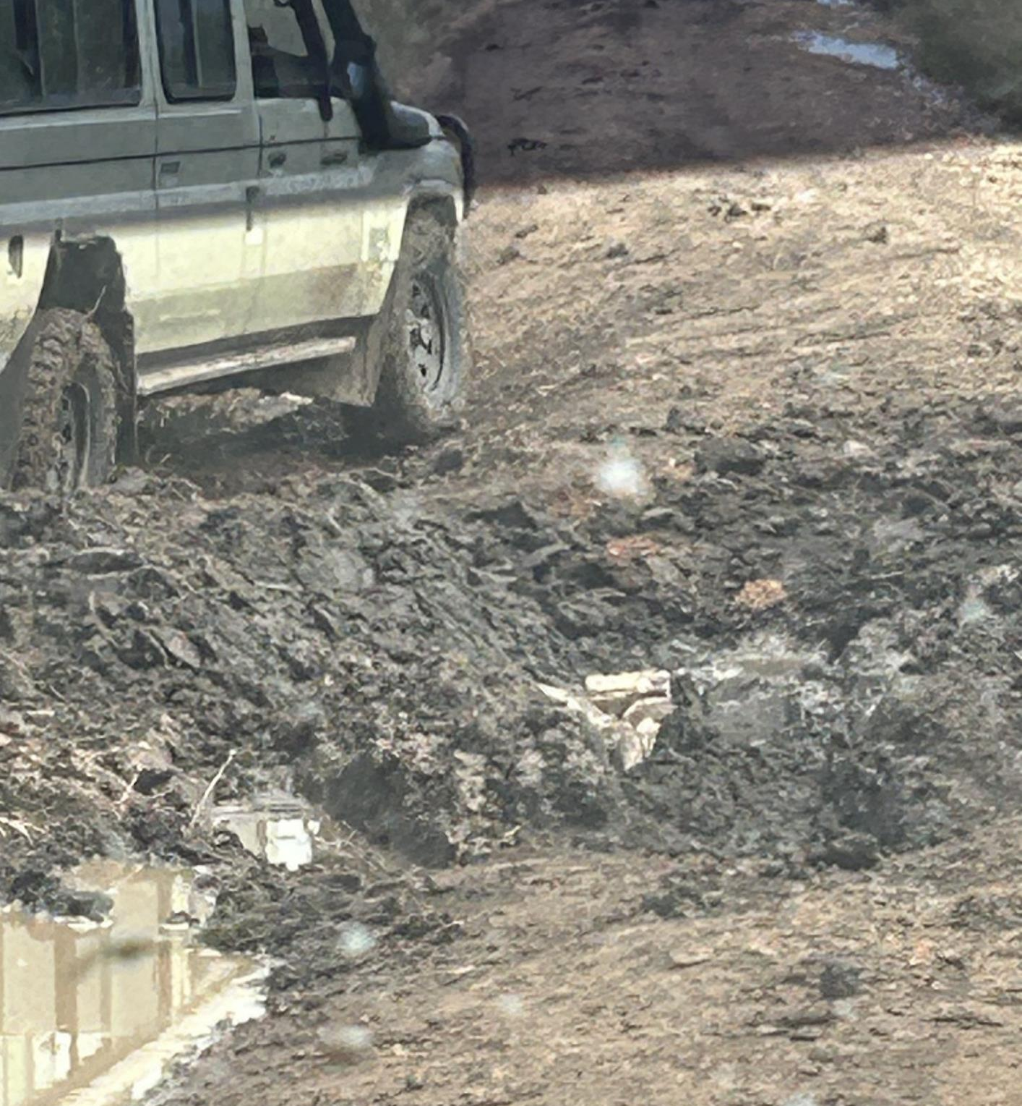
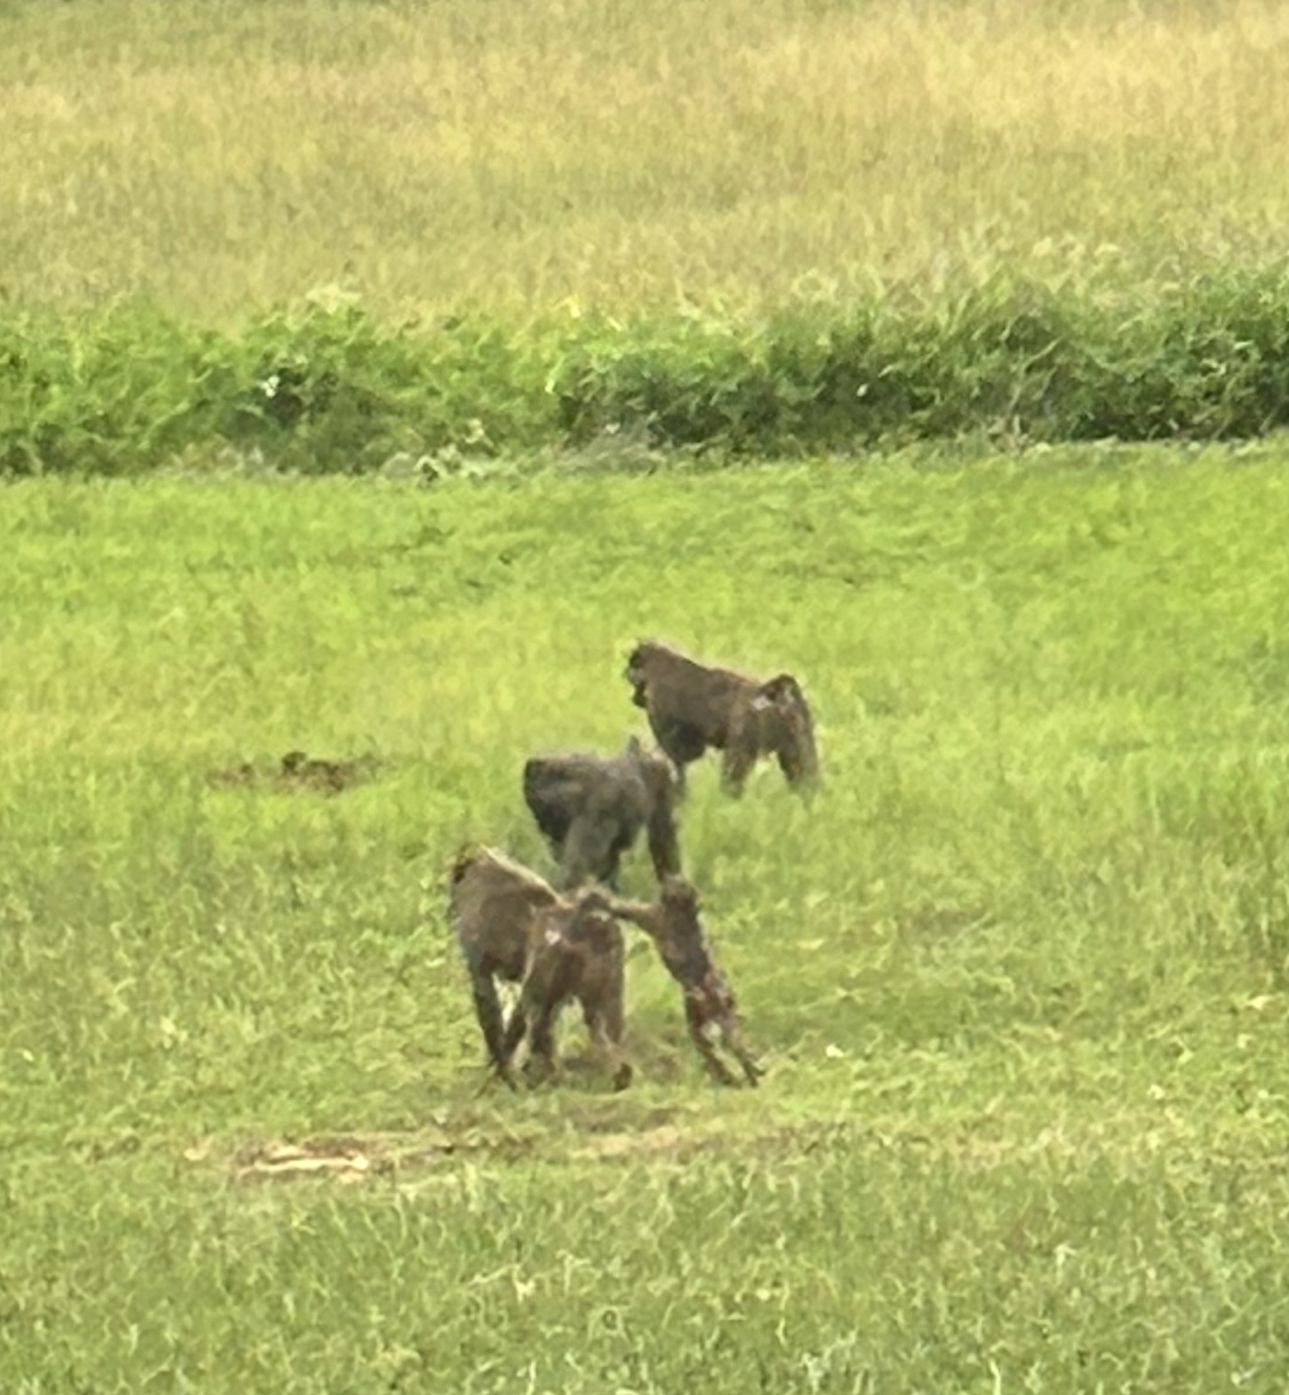
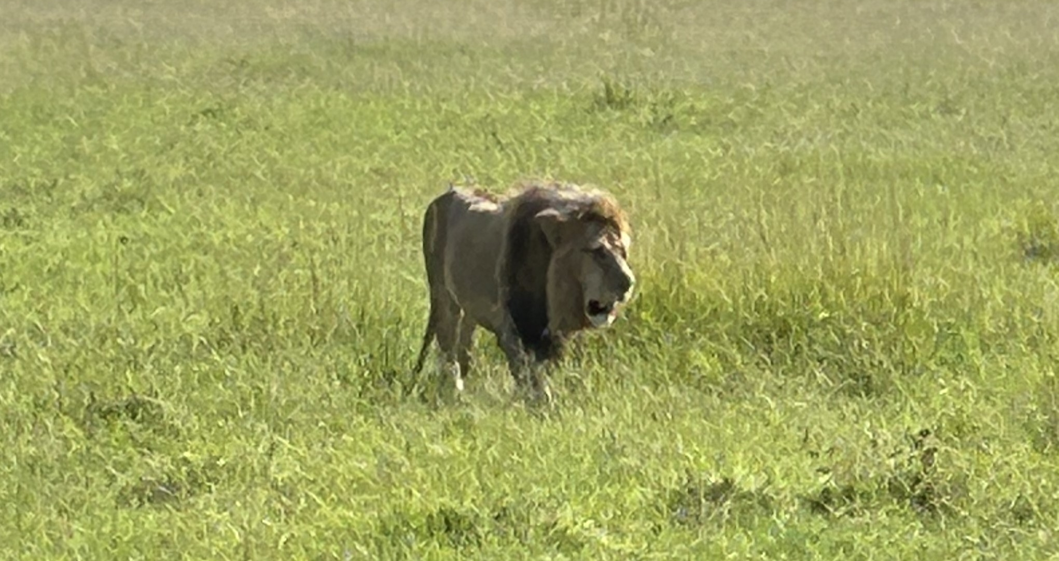
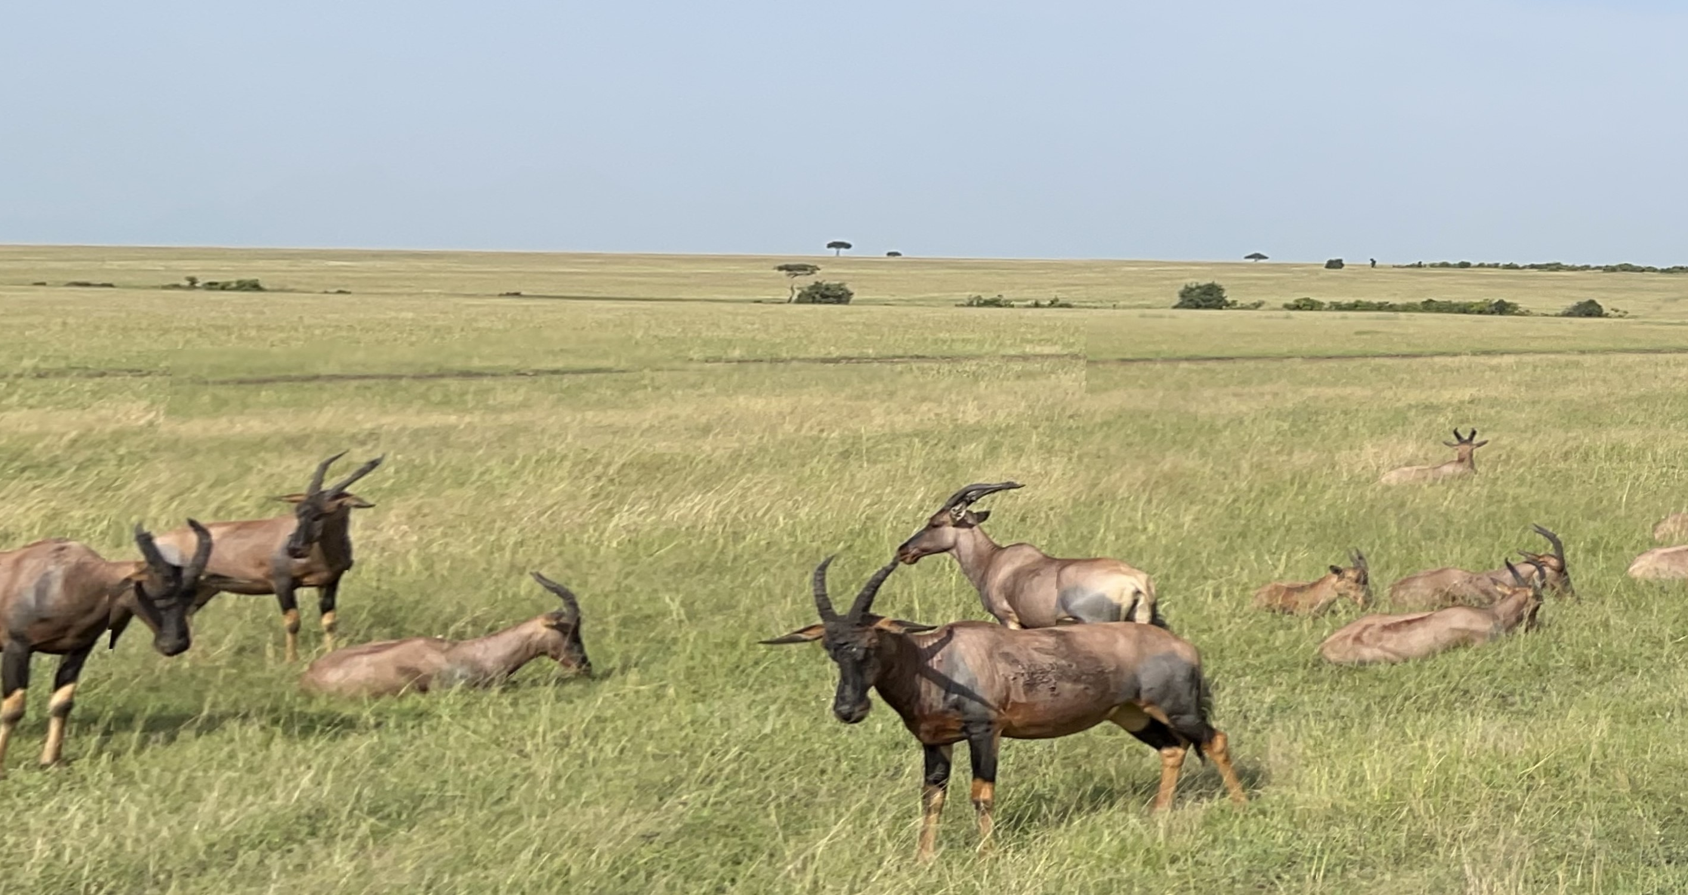
Ended at Masai Mara

Slide 5
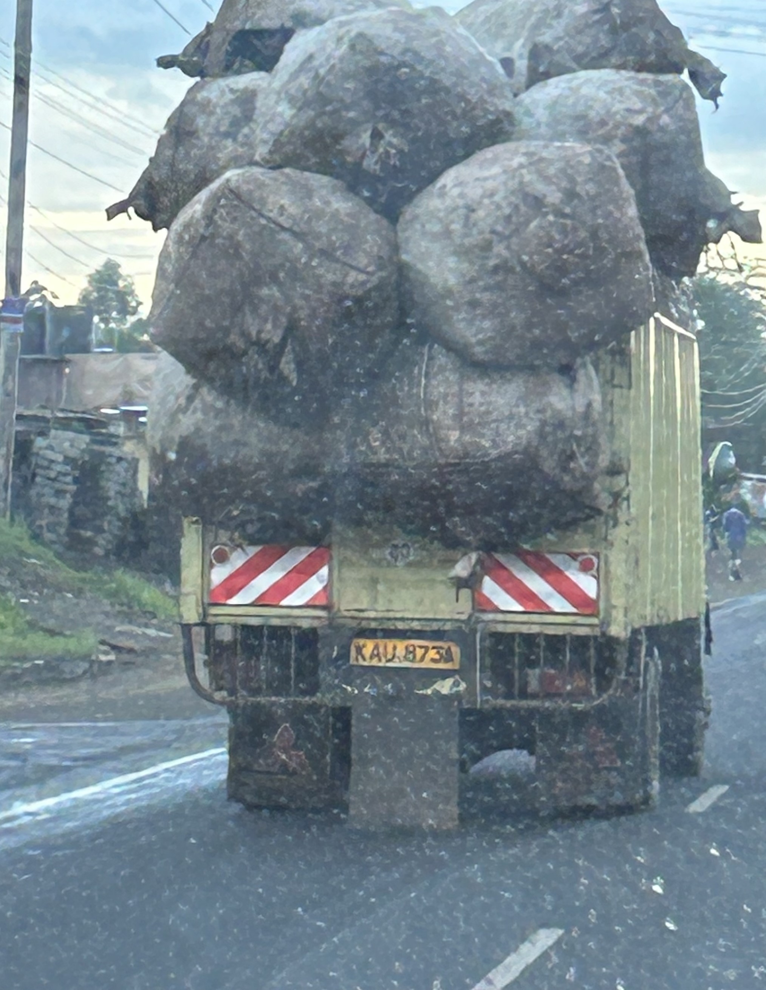
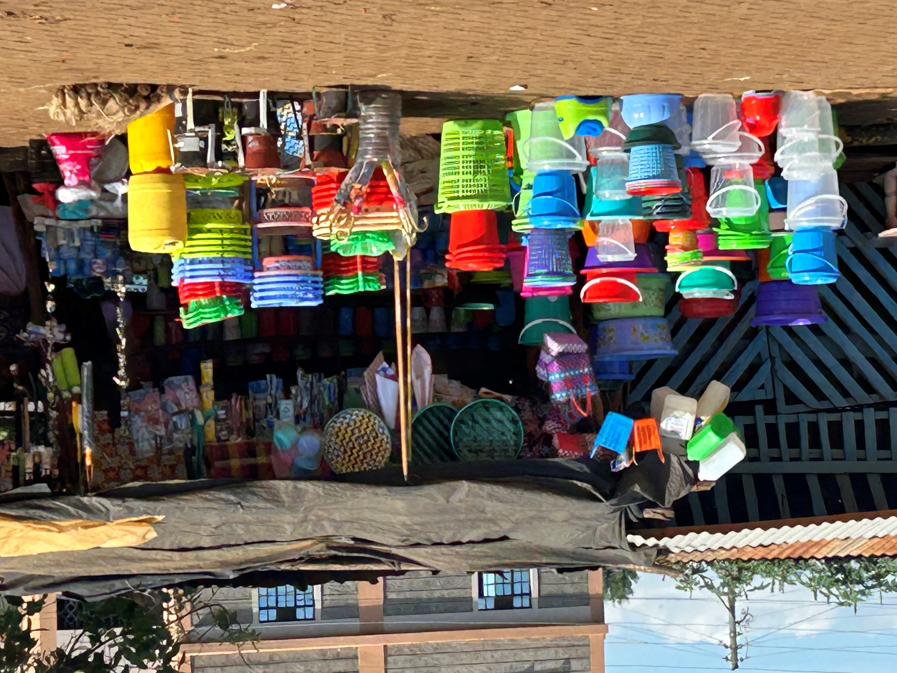
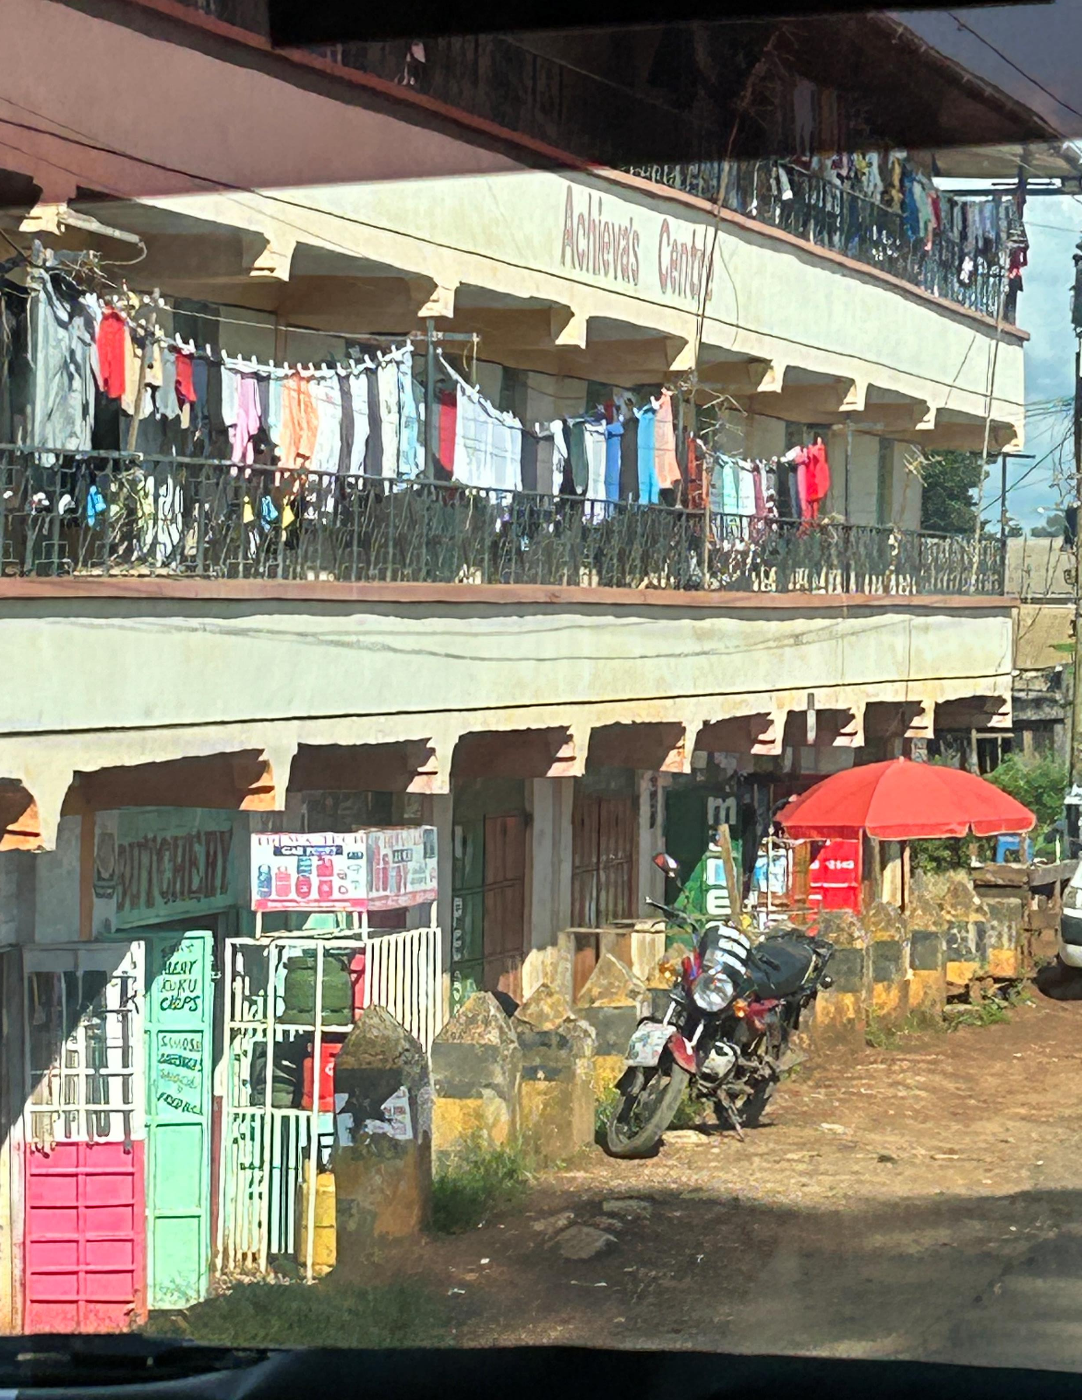
Focus on Building Capacity…

Slide 6
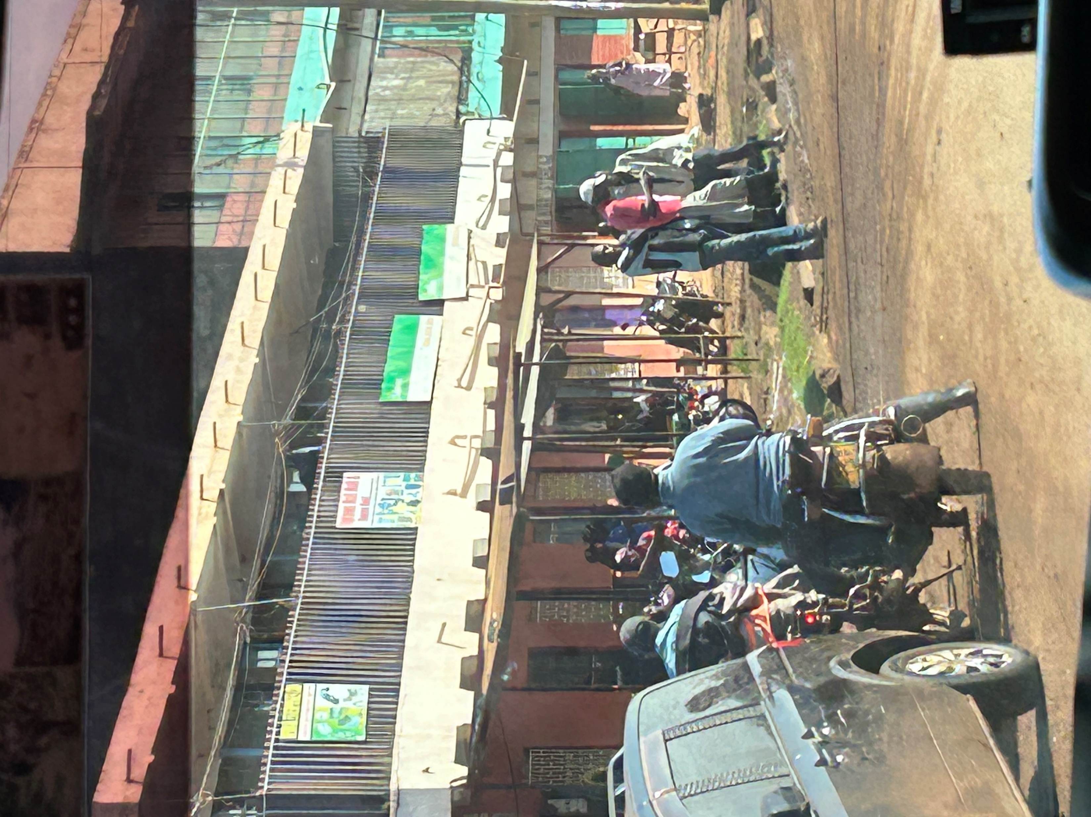
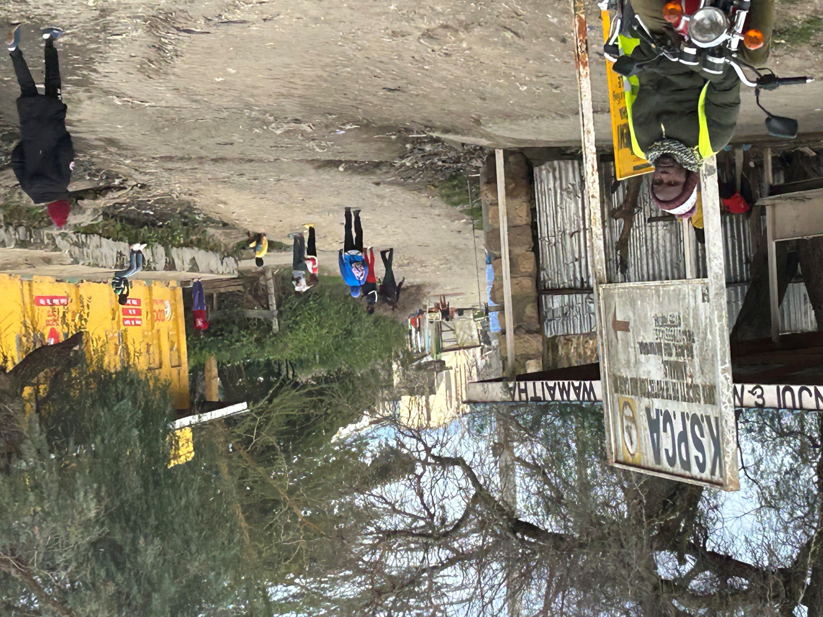
Kyiangia ……. to Kikuyu

Slide 7
“Listening is an attitude of the heart, a genuine desire to be with another which both attracts and heals.” L. J. Isham

Slide 8
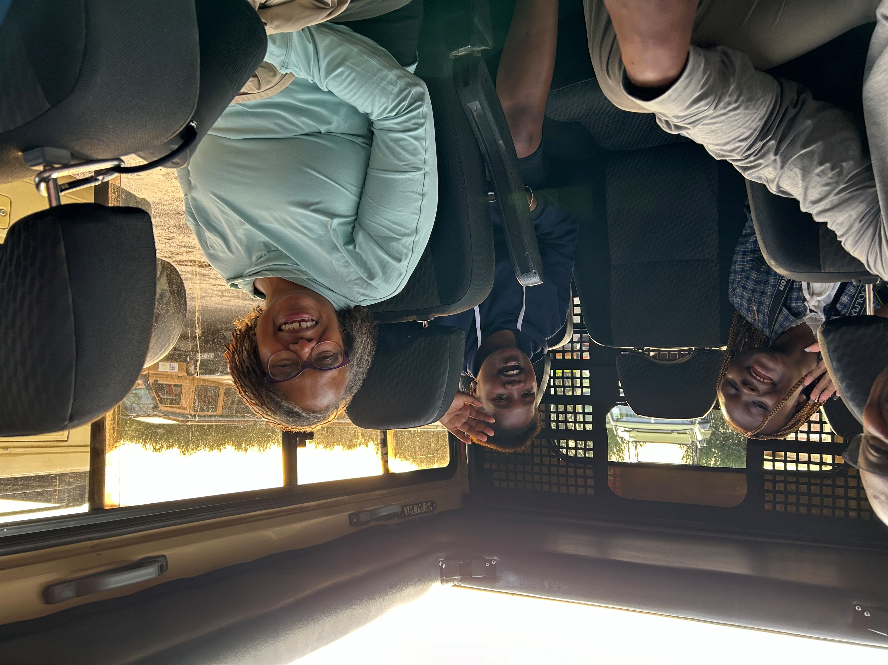
Healing is a matter of time,…
but it is sometimes also
a matter of opportunity."
– Hippocrates

Slide 9
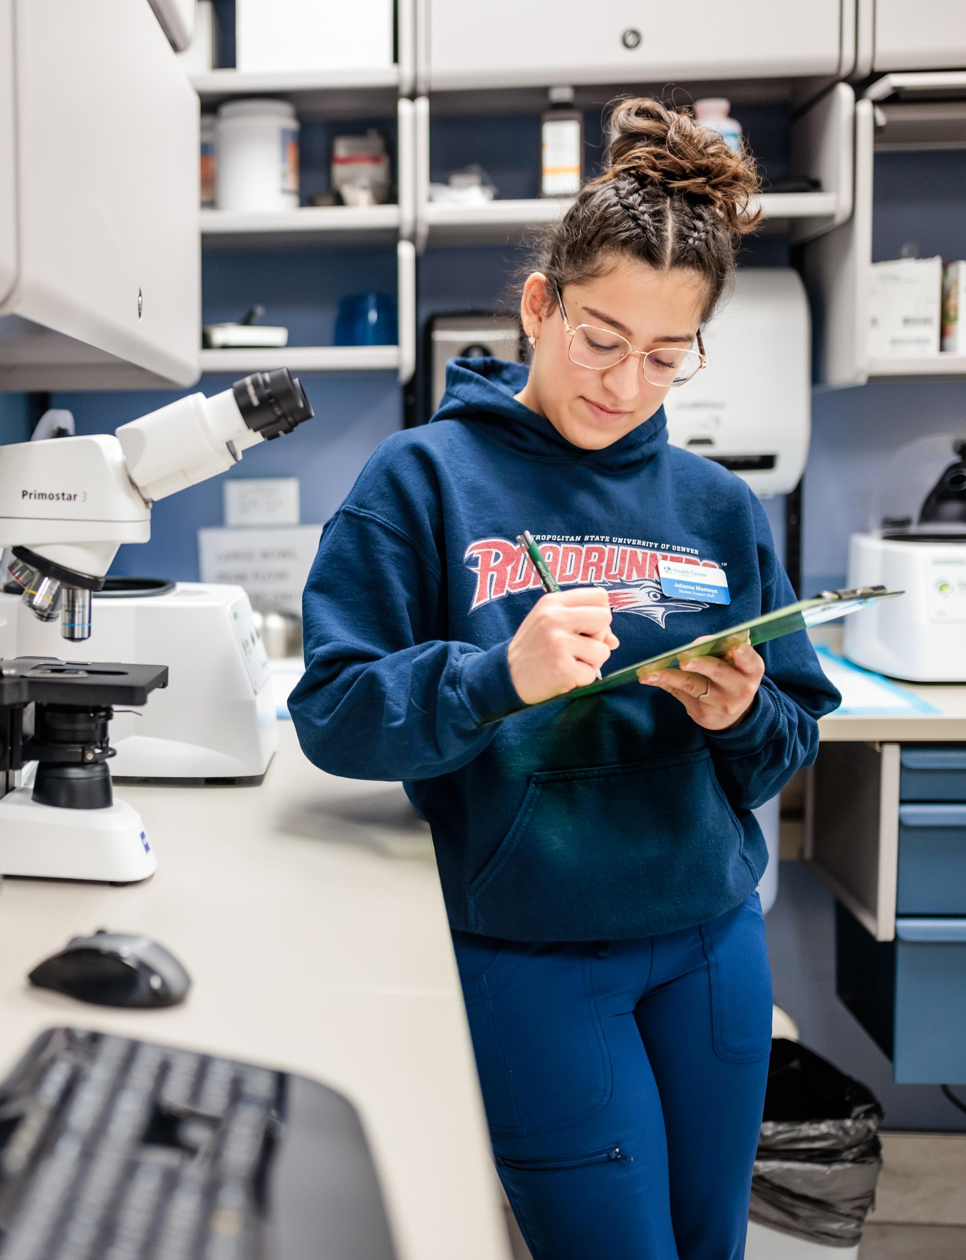
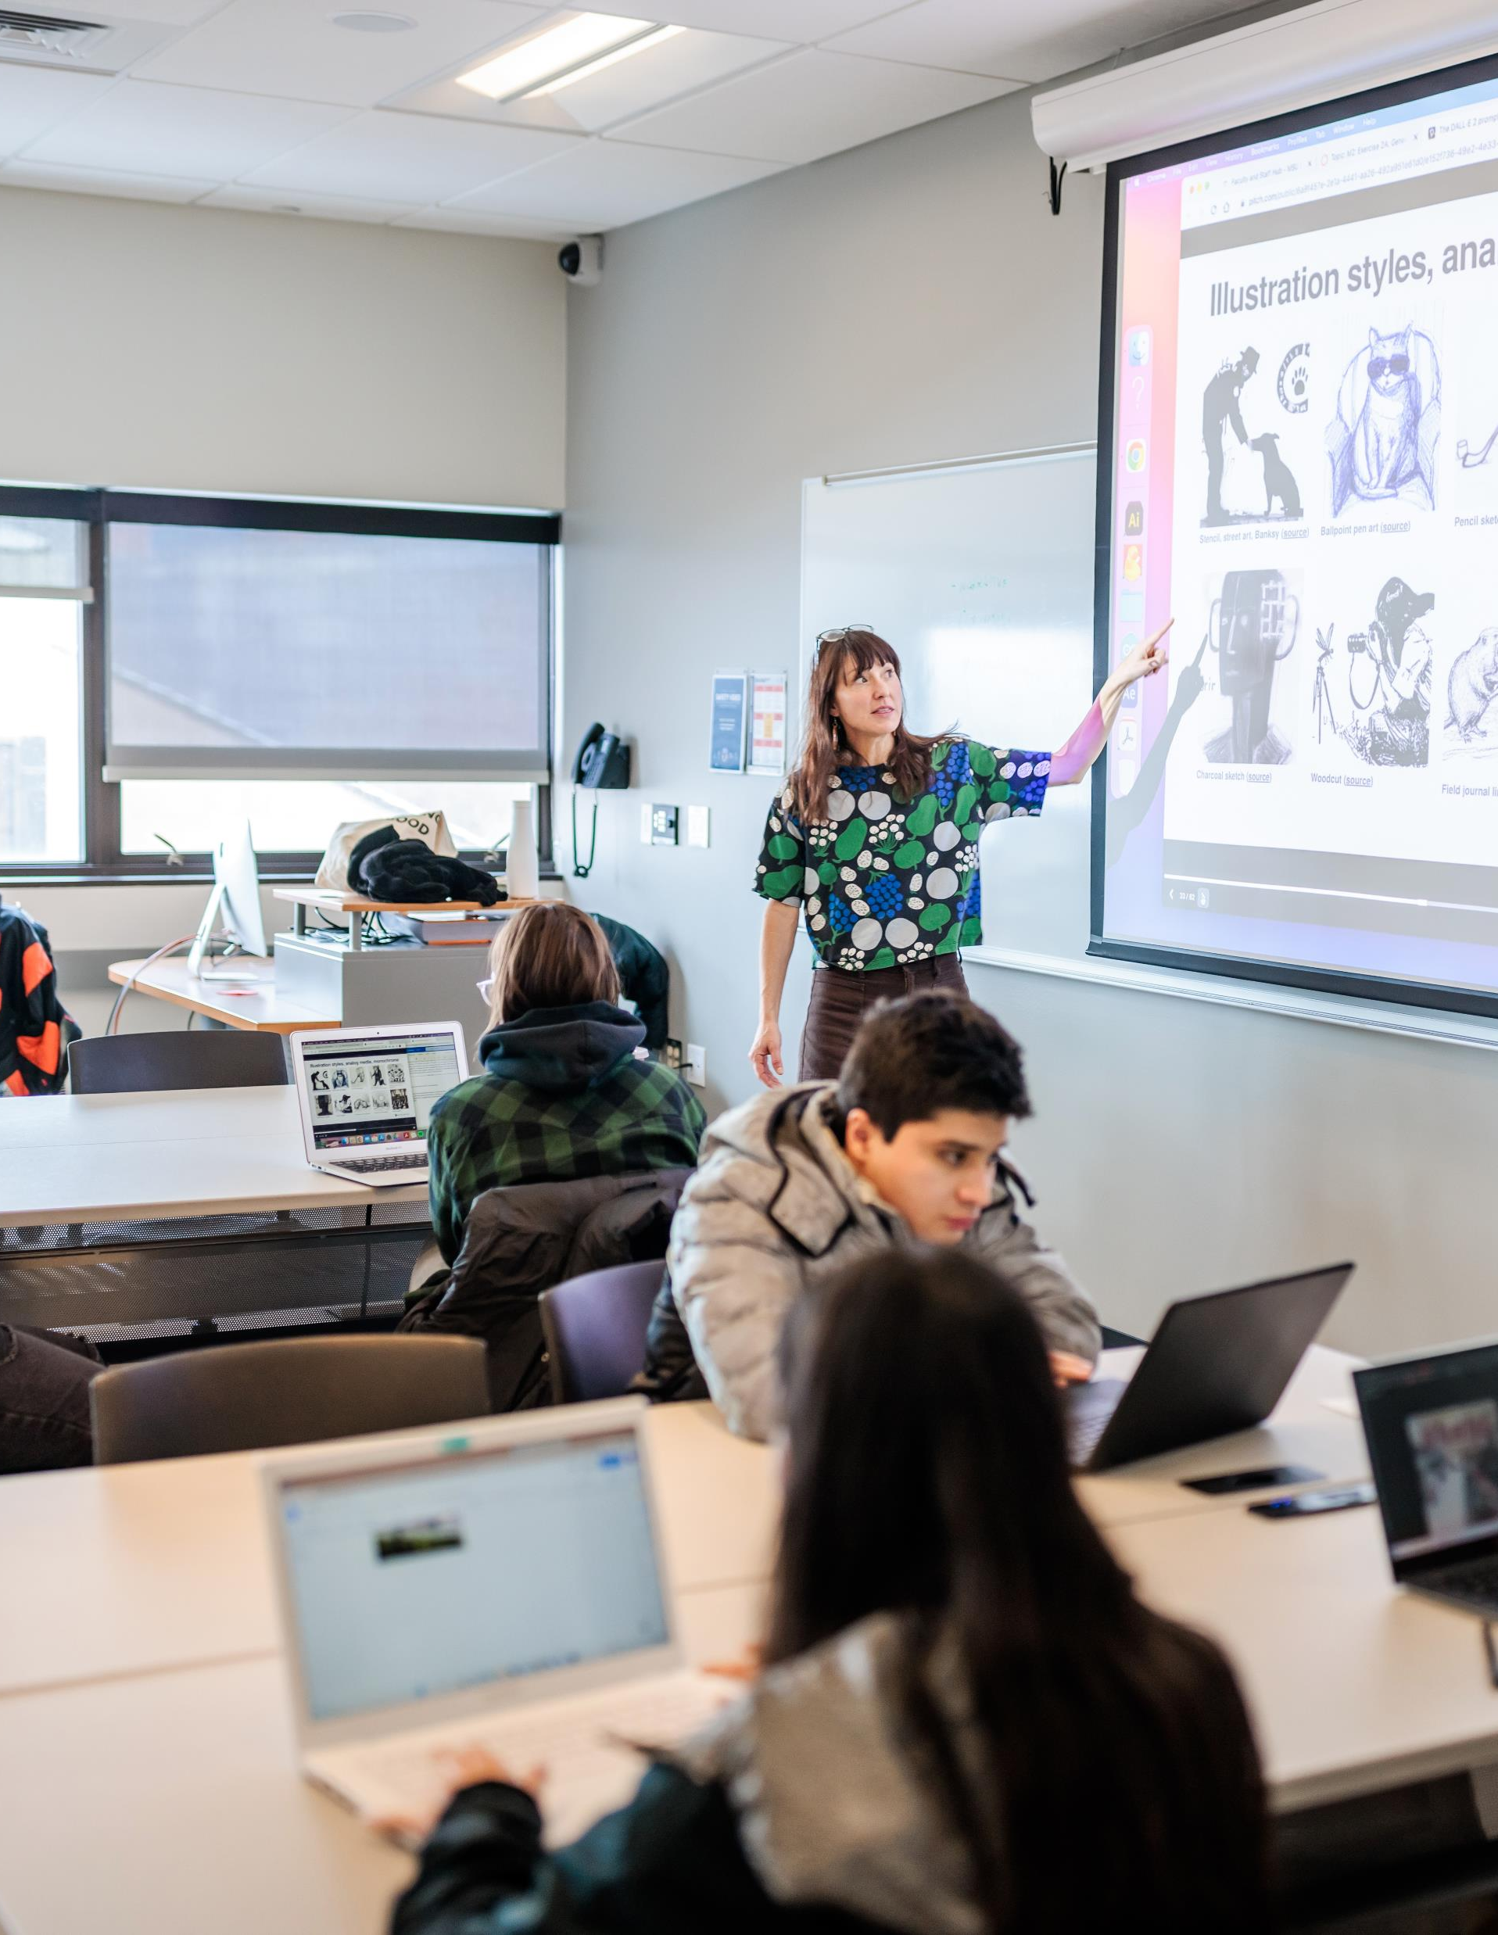
Holding the wisdom…. Through the change process…. brought us here today

Slide 10
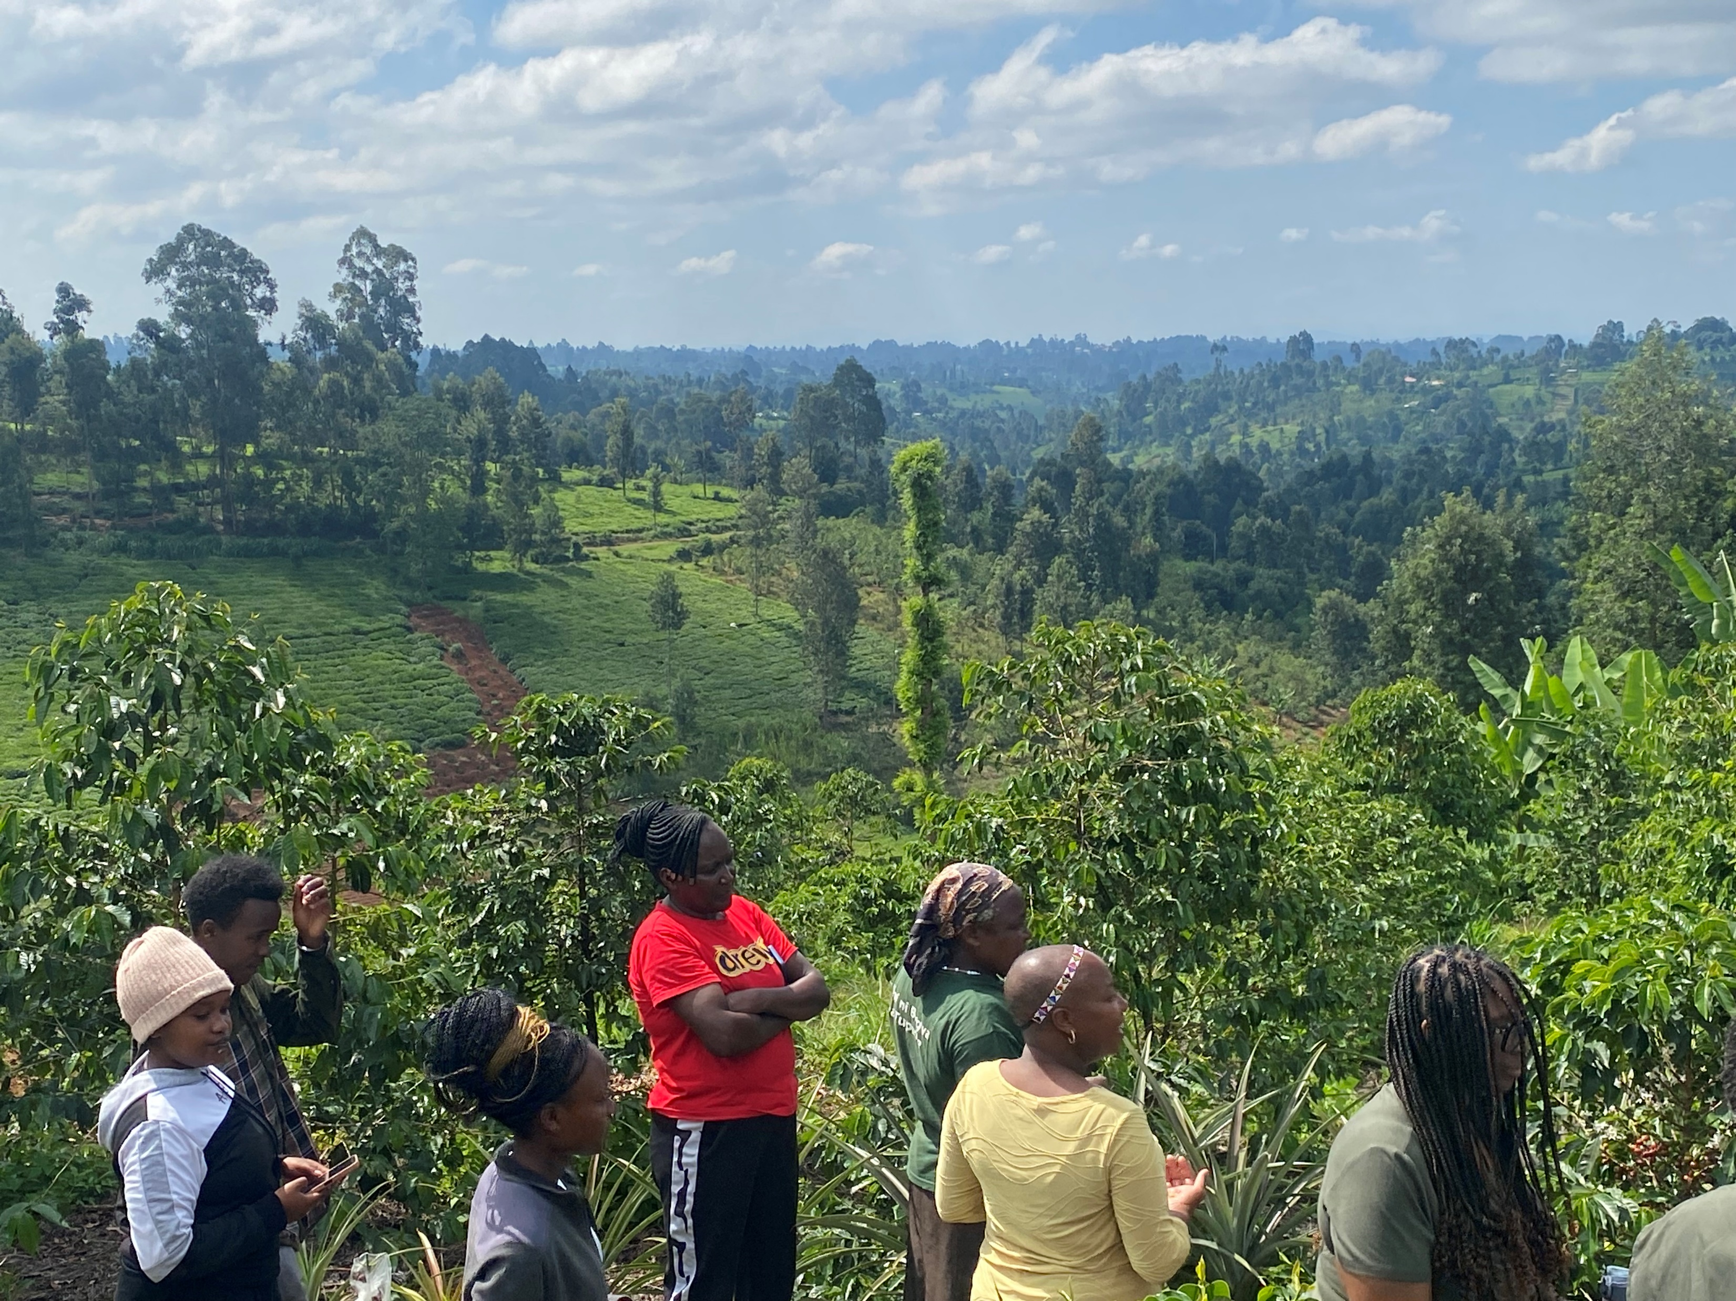
Weaving narratives of
Healing and Wellbeing
from an Indigenous perspective

Slide 11
Explore therapeutic approaches with BIPOC clients and address culturally based trauma and adversity

Slide 12
Support the behavioral health needs of refugees and migrant people across the US

Slide 13
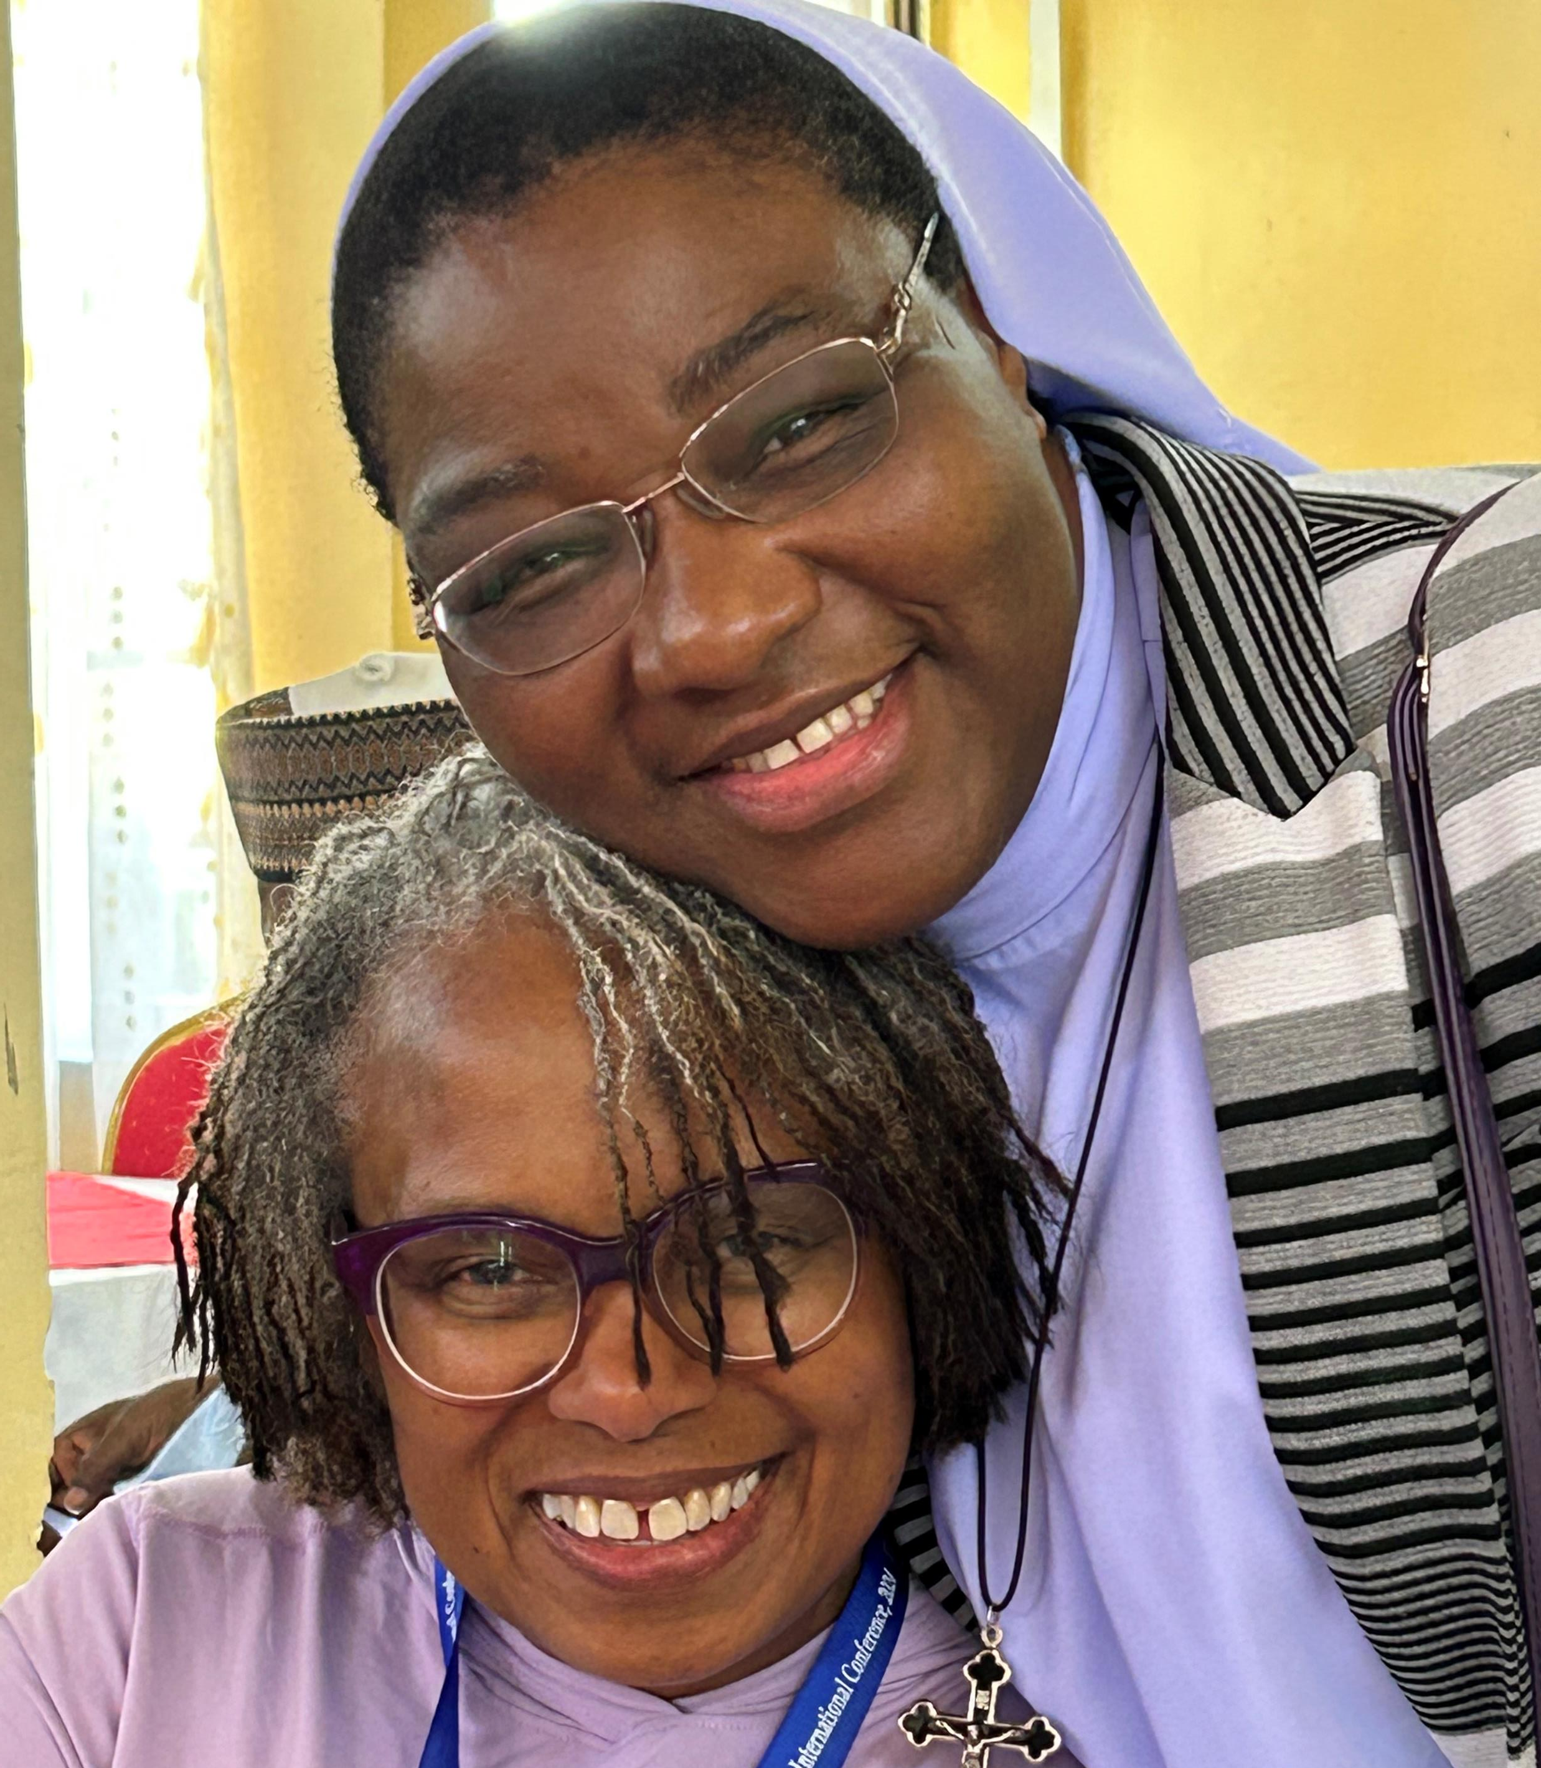
Consider the perspectives and insights of experienced clinicians on the Power for Health and Wounding

Slide 14
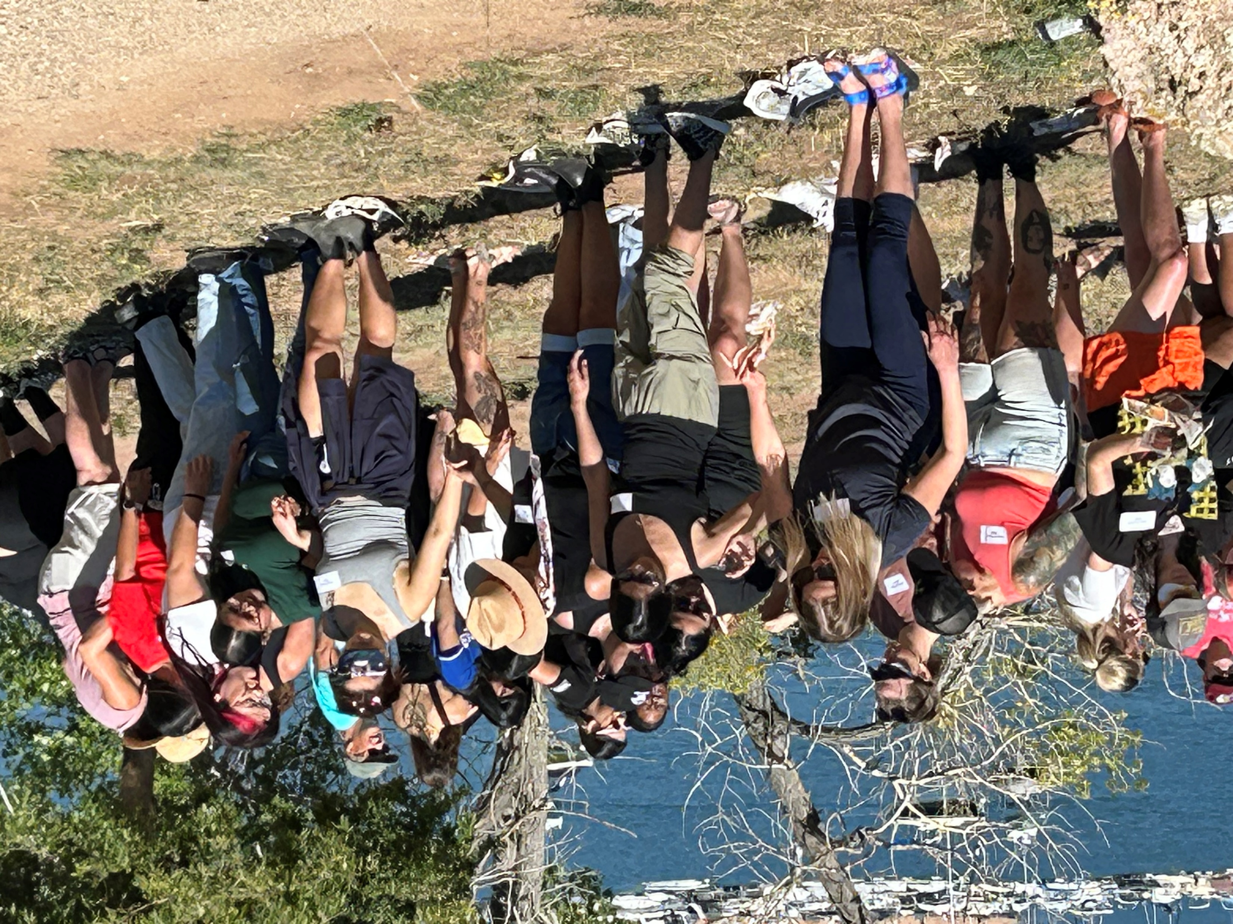
You must first let go…. before you can hold something new..

