Slide 1
BRIDGING THE GAP:
MERGING INDIGENOUS WISDOM AND CONTEMPORARY PERINATAL CARE
Mental and Behavioral Health Conference
Mental and Behavioral Health Conference
Metropolitan State University Denver
February 7, 2025
Dr. Tonya Myles-Day, LMSW

Slide 2

I would like to acknowledge the land on which I reside, in Buffalo, NY which is the territory of the Seneca Nation, a member of the (Ho dey no Shawnee) Haudenosaunee/Six Nations Confederacy. This territory is covered by The Dish with One Spoon Treaty of Peace and Friendship, a pledge to peaceably share and care for the resources around the Great Lakes. It is also covered by the 1794 Treaty of Canandaigua, between the United States Government and the Six Nations Confederacy, which further affirmed Haudenosaunee land rights and sovereignty in the State of New York. Today, this region is still the home to the Haudenosaunee people, and we are grateful for the opportunity to live, work, and share ideas in this territory.

Slide 3
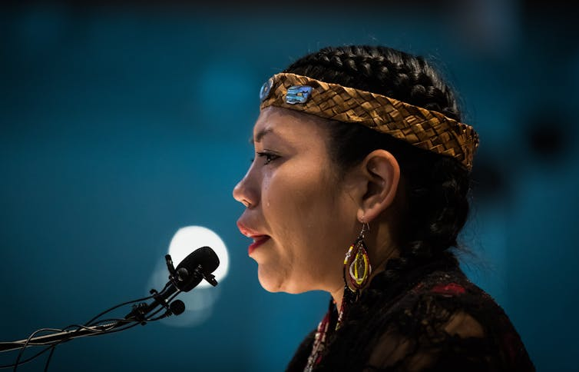
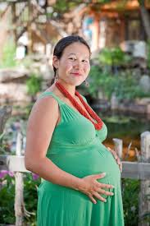
AGENDA
►Historical Context of Indigenous People and Social
Workers.
►Understanding the role of Indigenous knowledge in
Perinatal Care.
https://creativecommons.org/licenses/by-nd/3.0/
►Indigenous culture and childbirth.
►Identify barriers and Inequities in Perinatal Care for Indigenous
People.
►Develop integrated approaches for culturally safe Perinatal Care.
(Tribal Health, 2024)

Slide 4
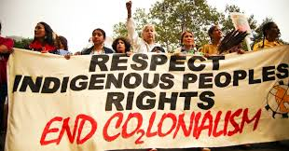
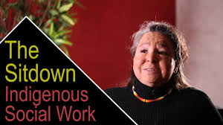
Historical Context
■ Agents of Assimilation (Swift & Callahan, 2009).
■ Enforcers of government policies (Sinclair, 2016).
■ Reservation welfare work (Swift & Callahan, 2009).
(Yulia Nesterova - Research Fellow, 2017)
(Fanshawe Institute of Indigenous Learning, 2020)

Slide 5
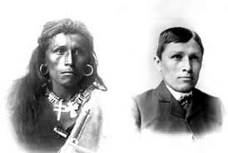
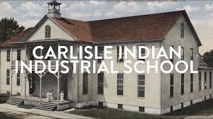
Historical Context
■ Child Welfare and the Indian Adoption Project (Blackstock, 2009).
■ Urban relocation programs (Chan et al., 2020).
■ Mental Health and Substance Abuse Services (Ruelle, 2017).
(Yu, 2009)
https://www.youtube.com/watch?v=tfOKRglt8e8

Slide 6
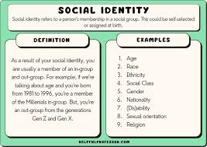
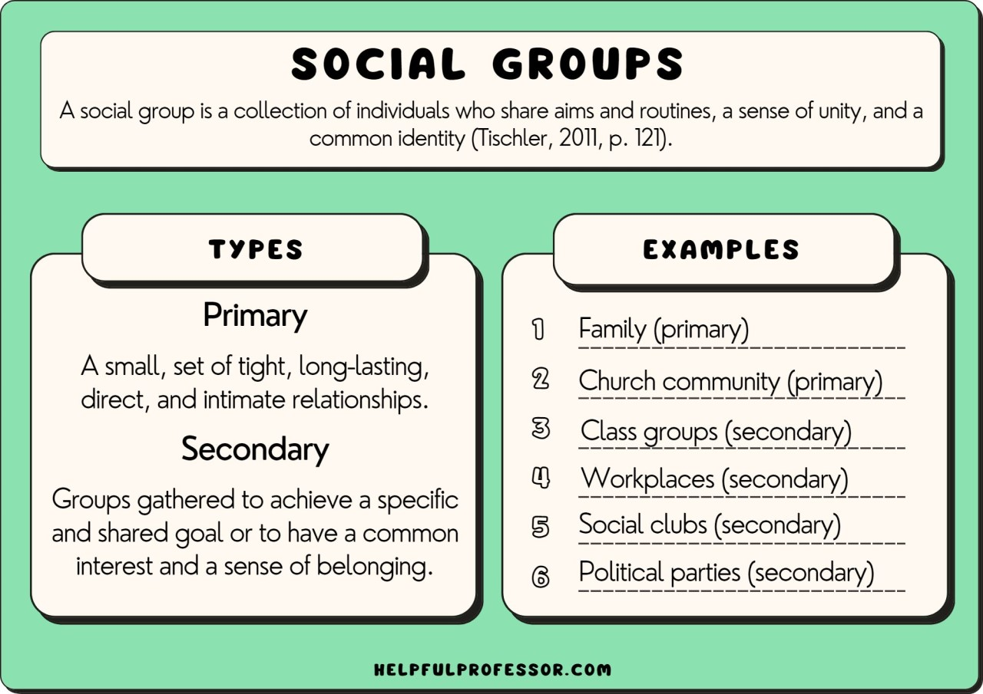
Understanding the role of Indigenous knowledge in
Perinatal Care
Drew, (2023, September 29)
Drew, (2023, September 29)

Slide 7
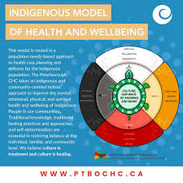
Key Aspects of Indigenous Knowledge in Perinatal Care
Holistic and Community-Centered Approach. (Shoko, 2018).
(Peterborough CHC, 2024)

Slide 8
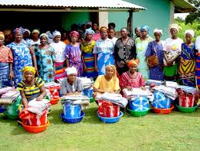
Key Aspects of Indigenous Knowledge in Perinatal Care
Traditional Birth Attendants and Midwifery. (Sinclair, 2016).
(Bergström & Goodburn, 2001)

Slide 9
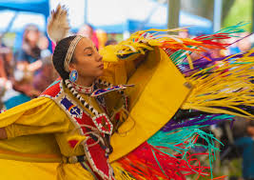
Key Aspects of Indigenous Knowledge in Perinatal Care
Spiritual and Cultural Practices. (Summers, 2015).
(Fitzner, Zach 2018)

Slide 10
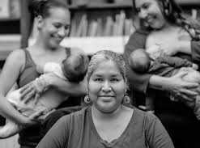
Key Aspects of Indigenous Knowledge in Perinatal Care
Breastfeeding and Postpartum Care.
(Swift & Callahan, 2009).

Slide 11
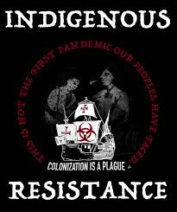
Key Aspects of Indigenous Knowledge in Perinatal Care
Resistance to Medical Colonialism.
(Kitching et al., 2020).
(Rudy, 2024)

Slide 12
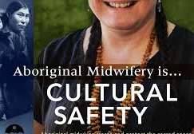
Historical and Contemporary Examples
Standing Rock and Indigenous Health Sovereignty (Ruelle, 2017).
Indigenous Midwifery (Churchill et al., 2020)
Traditional Healing and Herbal Medicine (Shoko, 2018).
The Indian Rebellion of 1857(Summers, 2015).
(Indigenous Birth of Alberta Mentorship Program, 2015)
COVID-19 Vaccine Equity and Indigenous Responses (Aylsworth et al., 2022)

Slide 13
How can Social Workers foster more equitable, inclusive care to merge Indigenous wisdom and perinatal care?
Please go to https://www.mentimeter.com/
https://www.mentimeter.com/app/presentation/alx2m7gnqrqhjbtv1sgoe3zxxavqnaqz/edit?question=6pcbrkx9sivn

Slide 14
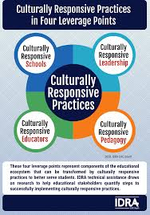

Social Workers, Stand Up!
Culturally Responsive Advocacy & Education (Goforth et al., 2022).
Integrating Traditional and Western Approaches (Goforth et al., 2022).
(IDRA EAC-South, 2020)
(Admin, 2024)

Slide 15

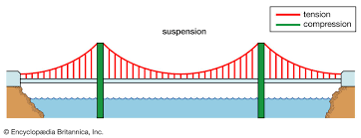
Social Workers, Stand Up!
Cultural Brokers and Advocates
■ Bridge the GAP (Kildea et al., 2010)
(Cultural broker family advocate program, 2021)
■Advocate for policies (Kildea et al., 2010)

Slide 16
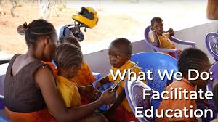
Social Workers, Stand Up!
Education and Facilitation
■ Educate (Hui et al., 2021)
■Facilitate (Hui et al., 2021)
(Cultural broker family advocate program, 2021)

Slide 17
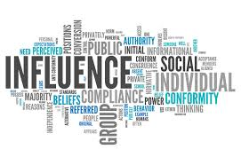
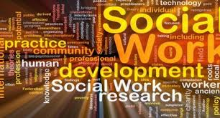
Social Workers, Stand Up!
Influencers and Developers
■ Policy Influencers (Smiley et al., 2021)
(Momanyi, 2023)
■Program Developers (Smiley et al., 2021)
(University & Work, Undergraduate)

Slide 18
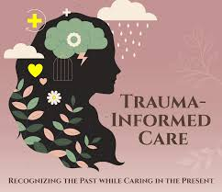
Social Workers, Stand Up!
Trauma-Informed Perspective
(Trauma informed care for teen girls, 2022)

Slide 19
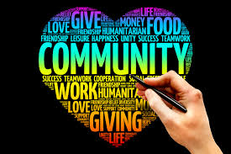
Social Workers, Stand Up!
Community
■ Trauma-Informed Practitioners (Corcoran et al., 2017)
(Barnhart, 2016).

Slide 20
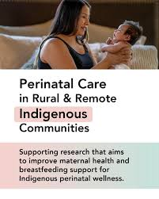
Social Workers, Stand Up!
Research and Knowledge Keepers
■ Research (Owais et al., 2020)
■ Knowledge Keepers (Owais et al., 2020)
(Barnhart, 2016).

Slide 21

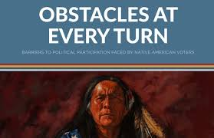
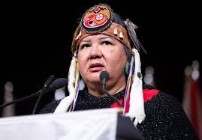
Barriers to Perinatal Care for Indigenous Populations
(Gasaway, 2021)
(Belfi, 2020)
(Taylor and Saba , 2022)

Slide 22
Barriers to Perinatal Care for Indigenous Populations
►Limited Access to Culturally Appropriate
Care (Marriott et al., 2021).
(Gasaway, 2021)
►Geographical Barriers (Chan et al., 2021).

Slide 23
Barriers to Perinatal Care for Indigenous Populations
►Historical Trauma and Mistrust of Healthcare
Systems (Dolan, 2024).
(Gasaway, 2021)
►Economic and Social Determinants (Kolahdooz et al., 2015).

Slide 24
Barriers to Perinatal Care for Indigenous Populations
►Discrimination and Racism in Healthcare
Settings (Kitching et al, 2020).
(Gasaway, 2021)
►Higher Rates of Substance Use Stigmatization
(Winters et al., 2020).

Slide 25
Barriers to Perinatal Care for Indigenous Populations
► Lack of Comprehensive Reproductive Health
Education (Kitching et al, 2020).
(Gasaway, 2021)

Slide 26
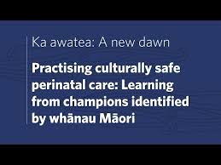
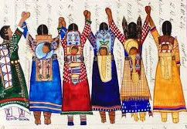
Integrative Approaches for Culturally Safe Perinatal Care
YouTube. (n.d.).
(Mamata, 2023)

Slide 27
Integrative Approaches for Culturally Safe Perinatal Care
◆ Community-Centered Care Models (Beadman et al., 2024).
(Mamata, 2023)

Slide 28

Integrative Approaches for Culturally Safe Perinatal Care
Trauma-Informed and Anti-Racist Practices (Beadman et al., 2024).
(California, 2022)
Notes:
.

Slide 29
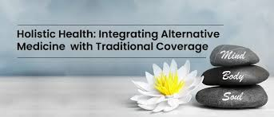
Integrative Approaches for Culturally Safe Perinatal Care
Incorporating Traditional and Holistic Practices (Beadman et al., 2024).
(Handa, 2024)

Slide 30
Integrative Approaches for Culturally Safe Perinatal Care
Holistic and Community-Based Support (Beadman et al., 2024).
(Handa, 2024)

Slide 31
Admin. (2024, August 6). Integration - definition, rules, properties, methods, types. Examples.com. https://www.examples.com/maths/integration.html
Aylsworth, L., Manca, T., Dubé, È., Labbé, F., Driedger, S. M., Benzies, K., ... & MacDonald, S. E. (2022). A qualitative investigation of facilitators and barriers to accessing COVID-19 vaccines among Racialized and Indigenous Peoples in Canada. Human Vaccines & Immunotherapeutics, 18(6), 2129827.
Barnhart, D., (2016, October 12). Community organizing. https://www.ministrymatters.com/all/entry/7779/community-organizing
Beadman, K. A., Sherwood, J., Gray, P., & McAloon, J. (2024). Self-determination in programmes of perinatal health for Aboriginal Communities: A systematic review. Australian and New Zealand journal of public health, 100169.
Bergström, S., & Goodburn, E. (2001). The role of traditional birth attendants in the reduction of maternal mortality. Safe motherhood strategies: a review of the evidence.
Blackstock, C. (2009). The occasional evil of angels: Learning from the experiences of Aboriginal peoples and social work. First Peoples Child & Family Review, 4(1), 28-37.
California, S. of. (n.d.). Safe spaces: Foundations of trauma-informed practice for educational and care settings. OSG. https://osg.ca.gov/safespaces/
.

Slide 32
Chan, J., Friborg, J., Zubizarreta, E., van Eck, J. W., Hanna, T. P., Bourque, J. M., ... & Polo, A. (2020). Examining geographic accessibility to radiotherapy in Canada and Greenland for indigenous populations: Measuring inequities to inform solutions. Radiotherapy and Oncology, 146, 1-8.
Chris.drew.98031506. (2023, September 29). 8 examples of social identity (Race, class and gender). Helpful Professor. https://helpfulprofessor.com/social-identity-examples/
Chris.drew.98031506. (2023a, May 14). 50 social groups examples. Helpful Professor. https://helpfulprofessor.com/social-groups-examples/
Churchill, M. E., Smylie, J. K., Wolfe, S. H., Bourgeois, C., Moeller, H., & Firestone, M. (2020). Conceptualising cultural safety at an Indigenous-focused midwifery practice in Toronto, Canada: qualitative interviews with Indigenous and non-Indigenous clients. BMJ open, 10(9), e038168.
Corcoran, P. M., Catling, C., & Homer, C. S. (2017). Models of midwifery care for Indigenous women and babies: a meta-synthesis. Women and Birth, 30(1), 77-86.
Creative commons. Deed - Attribution-No Derivs 3.0 Unported - Creative Commons. (n.d.). https://creativecommons.org/licenses/by-nd/3.0/
Cultural broker family advocate program. Downtown Fresno. (n.d.-b). https://www.downtownfresno.org/go/cultural-broker-family-advocate-program
Culturally responsive practices in four critical levels. IDRA. (n.d.). https://www.idra.org/support/culturally-responsive-practices-in-four-critical-levels/

Slide 33
Dolan, C. M. (2024). Historical trauma, health care distrust, and the legacy of Tuskegee: implications for nurse practitioner practice.
European colonization disrupted Indigenous governance, traditions, and social structures. Social work in the 19th and early 20th centuries was often aligned with colonial policies that sought to "civilize" Indigenous peoples. Missionaries, government agents, and social workers played roles in enforcing assimilation policies, viewing Indigenous cultures as inferior.
Fiolet, R., Woods, C., Moana, A. H., Reilly, R., Herrman, H., McLachlan, H., ... & Chamberlain, C. (2023). Community perspectives on delivering trauma-aware and culturally safe perinatal care for Aboriginal and Torres Strait Islander parents. Women and birth, 36(2), e254-e262.
Gasaway, R. (2021, December 28). 19 ways communications barriers can impact situational awareness. Situational Awareness Matters!TM. https://www.samatters.com/19-ways-communications-barriers-can-impact-situational-awareness/
Goforth, A. N., Nichols, L. M., Sun, J., Violante, A., Christopher, K., & Graham, N. (2022). Incorporating the indigenous evaluation framework for culturally responsive community engagement. Psychology in the Schools, 59(10), 1984-2004.
Handa, M. (2024b, June 21). Holistic health: Integrative medicine for healthy living. Care Health Insurance. https://www.careinsurance.com/blog/health-insurance-articles/holistic-health-integrating-alternative-medicine-with-traditional-coverage

Slide 34
Hui, A., Philips-Beck, W., Campbell, R., Sinclair, S., Kuzdak, C., Courchene, E., ... & Shen, G. X. (2021). Impact of remote prenatal education on program participation and breastfeeding of women in rural and remote Indigenous communities. EClinicalMedicine, 35.
Kildea, S., Kruske, S., Barclay, L., & Tracy, S. (2010). ‘Closing the Gap’: how maternity services can contribute to reducing poor maternal infant health outcomes for Aboriginal and Torres Strait Islander women. Rural and Remote Health, 10(3), 1-18.
Kill the Indian, save the man. Kill the Indian, Save the Man | Pennsylvania Center for the Book. (n.d.). https://pabook.libraries.psu.edu/literary-cultural-heritage-map-pa/feature-articles/kill-indian-save-man
Kitching, G. T., Firestone, M., Schei, B., Wolfe, S., Bourgeois, C., O’Campo, P., ... & Smylie, J. (2020). Unmet health needs and discrimination by healthcare providers among an Indigenous population in Toronto, Canada. Canadian Journal of Public Health, 111, 40-49.
Kolahdooz, F., Nader, F., Yi, K. J., & Sharma, S. (2015). Understanding the social determinants of health among Indigenous Canadians: priorities for health promotion policies and actions. Global health action, 8(1), 27968.
Mamata, P. (2023, June 1). Culturally safe and trauma-informed care for indigenous women: The Indigenous Birth Support Worker (IBSW) program. Culturally Safe and Trauma-Informed Care for Indigenous Women: The Indigenous Birth Support Worker (IBSW) Program. https://blogs.biomedcentral.com/bmcseriesblog/2023/06/01/culturally-safe-and-trauma-informed-care-for-indigenous-women-the-indigenous-birth-support-worker-ibsw-program/

Slide 35
Marriott, R., Reibel, T., Barrett, T. L., Bowen, A., Bradshaw, S., Kendall, S., ... & Robinson, M. (2021). Midwifery knowledge of equitable and culturally safe maternity care for Aboriginal women. Birth, 48(1), 132-138.
Momanyi, E. O. (2023, February 7). Policy making 101: 6 tips to influence the policy agenda. LinkedIn. https://www.linkedin.com/pulse/6-practical-ideas-how-influence-policy-agenda-eric-momanyi
New report outlines the obstacles Native Americans face in voting and political participation. Cultural Survival. (n.d.). https://www.culturalsurvival.org/news/new-report-outlines-obstacles-native-americans-face-voting-and-political-participation
Owais, S., Faltyn, M., Johnson, A. V., Gabel, C., Downey, B., Kates, N., & Van Lieshout, R. J. (2020). The perinatal mental health of indigenous women: a systematic review and meta-analysis. The Canadian Journal of Psychiatry, 65(3), 149-163.
Preserving native cultural practices yet allowing them to evolve. Earth.com. (n.d.). https://www.earth.com/news/preserving-native-cultural-practice/#google_vignette
Rudy. (2024, March 7). Poster: Indigenous Resistance – Colonization is a plague. Indigenous Action Media. https://www.indigenousaction.org/poster-indigenous-resistance-colonization-is-a-plague/
Ruelle, M. L. (2017). Ecological relations and Indigenous food sovereignty in Standing Rock. American Indian Culture and Research Journal, 41(3), 113-125.
Shoko, T. (2018). Traditional herbal medicine and healing in Zimbabwe. Journal of Traditional Medicine & Clinical Naturopathy, 7(1), 1-3.

Slide 36
Sinclair, R. (2016). The Indigenous child removal system in Canada: An examination of legal decision-making and racial bias. First Peoples Child & Family Review, 11(2), 8-18.
Smylie, J., Kirst, M., McShane, K., Firestone, M., Wolfe, S., & O'Campo, P. (2016). Understanding the role of Indigenous community participation in Indigenous prenatal and infant-toddler health promotion programs in Canada: A realist review. Social Science & Medicine, 150, 128-143.
Summers, C. C. (2015). The Indian Rebellion of 1857. Tenor of Our Times, 4(1), 42.
Swift, K., & Callahan, M. (2009). At risk: Social justice in child welfare and other human services. University of Toronto Press.
Taylor, S., and Saba, M. The Canadian Press. (2022, November 29). Proposed language law changes pose more “barriers” for indigenous people, AFN says. Toronto Star. https://www.thestar.com/politics/proposed-language-law-changes-pose-more-barriers-for-indigenous-people-afn-says/article_492277c4-ccf5-50c1-b1b8-85e98526d9b3.html
Trained traditional midwives save lives. Archive - U.S. Agency for International Development. (n.d.). https://2012-2017.usaid.gov/results-data/success-stories/trained-traditional-midwives-save-lives
Trauma informed care for teen girls. Roots Renewal Ranch. (2022, July 12). https://rootsrenewalranch.com/trauma-informed-care/

Slide 37
Tribal Health. (2024, May 10). Indigenous midwifery: Reinventing native pregnancy and birth. https://tribalhealth.com/midwifery/
University, T. S., & Work, S. (n.d.). Undergraduate. Social Work. https://www.tnstate.edu/socialwork/
What we do – facilitate education. Word Forest. (n.d.). https://www.wordforest.org/what-we-do-facilitate-education/
Winters, E., & Harris, N. (2020). The impact of indigenous identity and treatment seeking intention on the stigmatization of substance use. International Journal of Mental Health and Addiction, 18(5), 1403-1415.
YouTube. (n.d.). YouTube. https://www.youtube.com/watch?reload=9&v=kpmbDrg4wcY
YouTube. (n.d.). YouTube. https://www.youtube.com/watch?v=tfOKRglt8e8
Yulia Nesterova - Research Fellow, U. of G. (2017, September 28). Indigenous peoples: Key trends that affect their development. Impakter. https://impakter.com/indigenous-peoples-part-two/

Slide 38
Thank You!
Dr. Tonya Myles-Day, LMSW
The University at Buffalo, School of Social Work
tonyamyl@buffalo.edu
“Be the change you want to see in the world” ~ Ghandi

