Slide 1
Exploring Generative AI and Its Applications
Workshop #2 in the AI Empowerment in Higher Education Series
Friday, April 26, 2024

Slide 2
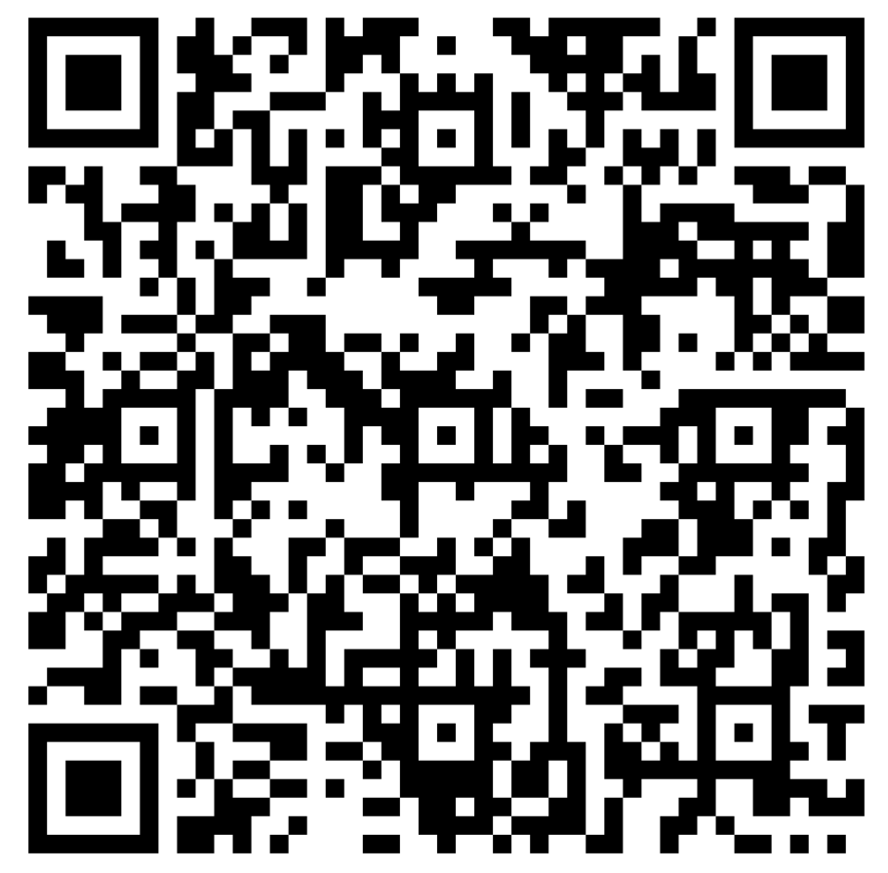
How is our generative AI usage?
tinyurl.com/Workshop2Pre

Slide 4
Today’s Agenda
Connection to Workshop 1
Examples of Generative AI Usage
Sentiint AI Introduction/Demo

Slide 5
Connections to Workshop 1

Slide 6
Supports In-Progress

Slide 7
Time for some fun!

Slide 8
1. ChatGPT 3.5 + Copilot
2. Adobe Suite
3. ChatGPT 4
4. Copilot Studio

Slide 9
Shane Jackson
Lecturer of Computer Information Systems

Slide 10
Let’s try this again
tinyurl.com/Workshop2Post

Slide 12
Thank you!

