Slide 2
Possibilities
Content editing
Line editing
Copy editing
Proofreading
Ghostwriting
Content writing
Transcribing
Voice acting
Mixing
Mastering
Customer service
Translating

Slide 3
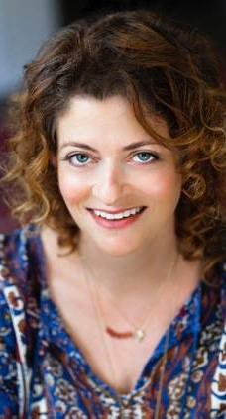
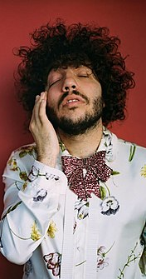
Types
Co authorship: ghostwriters who get credit as one of two authors
Collaboration: ghostwriters who may get limited credit (e.g. Hillary Lifton who gets credited on title page)
Sole authorship: ghostwriter gets no credit (e.g. Benny Blanco who is credited as a producer only)

Slide 4
Top-Performing Genres
Romance/Erotica ($1.44 billion)
Crime/Mystery ($728.2 million)
Religious/Inspirational ($720 million)
Science Fiction/Fantasy ($590.2 million)
Horror ($79.6 million)

Slide 5
Avoiding The Box
What do you want out of freelancing?
Building a portfolio and profile
Genres and pay: Amazon

Slide 6
Authors who don’t have enough time
Amazon representatives
Family members bonding over a shared interest
Other hobbyists
Retired, trying to build savings
Authors applying to contests
Different
Types Of
Clients
Different
Types Of Clients

Slide 7
Getting Started
Set up a profile and finish as much as possible
Include things that you think make you different
Apply to entry-level, one-time positions
Be humble, take whatever is doable, and work your way up
Specialize your profiles early on
Play the numbers game

Slide 8
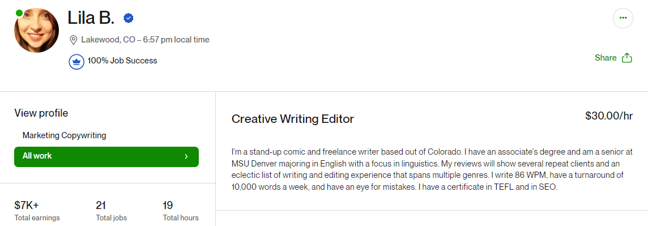

Slide 9
Is it Doable?
Limitations
Turnaround
Quality
Expectations and genre conventions
Formatting
Is it Doable?

Slide 10
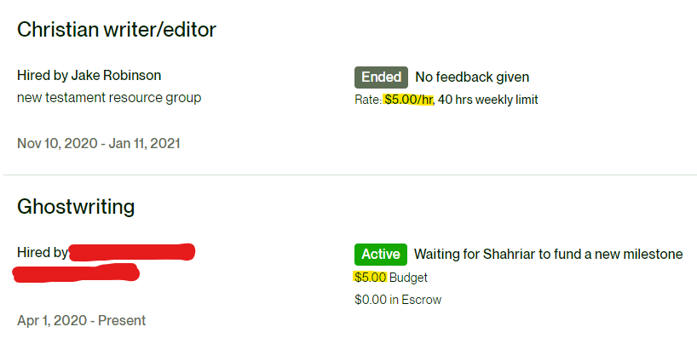

Slide 12
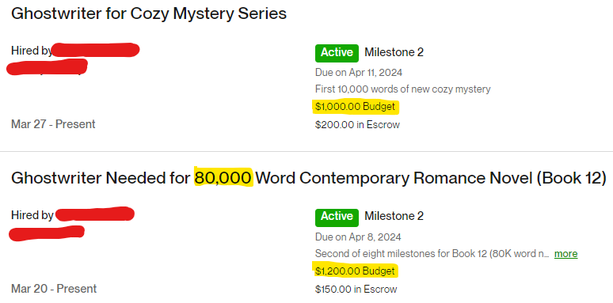

Slide 14
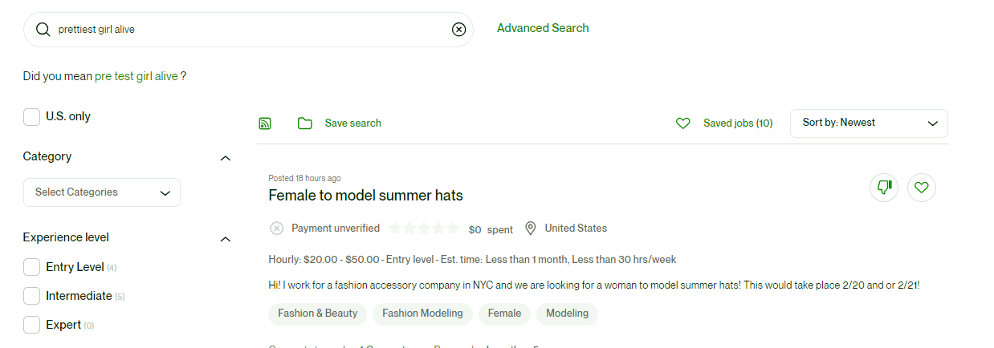

Slide 15
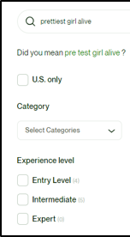
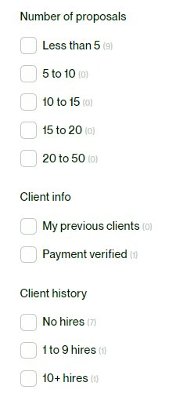
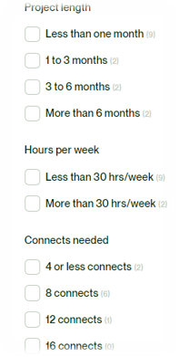
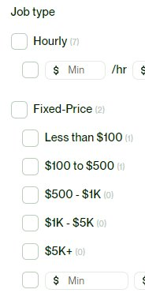

Slide 16
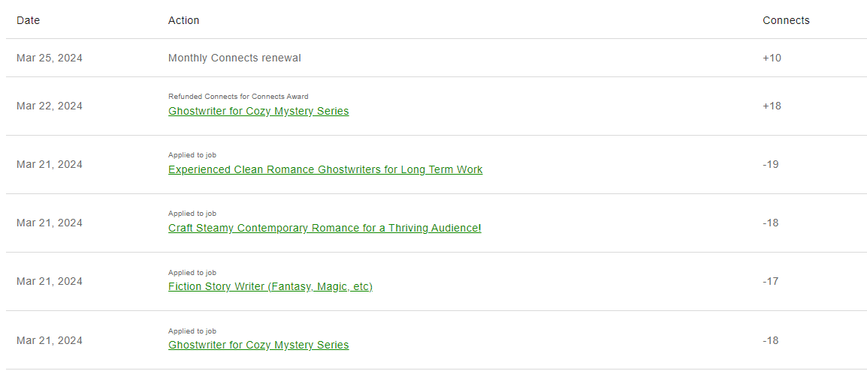

Slide 17
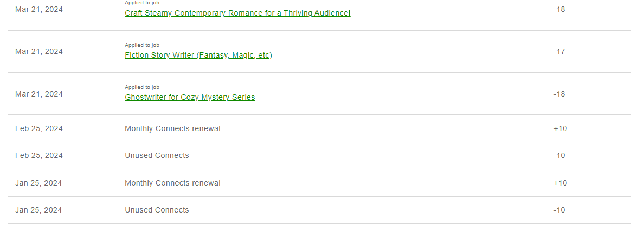

Slide 18
What To Avoid in NDAs and Contracts (If possible)
NDAs with no portfolio clause
NDAs with no non-publish clause
Contracts with only one pay out and no milestones
NDAs with no portfolio clause
NDAs with no non-publish clause
Contracts with only one pay out and no milestones
What To Avoid in NDAs and Contracts (If possible)

Slide 20
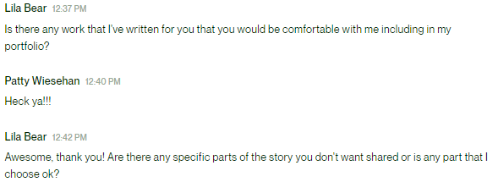

Slide 21
Tips and Tricks
Chat GPT
lump sum (or milestone) projects more fruitful than hourly, although hourly pay more
https://calculator.academy/rate-per-word-calculator/

Slide 22
PRICE PER WORD = .025
PRICE PER WORD = .015

Slide 23
(some will balk at going over .02)
I know my worth.

Slide 24
Other Options

Slide 25
Go Get Your Money
(and experience, I guess)

