Slide 1
Introduction to Artificial Intelligence
Workshop #1 in the AI Empowerment in Higher Education Series
Friday, March 29, 2024

Slide 2
Order of Business
tinyurl.com/AIWorkshop1Agenda

Slide 3
But first, a little information gathering
tinyurl.com/AIintropresurvey

Slide 5
IMAGINE
BUILD
SHARE

Slide 6
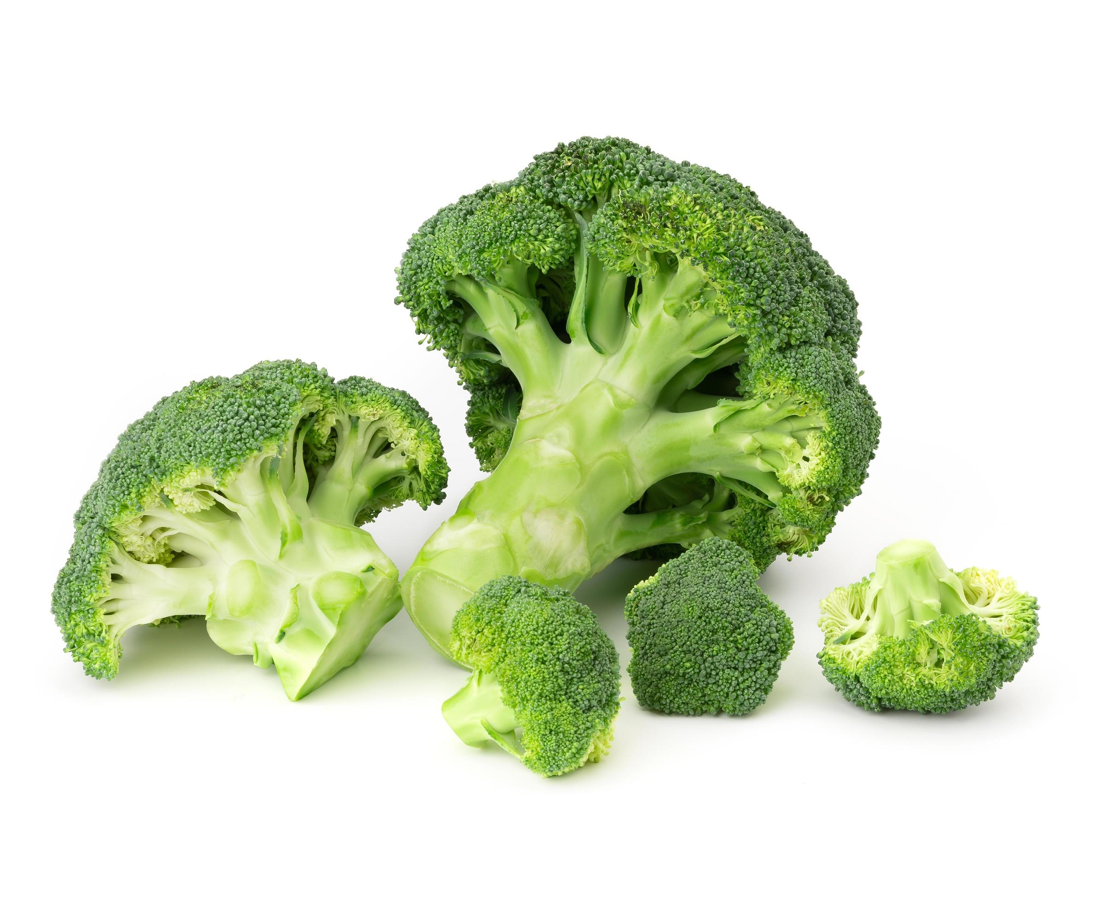

Slide 8
A History of Artificial Intelligence

Slide 9
Guess AI’s age!
2-5 years
6-10 years
11-50 years
More than 50 years

Slide 10
Genesis of AI
The Naming Ceremony:
Dartmouth Conference
ELIZA
1950
1960
1956
1966
Birth: Turing Question
Creation of Perceptron

Slide 11
AI Winter and the Boom
Expert Systems
AI Winter
1974 -1980
1986
1980
1987-1993
AI Winter
Model of Back Propagation

Slide 12
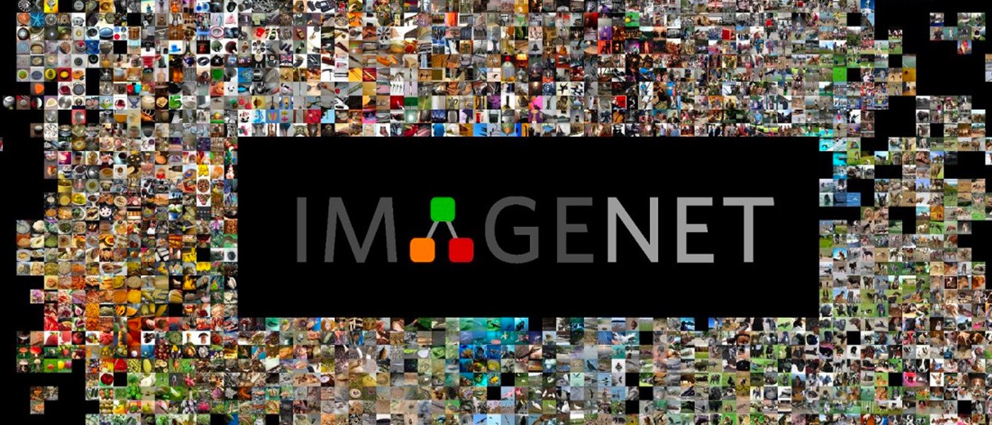
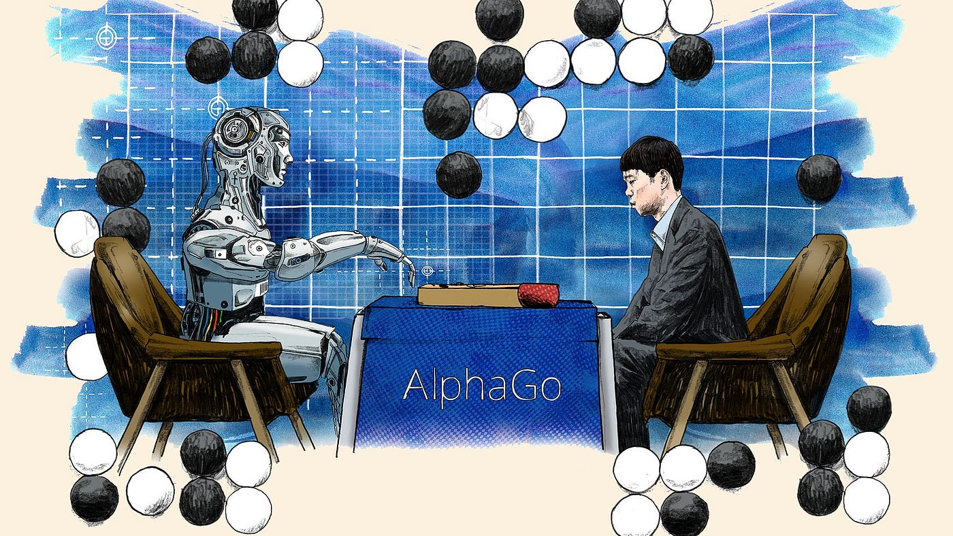
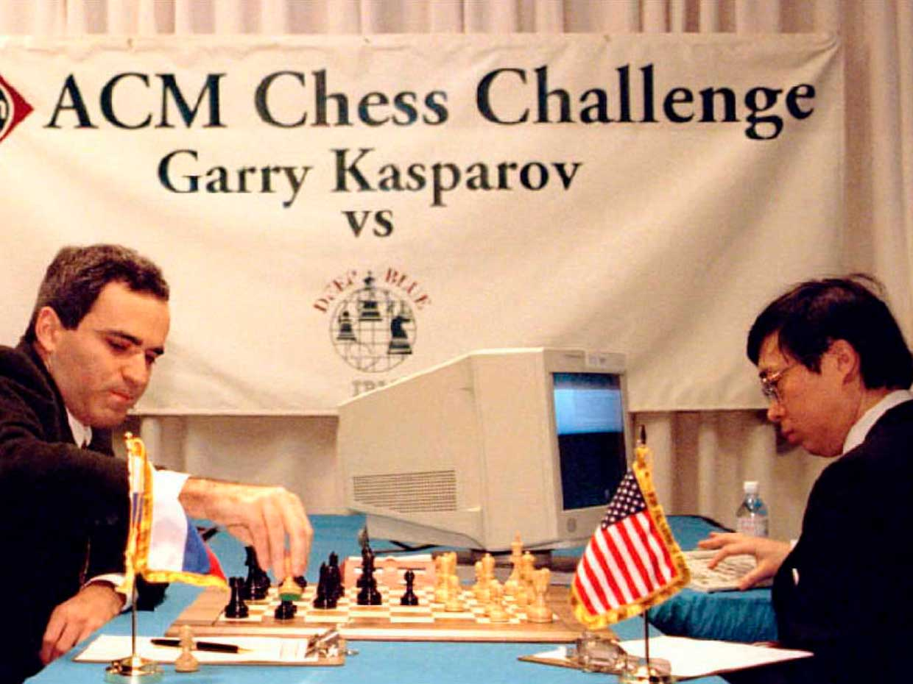
AI Renaissance
DeepMind’s
AlphaGo
ImageNet
1997
2015
2010
2016
IBM’s Deep Blue
Open AI founded

Slide 13
Deep Learning, Big data & Artificial General Intelligence (AGI)
Microsoft Backed Open AI Open AI releases GPT-3, DALL-E
AI Ethics Movement
2017-18
2021-22
2019-20
2024…………
Language Models
GPT-1 and GPT-2
GPT-3 Under Open-Source License
And GPT-Prime

Slide 14
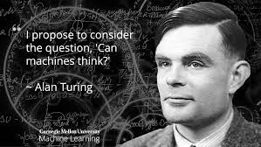
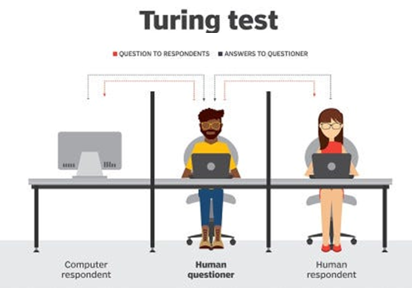
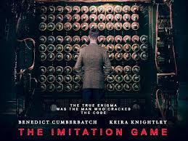
The Genesis of AI
https://medium.com/swlh/can-machines-think-9fc81e61ac6
https://medium.com/@devartimahakalkar/leap-into-machine-learning-6a605305a6c6

Slide 15
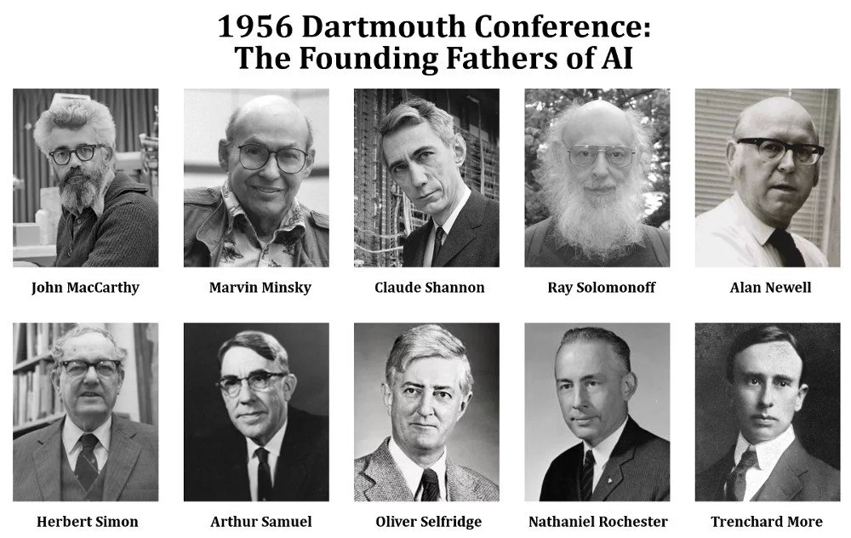
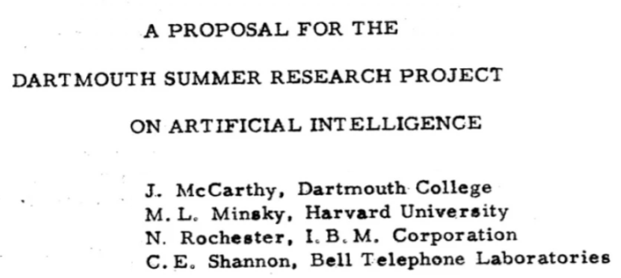
Naming & Birth of AI Research
cybernetics
automata theory
Artificial Intelligence
complex information processing
Dartmouth workshop. (2024, February 1). In Wikipedia. https://en.wikipedia.org/wiki/Dartmouth_workshop

Slide 16
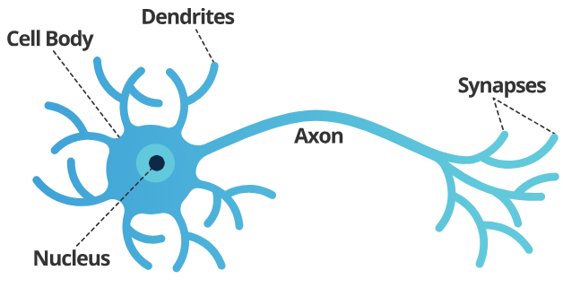
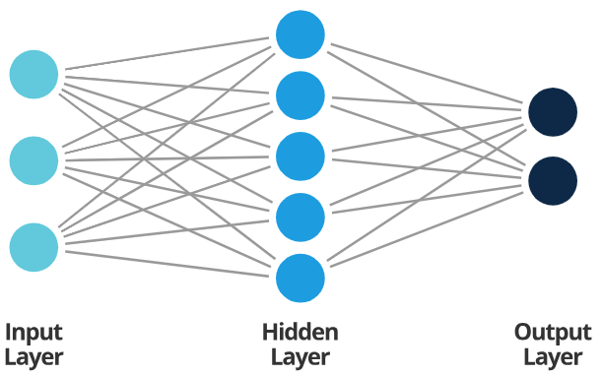
Perceptron – Machine Learning
Am I attending AI Workshop #1?
Bad Weather ?
1
Yes/ No
Add up & compare with the threshold
5
Priority ?
?
Yes/ No
3
Virtual Option?
Yes/ No

Slide 17
https://www.linkedin.com/pulse/decoding-machine-learning-supervised-unsupervised-daniel-wiczew/

Slide 18
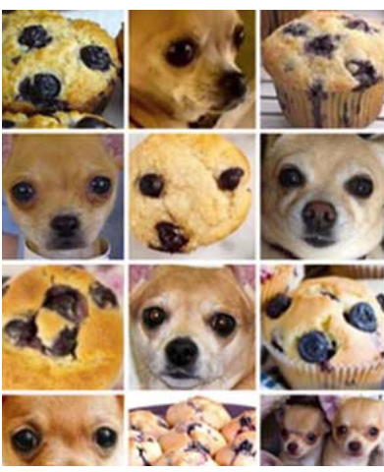
Chihuahua or muffin?

Slide 19
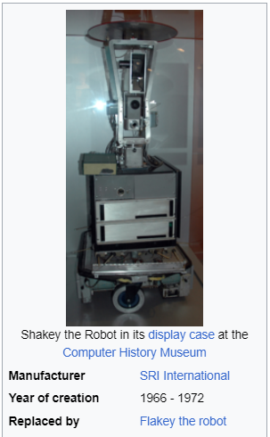
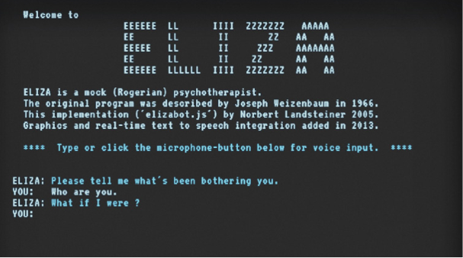
The First Wave of AI Research
ELIZA was the first chatbot that emulates a Rogerian psychotherapist.
Designed by Joseph Weizenbaum from MIT
Shakey, the world's first mobile intelligent robot that combined AI, computer vision, navigation capabilities and NLP. It became known as the grandfather of self-driving cars and drones.
ELIZA. In Wikipedia. https://en.wikipedia.org/wiki/ELIZA
Shakey the robot. In Wikipedia. https://en.wikipedia.org/wiki/Shakey_the_robot

Slide 20
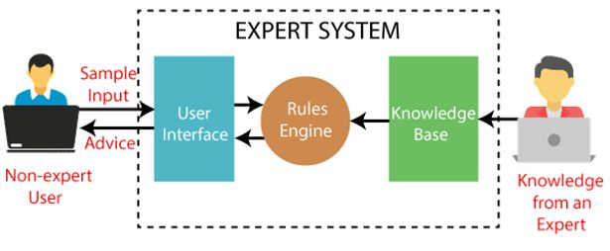
Expert Systems
DENDRAL, The first expert system a chemical-analysis expert system developed in the 1960s by Stanford University researchers Edward Feigenbaum and Joshua Lederberg.

Slide 21
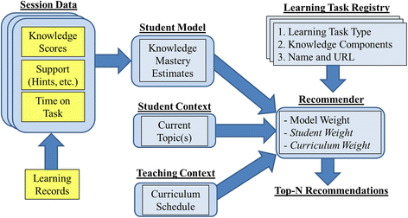
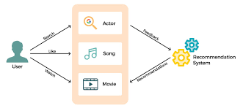
Expert Systems –> Recommendation Systems Examples
AI Workshop #1
AI Workshop #2
AI Workshop #3
AI Workshop #4

Slide 22
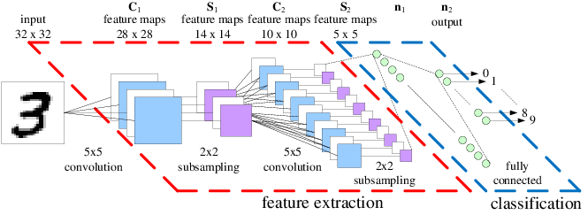
Machine Learning – Convolutional Neural Network(CNN)
Denker et al. (1989) designed a 2-D CNN system to recognize hand-written ZIP Code numbers
Convolutional neural network.. In Wikipedia. https://en.wikipedia.org/wiki/Convolutional_neural_network

Slide 23
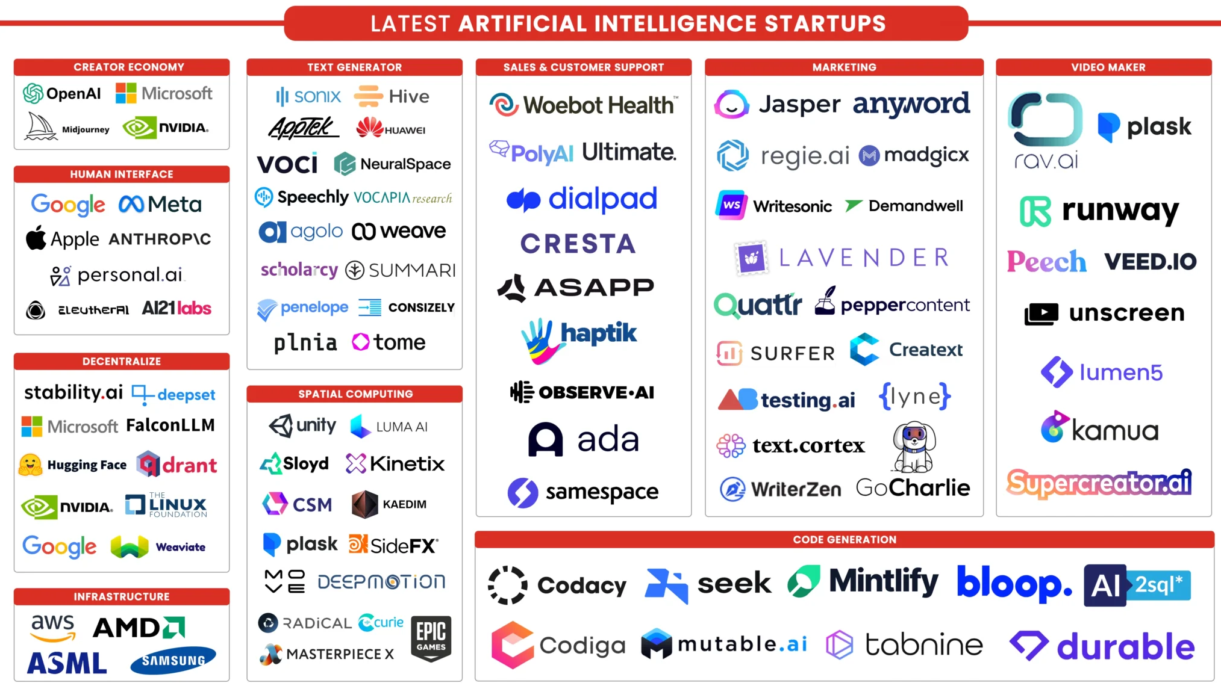
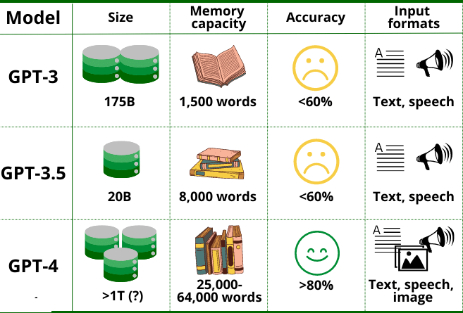
Generative Pre-trained Transformers (GPT)
Source: https://jonascleveland.com/top-generative-ai-tools/

Slide 24
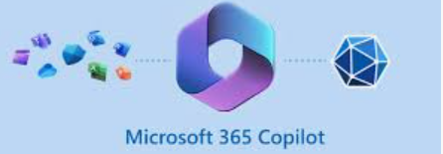
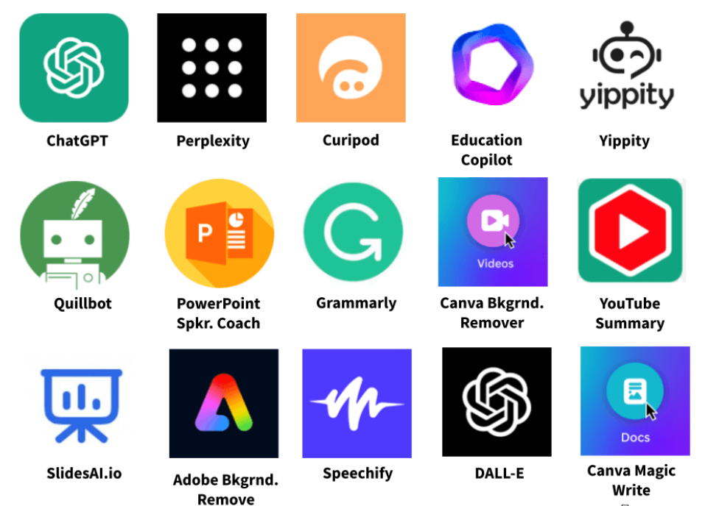
Try & Learn

Slide 25
Deep Learning and NLP

Slide 26
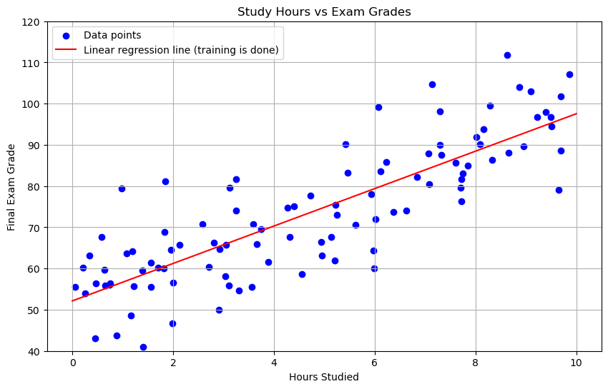
From Machine Learning to Deep Learning
Common form of supervised learning: Linear Regression

Slide 27
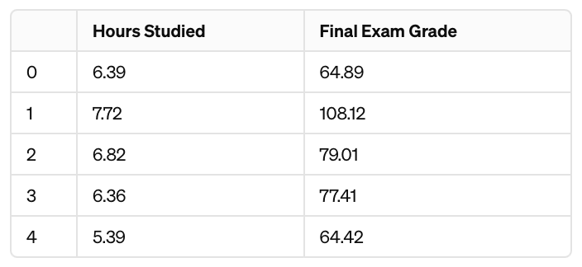
Linear Regression
Linear Regression Dataset (Training Data)
X = Hours Studied
Y = Final Exam Grade

Slide 28
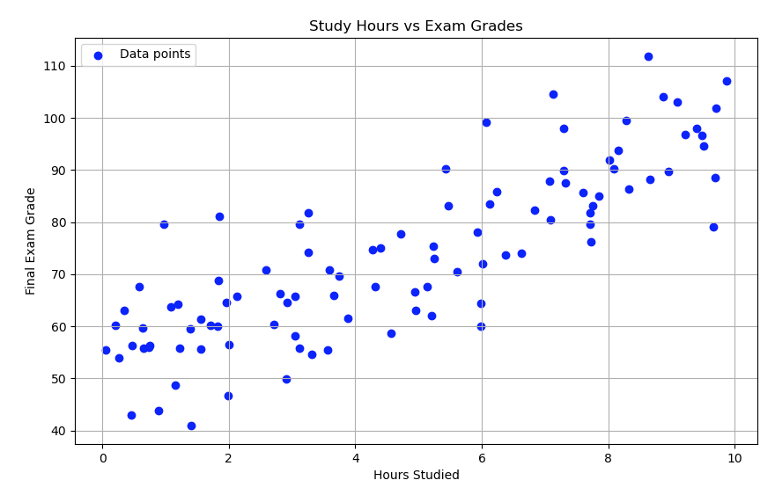
Linear Regression
Linear Regression Dataset (Training Data)
X = Hours Studied
Y = Final Exam Grade

Slide 29
Linear Regression
Linear Regression Model Definition
Y_{new} = Predicted Final Exam Grade for a new or unobserved student
(with a value for X_{new})

Slide 30
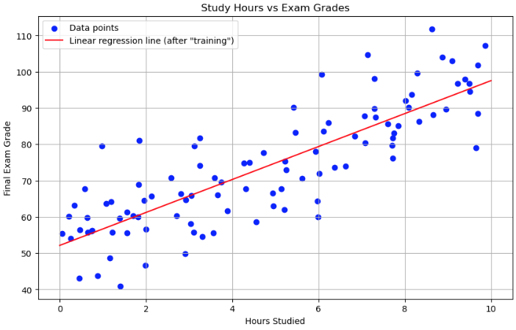
Linear Regression
Linear Regression Model Definition
or

Slide 31
Linear Regression
Machine learning models/systems have two distinct stages of development/use
Predicting a new output/result for a new input:

Slide 32
Linear Regression
Machine learning models/systems have two distinct stages of development/use
Predicting a new output/result for a new input:
Before making predictions, the model needs to be trained/fit:

Slide 33
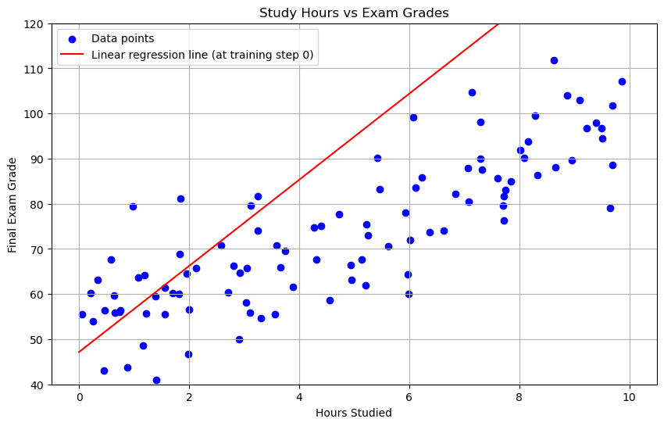
Linear Regression
“Training” a Linear Regression Model to find values of b and w
Training Step 0
b = 47.2
w = 9.5

Slide 34
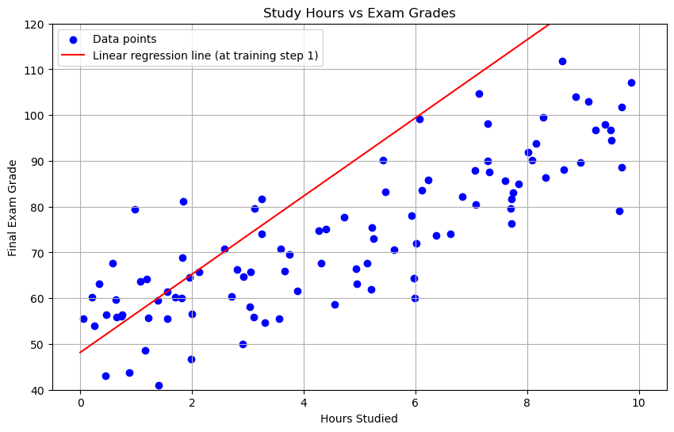
Linear Regression
“Training” a Linear Regression Model to find values of b and w
Training Step 1
b = 48.2
w = 8.5

Slide 35
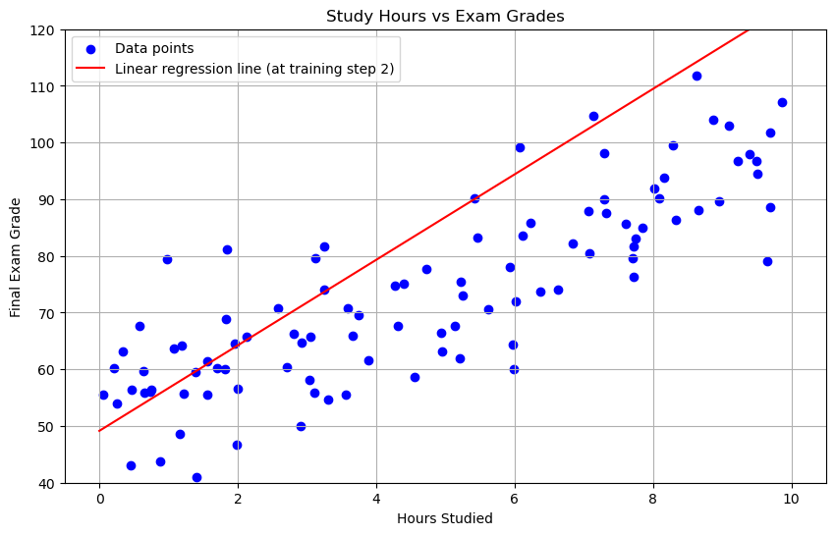
Linear Regression
“Training” a Linear Regression Model to find values of b and w
Training Step 2
b = 49.2
w = 7.5

Slide 36
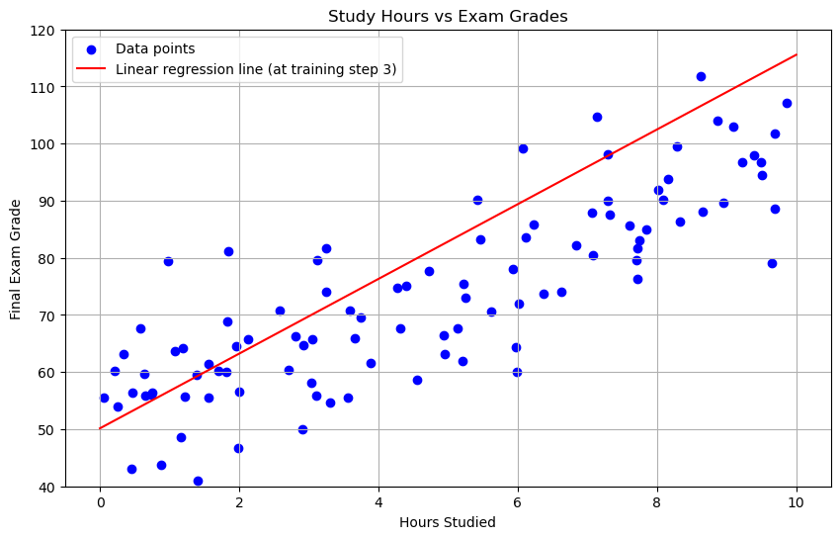
Linear Regression
“Training” a Linear Regression Model to find values of b and w
Training Step 3
b = 50.2
w = 6.5

Slide 37
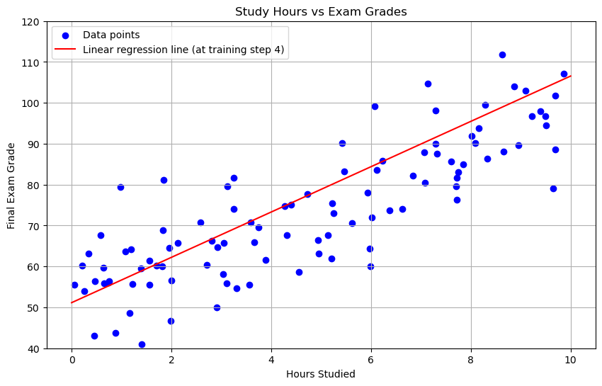
Linear Regression
“Training” a Linear Regression Model to find values of b and w
Training Step 4
b = 51.2
w = 5.5

Slide 38
Linear Regression
“Training” a Linear Regression Model to find values of b and w
Training Step 5
b = 52.2
w = 4.5

Slide 39
Linear Regression
“Training” a Linear Regression Model to find values of b and w
Training is done
b = 52.2
w = 4.5

Slide 40
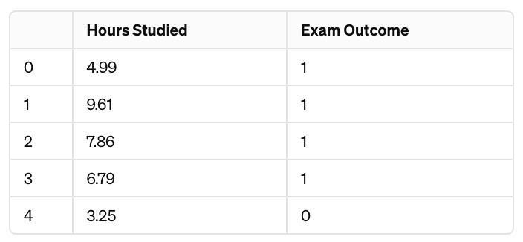
Logistic Regression for Classification
Logistic Regression Dataset (Training Data)
X = Hours Studied
Y = Pass (1) or Fail (0) Final Exam

Slide 41
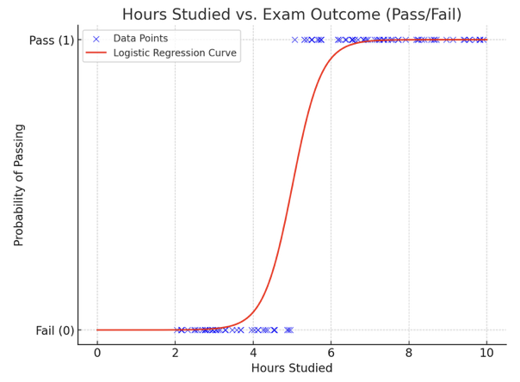
Logistic Regression for Classification
Logistic Regression Model Definition
p = Probability Student passes Final, with

Slide 42
Logistic Regression with More Inputs
Logistic Regression with more input variables or features
Data
X₁ = Hours Studied
X₂ = Student GPA
X₃ = Class Attendance Rate
…
X_{k} = Number of Study Sessions
Y = Pass(1)/Fail(0) Final Exam
Model
p = Probability of Passing Final

Slide 43
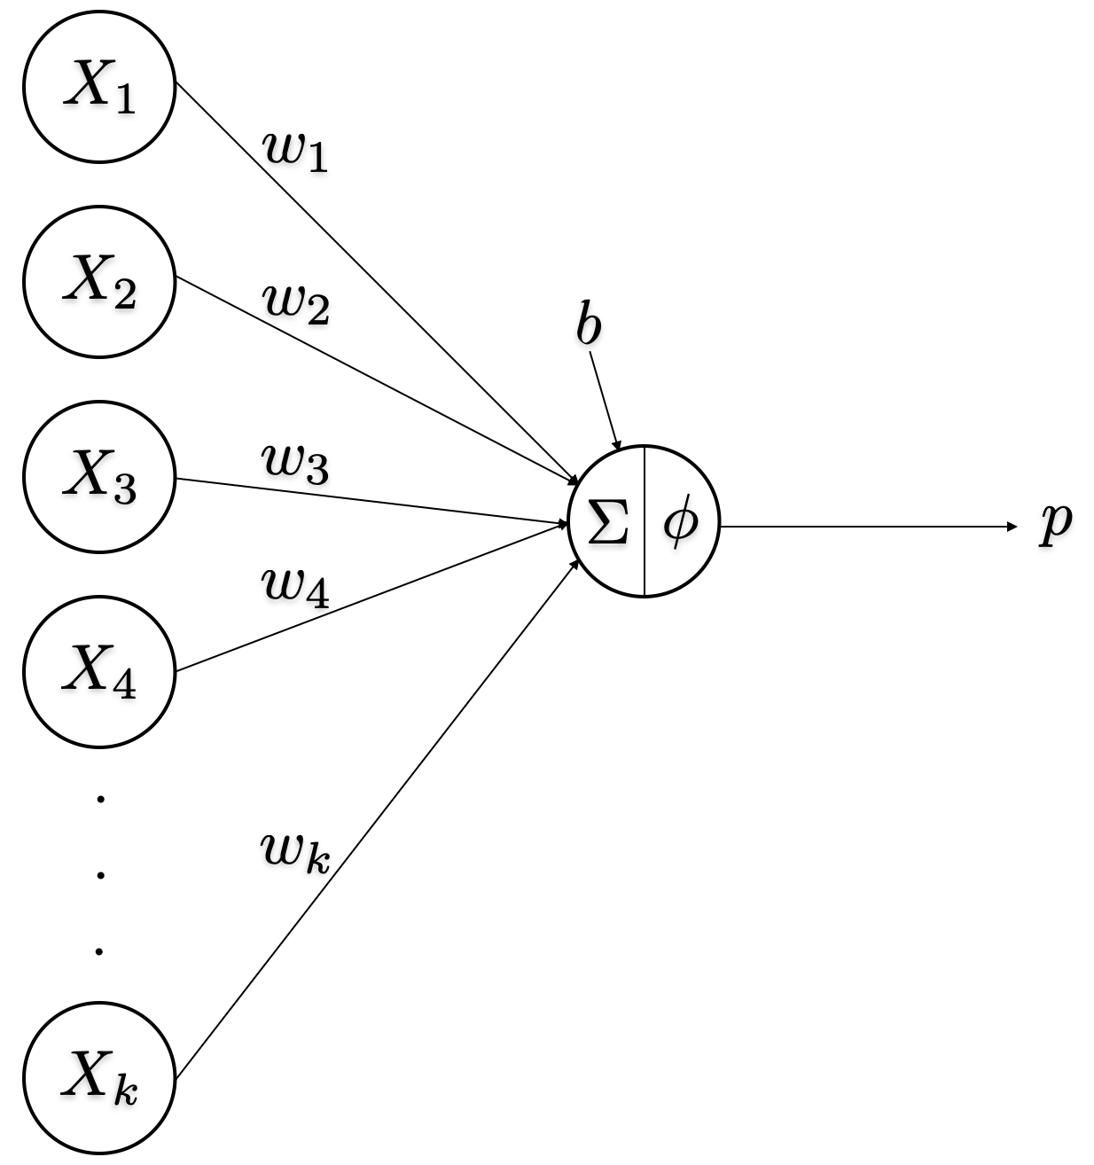
Logistic Regression with More Inputs
Logistic Regression with more input variables or features
Data
X₁ = Hours Studied
X₂ = Student GPA
X₃ = Class Attendance Rate
…
X_{k} = Number of Study Sessions
Y = Pass(1)/Fail(0) Final Exam
Model
p = Probability of Passing Final

Slide 44
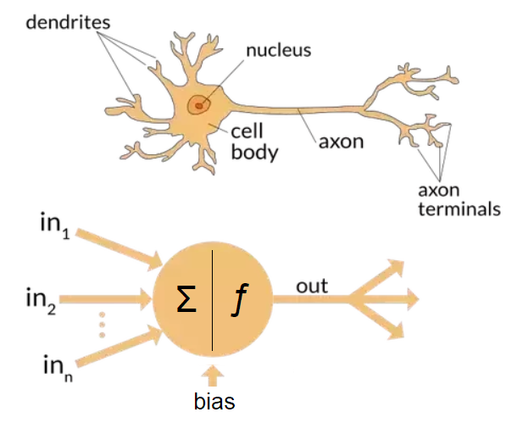
Biological Neurons to Artificial Neurons

Slide 45
Biological Neurons to Artificial Neurons

Slide 46
Logistic Regression is an Artificial Neuron
Logistic Regression and a Perceptron (or Single-layer Perceptron) are equivalent
Model:

Slide 47
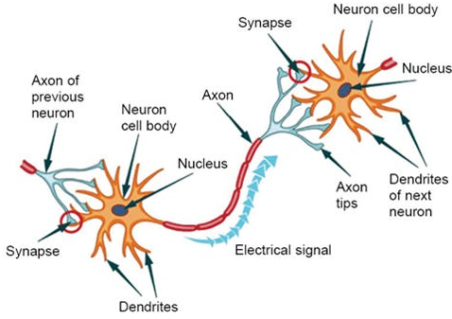
Neurons link to other Neurons
http://www.humanagingcentral.com/brain_page.html

Slide 48
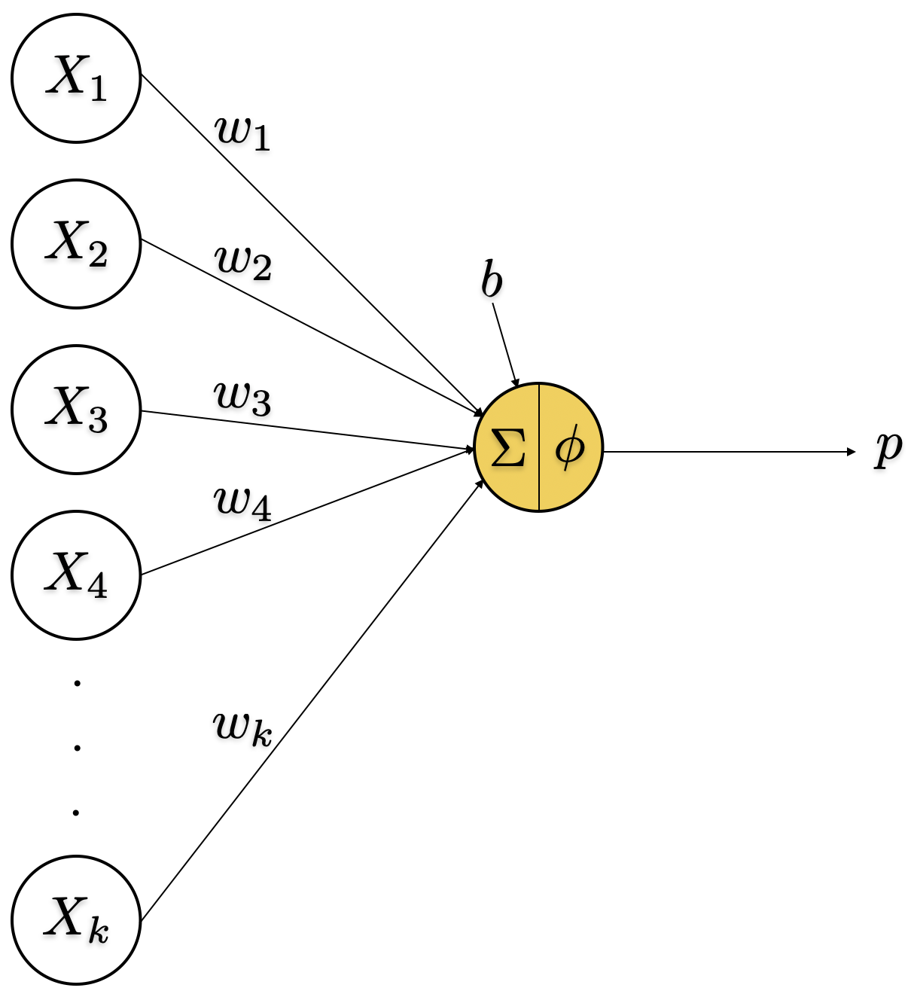
Single-Layer Perceptron
Single-layer Perceptron is the most basic neural network
Model:

Slide 49
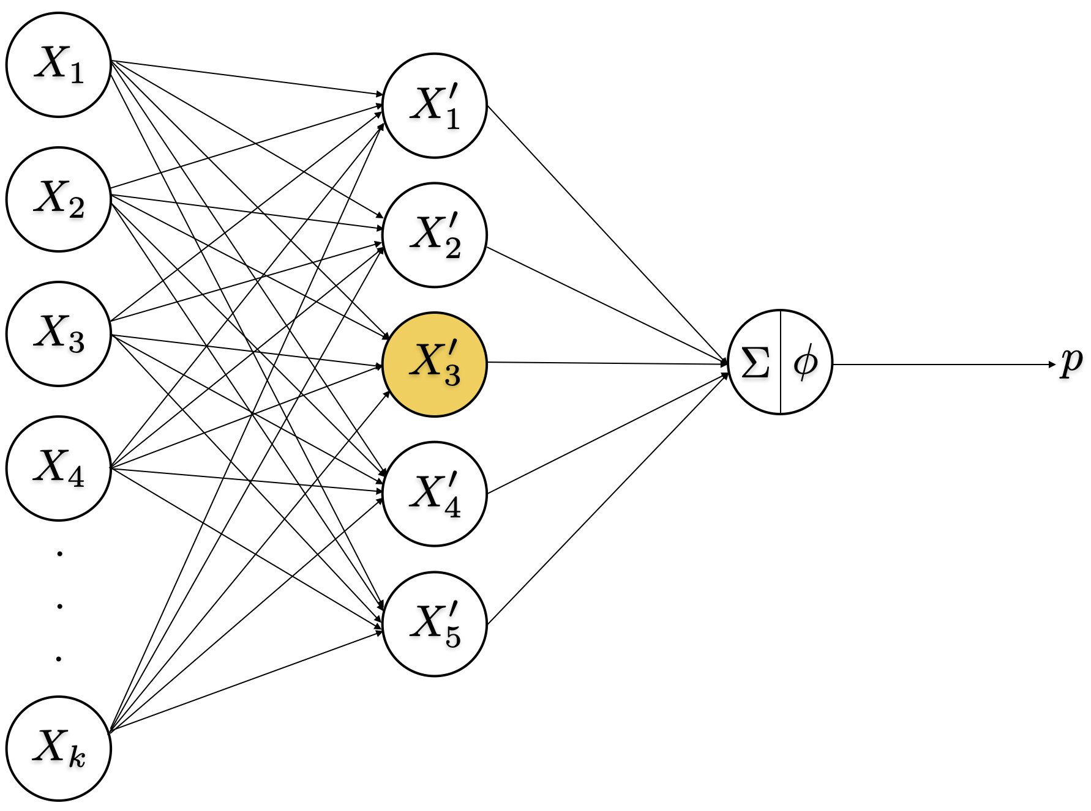
Multi-Layer Perceptron
Multi-layer Perceptron is a neural network with one or more ‘hidden’ layers
are referred to as inputs or features

Slide 50
Multi-Layer Perceptron
Multi-layer Perceptron is a neural network with one or more ‘hidden’ layers
are referred to as inputs or features
can be considered intermediate features

Slide 51
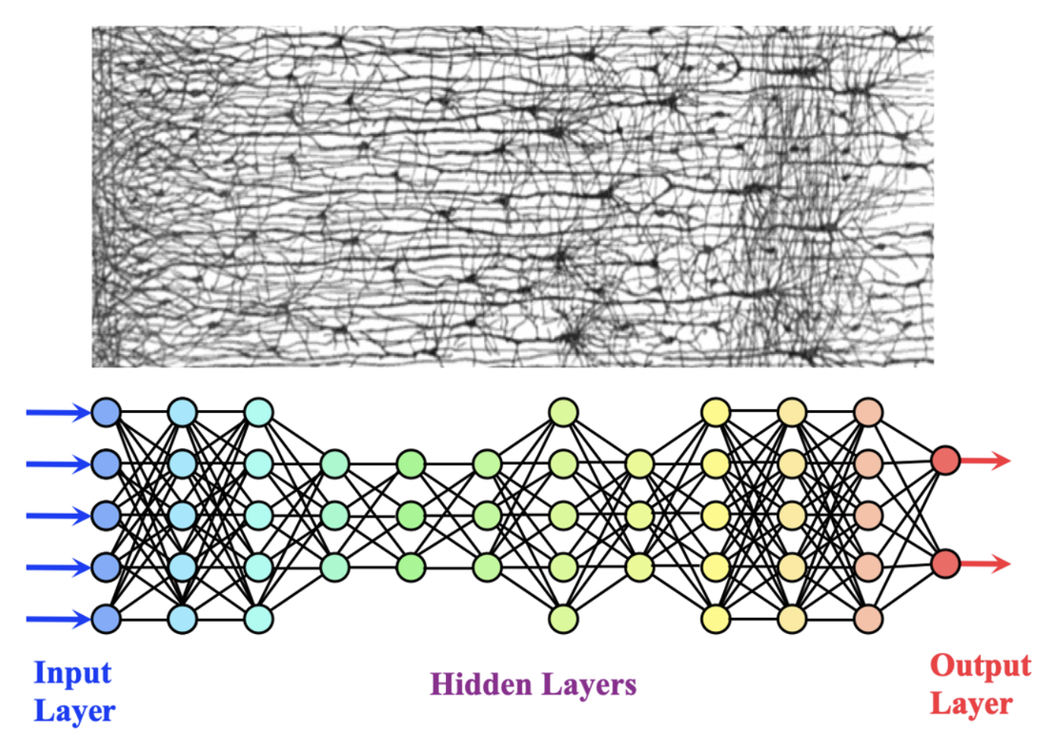
Deep Learning = Neural Network with Many Layers
https://mriquestions.com/what-is-a-neural-network.html

Slide 52
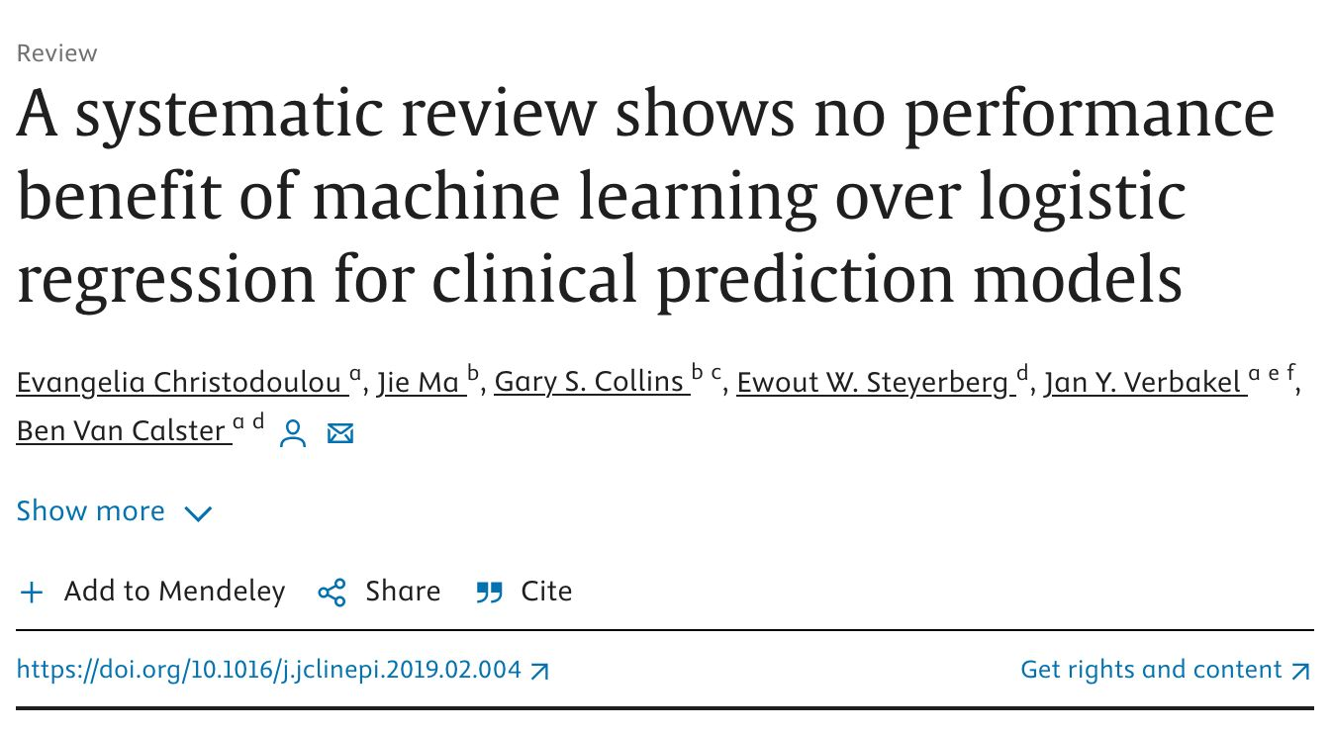
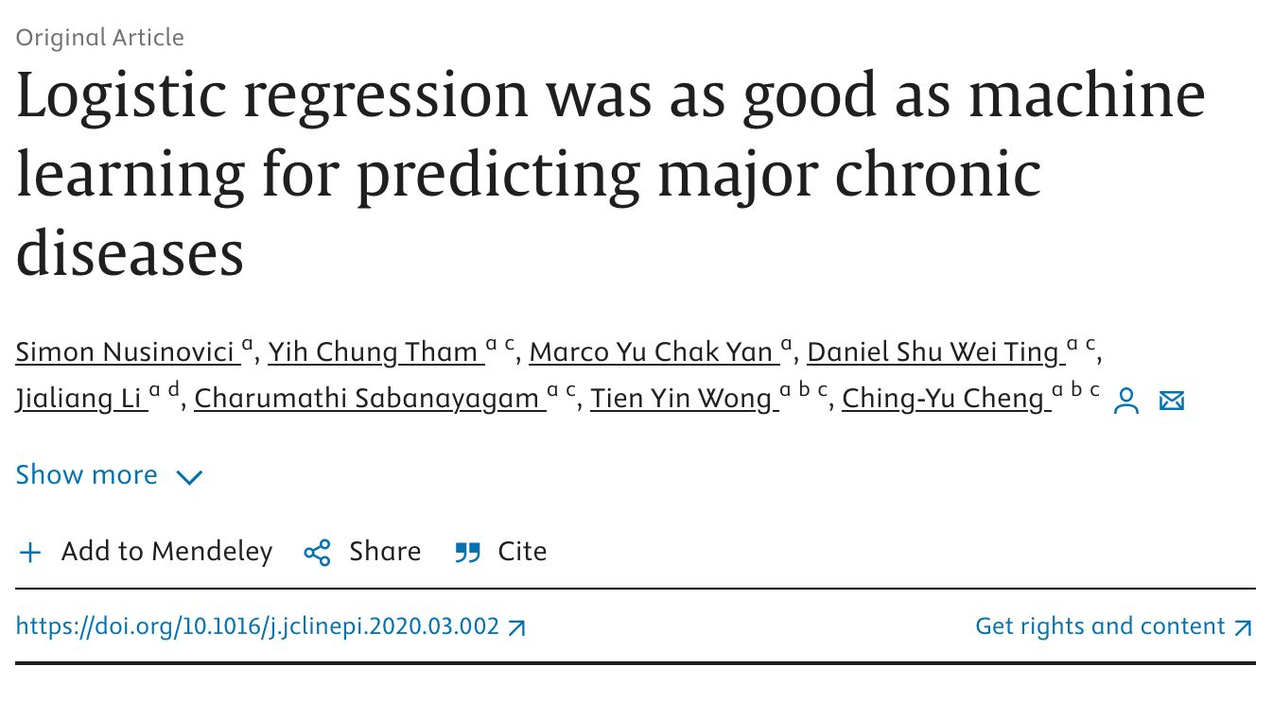
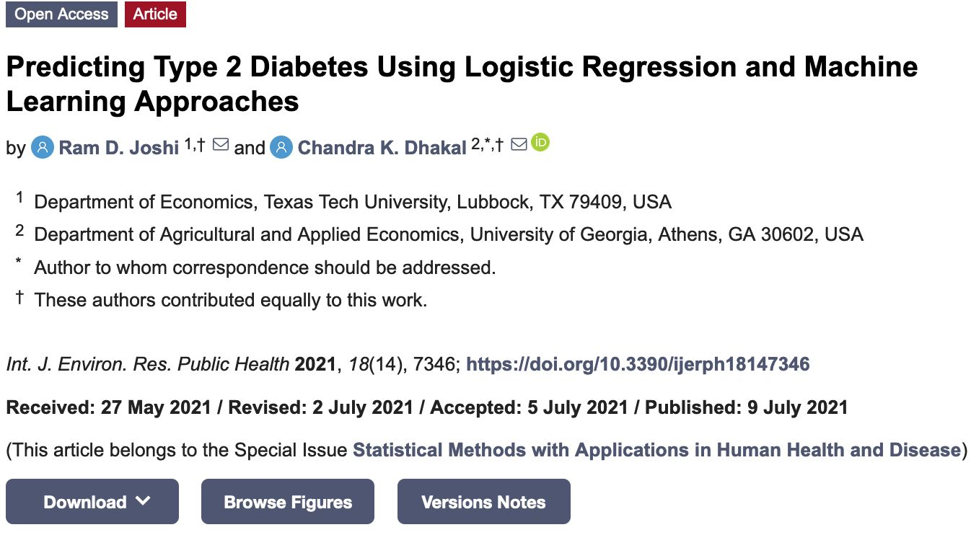
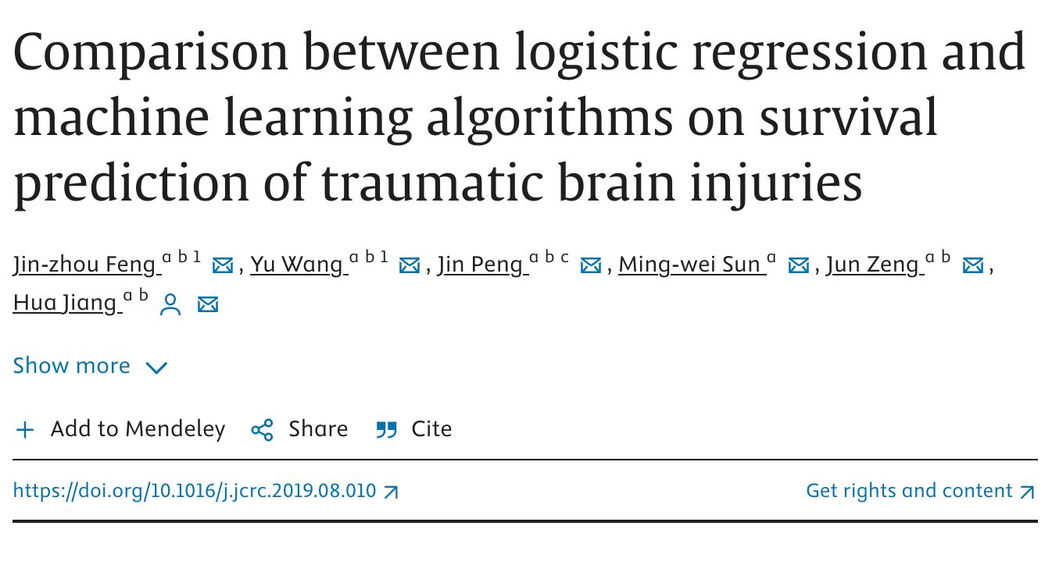
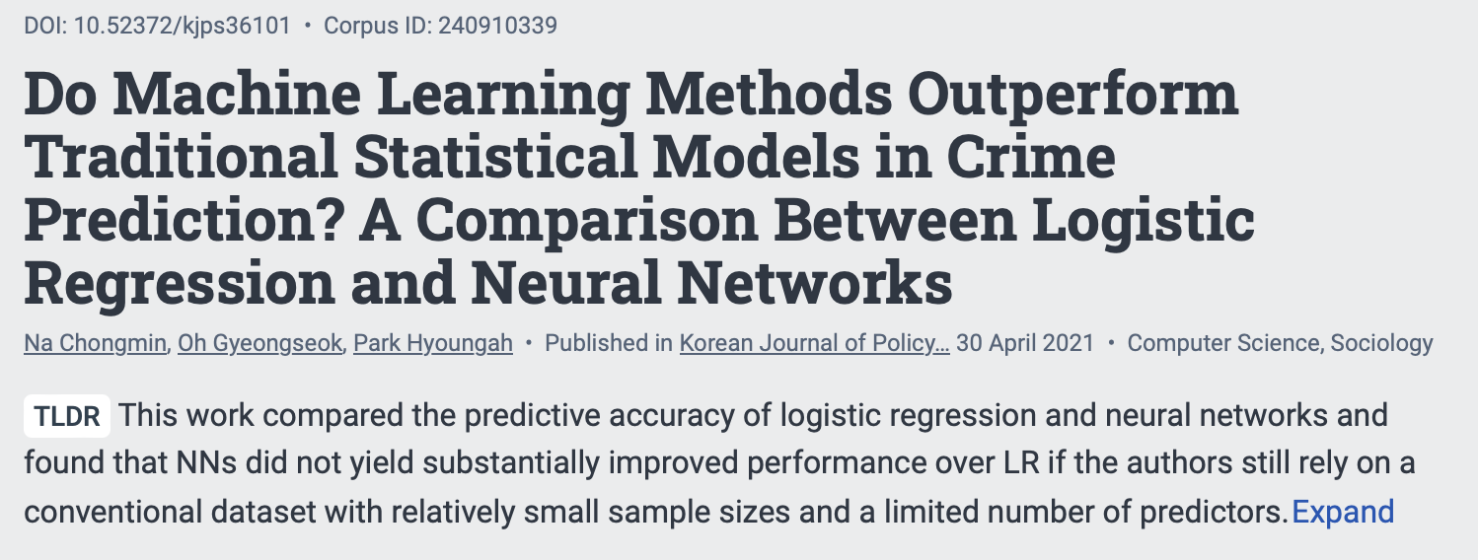
Deep Learning
Q: Are all those extra layers really needed?

Slide 53
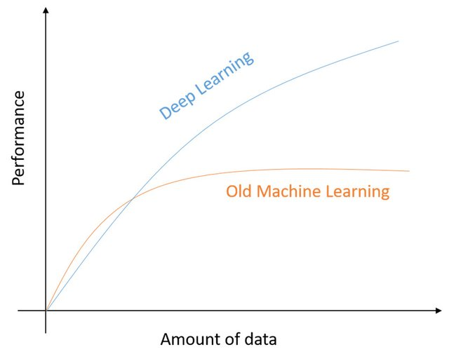
Deep Learning
Q: Are all those extra layers really needed?
A: It depends
https://www.researchgate.net/publication/331540139_A_State-of-the-Art_Survey_on_Deep_Learning_Theory_and_Architectures/

Slide 54
Deep Learning
Q: What do the the extra layers do? How do they help?
Traditional ML models typically require onerous feature engineering to be done (by a human)
https://www.intel.com/content/www/us/en/developer/topic-technology/artificial-intelligence/training/course-artificial-intelligence.html

Slide 55
Deep Learning
Q: What do the the extra layers do? How do they help?
Traditional ML models typically require onerous feature engineering to be done (by a human)
Extra layers in a Deep Learning model allow it to learn the features on its own
https://www.intel.com/content/www/us/en/developer/topic-technology/artificial-intelligence/training/course-artificial-intelligence.html

Slide 56
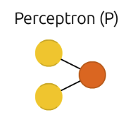
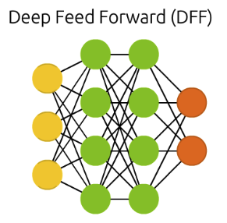
Common Neural Network Architectures
Single Perceptron and ‘Feed-forward’ architectures
https://www.asimovinstitute.org/neural-network-zoo/

Slide 57
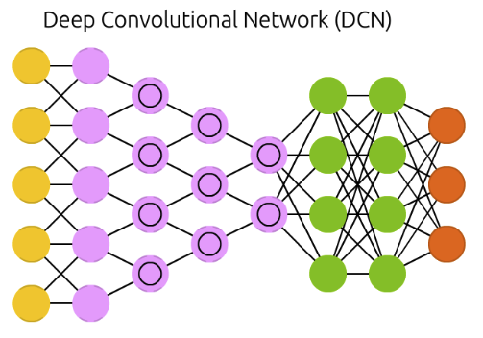
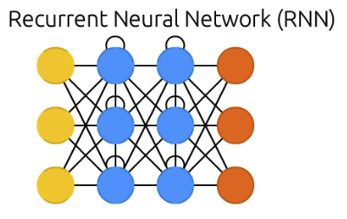
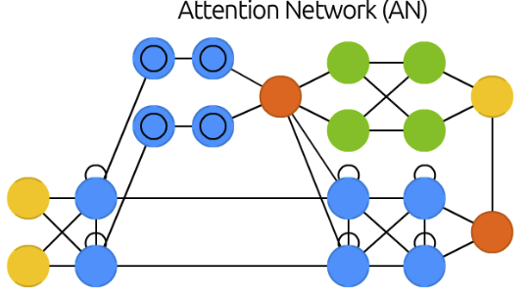
Common Neural Network Architectures
Single Perceptron and ‘Feed-forward’ architectures
Other architectures found to be more conducive to learning intermediate features of the data
https://www.asimovinstitute.org/neural-network-zoo/

Slide 58
Neural Network Architectures
Convolutional Neural Network Architecture
Different input images One feature from Layer 3 for each image
https://www.semanticscholar.org/paper/Visualizing-and-Understanding-Convolutional-Zeiler-Fergus/1a2a770d23b4a171fa81de62a78a3deb0588f238

Slide 59
Deep Learning Revolution Part 1: Vision
2012 – AlexNet far exceeds accuracy of any other machine learning model in predicting the object in an image
(AlexNet classified which of 1000 objects is in an image)
Krizhevsky, A., Sutskever, I., & Hinton, G. E. (2012). Imagenet classification with deep convolutional neural networks. Advances in neural information processing systems, 25.

Slide 60
Deep Learning Revolution Part 1: Vision
2012 – AlexNet far exceeds accuracy of any other machine learning model in predicting the object in an image
AlexNet was not only an architecture innovation
It was also made possible due to the availability of:
computing resources (w/ video graphics hardware)
vast dataset (15M images labelled)
Krizhevsky, A., Sutskever, I., & Hinton, G. E. (2012). Imagenet classification with deep convolutional neural networks. Advances in neural information processing systems, 25.

Slide 61
AI for Language/Speech
Q: Language was arguably the original AI problem, so why did it lag behind?

Slide 62
AI for Language/Speech
Q: Language was arguably the original AI problem, so why did it lag behind?
Ambiguity – “I saw the boy with my binoculars”

Slide 63
AI for Language/Speech
Q: Language was arguably the original AI problem, so why did it lag behind?
Ambiguity – “I saw the boy with my binoculars”
Synonyms/homonyms – “I ran to the store because we ran out of milk”

Slide 64
AI for Language/Speech
Q: Language was arguably the original AI problem, so why did it lag behind?
Ambiguity – “I saw the boy with my binoculars”
Synonyms/homonyms – “I ran to the store because we ran out of milk”
Irony and sarcasm – “Yeah, right”

Slide 65
AI for Language/Speech
Q: Language was arguably the original AI problem, so why did it lag behind?
Ambiguity – “I saw the boy with my binoculars”
Synonyms/homonyms – “I ran to the store because we ran out of milk”
Irony and sarcasm – “Yeah, right”
Colloquialisms/slang – “The vodka is good, but the meat is rotten”*
* a phrase purportedly translated from English to Russian back to English in early machine translation days

Slide 66
AI for Language/Speech
Q: Language was arguably the original AI problem, so why did it lag behind?
Ambiguity – “I saw the boy with my binoculars”
Synonyms/homonyms – “I ran to the store because we ran out of milk”
Irony and sarcasm – “Yeah, right”
Colloquialisms/slang – “The vodka is good, but the meat is rotten”*
Domain-specific language – “Haaland got a brace in the match”
* a phrase purportedly translated from English to Russian back to English in early machine translation days

Slide 67
AI for Language/Speech
Q: Language was arguably the original AI problem, so why did it lag behind?
Ambiguity – “I saw the boy with my binoculars”
Synonyms/homonyms – “I ran to the store because we ran out of milk”
Irony and sarcasm – “Yeah, right”
Colloquialisms/slang – “The vodka is good, but the meat is rotten”*
Domain-specific language – “Haaland got a brace in the match”
Errors in text or speech
…
* a phrase purportedly translated from English to Russian back to English in early machine translation days

Slide 68
AI for Language/Speech
Q: Language was arguably the original AI problem, so why did it lag behind?
Ambiguity – “I saw the boy with my binoculars”
Synonyms/homonyms – “I ran to the store because we ran out of milk”
Irony and sarcasm – “Yeah, right”
Colloquialisms/slang – “The vodka is good, but the meat is rotten”*
Domain-specific language – “Haaland got a brace in the match”
Errors in text or speech
…
Text as a model input is more challenging than image input
* a phrase purportedly translated from English to Russian back to English in early machine translation days

Slide 69
Moravec’s Paradox
”The main lesson of thirty-five years of AI
research is that the hard problems are easy,
and the easy problems are hard.”
Stephen Pinker (1994)

Slide 70
Reading Text Data into a Neural Network
Challenges of reading text data into a model:
Variable length inputs – Image can easily be converted/cropped to all be the same size, but to deal with this for text?
https://tiktokenizer.vercel.app/?encoder=gpt2

Slide 71
Reading Text Data into a Neural Network
Challenges of reading text data into a model:
Variable length inputs – Image can easily be converted/cropped to all be the same size, but to deal with this for text?

Slide 72
Reading Text Data into a Neural Network
Challenges of reading text data into a model:
Variable length inputs
Converting a word to a number – Images are represented by pixels, which have a number value associated with them already, but how to convert words (or characters) to numbers?

Slide 73
Reading Text Data into a Neural Network
Challenges of reading text data into a model:
Variable length inputs
Converting a word to a number – Images are represented by pixels, which have a number value associated with them already, but how to convert words (or characters) to numbers?
https://tiktokenizer.vercel.app/?encoder=gpt2

Slide 74
Reading Text Data into a Neural Network
Challenges of reading text data into a model:
Variable length inputs
Converting a word to a number – Images are represented by pixels, which have a number value associated with them already, but how to convert words (or characters) to numbers?
https://tiktokenizer.vercel.app/?encoder=gpt2

Slide 75
Tokenization is often the culprit
Language model issues that are often related to tokenization:
Not being able to do simple arithmetic
Not working well in other languages (e.g. Japanese)
Trouble spelling words
Trouble writing a word backwards
Glitch Tokens

Slide 76
Deep Learning Revolution Part 2: Language
2017 – Transformer architecture is released that emphasizes ‘Attention’ and both
outperforms existing language models and
can better utilize computing resources (allowing for larger models and datasets)
Vaswani, A., Shazeer, N., Parmar, N., Uszkoreit, J., Jones, L., Gomez, A. N., ... & Polosukhin, I. (2017). Attention is all you need. Advances in neural information processing systems, 30.

Slide 77
Deep Learning Revolution Part 2: Language
2017 – Transformer architecture is released that emphasizes ‘Attention’ and both
outperforms existing language models and
can better utilize computing resources (allowing for larger models and datasets)
Vaswani, A., Shazeer, N., Parmar, N., Uszkoreit, J., Jones, L., Gomez, A. N., ... & Polosukhin, I. (2017). Attention is all you need. Advances in neural information processing systems, 30.

Slide 78
Transformers become prevailing architecture
2018
Google releases BERT (… Transformers)
OpenAI releases GPT-1 (Generative Pre-trained Transformer)
* https://openai.com/research/better-language-models

Slide 79
Transformers become prevailing architecture
2018
Google releases BERT (… Transformers)
OpenAI releases GPT-1 (Generative Pre-trained Transformer)
2019 (models begin to reach level of human-generated text)
Google releases T5 (… Transformer)
Meta releases BART (… Transformer)
OpenAI releases GPT-2*
* https://openai.com/research/better-language-models

Slide 80
Transformers become prevailing architecture
2018
Google releases BERT (… Transformers)
OpenAI releases GPT-1 (Generative Pre-trained Transformer)
2019 (models begin to reach level of human-generated text)
Google releases T5 (… Transformer)
Meta releases BART (… Transformer)
OpenAI releases GPT-2*
2020
GPT-3
2021
GPT-J, GPT-Neo, and other open-source models
* https://openai.com/research/better-language-models

Slide 81
Transformers became prevailing architecture, but…
Transformer-based models still did produce output that aligned with human intentions/expectations
Example with GPT-3*
Human Prompt/Input:
Explain the moon landing to a 6 year old in a few sentences.
GPT-3 Output:
Explain the theory of gravity to a 6 year old.
Explain the theory of relativity to a 6 year old in a few sentences.
Explain the big bang theory to a 6 year old.
Explain evolution to a 6 year old.
* https://openai.com/research/instruction-following

Slide 82
Transformers became prevailing architecture, but…
Transformer-based models still did produce output that aligned with human intentions/expectations
Example with InstructGPT*
Human Prompt/Input:
Explain the moon landing to a 6 year old in a few sentences.
InstructGPT Output:
People went to the moon, and they took pictures of what they saw, and sent them back to the earth so we could all see them.
* https://openai.com/research/instruction-following

Slide 83
Responsible AI
Development and deployment of AI should:
maximize benefits and minimizes harms
contribute to the common good
reflect shared human values and ethical principles

Slide 84
Responsible AI
Many principles/pillars on development/deployment of AI:
Google – https://ai.google/responsibility/principles/
IBM – https://www.ibm.com/impact/ai-ethics
Association for Computing Machinery
Department of Defense
United Nations

Slide 85
Responsible AI
Foundational topics on ethical development of AI/ML systems:
Bias and Fairness
Accountability and Explainability
Privacy, Safety, and Security
Data Rights

Slide 86
Responsible AI: Bias and Fairness
Instances of models creating/perpetuating inequities
Recidivism Prediction – COMPAS (a tool used in U.S. courts to assess likelihood of a repeat offender) was found to disproportionately predict that African-American defendants of having a higher risk of recidivism than white defendants

Slide 87
Responsible AI: Bias and Fairness
Instances of models creating/perpetuating inequities
Recidivism Prediction – COMPAS (a tool used in U.S. courts to assess likelihood of a repeat offender) was found to disproportionately predict that African-American defendants of having a higher risk of recidivism than white defendants
Hiring/Employment – Amazon had to scrap its AI recruitment tool after discovering it favored resumes with more typically male characteristics (due to biases present in the training data)

Slide 88
Responsible AI: Bias and Fairness
Instances of models creating/perpetuating inequities
Recidivism Prediction – COMPAS (a tool used in U.S. courts to assess likelihood of a repeat offender) was found to disproportionately predict that African-American defendants of having a higher risk of recidivism than white defendants
Hiring/Employment – Amazon had to scrap its AI recruitment tool after discovering it favored resumes with more typically male characteristics (due to biases present in the training data)
Healthcare* – an algorithm was seen to recommend healthcare treatment in a way that resulted in black patients (algorithm used healthcare costs as a proxy for health; this highlighted historic inequities in which, on average, less money was spent on a black patient than on a white patient with the same level of health)
* Ziad Obermeyer et al. ,Dissecting racial bias in an algorithm used to manage the health of populations.Science366,447-453(2019).DOI:10.1126/science.aax2342

Slide 89
Responsible AI: Bias and Fairness
Instances of models creating/perpetuating inequities
Recidivism Prediction – COMPAS (a tool used in U.S. courts to assess likelihood of a repeat offender) was found to disproportionately predict that African-American defendants of having a higher risk of recidivism than white defendants
Hiring/Employment – Amazon had to scrap its AI recruitment tool after discovering it favored resumes with more typically male characteristics (due to biases present in the training data)
Healthcare* – an algorithm was seen to recommend healthcare treatment in a way that resulted in black patients (algorithm used healthcare costs as a proxy for health; this highlighted historic inequities in which, on average, less money was spent on a black patient than on a white patient with the same level of health)
Credit/Lending** – Apple credit card reportedly exhibiting gender bias by giving women a much lower credit limit than men when financial status is same or similar
* Ziad Obermeyer et al. ,Dissecting racial bias in an algorithm used to manage the health of populations.Science366,447-453(2019).DOI:10.1126/science.aax2342
** https://www.wired.com/story/the-apple-card-didnt-see-genderand-thats-the-problem/

Slide 90
Responsible AI: Bias and Fairness
Instances of Facial Recognition systems creating/perpetuating inequities
Gender prediction models have much higher error rates for dark-skinned individuals
Buolamwini, J., & Gebru, T. (2018, January). Gender shades: Intersectional accuracy disparities in commercial gender classification. In Conference on fairness, accountability and transparency (pp. 77-91). PMLR.

Slide 91
Responsible AI: Bias and Fairness
Instances of Facial Recognition systems creating/perpetuating inequities
Gender prediction models have much higher error rates for dark-skinned individuals
Training dataset is often the source of bias

Slide 92
Responsible AI: Bias and Fairness
Instances of Facial Recognition systems creating/perpetuating inequities
Uber’s Facial-ID system misidentified dark-skinned drivers more often
https://www.bbc.com/news/technology-68655429

Slide 93
Responsible AI: Accountability and Explainability
Instances of Facial Recognition systems creating/perpetuating inequities
Lack of recourse, or delayed recourse is also an accountability issue
https://www.bbc.com/news/technology-68655429

Slide 94
Responsible AI: Accountability and Explainability
Even simple computer systems making decisions for customers/citizens need to have accountability and explainability built in
https://www.aclu.org/news/privacy-technology/pitfalls-artificial-intelligence-decisionmaking-highlighted-idaho-aclu-case

Slide 95
Responsible AI: Bias and Fairness
Bias may also appear in less immediate/direct ways
Google translate using Turkish gender-neutral pronoun, ‘O’

Slide 96
Responsible AI: Bias and Fairness
Bias may also appear in less immediate/direct ways
Google translate using Turkish gender-neutral pronoun, ‘O’

Slide 97
Responsible AI: Bias and Fairness
Image generation Generative AI can further amplify biases*
Actual gender proportions for professions versus Gen AI proportions
https://www.nature.com/articles/d41586-024-00674-9

Slide 98
Responsible AI: Bias and Fairness
Image generation Generative AI can further amplify biases*
Actual gender proportions for professions versus Gen AI proportions
https://www.nature.com/articles/d41586-024-00674-9

Slide 99
Responsible AI: Bias and Fairness
Attempting to fix/remove bias is not easy though
Google’s new Generative AI tool creating an image of, ”a 1943 German soldier”*
* https://www.nytimes.com/2024/02/22/technology/google-gemini-german-uniforms.html

Slide 100
Responsible AI: Privacy, Safety, Security
Data privacy can be an issue if your data is being used without your knowledge to train a model and a Generative AI model performs unexpectedly
Gen AI models are tuned to prevent training data from being produced, but this can be circumvented*
* https://not-just-memorization.github.io/extracting-training-data-from-chatgpt.html

Slide 101
Responsible AI: Privacy, Safety, Security
Gen AI could could impact an individual person’s safety/security directly
* https://www.cnbc.com/2023/02/16/microsofts-bing-ai-is-leading-to-creepy-experiences-for-users.html

Slide 102
Responsible AI: Privacy, Safety, Security
Or, Gen AI could enable bad actors to carry out threatening/dangerous actions
OpenAI shared some harmful prompts that could be used,
and what GPT- 4 would produce after addressing it*
* GPT-4 Technical Report https://arxiv.org/abs/2303.08774

Slide 103
Responsible AI: Data Rights
Gen AI is still in its early stages, so questions of data ownership are yet to be settled
A list of copyright infringement cases related to GenAI:
https://www.getadri.ai/ai-copyright-lawsuits

Slide 104
Q&A and Discussion

Slide 105
Wrap Up

Slide 106
Let’s try this again
tinyurl.com/AIintropostsurvey

Slide 108
AI for All
Resources to Assist the MSU Denver Community
with Applying AI Effectively
msudenver.edu/ai

Slide 109
Workshop 2: Exploring Generative AI & Its Applications
Friday, April 26 from 1-2:45pm
tinyurl.com/Workshop2RSVP

Slide 110
AI in the College Classroom: Supporting Faculty and Personalizing Student Learning
Wednesday April 17, 2024 from 12:30-1:30pm in CAVEA
Led by Travis Masingale, Professor of Design from Eastern Washington University
Discover how AI tools like ChatGPT, Gemini, and Claude can assist with tasks like curriculum development, assignment design, and rubric creation. Learn how to craft effective AI prompts that generate meaningful and insightful responses.
The talk will demonstrate how AI can be used to promote active, ethical learning and improve educational outcomes for all students by supporting faculty and personalizing learning experiences.

Slide 111
Thank you!

