Slide 1
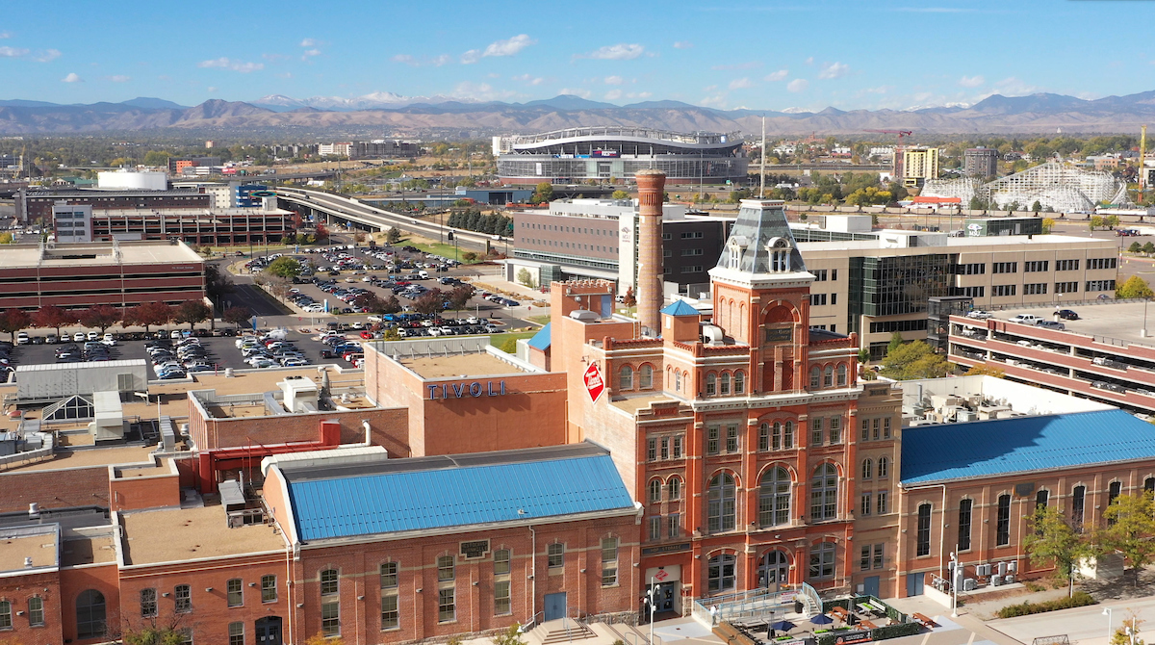
Welcome to MSU Denver!!

Slide 3
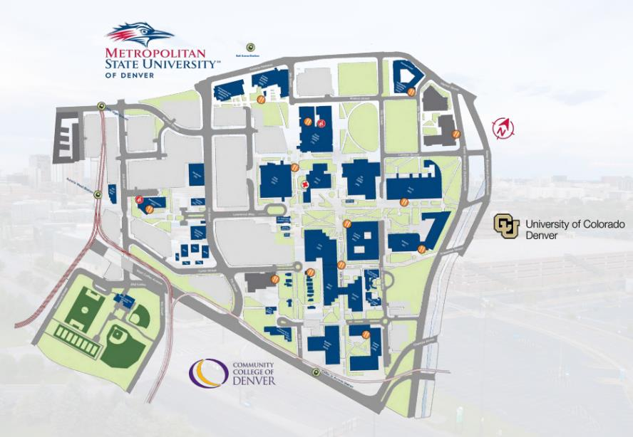
FOUNDED IN 1965
TRI-INSTITUTIONAL
HISPANIC-SERVING INSTITUTION
BEST FOR VETS
YELLOW RIBBON SCHOOL
#1 TRANSFER INSTITUTION
IN COLORADO
About MSU Denver
Academics & Support
Student Life & Athletics
Admission Requirements
Pay for College
Classes lead to Careers
Stay Connected

Slide 4
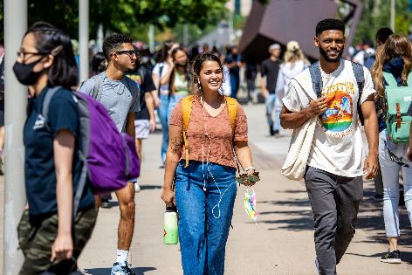
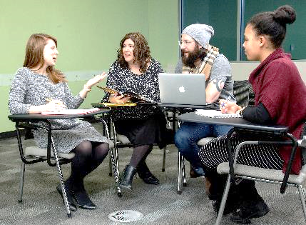
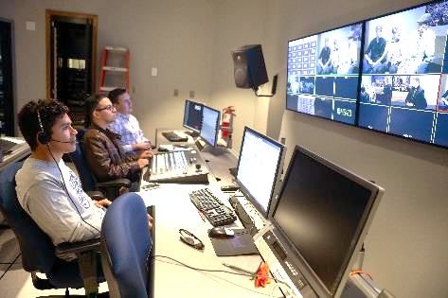
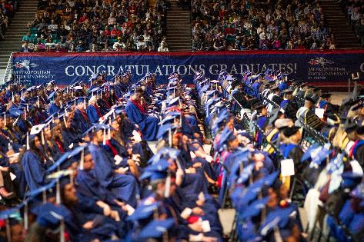
21
19:1
average class size
student to faculty ratio
About MSU Denver
Academics & Support
Student Life & Athletics
Admission Requirements
Pay for College
Classes lead to Careers
Stay Connected

Slide 5
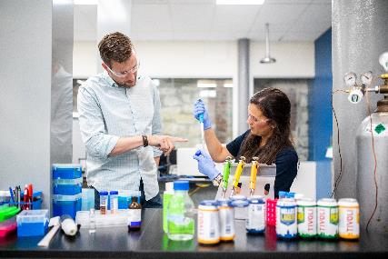
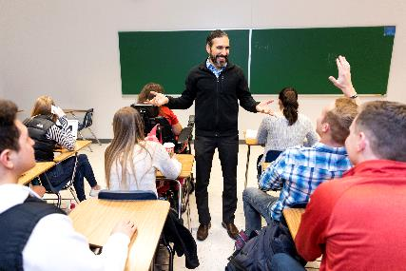
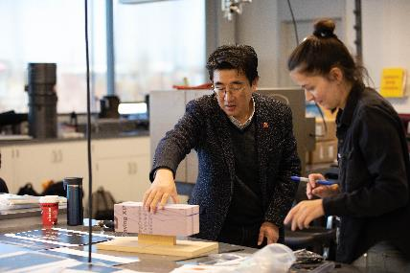
Learn from leaders in the format that’s best for you.
Class Instruction
Faculty Leaders
Flexible Formats
99%
National experts
Industry icons
Noted academics
Focus on hands-on learning, student success and development of the next generation of industry leaders
of classes are taught by faculty, not teaching assistants
In-person, online or hybrid
Daytime, evening and weekend classes
About MSU Denver
Academics & Support
Student Life & Athletics
Admission Requirements
Pay for College
Classes lead to Careers
Stay Connected

Slide 6
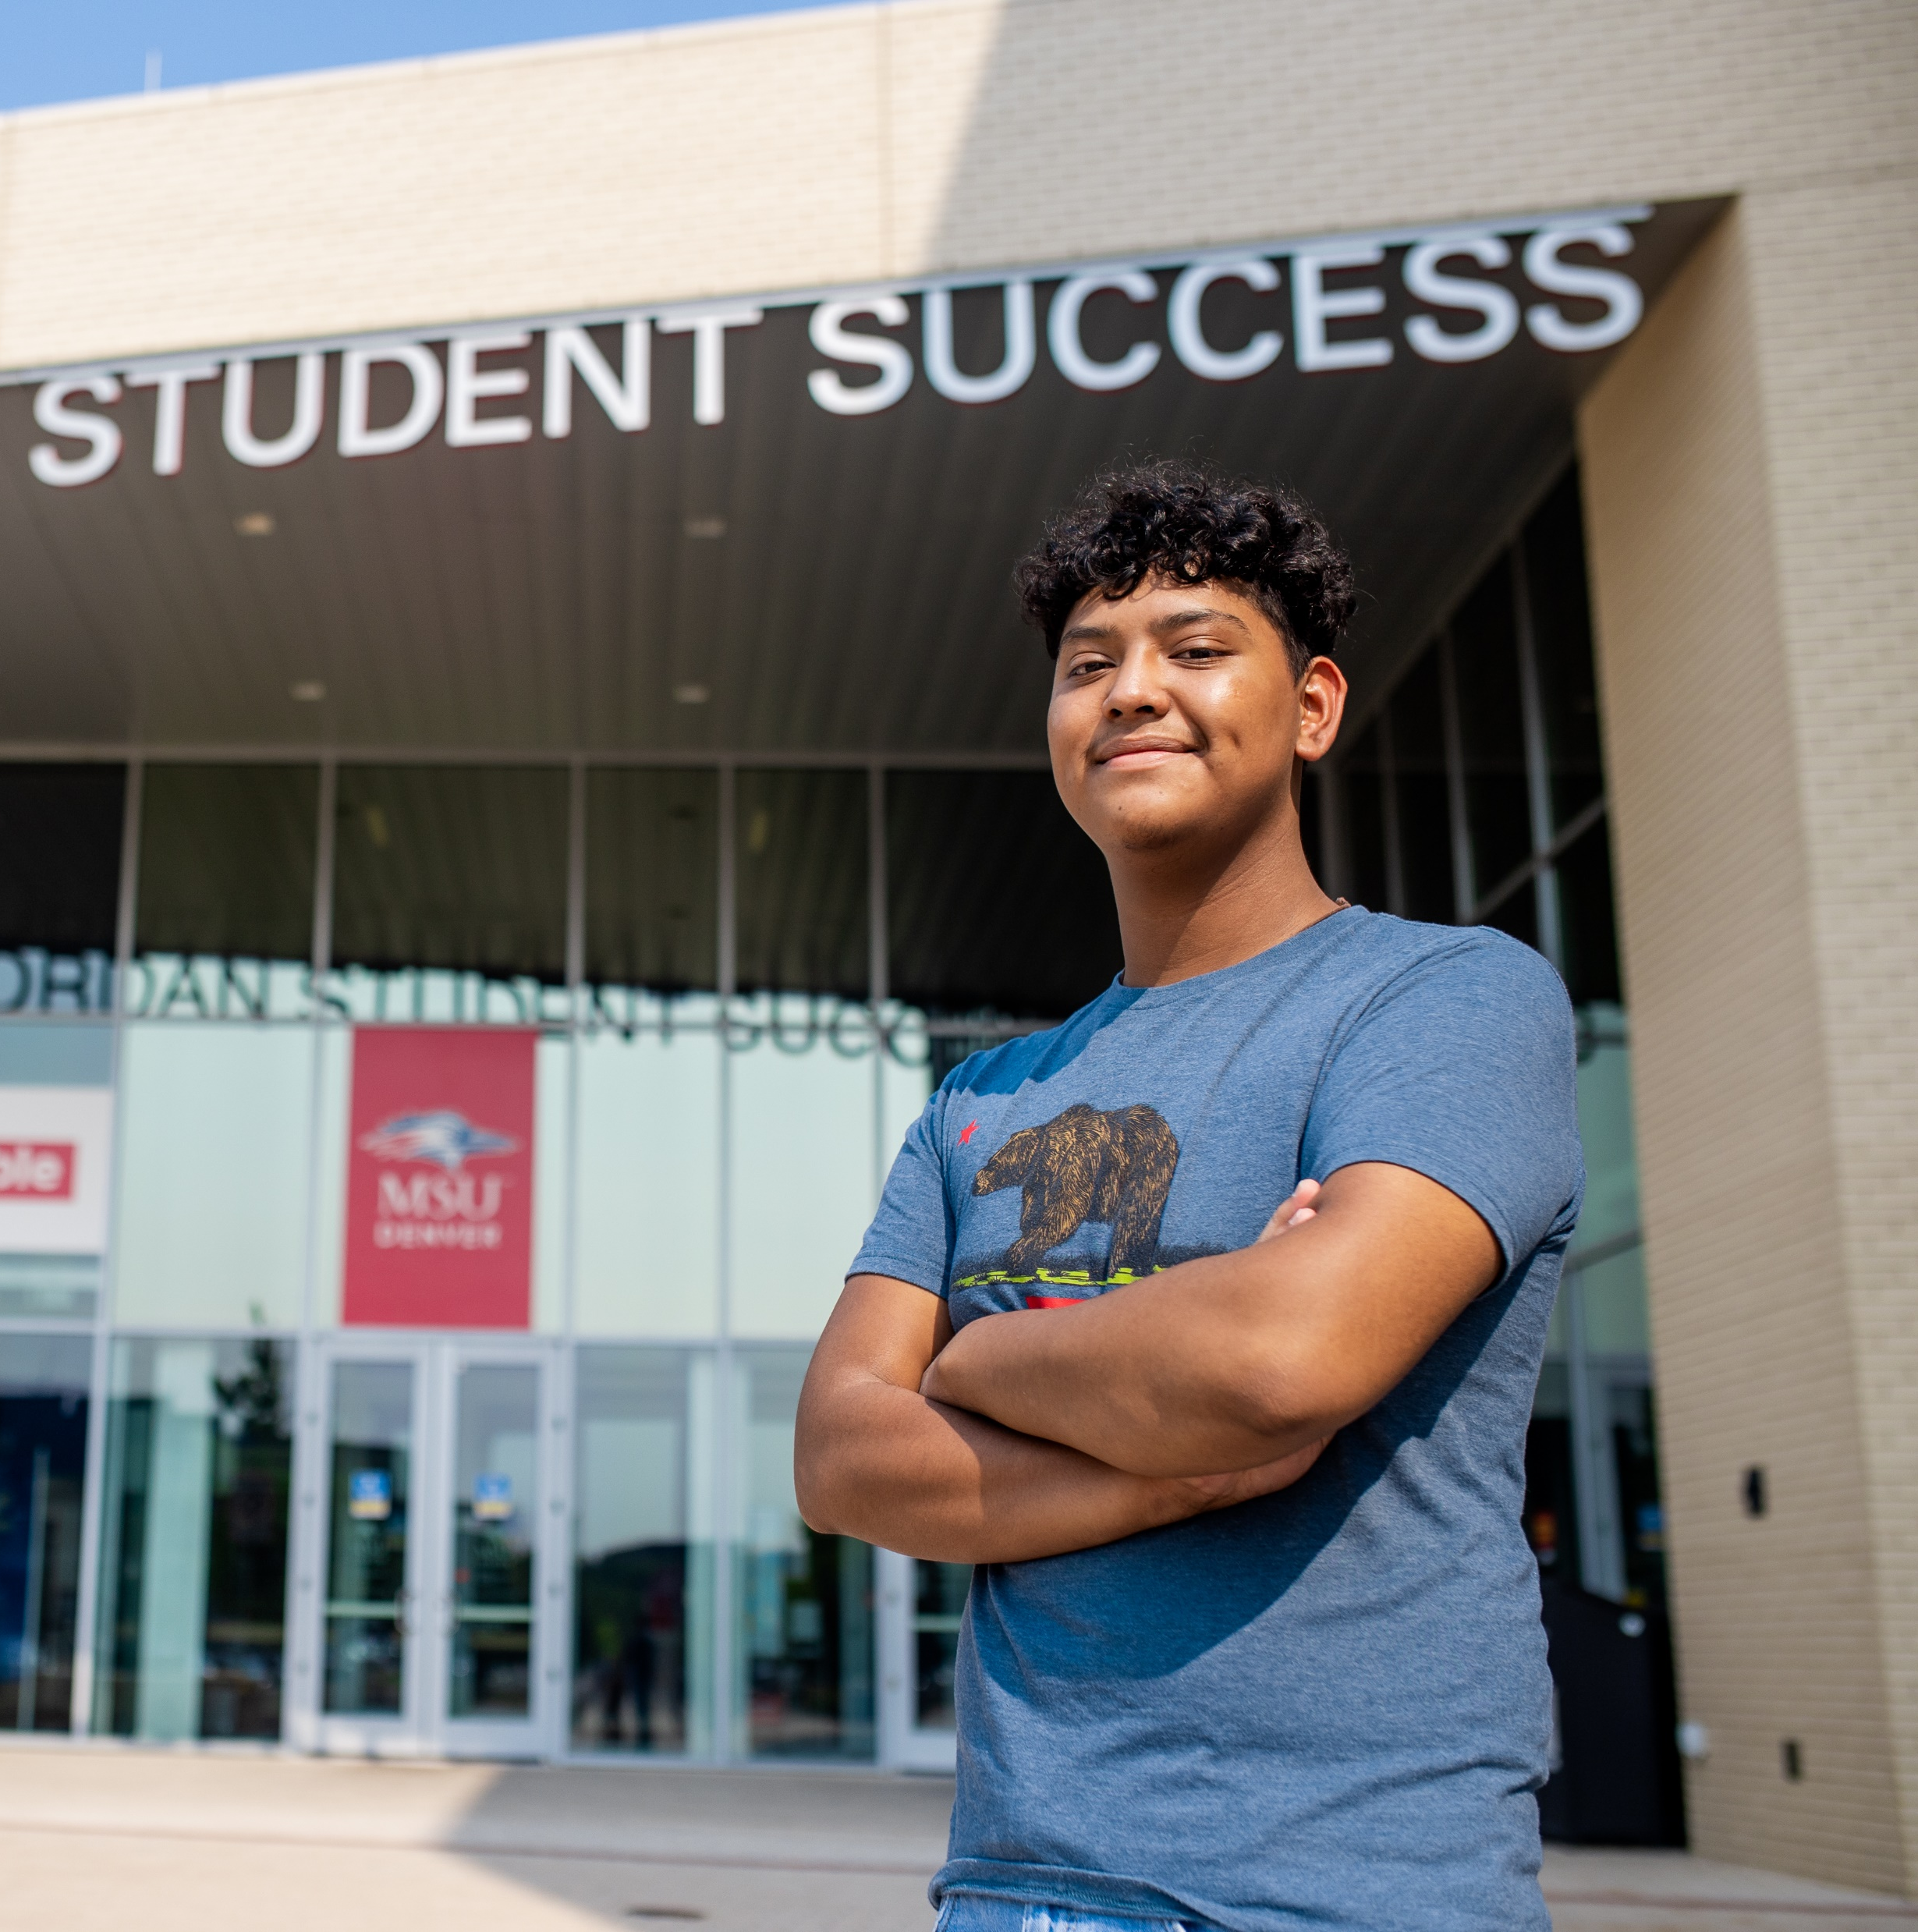
Student Support Resources
Peer Mentoring
Advising
Tutoring
Faculty Office Hours
Transfer Student Success
Veteran and Military Student Services
Counseling Center
Supplemental Instructions
First-Generation Student Initiatives
Immigrant Services
College Assistance Migrant Program (CAMP)
Access Center
LGBTQ Student Resource Center
Center for Multicultural Excellence and Inclusion (CMEI)
About MSU Denver
Academics & Support
Student Life & Athletics
Admission Requirements
Pay for College
Classes lead to Careers
Stay Connected

Slide 7
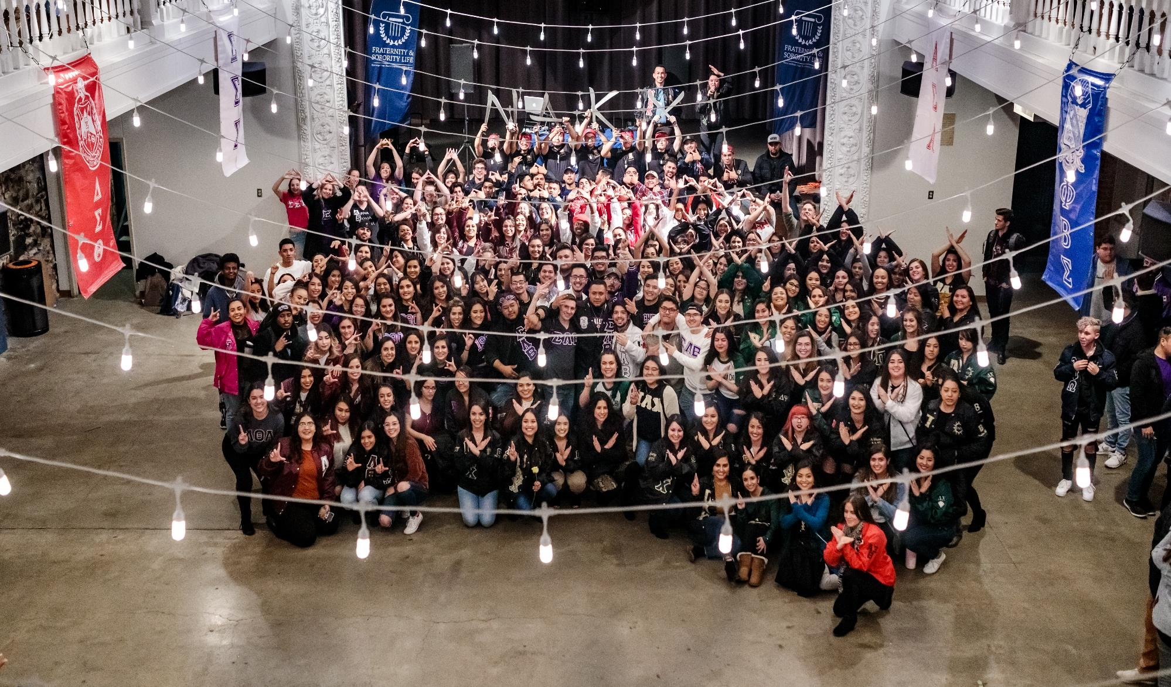
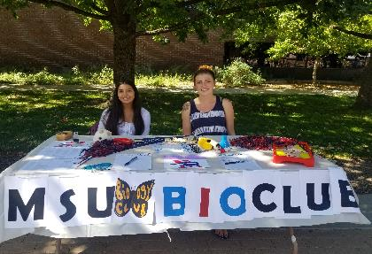
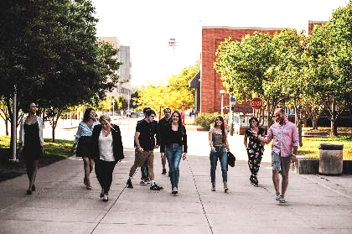
Get Involved & Build Community
Student Clubs & Organizations
Fraternity & Sorority Life
Met Media
Racial Equity & Leadership Programs
The Student Advocacy Council
& more!
About MSU Denver
Academics & Support
Student Life & Athletics
Admission Requirements
Pay for College
Classes lead to Careers
Stay Connected

Slide 8
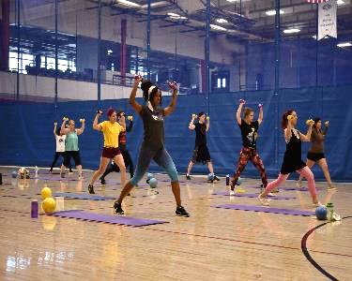
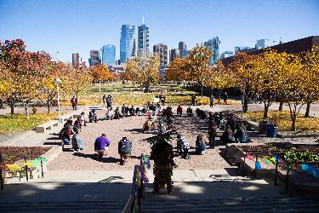
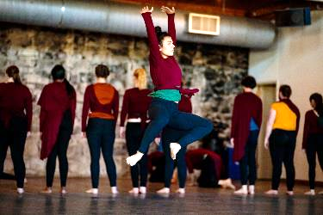
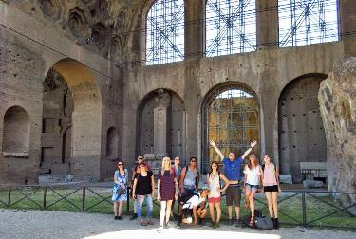
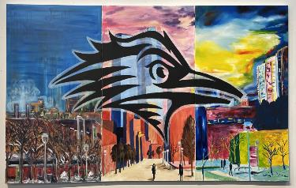
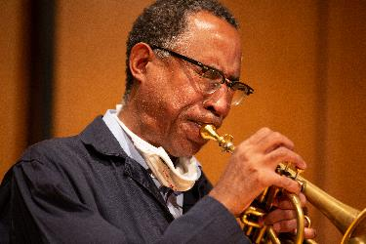
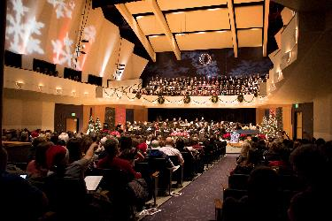
Keep Exploring
on campus
across Colorado
& throughout the world
About MSU Denver
Academics & Support
Student Life & Athletics
Admission Requirements
Pay for College
Classes lead to Careers
Stay Connected

Slide 9
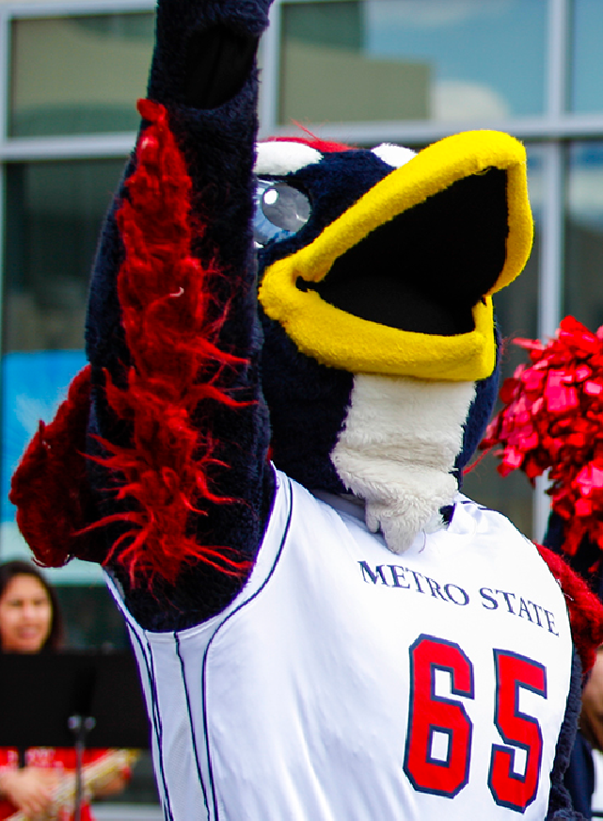
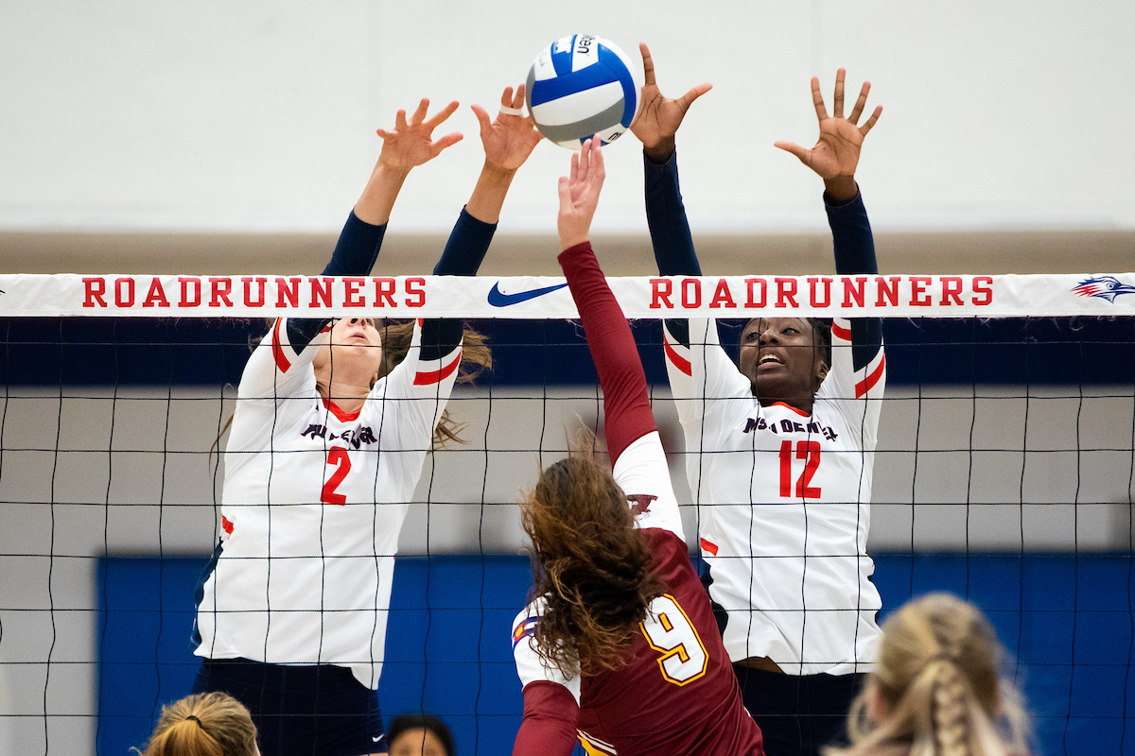
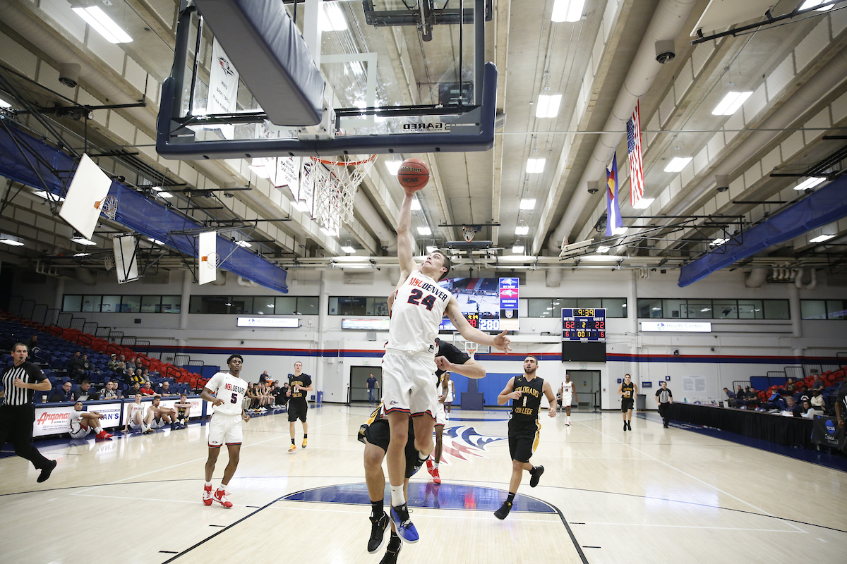
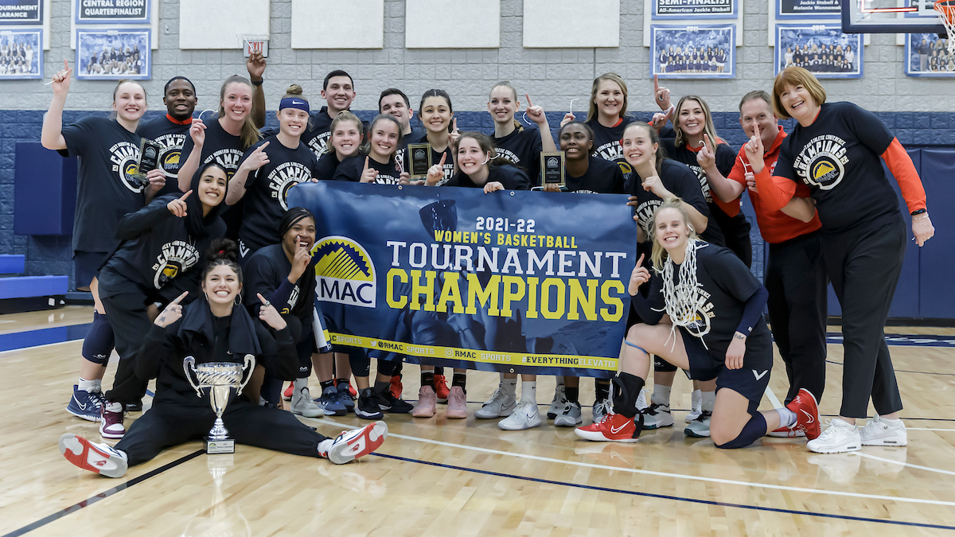
GET ROWDY
16 NCAA DIVISION II SPORTS
WOMEN’S
MEN’S
Basketball
Cross Country
Golf
Soccer
Softball
Tennis
Indoor Track
Outdoor Track
Volleyball
Baseball
Basketball
Cross Country
Soccer
Tennis
Indoor Track
Outdoor Track
CLUB & INTRAMURAL SPORTS
Poms
Cheer
Lacrosse
Ice Hockey
Ski & Ride
eSports
& more!
About MSU Denver
Academics & Support
Student Life & Athletics
Admission Requirements
Pay for College
Classes lead to Careers
Stay Connected

Slide 10
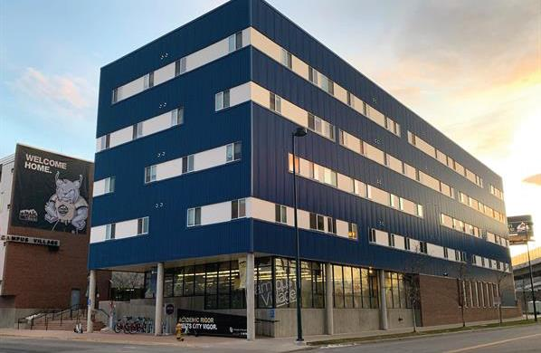
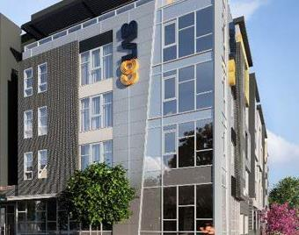
Thrive Where You Live
The opportunity to choose your own housing path:
Stay in your current housing
Live on-campus at Lynx Crossing
Join one of three off-campus student-housing locations
Use the MSU Denver Off-Campus Housing Website to find a roommate and explore nearby housing options
msudenver.edu/housing
About MSU Denver
Academics & Support
Student Life & Athletics
Admission Requirements
Pay for College
Classes lead to Careers
Stay Connected

Slide 11
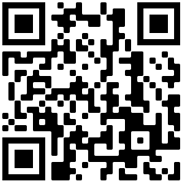
Application Process
Application Deadlines
Spring 2024
Priority: Nov. 1, 2023
Summer 2024
Priority: April 1, 2024
Fall 2024
Priority: Nov. 1, 2023
3 Easy Steps to Apply to MSU Denver
1
Apply Today!
Complete Online Application for free
msudenver.edu/apply
2
Receive admission decision in as little as 3 days
International Deadlines
Spring 2024
Nov. 1, 2024
Summer 2024
April 1, 2024
Fall 2024
June 15, 2024
3
Submit official documents, if admitted
About MSU Denver
Academics & Support
Student Life & Athletics
Admission Requirements
Pay for College
Classes lead to Careers
Stay Connected

Slide 12
First-Time College Students
Age 19 and under
Are you interested in attending college for the first time?
Follow these requirements if you are wanting to enroll after graduating high school or if you feel ready to continue your education, regardless of your age.
What we look at
Academic record: grades, classes, etc.
Higher Education Admissions Recommendations (HEAR)
Test scores: ACT and/or SAT (optional)
Additional Factors
Guaranteed Admission
You will be guaranteed admission to MSU Denver if you have a cumulative, unweighted GPA or 2.0 or higher.
If your GPA is below 2.0, you will be required to provide additional documents.
Unofficial transcript(s)
A personal statement
Letter of recommendation (optional)
Age 20 and older
What we look at
Completion of high school
OR
Qualifying GED scores
Scores of 145 or higher on all four sections may be used for admission at any age
About MSU Denver
Academics & Support
Student Life & Athletics
Admission Requirements
Pay for College
Classes lead to Careers
Stay Connected

Slide 13
Transfer Students
More than 24 credits completed
Are you currently enrolled or previously attended another college or university and are interested in transferring your completed credits to MSU Denver?
Follow these requirements based upon the number of credits you have completed AFTER high school graduation.
If you are 19 years old or younger
Only your college transcripts will be considered in the review of your application.
If you are 20 years old or older
You will be automatically admitted, regardless of your cumulative GPA.
Fewer than 24 credits completed
Transferology
Create a free account explore transfer credits.
View accurate course and credit equivalencies.
See how your course work, exams and military learning experiences will transfer to MSU Denver.
Build a plan to know how your courses transfer to your specific major at MSU Denver.
www.transferology.com/school/msudenver
If you are 19 years old or younger
Follow the admission requirements for first-time college students.
If you are 20 years old or older
An official high school transcript or GED transcript will be required.
About MSU Denver
Academics & Support
Student Life & Athletics
Admission Requirements
Pay for College
Classes lead to Careers
Stay Connected

Slide 14
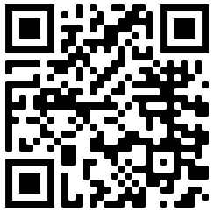
Cost and Financial Aid
Learn more about financial aid
$4,393.70
$11,882.90
$8,255.90
Colorado Resident, with COF
Non-Resident
Western Undergraduate Exchange (WUE)
msudenver.edu/financialaid
Based upon 12 credit hours per semester
About MSU Denver
Academics & Support
Student Life & Athletics
Admission Requirements
Pay for College
Classes lead to Careers
Stay Connected

Slide 15
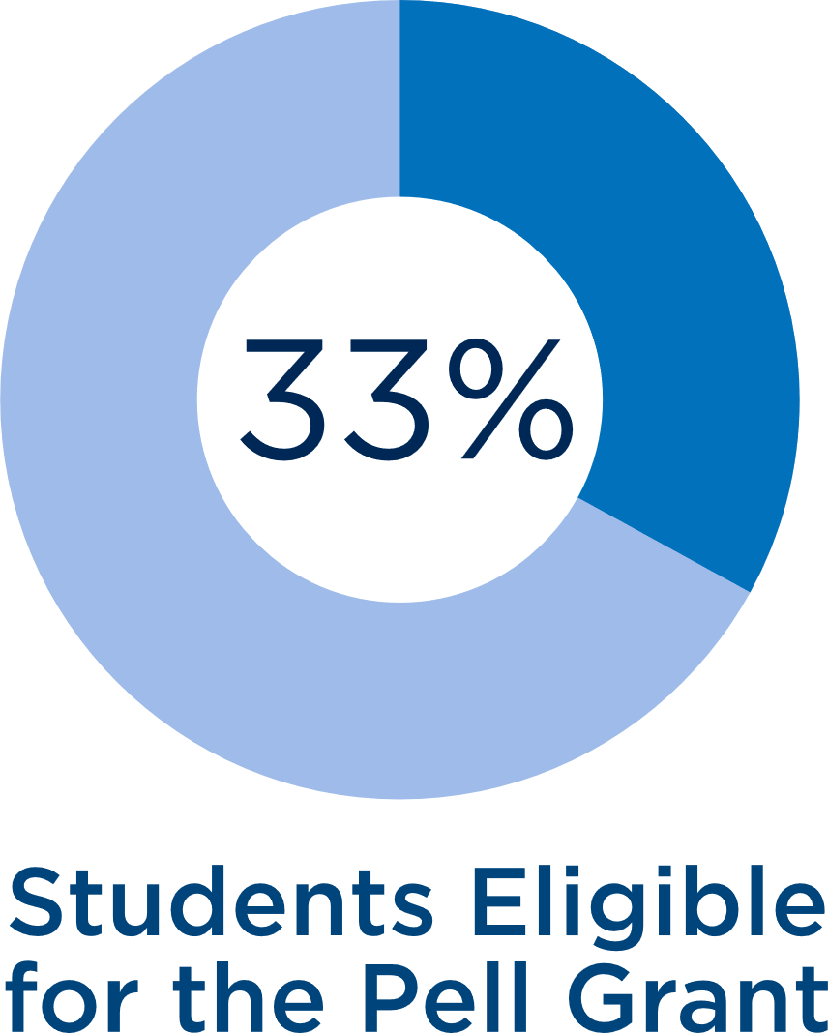
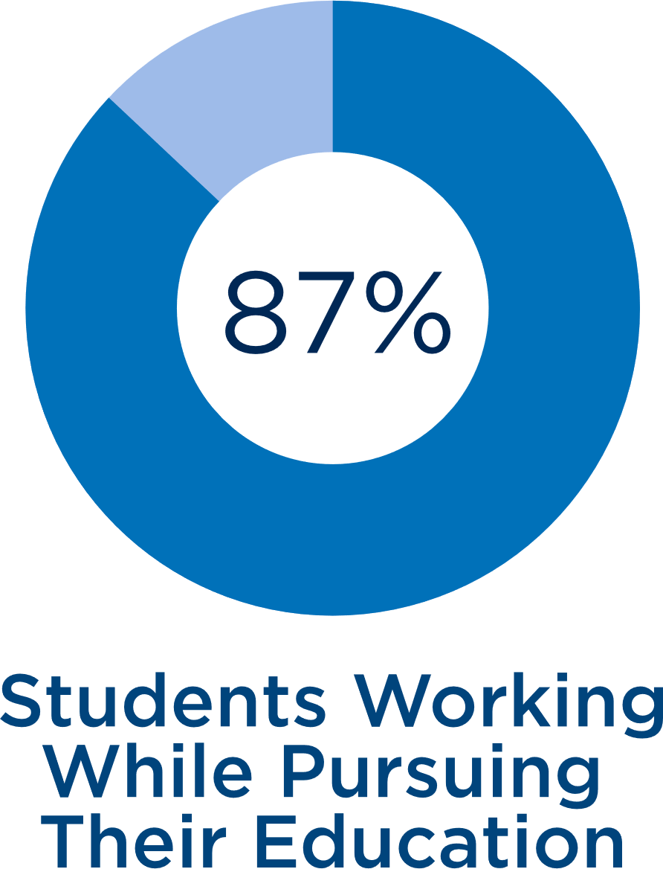
Funding Your Future
FAFSA
Free Application for Federal Student Aid
MSU Denver Code:
001360
CASFA
Colorado Application for State Financial Aid
GRANTS
LOANS
WORK-STUDY
Financial awards that do not need to be repaid.
A financing option that must be repaid. You need to manually accept loans.
Financial award used to fund student employment. You can search for jobs online.
Learn more about financial aid
About MSU Denver
Academics & Support
Student Life & Athletics
Admission Requirements
Pay for College
Classes lead to Careers
Stay Connected

Slide 16
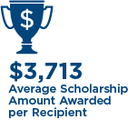
Scholarships
MSU Denver Scholarship Application
Raise.Me Micro-Scholarships
Accepting applications for 2023-24 academic year. The 2024-25 application opens in December 2023.
One application for 270+ scholarship opportunities
Earn money toward your education at MSU Denver
Complete a profile and enter updates as you complete micro-scholarship criteria and activities, such as attending college tours
Priority Deadline
March 1
Create a Raise.Me Account Today!
External Scholarships
Additional opportunities to help fund your education
About MSU Denver
Academics & Support
Student Life & Athletics
Admission Requirements
Pay for College
Classes lead to Careers
Stay Connected

Slide 17
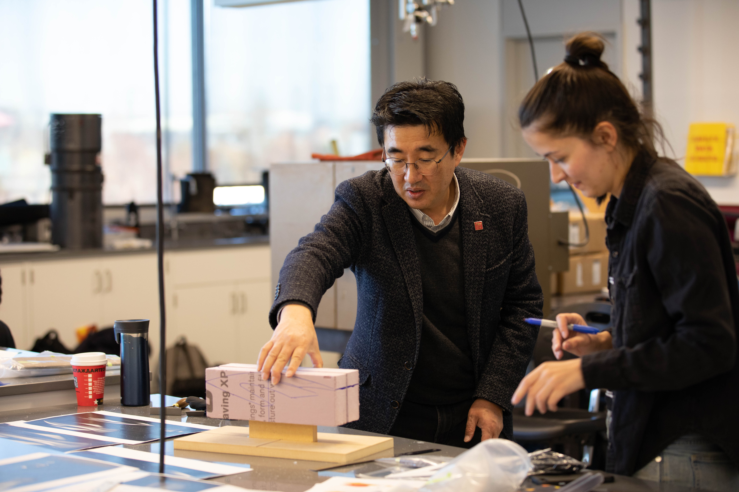
You have a DREAM.
We’ll make it POSSIBLE.
Classroom to Career (C2) Hub
Career Assessment
Exploratory Advising
Student Employment
Internship Search & Support
Scholarship Support and Retention
Graduate School Application Support
Earn & Learn Program
330 Business Partners
Service Learning
Real-world Solutions
About MSU Denver
Academics & Support
Student Life & Athletics
Admission Requirements
Pay for College
Classes lead to Careers
Stay Connected

Slide 18
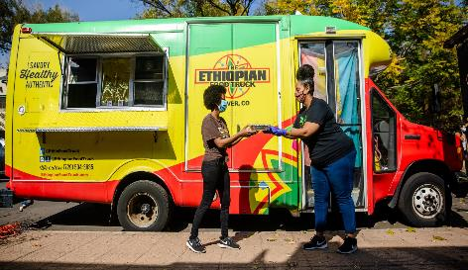
105,000+ Alumni
Fetien Gebre-Michael
Business Marketing, 2014
Konjo Catering & Food Truck
Top 10 Industries of
MSU Denver Alumni
Consulting Services
Consumer Products / Retail
Education
Financial Services
Government
Health Care / Pharmacology / Biotechnology
Hospitality / Tourism
Nonprofit Organizations
Technology
Transportation
Hamant Patel and Matt Maley
Business, 1990 and 2006
Element Hotels
Top 10 Employers of
MSU Denver Alumni
Centura Health
Charles Schwab
Children’s Hospital Colorado
City and County of Denver
Denver Health
Denver Public Schools
Dish Network
Kaiser Permanente
Lockheed Martin
UCHealth
Ashley Frazier
Fine Arts, 2012
Meow Wolf Convergence Station
About MSU Denver
Academics & Support
Student Life & Athletics
Admission Requirements
Pay for College
Classes lead to Careers
Stay Connected

Slide 19
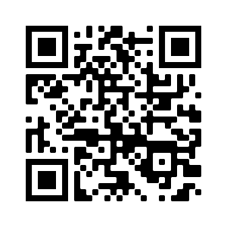
CONNECT WITH YOUR COUNSELOR
Every student is assigned an Admissions Counselor to help them through the admissions process.
You can ask them questions via email, text, phone call or video meeting.
FIND YOUR COUNSELOR
Make sure you get your
Admission Counselor’s business card before leaving today!
About MSU Denver
Academics & Support
Student Life & Athletics
Admission Requirements
Pay for College
Classes lead to Careers
Stay Connected

Slide 20
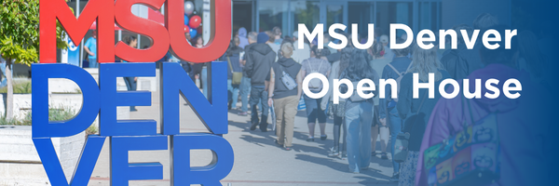
SAVE THE DATE
SATURDAY, OCTOBER 28 9:00AM-12:00PM
(8:30 Check-in and breakfast)
EXPLORE Academic & Resource Fair,
Sample Lectures, Campus Tours, and MORE!
About MSU Denver
Academics & Support
Student Life & Athletics
Admission Requirements
Pay for College
Classes lead to Careers
Stay Connected

Slide 21
Important Dates and Events
Fall Open House
October 28th
Dream.us Scholarship opens
November 1st
Creando tu Camino (Spanish Speaking Admissions event)
November 11th
FAFSA and CASFA opens
December
MSU Denver General Scholarship opens
December

Slide 22
STAY CONNECTED
SOCIAL MEDIA @MSUDenverAdmissions
EMAIL admissions@msudenver.edu
PHONE 303-556-3058
About MSU Denver
Academics & Support
Student Life & Athletics
Admission Requirements
Pay for College
Classes lead to Careers
Stay Connected

