Slide 1
An Overview of the Fiscal Year 2023-24
Proposed Budget
Board of Trustees Finance Committee Meeting
June 1, 2023

Slide 2
Overview of Budget Proposal
Priorities Investing in people Stuff That Works (STWs) Sustaining momentum Meeting students where they are Building faculty capacity Focus on innovation and effectiveness | Assumptions Structurally balanced budget Transitional year … focus on general fund Fold one-time on-going budgets into base Use one-time funds for one-time costs Set path to re-build fund balance Single phase budget
Revenue Levers State appropriation Enrollment Tuition and fees | Expenditure Levers Compensation Mandatory costs One-time on-going costs Other budget increases
2

Slide 3
Overarching Themes
Single phase budget
Balanced budget
Invest in students and employees
Establish and begin to honor a minimum fund balance as a matter of deliberate policy
3
Notes:
Balancing Act

Slide 4
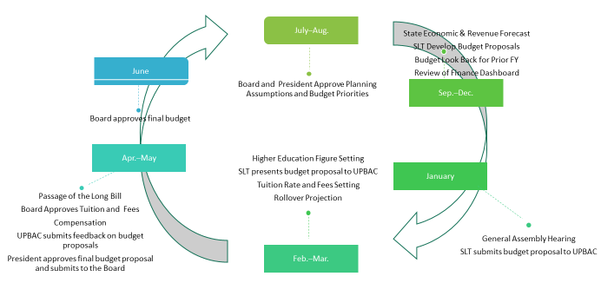
Budget Calendar
4
Notes:
Call out September look back and finance dashboards
Transition with priorities

Slide 5
Priorities

Slide 6
The president “will be looking for a budget recommendation that ensures the viability of the following priority areas:”
People
Stuff That Works/STWs
Sustaining momentum
Meeting students where they are
Faculty Workload Innovation/Building Faculty Capacity
Focus on Innovation and Efficiencies
President’s Priorities:
6

Slide 7
Assumptions

Slide 8
FY24 Budget Assumptions
Balanced budget
During transitional year, focus on general fund
One-time on-going folded into base
One-time funds only used for true one-time costs
End fund balance declines and lay the groundwork to begin restoring fund balances, with an ultimate goal of establishing a policy of 15% of annual revenues
Single phase budget…mid-year budget revisions would be triggered by:
    Changes in tuition forecast (October)
    Legislative budget changes (General Assembly or JBC action)
    Unforeseen changes in financial situation or programmatic needs
    Changes in University Priorities (as directed by the President or Board)
8

Slide 9
Transparency and Shared Governance
UPBAC
  Broad representation of stakeholders
  Topically educated on MSU Denver budget process and priorities
  Weekly meetings from February – May to evaluate budget drivers
  Responsible for communication to senior leadership and campus community
Balancing Act
  Budget development tool to collect and evaluate trade offs
  Used with senior leadership and UPBAC
  Available for use in Branches and Departments going forward
  Budget recommendations informed by Balancing Act exercises.
9
Notes:
Academic Affairs, Student Affairs, Advancement, Finance and Administration (CFO), Strategy Diversity, Equity, and Inclusion (VP/CDO), University Communications and Marketing, Athletics, Faculty Senate Representative, Staff Senate Representative, Student (TSAC) Representative, College Deans, Council of Chairs and Directors, COO (SLT Liaison) - Ex Officio, Chief Strategy Officer - Ex Officio, Faculty Union - Ex Officio, Facilities - Ex Officio, Government Relations - Ex Officio, Office of the President (Chief of Staff) - Ex Officio, Faculty Affairs - Ex Officio

Slide 10
Revenue Drivers

Slide 11
Revenue Levers
Primary revenue levers include:
State funding
Enrollment
Tuition
Student fees
11

Slide 12
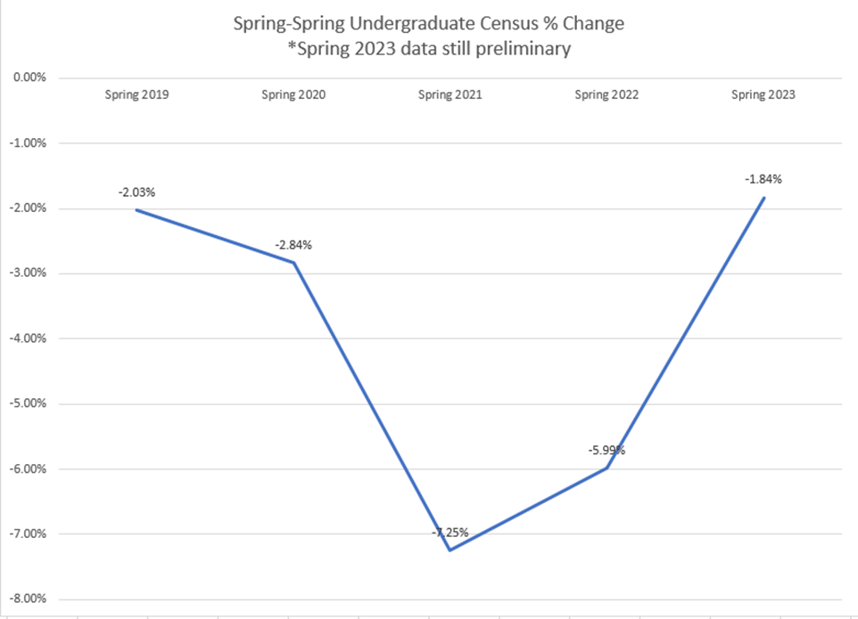
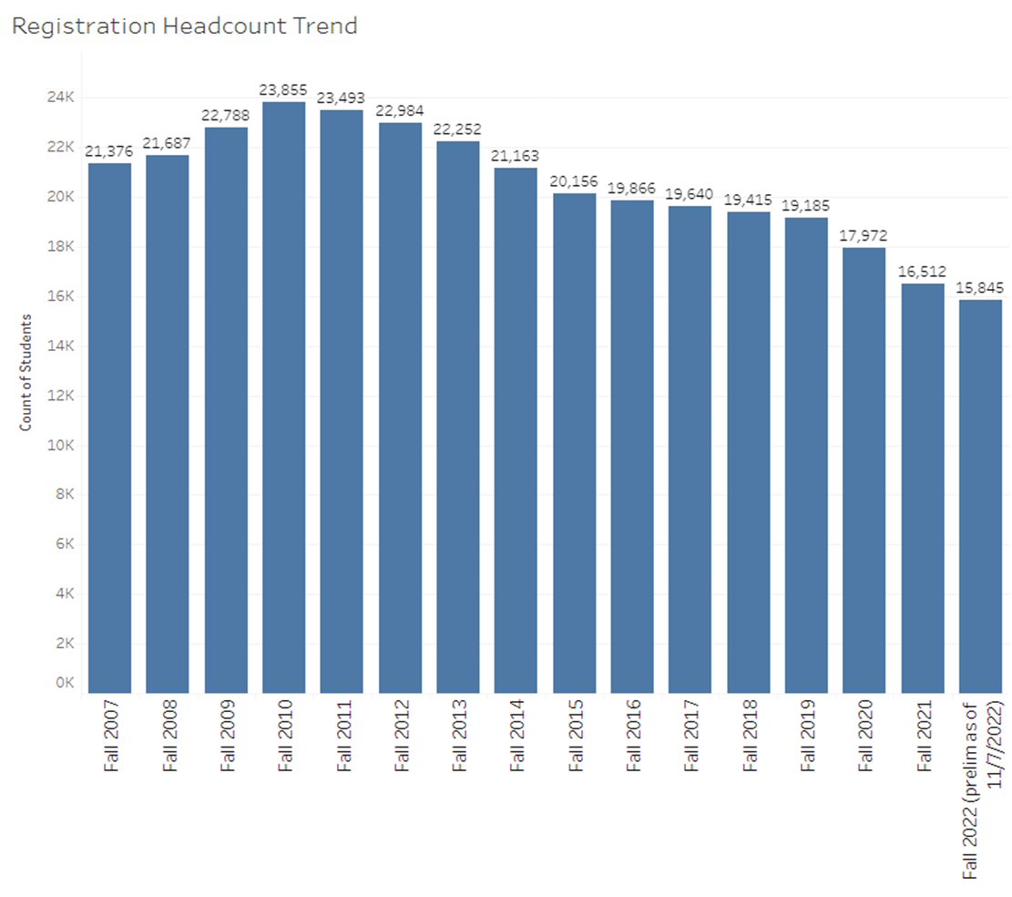
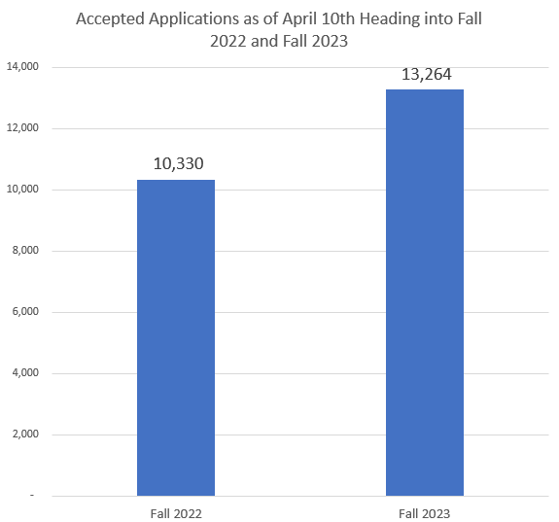
Proposed budget based on a conservative assumption of a 2.0% enrollment decline for fall 2023.
Enrollment
+28.4%
12

Slide 13
Revenue Drivers
Tuition and Fees – current recommendation
Increase tuition by the maximum allowable 5%
  Due to tuition lock, only applies to newly enrolled students
  Generates $1.8M in additional revenue
  Additional cost per resident student is $423/year*
Increase fees by the maximum allowable 5%
  Fees generally flow into auxiliary funds
  Additional cost per resident student is $96 /year*
  Expenditures from fees currently exceed annual revenues, even with a 5% increase
*Full time student enrolled in 30 credit hours
13

Slide 14
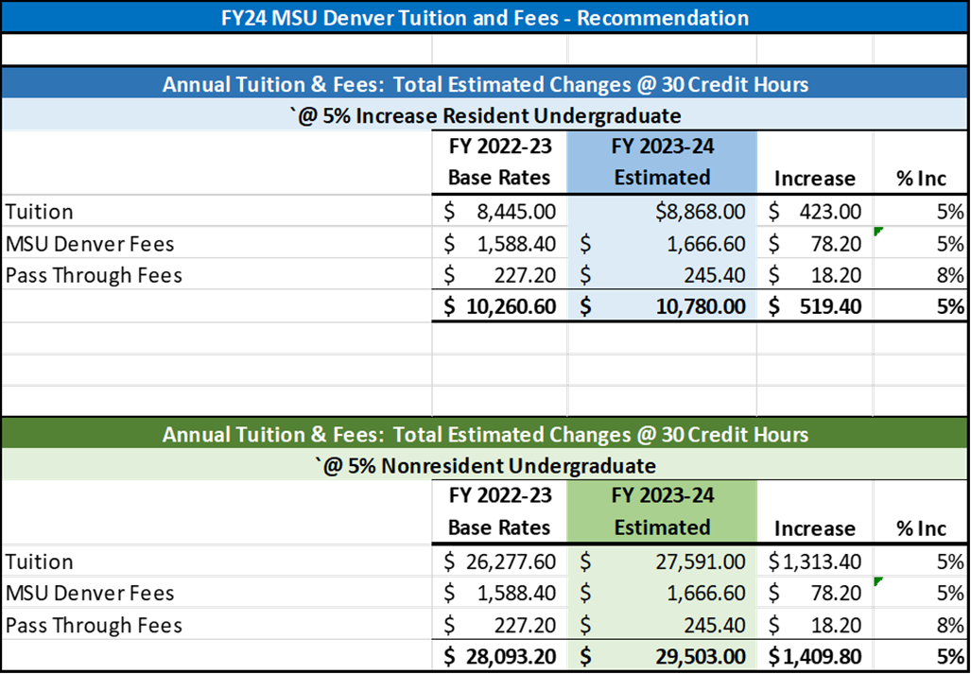
Tuition and Fees Increase
Summary
14

Slide 15
Expenditure Drivers

Slide 16
Historical Salary Increases
Compensation Increases
Next steps on compensation after this year’s budget
  re-launch compensation committee
  pay equity study
16

Slide 17
Faculty Compensation Overview
17

Slide 18
Professional Staff Compensation Overview
18

Slide 19
Compensation
Considerations
Classified staff will receive a 5% salary increase
Historically salary increases have been implemented on October 1, creating administrative challenges
5% compensation increase on October 1 costs $5.3 million
4% compensation increase on July 1 costs $5.8 million
Recommendation
4% compensation increase beginning on July 1 or on the first contract date after July 1
Potential one time, 1% bonus for faculty and non-classified employees in the fall if student retention exceeds budget projections by enough to cover the additional pay.
Set a salary floor for full time employees equal to the minimum living wage for a single full-time employee as defined by the MIT Living Wage Index
Re-launch compensation committee in summer 2023
Conduct equity pay study in 2023
19
Notes:
Joint Budget Committee March forecast had an inflation estimate for next year of 4.9%.

Slide 20
Expenditure Drivers
Other new investments
Fully account for on-going operations and budget execution
Critical maintenance – roof repairs of AES building
Launch of new college of Aerospace, Computing, Engineering and Design
Infrastructure investments – phone system replacement and access management
Targeted programs
  Government affairs: coordinator and sponsorships
  HSI Graduate Assistant/Faculty Liaison
20

Slide 21
Strategic Initiatives
Proposed plan for Stuff That Works, Promise Programs and HEERF Funds
Continue spend down of initial allocations
Summer/Fall 2023 review of programs based on
  Budget execution
  Success metrics
  ROI (where applicable)
Based on program review, incorporation of programs into multi-year budget
If funds exhausted for FY24, fund at current levels for one additional year using one-time funds.
21

Slide 22
Fund Balance/Reserves

Slide 23
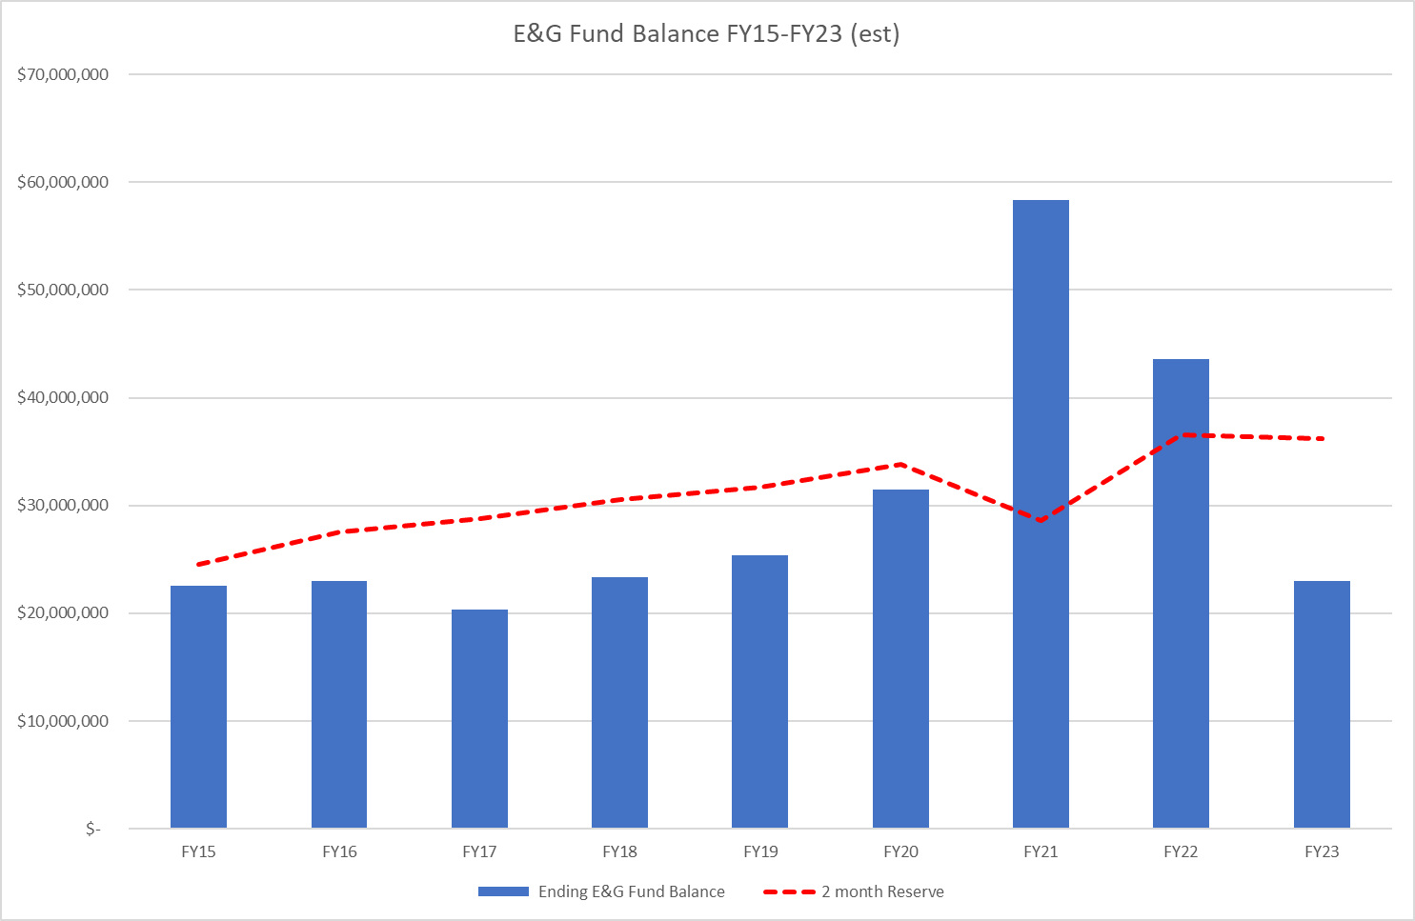
Historical Fund Balance
23

Slide 24

Main Fund Balance Roll Forward/Reserves
Recovered Revenues from
HEERF
$5.1 million
=
$22.5 million unrestricted
E&G
$5.3 million
Admin. Service Recovery
$12.1 million
24

Slide 25
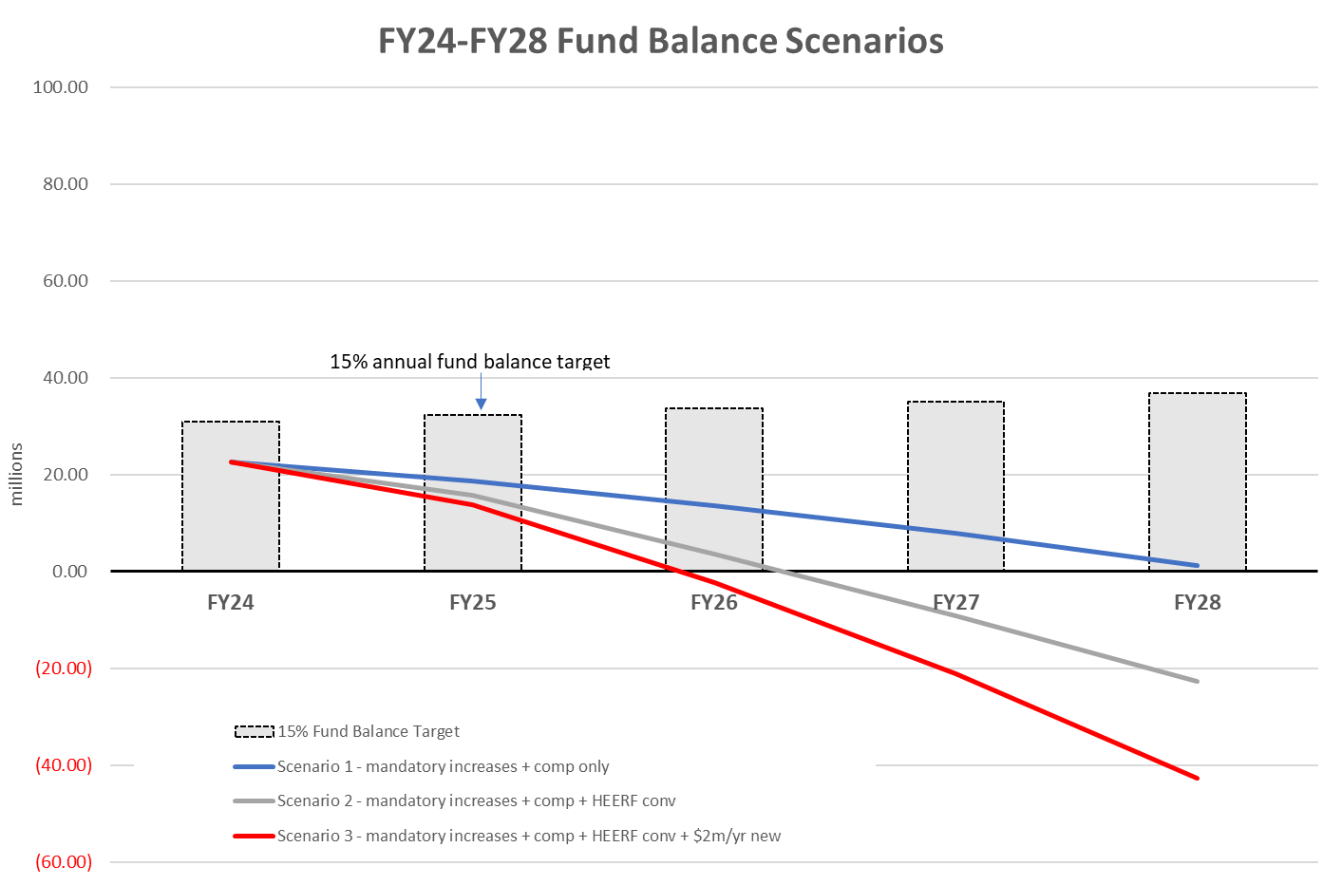
Fund Balance Projections
25

Slide 26
Fund Balance Goal
Discuss a fund balance policy of 15% of annual expenditures in undesignated funds*
For FY24, stop reducing fund balance and remain flat at $22.5 million
Aim for 15% of annual expenditures by FY28 (~$2 million/year plus expenditure growth)
Draft fund balance policy to be reviewed by policy committee
*At current spending levels, this would be a target of $31 million
26

Slide 27
Balancing

Slide 28
Current Proposal
28

Slide 29
Board Approval Items
The Board of Trustees are requested to approve the following budget items:
The E&G budget will be set at $205.8 million for FY24
Resident and non-resident tuition will increase by 5% for FY24
Mandatory fees will increase by 5% for FY24
The Student Affairs Fee budget for FY24 will be established at $2,611,030
Undergraduate cash program fees will remain flat for FY24 and graduate cash program fees will be set as outlined in the Tuition and Fee Rates memo presented to the Board.
Program fees for E&G funded programs will remain flat with the exceptions of:
  The Restaurant Program Fee will increase by $7.00 (from $33.00 to $40.00) based on increased food costs.
  The On-Line Enrollment Fee will remain flat but allowable uses of fee revenue will be expanded to include “direct student scholarships and cost of attendance support for on-line students”.
29

Slide 30
Other Considerations
To the extent that additional resources become available, direct them first to compensation to reach salary increases of 5% in FY24 and then to growing the fund balance by 1% of expenditures (~$2 million)
Evaluate STWs, Promise Programs and unspent HEERF funds with UPBAC and Senior Leadership over the summer
Re-launch compensation committee to carefully consider
  On-going strategy for distribution of compensation growth
  Metrics and processes for evaluating and addressing competitiveness
  Findings of equity pay study
  Total rewards
30

Slide 31
Appendix:
Tuition and Compensation Comparison
Board of Trustees Finance Committee Meeting
June 1, 2023

Slide 32
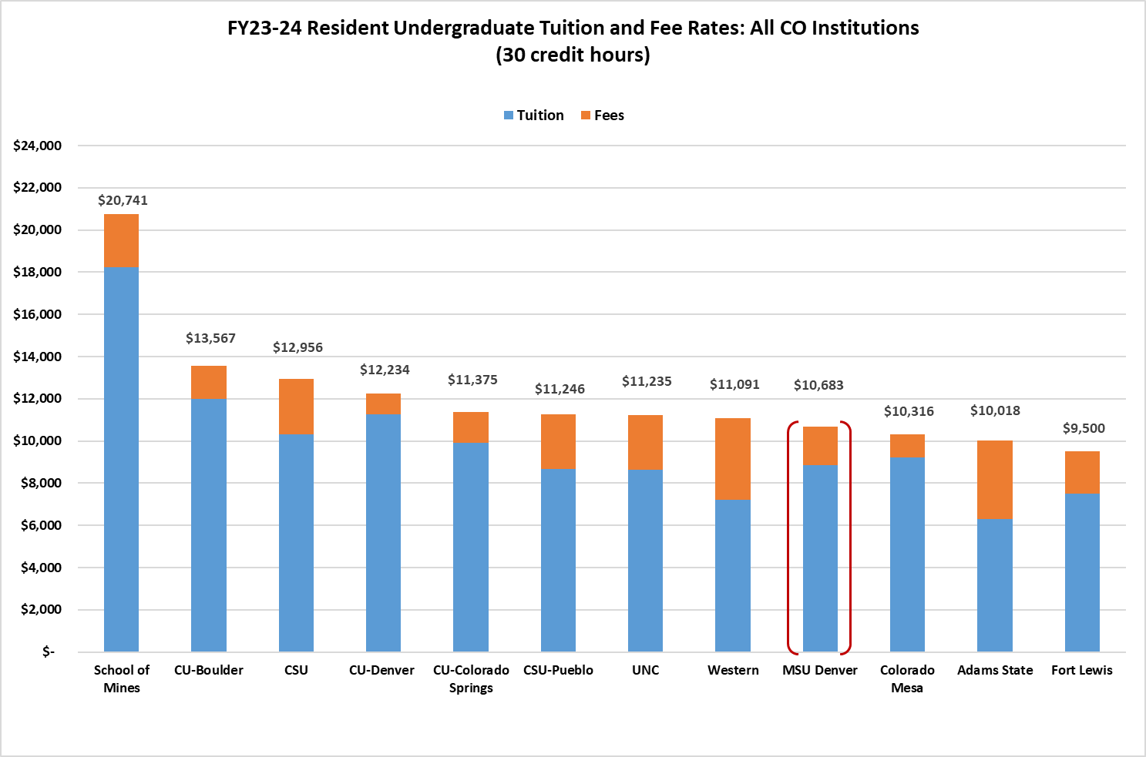
Tuition Comparison (Resident)
32

Slide 33
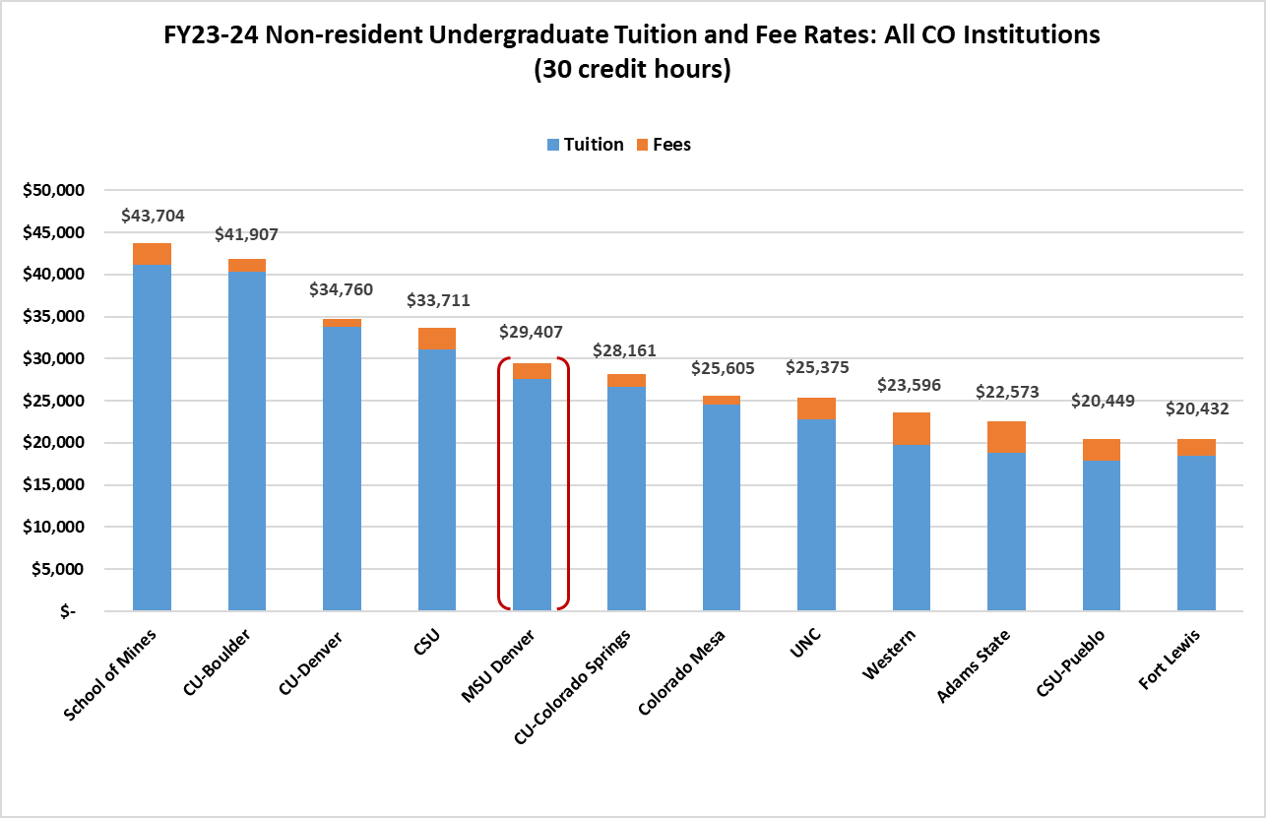
Tuition Comparison (Non-resident)
33
Notes:
Balancing Act

Slide 34
Compensation
Comparison
UNC did a mid-year comp adjustment of 2% in January. They will do less than 5% for next year, but the total will likely exceed 5%
CMC is planning on 5%
Mesa will do 5% for their pool, but it will be distributed based on COLA, market adjustments and performance
Mines will not exceed 5%
Western is targeting 5%
CSU is proposing 5% plus a floor of $50k for lowest paid admin staff
MSU Denver is proposing 4% effective July 1
  3 months earlier than in recent years
  Results in the equivalent of a 5.33% in October
34
Notes:
Call out September look back and finance dashboards
Transition with priorities

