Slide 1
FY 2022-23 Proposed Phase I Budget/
Tuition and Fee Rates
May 5, 2022
Board of Trustees
Special Finance Committee

Slide 2
FY23 State Funding
Long-bill for higher education includes:
An additional $105 million for:
$55.0 million = Step 2 of the performance model to cover core cost increase.
$50.0 million = Step 1 intended for the retention of first generation, underrepresented minority, and low-income students.
The Long Bill also includes a 2% tuition cap for resident undergraduate students.
2

Slide 3
STRATEGIC FINANCIAL ALLOCATIONS: FY2023
3

Slide 4
Proposed Tuition Rate
The BRC considered 3 tuition increase scenarios:
2% resident and non-resident tuition increase
1% resident and non-resident tuition increase
No tuition increase
The BRC has recommended a two percent resident and non-resident tuition increase for FY23.
This would add $60.50 per semester for a typical resident MSU Denver student carrying 11 credit hours or $82.50 per semester for 15 credit hours.
4

Slide 5
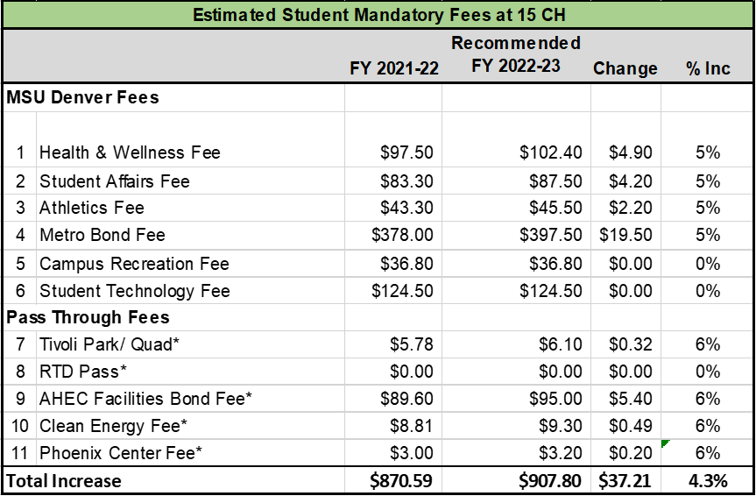
The BRC recommends the following changes to mandatory fees to offset additional costs:
Five percent increase to the Health and Wellness fee, Student Affairs, Athletics, and the Metro Bond fee.
No increases to the Student Technology Fee or Campus Rec Fee.
AHEC has proposed a CPI increase for their fees of about 6.0%.
Mandatory Fee Increases
5

Slide 6
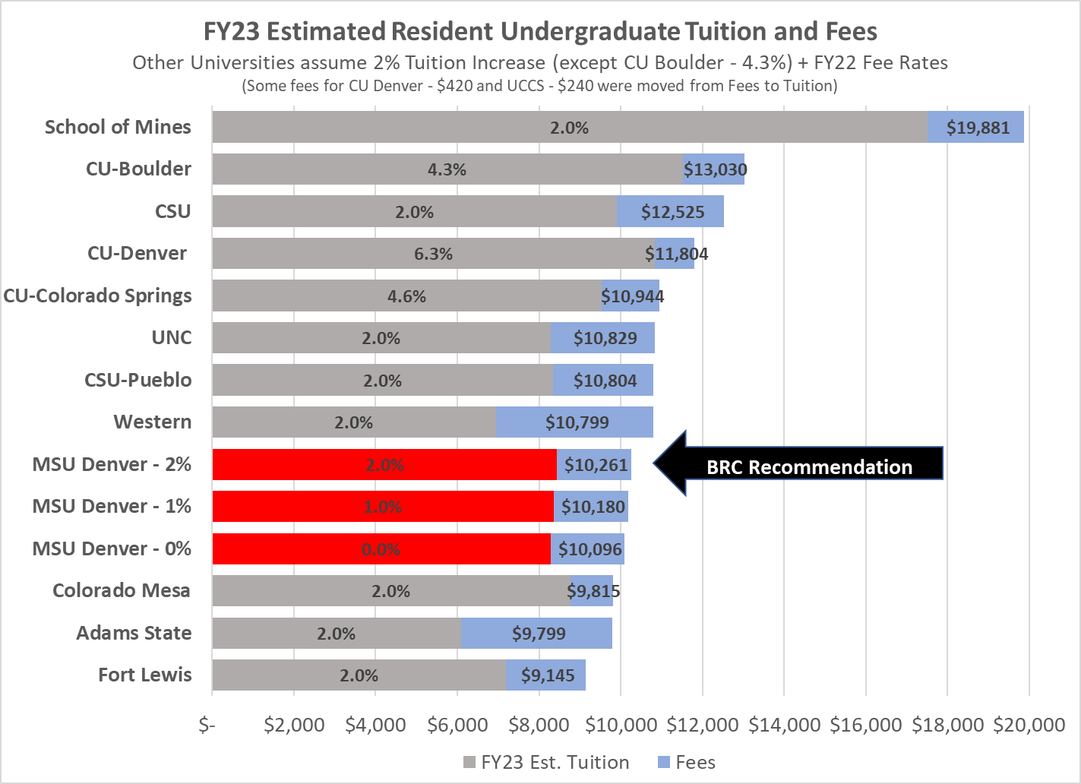
Estimated FY23 Resident Tuition Rate Comparison:
3 Scenarios
6

Slide 7
PHASE II BUDGET TIMELINE
7

Slide 8

Questions?
8

Slide 9
Phase I Budget Allocation
$4.3M phase I proposed budget covers:
Mandatory cost adjustments and current obligations
9

