Slide 1
Fiscal Year 2020-21
Proposed Budget
Phase II
September 3, 2020
Board of Trustees Finance Committee Meeting
Prepared by: MSU Denver Budget Office

Slide 2
Summary of Proposed Changes for Phase II:
Assumptions:
7% decline in resident and 20% decline in non-resident enrollment for the full year.
Classes will continue to be mostly online for the Spring 2021 semester.
Tuition & Fee Recommendations:
Increase tuition by 3% for both resident and non-resident effective Spring 2021 semester
Maintain the alternative fee schedule that was approved for the Fall 2020 semester for Spring & Summer 2021.
Phase II Additional Budget Recommendation:
Faculty Promotions Equity
Financial Aid for students with highest needs and Pell eligible students.

Slide 3
Spring & Summer Tuition and Fees:
Decision Factors
Impact on Student
Learning Environ-ment
Economic Outlook
Impact on Budget
Total additional cost to student
Will remain mostly online
Limited access to on-campus services
Potential loss of services
Tuition increase could mitigate the budget shortfall for FY21 and future years
Recession= ongoing shortfalls at the State level
Students face increased economic barriers

Slide 4
Impact of Tuition Rates on Budget and Students
3% increase = an additional $1.7 million in revenue
  $12 million revenue shortfall versus $14 million
Inc. to student = $108 per semester at 15 credit hours

Slide 5
Proposed Mandatory Fees: Spring and Summer 2021
Recommendation: Maintain the fall structure through Spring 2021 & Summer 2021.
Issue:
Fee structure was modified for Fall to accommodate the mostly online learning environment.
For spring, the fee structure will revert back to normal.
With classes mainly online for Spring, traditionally on-campus students will be forced to take more courses online this will mean higher fees for students.
Students will pay fees for services that they cannot fully access, such as Campus Recreation and Athletics.
RTD Bus Pass – Fee was waived for Fall because University opted out of contract. If it is not waived in Spring, the fee would be assessed to students.

Slide 6
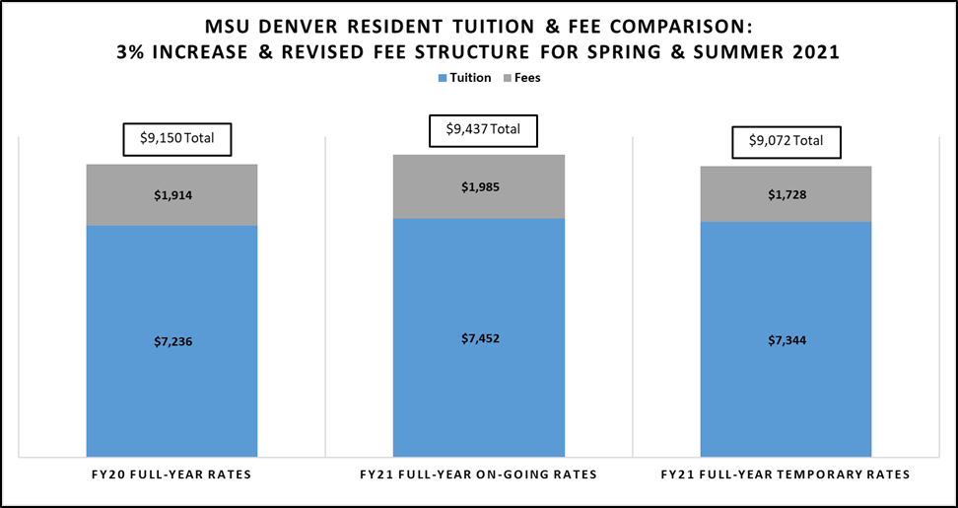
Academic Year Cost: Resident Undergraduate
  Includes: 3% fee increase effective Spring & revised fee structure
  Excludes: RTD Fee

Slide 7
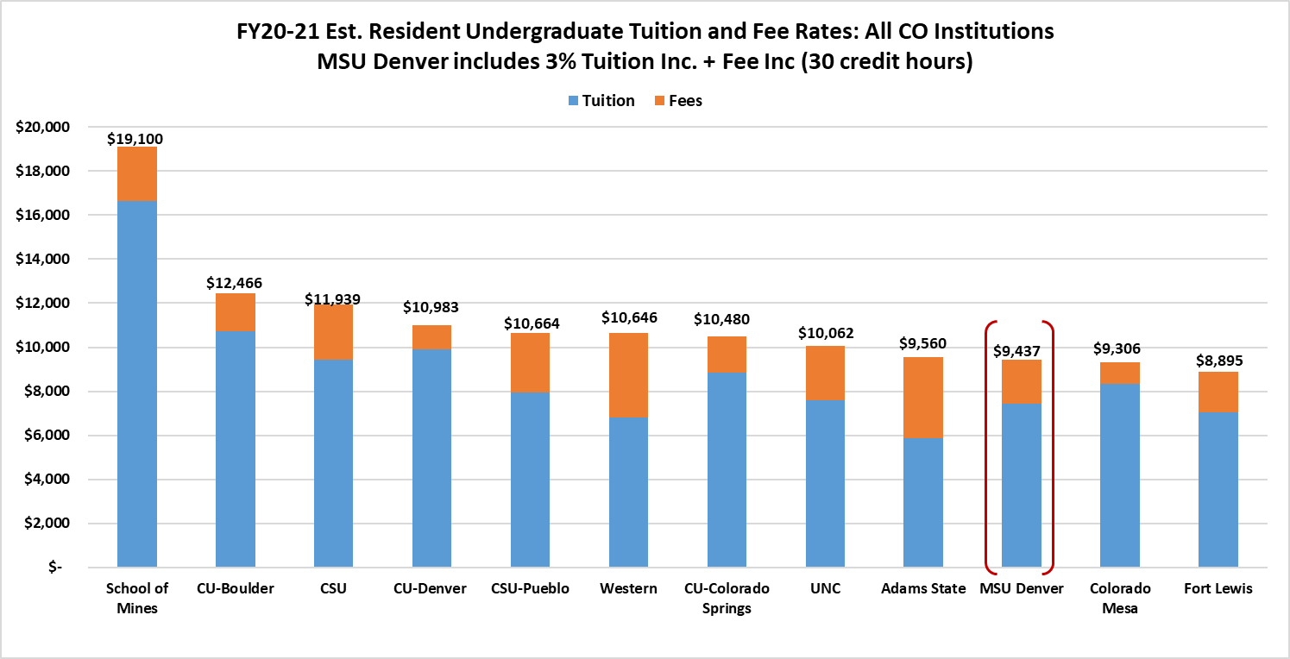
Colorado Comparison for On-going Rate:
Resident Undergraduate
Source: FY20-21 Tuition and Fee Schedules on IHE websites

Slide 8
Additional Budget Allocations
$400,000 for faculty promotion equity issue:
Salary increases granted with promotion for faculty are not enough to bring faculty up to the minimum salary established through CUPA.
Consequently, newly promoted professors where making significantly less than those that were promoted last year.
Recommendation: Bring faculty promoted as of Fall 2020 to the minimum salary level using last year’s CUPA.
$680,000 for financial aid
Cover 3% tuition increase for students with the highest need and Pell eligible students.

Slide 9
FY2020-21 Estimated
Phase II Budget

Slide 10
Questions/Comments?

Slide 11
Fee Structure Changes

Slide 12
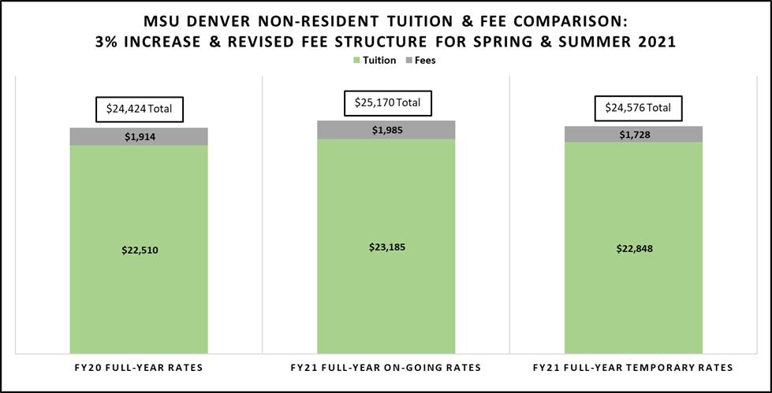
Academic Year Cost: Non-resident Undergraduate
  Includes: 3% fee increase effective Spring & revised fee structure
  Excludes: RTD Fee

Slide 13
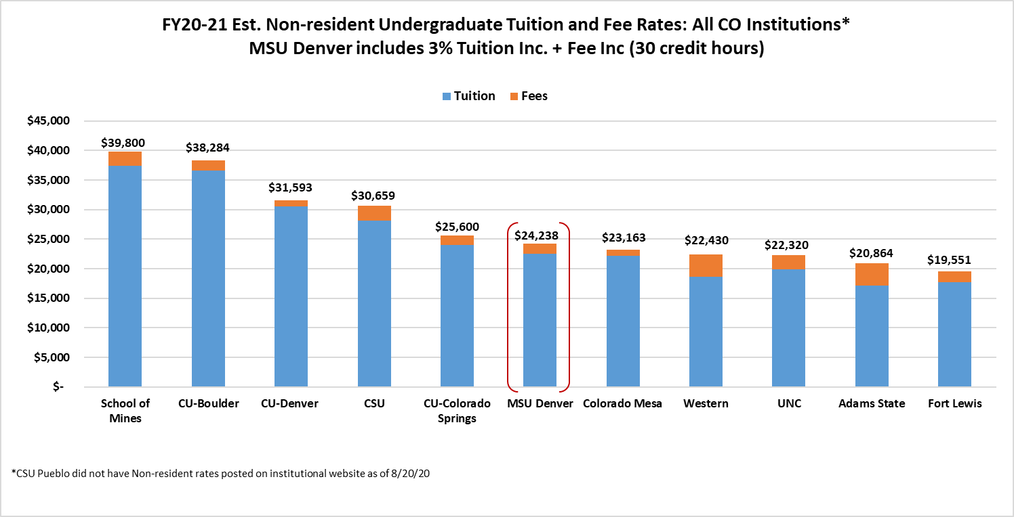
Colorado Comparison for On-going Rate:
Non-resident Undergraduate
Source: FY20-21 Tuition and Fee Schedules on IHE websites

