Slide 1
Indigenous Language Immersion Curriculum Development
Dr. Martin Reinhardt
Chair/Associate Professor
Native American Studies
Northern Michigan University
Dr. Jioanna Carjuzaa
Executive Director of the Center for Bilingual and Multicultural Education
Associate Professor
Montana State University

Slide 2
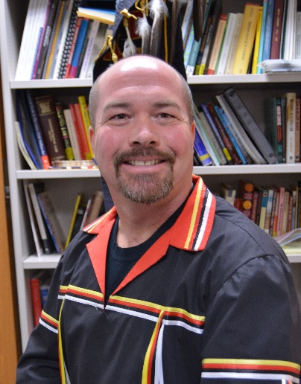
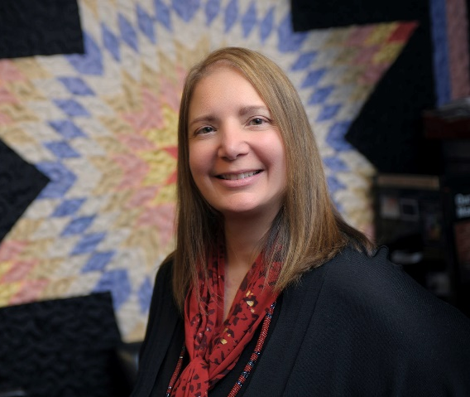
About the Presenters
Dr. Martin Reinhardt
Marty is an Anishinaabe Ojibway citizen of the Sault Ste. Marie Tribe of Chippewa Indians from Michigan. He has a Ph.D. in Educational Leadership from the Pennsylvania State University, where his doctoral research focused on Indian education and the law with a special focus on treaty educational provisions. His current research focuses on revitalization of traditional Indian education systems.
Dr. Jioanna Carjuzaa
Jioanna holds a Ph.D. in Multicultural, Social and Bilingual Foundations of Education from the University of Colorado-Boulder. At MSU she serves as the Executive Director of the Center for Bilingual and Multicultural Education. She is grateful to serve as the facilitator for IEFA professional development opportunities, as the co-advisor to American Indian Council, and as the faculty advisor for Wanji Oyate Education Cohort for Native students pursuing teaching careers. She is lead-author of Teaching in the Middle and Secondary Schools, Pearson's leading methodology textbook which is now in its 11th edition. She was the recipient of the 2013 G. Pritchy Smith Multicultural Educator of the Year Award.

Slide 3
A Very Important Question
In 2012, the Windwalker Corporation and the Center for Applied Linguistics conducted a review of literature on the current status and effectiveness of Indigenous language immersion programs.
They were hoping that their findings would help provide an answer to a very important question that we will be addressing in this webinar today.
How should Indigenous languages be introduced or maintained in schools?

Slide 4
The Core Relationships of Indigenous Language Immersion Programs (ILIP)
Indigenous languages (IL) are the core of Indigenous language immersion programs.
Indigenous language teachers (ILT) carry this and other special knowledge with them and share it with Indigenous language learners (ILL).
General education teachers (GET) also carry special knowledge with them and share it with Indigenous language learners.

Slide 5
Indigenous Language Learner Continuum
Indigenous First Language Only
Indigenous/Non-Indigenous Mix Language with Indigenous Dominant
Indigenous/Non-Indigenous Bilingual
Non-Indigenous/Indigenous Mix Language with Non-Indigenous Dominant
Non-Indigenous First Language Only

Slide 6
Other Learner Considerations
Besides their place on the Indigenous Language Learner Continuum, curriculum developers should also consider the following regarding the learners:
Age
Grade level
Ability
Cultural background
Availability of educational resources
Time in class and additional exposure to the language

Slide 7
Scenario A
Indigenous Language Teachers
General Education Teachers
IL
Indigenous Language Learners

Slide 8
Scenario B
General Education Teachers
Indigenous Language Teachers
IL
Indigenous Language Learners

Slide 9
Scenario C
Indigenous Language Teachers
Indigenous Language Learners
IL
General Education Teachers

Slide 10
ILIP Types
Although many schools and communities are currently implementing, or are considering, Indigenous language immersion programs, they are approaching it in a various ways:
Total immersion
½ day immersion
Immersion classes
Immersion camps
Online immersion
Bi-lingual immersion
Etc.

Slide 11
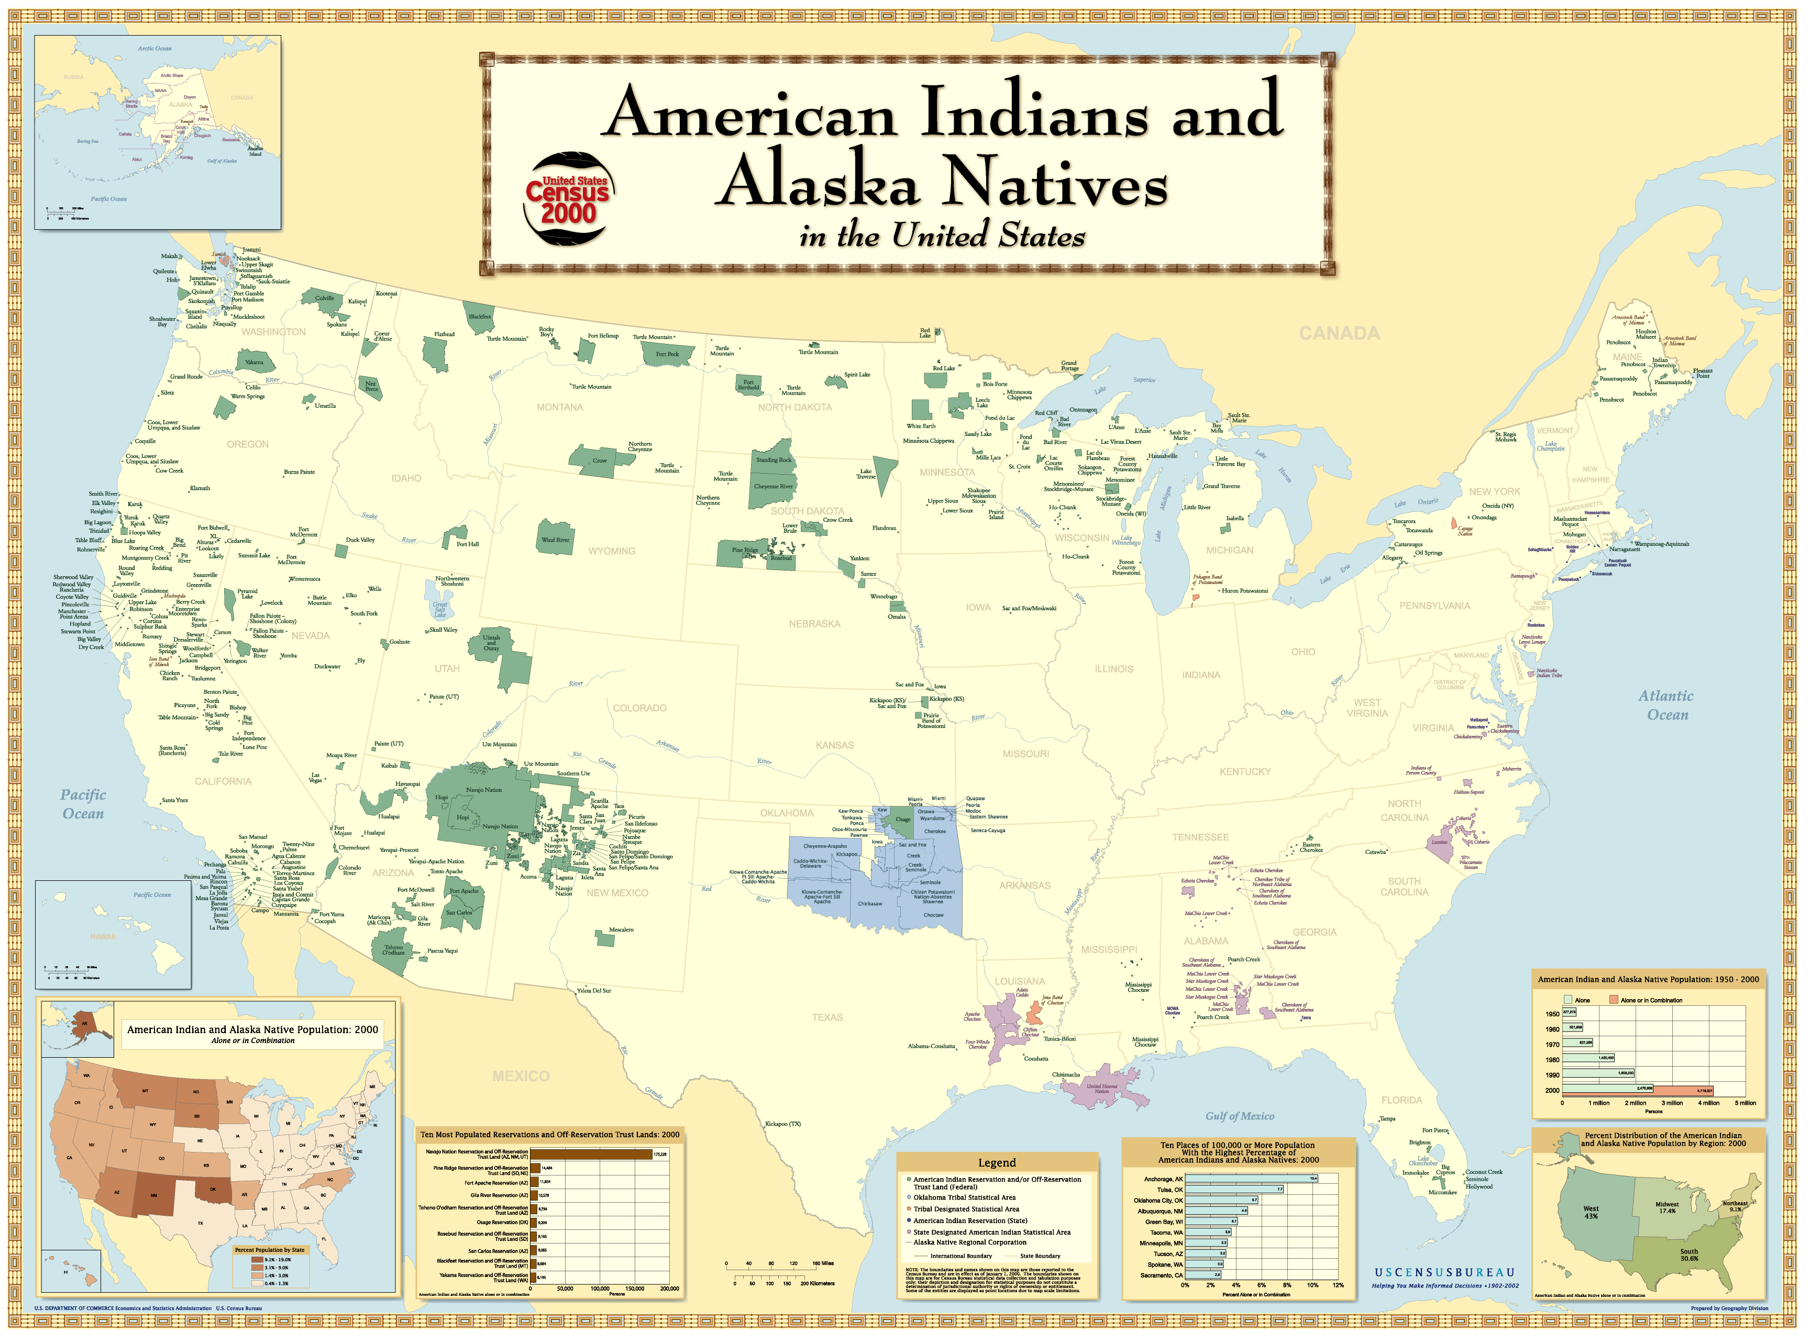
ILIP As Diverse as Indigenous Peoples Themselves
We should expect that given the great amount of diversity amongst Indigenous peoples that we will see a vast range of ILIPs as well.
There are almost 300 Indigenous languages in North America.
There are currently 567 federally recognized tribes in the US.

Slide 12
Culturally Based Education
Demmert & Towner’s six critical elements of Culturally Based Education (CBE:
Recognition and use of Native American (American Indian, Alaska Native, Native Hawaiian) languages (either bilingually or as a first or second language)
Pedagogy that stresses traditional cultural characteristics and adult-child interactions as the starting place for education (mores that are currently practiced in the community and that may differ from community to community)
Pedagogy in which teaching strategies are congruent with the traditional culture, as well as with contemporary ways of knowing and learning (opportunities to observe, opportunities to practice, and opportunities to demonstrate skills)
Curriculum that is based on traditional culture and recognizes the importance of Native spirituality while placing the education of young children in a contemporary context (e.g., use and understanding of the visual arts, legends, oral histories, and fundamental beliefs of the community)
Strong Native community participation (including parents, elders, and other community resources) in educating children and in the planning and operation of school activities
Knowledge and use of the social and political mores of the community

Slide 13
Culture-Based Indigenous Language Use
Education Northwest (2014) recommends the following in regard to use of Indigenous languages in the classroom:
The Indigenous language is used as a primary language of instruction across the grades and the curriculum.
The program integrates a multilingual approach to learning in ways that promote the distinctive spiritual, cultural, and social mores of the community.
The language is used and reinforced in community social and cultural environments.

Slide 14
The Whole Child, The Whole Curriculum, The Whole Community
According to McCarty (2014), ILIPs should be:
voluntary, and parents should participate often.
additive, building on students’ first-language abilities as a foundation.
full-day or most-of-the-day, complemented by after-school and summer programs.
systematic, incorporating Indigenous cultural content and culturally appropriate ways of teaching and learning.
engaging students in learning math, science, social studies, music, art, English, etc.
(http://indiancountrytodaymedianetwork.com/2014/09/01/teaching-whole-child-language-immersion-and-student-achievement-156685)

Slide 15
Language Interdependence Principle
“In a 2005 government-commissioned study of best practices in immersion schooling in New Zealand…found that Māori-medium programs in which 81 to 100 percent of instruction took place in Māori—called Level 1 programs—produced the strongest academic gains…[due to the] “language interdependence principle”: The stronger a child becomes in Māori, the more likely s/he is to be successful in English.”
“Immersion requires several years to demonstrate optimal results; students who participated in Level 1 immersion for 6 to 8 years reaped the greatest linguistic, cognitive, cultural, and academic benefits.”
(http://indiancountrytodaymedianetwork.com/2014/09/01/teaching-whole-child-language-immersion-and-student-achievement-156685)

Slide 16
CREDE Standards for Effective Pedagogy
Joint Productive Activity: Teachers and Students Producing Together
Language Development: Developing Language and Literacy Across the Curriculum
Contextualization: Making Meaning: Connecting School to Students' Lives
Challenging Activities: Teaching Complex Thinking
Instructional Conversation: Teaching Through Conversation
(http://crede.berkeley.edu/research/crede/standards.html)

Slide 17
Bank’s Stages of Multicultural Curriculum Transformation
0. Mainstream Approach: The curriculum reflects only non-Indigenous cultures, or is biased against Indigenous cultures.
1. Contributions Approach: The curriculum focuses on Indigenous heroes and holidays and discrete cultural elements, and the primary focus remains non-Indigenous.
2. Additive Approach: Indigenous content, concepts, themes, and perspective are included in the curriculum, but the primary focus remains non-Indigenous.
3. Transformative Approach: Structure of the curriculum is changed to facilitate student understanding of concepts, issues, events and themes from the perspectives of Indigenous cultural groups.
4. Social Action Approach: Students make decisions on important Indigenous social issues and take actions to help solve them.
(As adapted from: Gorski, 2012)

Slide 18
Student-Centered Teaching and Learning
Student-centered teaching and learning focuses on (see Chapter 8):
active learning, in which students solve problems, answer questions, formulate questions of their own, discuss, explain, debate, or brainstorm during class;
cooperative learning, in which students work in teams on problems and projects under conditions that assure both positive interdependence and individual accountability;
and inductive teaching and learning, in which students are first presented with challenges (questions or problems) and learn the course material in the context of addressing the challenges.
(Felder, nd)

Slide 19
Evaluating Indigenous Curriculum Materials
For a comprehensive guide check out:
Evaluating American Indian Materials and Resources for the Classroom. Written by Dr. Murton McClusky. Revised by Laura Ferguson. Published by the Montana Office of Public Instruction, Indian Education Division. 1992/rev. 2015 (this resource is available for free through OPI or download it at opi.mt.gov)

Slide 20
Indigenous Curriculum Materials Checklist: Labels and Identity Construction
Labels are used appropriately and identities are used as constructed by Indigenous peoples themselves.
Example: Indian versus Anishinaabe

Slide 21
Indigenous Curriculum Materials Checklist: Cultural and Linguistic Accuracy
Cultural and linguistic references are accurate and have been authenticated by the appropriate tribal groups.
Example: Nimaama and Nipaapa versus Ngashe miinwaa Nos

Slide 22
Indigenous Curriculum Materials Checklist: Historical Accuracy
Historical references are accurate to the time period and have been authenticated by more than one source.
Example: No tomatoes present in the Great Lakes Region prior to 1600.

Slide 23
Legality and Authority
Authorship and illustrator credentials clearly indicate if the materials were created by an American Indian in accordance with PL 101-164 of 1990 the Indian Arts and Crafts Act, and if this work was completed for, or on behalf of, an Indian tribe or other entity.
Example: Dr. Martin Reinhardt is a citizen of the Sault Ste. Marie Tribe of Chippewa Indians and developed this power point presentation for Montana State University and the Region VIII Equity Assistance Center.

Slide 24
Indigenous Curriculum Materials Checklist: Sources and Credibility
All sources of information are clearly indicated and have been cited or recommended by other trustworthy sources. The content has not been misappropriated, or bastardized.
Example: Slapin, B. & Seale, D. (2006). Through Indian eyes: The Native experience in books for children. Berkley: Oyate.

Slide 25
Indigenous Curriculum Materials Checklist: Generalizations and Specificity
Tribes are not clumped together. If they are grouped with other tribes, it is done so appropriately based on shared concerns or backgrounds.
Example: There are currently 567 federally recognized tribes in the US.

Slide 26
Indigenous Curriculum Materials Checklist: Invisibility, Tokenization, Fragmentation, and Isolation
Concepts, tribes, and people are included in a robust manner when appropriate, not tokenized, fragmented, or isolated within the materials.
Example: A curricular unit on mining includes mention of “the earliest miners were American Indian”, but says nothing about the type of mining, the impact of low intensity and high intensity mining on their lands, and current Indian perspectives on mining.

Slide 27
Indigenous Curriculum Materials Checklist: Stereotypes
Can be positive, or negative, and both can be damaging to self-image and relationships.
Examples: The crying Indian or the casino Indian.

Slide 28
Indigenous Curriculum Materials Checklist: Perspectives
Indian perspectives are included and may be shown in contrast to non-Indian perspectives.
Example: US Independence Day

Slide 29
Indigenous Curriculum Materials Checklist: Unreality
Negative concepts are not glossed over or excluded.
Example: Thanksgiving Day stories.

Slide 30
Indigenous Curriculum Materials Checklist: Friendly Wording
Anti-Indian biased/loaded words are not used.
Examples: Discovered, earliest settlers, unexplored, etc.

Slide 31
Indigenous Interdisciplinary Thematic Unit
Indigenous Interdisciplinary Thematic Unit (IITU) (pages 176-179)
Indigenous Interdisciplinary Thematic Units provide students with an opportunity to study an Indigenous culturally based theme that crosses the boundaries of two or more academic disciplines, while connecting the classroom with tribal communities and families.

Slide 32
Standards Alignment
Tribal Standards: All tribes have the sovereign authority to create and implement their own standards. Many tribes have not yet articulated such standards, but may be in the process of developing them.
State/Common Core State Standards: Educators are very familiar with the process of aligning their activities with state standards. This can be extremely tedious and time consuming. Encountering resistance is common when trying to introduce new methods and materials into schools and classrooms. (pages 31-33)
National Standards: Discipline/area specific standards also influence tribal, state, and local preferences and practices. (pages 122-125)

Slide 33
Vertical and Horizontal Alignment
Also referred to as Scope and Sequence (See Chapters 5 and 6)
By incorporating both vertical and horizontal alignment, the students will be able to see the natural connections of the subject matter with multiple aspects of their lives.
Vertical alignment may be thought of as connecting lower grades and upper grades, as well as connecting children with adults.
Horizontal alignment may be thought of as connecting classrooms within the same grade, as well as connecting classrooms with other aspects of the school, community, and families.
Example: The Meskwaki Settlement School implemented a school/community activity focused on identity and revitalization of traditional cultural knowledge. All of the students, faculty, and staff created identity cubes…

Slide 34
Essential Steps of an IITU (As adapted from Roberts & Kellough, 2008)
1. Select an Indigenous theme.
2. Write an overview that includes goals, major concepts, and instructional objectives. This is often standards driven.
3. Identify instructional resources including technology and community.
4. Organize the subject matter including questions, potential experiences, and activities.
5. Plan and arrange the classroom environment in a way that will stimulate student learning and encourage them to want to know more about the theme.
6. Consider including a variety of best practices.
7. Plan a finale.

Slide 35
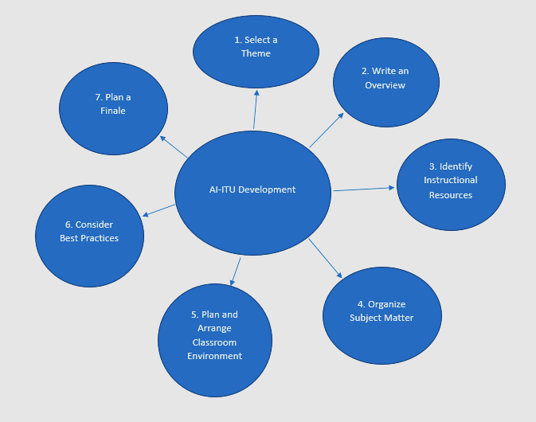
Mind Mapping
Mind maps can help you organize your thoughts and various components of your IITU.

Slide 36
References
Best, J. (et al). (2013). Culturally Based Education for Indigenous Language and Culture: A National Forum to Establish Priorities for Future Research. Forum Briefing Materials. Rapid City, South Dakota
Center for Research on Education, Diversity & Excellence (CREDE). (2011). CREDE ECE-7 Rubric: An Instrument to Measure Use of the CREDE Standards in Early Childhood Classrooms. http://manoa.hawaii.edu/coe/crede/sample-page/#rubric
Cubbins, E. (2000). Techniques for Evaluating American Indian Websites. http://www.u.arizona.edu/~ecubbins/webcrit.html
Education Northwest. (2014). Working With Indigenous Communities–Evidence Blast. http://educationnorthwest.org/resources/working-indigenous-communities%E2%80%93evidence-blast
Felder, R. (nd). Student-Centered Teaching and Learning. http://www4.ncsu.edu/unity/lockers/users/f/felder/public/Student-Centered.html
Gorski, P. (2012). Stages of multicultural curriculum transformation. http://www.edchange.org/multicultural/curriculum/steps.html
Lindala, A. (2013). NAS 320 American Indians: Identity and Media Images. Course Materials. Northern Michigan University, Center for Native American Studies.
McCarty, T. (9/1/14) “Teaching the Whole Child: Language Immersion and Student Achievement”. Indian Country Today. http://indiancountrytodaymedianetwork.com/2014/09/01/teaching-whole-child-language-immersion-and-student-achievement-156685
Reinhardt, M. & Maday, T. (2005). Interdisciplinary Manual for American Indian Inclusion. Marquette: Northern Michigan University, Center for Native American Studies.
Roberts, P. & Kellough, R. (2008). A Guide for Developing Interdisciplinary Thematic Units. 4th Ed. Upper Saddle River, NJ: Pearson Education, Inc.
Sadker, M. & D. Sadker. (1982). Sex Equity Handbook for Schools. New York: Longman, Inc.
Slapin, B. & Seale, D. (2006). Through Indian eyes: The Native experience in books for children. Berkley: Oyate.
Tri-State Collaborative. (2012). Tri-State Quality Review Rubric for Lessons and Units, http://www.engageny.org/resource/tri-state-quality-review-rubric-and-rating-process

