Slide 1
Anishinaabe Bimaadiziwin
Barbara Nolan, Anishinaabemowin Kinomaagekwe

Slide 2
What to do
Listen
Watch the teacher
Try to catch the meaning
Try to answer if you can in Anishinaabemowin (or English)
Do the activities when told to

Slide 3
Wegnesh Ezhichigemgak Maanda?

Slide 5
Mzinbiigen
Waawiyeyaa
Aazhide’aakodan
Tisigek
Waabinong-Ozaawaa
Zhaawanong-Miskwaa
Ninga-bii’awanong-Makadewaa
Giwedinong-Waabshkaa

Slide 6
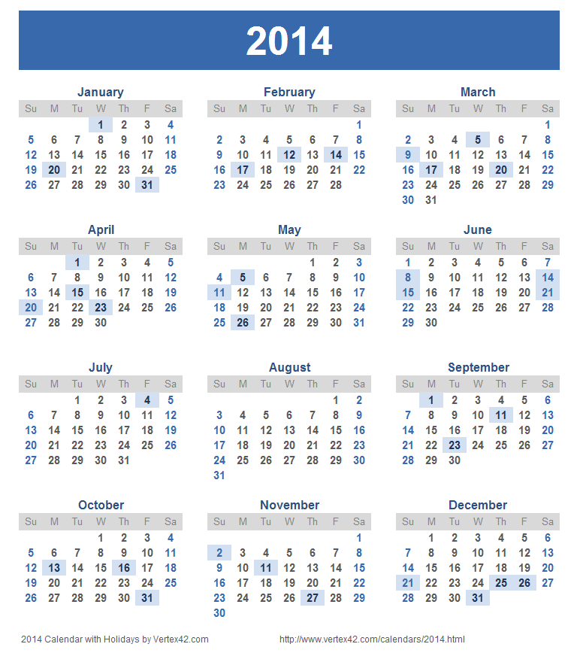
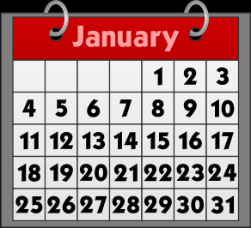
Wegnesh Ezhichigemgak Nonda?

Slide 7
Gchi-osnaagwa
Gchi-oswaabang
Osnaagwa
Oswaabang
Jiinaagwa
Waabang
Nongwa
January 2016
6 | 7 | 8 | 9 | 10 | 11 | 12

Slide 8
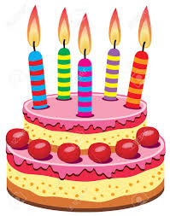
Mzinbii’an
Anishinaabe Biimskobiigen
Aaniish ensabiboongiziyin?

Slide 9
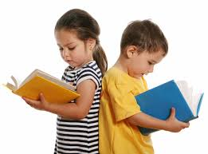
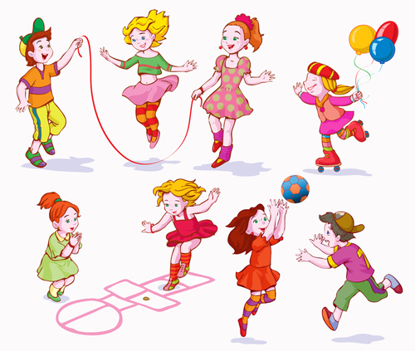
Wenesh Gaa-zhichigeyin Jiinaagwa

Slide 10
Kwaabimin

Slide 11
Jiinaagwa kii-waabimin
Nongwa

Slide 12
Waabang Ka-waabimin
Nongwa

Slide 13
Miigwech
Baamaapii

