Slide 1
Intro to the Office of Sponsored Research and Programs (OSRP)
04/01/22
Elizabeth (Betsy) Jinks, Director

Slide 2
Presentation Overview
Introduction and Overview of OSRP
Pre-Award
Proposal Submission Process
Awards Management
OSRP Goals

Slide 3
What is a Sponsored Project?
Externally funded research, public service or instruction activity
Funded by a grant, contract or cooperative agreement
Usually requires a report or deliverable and fiscal accountability
Funding is for a specific purpose and time period
Not an unrestricted gift

Slide 4
Grant Lifecycle

Slide 5
What We Do
Handle all proposal activity for the University
Negotiate and approve awards, including amendments
Draft subawards
Handle prior approval requests
Provide current information, advice, and assistance to faculty and staff related to sponsored programs
Authorized Officials for the University

Slide 6
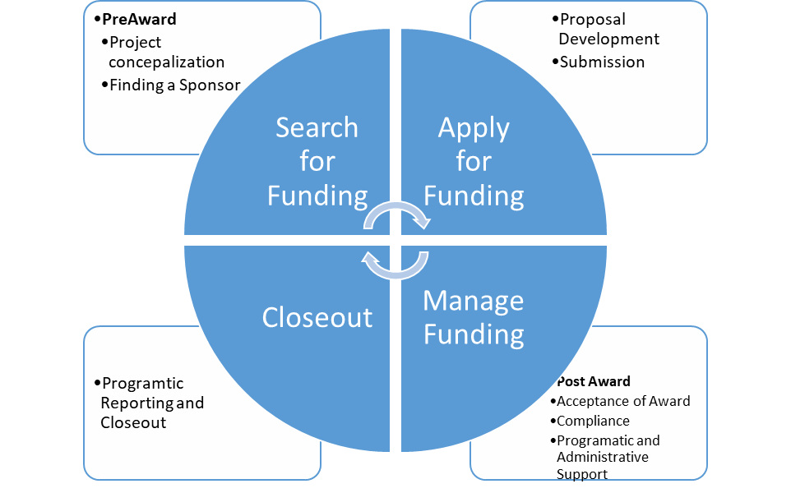

Slide 7
OSRP Statistics
More than 45 new and continuing grants totaling nearly $55 million from state, local and federal agencies
$6.5 Million in HSI awards
$11.2 Million new awards for FY22

Slide 8
OSRP Team
Elizabeth “Betsy” Jinks, Director
Kristin Schneider Baldwin, MA, CRA, CPRA , Assistant Director
Charli-Pringle North, MPH, Asst. Director, Awards Management and Compliance
Faith Fitzgerald, Post Awards Manager
Tim Hawkins, Proposal Development Specialist
Angela Alfaro, Proposal Development Specialist

Slide 9
PreAward

Slide 10
Transactional-Based Funding
Transactional funding is the traditional ‘application – grant – report’ style of funding most of us are familiar with. It is typically carried out at arm’s-length, with applications for projects which address immediate needs
Common Characteristics:
Low level of funder engagement
High Volume of applications
Immediate needs (research, scholarship, equipment)
Government grants are generally treated as exchange transactions due to the common practice of governments purchasing goods or services for a particular population or the general public (although, private funders can provide exchange transactions as well).
Notes:
Debrief
How did it feel to talk about your passion?
How did it feel to listen?
What happened for you as you listened?
What connections did you begin to make in terms of MSU Denver?
What did you learn about what’s necessary for people to make a “gift of a lifetime?”

Slide 11
OSRP Pre-Award Current Model of Grant Writing and Process

Slide 12
OSRP Administrative services Basic Functions- Proposal Stage
Disseminate funding opportunities
Build compliant budgets
Review agency guidelines to ensure compliance
Complete sponsor forms
Prepare certifications and facilitate university approval
Submit proposals

Slide 13
Grantee Roles and Responsibilities
A summary of Grantee participants' roles and responsibilities:
Authorized Organizational Representative (AOR): The AOR, in OSRP, also known as Signing Official (SO) , is the designated representative of the grantee organization in matters related to the award and administration of its grants, including those that require sponsor approval. In signing a grant application, this individual certifies that the applicant organization will comply with all applicable assurances and certifications referenced in the application. This individual's signature further certifies that the applicant organization will be accountable both for the appropriate use of funds awarded and for the performance of the grant-supported project or activities resulting from the application.
Project Director(s)/ Principal Investigator(s) (PD/PI): The PD/PIs are the individual(s) designated by the applicant organization to have the appropriate level of authority and responsibility to direct the project or program supported by the award. The applicant organization may designate multiple individuals as PIs who share the authority and responsibility for leading and directing the project, intellectually and logistically. Each PI is responsible and accountable to the grantee organization, or as appropriate, to a collaborating organization, for the proper conduct of the project or program, including the submission of all required reports.

Slide 14
Resources
OSRP Website
Federal Websites
National Science Foundation
National Institute of Health
Health and Human Services
Uniform Administrative Requirements, Cost Principles, and Audit Requirements for Federal Awards (2 CFR 200)

Slide 15
Resources Continued
OSRP Funding Databases Main Page
https://www.msudenver.edu/sponsored-research-programs/locate-funding-opportunities/funding-databases/
Pivot Funding Opportunity Database
https://pivot.proquest.com/
AASCU Grant Resource Center
https://www.aascu.org/GRC/
User Name: msudenver
Password: academic
OSRP Research Request Form
https://www.msudenver.edu/sponsored-research-programs/locate-funding-opportunities/request-funding-research/
Notes:
Hi! As Betsy said I’m Kristin Baldwin, Asst Director and cpra and cra proposal dev spec for univ init, center, offices and programs. We have many outreach ideas to make faculty and staff more aware of our services and resources, including sending out surveys regarding research interests and preferences for receiving funding opportunities.
But we’d also like to make the Chairs aware of our services in case a faculty member expresses interest in pursuing funding but missed our communications.
So the main resources I wanted to share with you today are the Pivot Funding Opportunity Database,
American Association of State College and Universities (AASCU) Grant Resource Center and the
OSRP Research Request Form,
Links to all of these resources are available on our Funding Databases page of our website and on the printout of this slide that I’ll drop into the chat. Next slide.

Slide 16
Awards Management

Slide 17
OSRP Administrative services Basic Functions-Award Stage
Review terms and conditions for acceptability
Negotiate terms if needed
Run Compliance Checks
Work with PI to revise budgets
Sign and accept award materials
Process subawards
Track all programtic deliverables

Slide 18
Current Post Award Process

Slide 19
OSRP Administrative services Basic Functions-Award Maintenance
Seek prior approvals from sponsor
Serve as liaison between the PI and sponsor
Perform budget revisions
Complete closeout documents

Slide 20
Goals

Slide 21
PILLAR V: ORGANIZATIONAL AGILITY AND SUSTAINABILITY

Slide 22
Looking Ahead
Increase our funding imprint
Total increase of 20% raised in government grants
Building a sustainable infrastructure
Indirect/Direct Costs
Building an HSI Reputation in the Grants Field

Slide 23
Initiatives
Training & Education
RAG MAG
Content Specific Trainings
System Software
CAYUSE
Faculty Grant Resource Center
OSRP Proposal
NSF Ethical and Responsible Research Hub

Slide 24
Questions & Comments?

