Slide 1
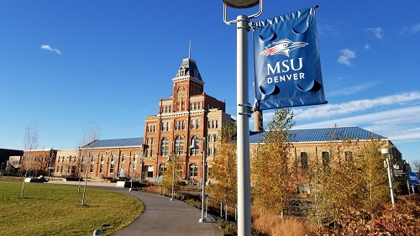
MSU Institutional review board (IRB) & submission process
Chair: Lisa Badanes, Psychology
HSPP Manager: Mike Heathcote
hspp@msudenver.edu
https://msudenver.edu/irb/

Slide 2
What is an institutional review board?
IRB’s serve as an objective third party to ensure the protection of the rights and welfare of human research subjects.
IRB’s review submissions based on the criteria set forth in the Common Rule (45 CFR part 46), The Belmont Report and The Nuremberg Code.
The board must consist of at least 5 members, with at least 1 community member. Also involving scientists and non-scientists.
The MSU board meets on a monthly basis, during the fall & spring semesters, to review and discuss projects.
There is never a bad time to submit a project for review, we accept projects year round.

Slide 3
Msu Institutional review board members
Lisa Badanes - Chair
Psychology
Mo Flynn – Assistant Chair
Psychology
Siva priya Santhanam
Speech, Language & Hearing Sciences
Ray Gornell
Counseling Center
Di Jia
Criminal Justice & Criminology
Mike Heathcote
Human Subject Protection Program
Tony Nunez
Human Performance and Sport
Erin Burke-Leaver
Community Member
Catharine McCord
Community Member
*Contact us if you are interested in joining!

Slide 4
Project reviews by year
Year | New Projects | Total Submissions
2019 | 65 | 129
2020 | 77 | 133
2021 | 144 | 329

Slide 5
how covid has changed our research landscape
Many projects have transitioned to online surveys
Qualtrics
Increase in Social Media Recruitment
Over the past year, annual submissions have more than doubled
New submission platform (Cayuse) provides a more streamlined process to handle increased workload
Currently adding more IRB members
Increase in Faculty & Student engagement
1-on-1 trainings/meetings with staff & students
Classroom presentations on research ethics & IRB process

Slide 6
Why are IRBs important???
Examples of unethical research…
Human Radiation Experiments (WWII era)
-Performed by Department of Defense and Public Health Service, among others.
-Experiments included feeding radioactive material to mentally disabled children, administering radioactive iron to impoverished pregnant women, etc.
Nazi War Crimes (WWII)
-Performed on large numbers of prisoners, including children.
-Experiments included freezing, malaria, mustard gas, head injuries, immunization, etc.
Tuskegee Syphilis Study (1932-1972)
-Performed by US Public Health Service.
-Studied long term effects of untreated syphilis.
These studies exploited vulnerable populations, lacked informed consent, involved coercion and deception.
Notes:
There have been numerous unethical research studies that have helped create the laws and regulations we have today.
Ethical research has huge impacts. Researchers need to stay unbiased, no matter what. Especially in today’s society with all the fake news, misleading information and click-bait articles. Research articles, one would hope, should be at least one source of unbiased perspective. With that being said, research has led us astray a number of times. If we were to address the lack research ethics in many of these cases, it could have solved many problems. Success drives immediate goals, but ethics steer our society long term.
One endeavor not listed in the previous list is the Sugar Industry, which is where I would like start off, and then we can talk about the Tuskegee Study.

Slide 7
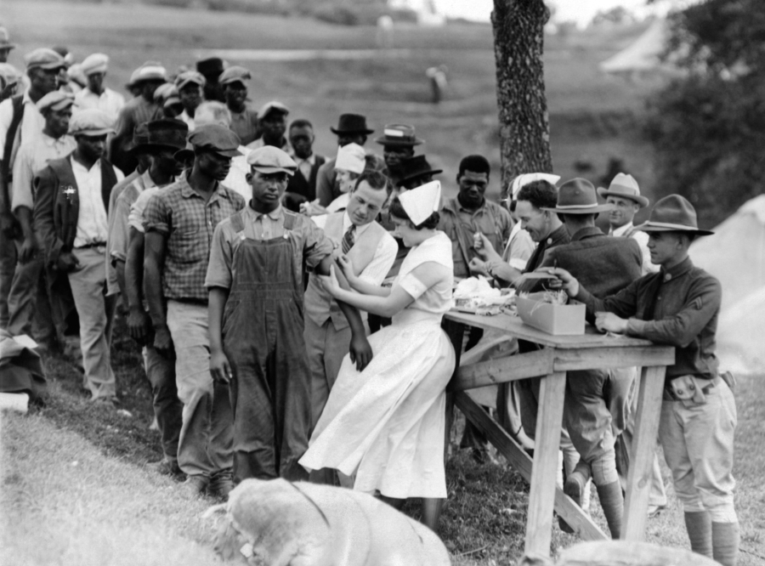
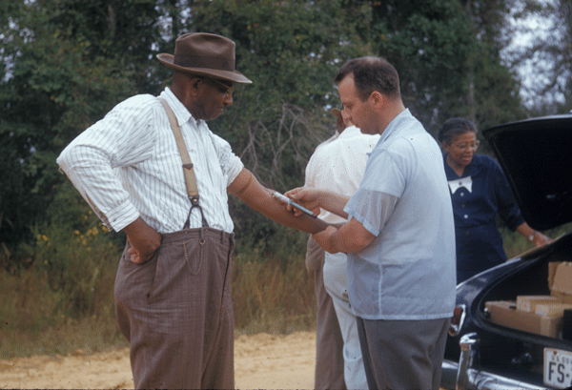
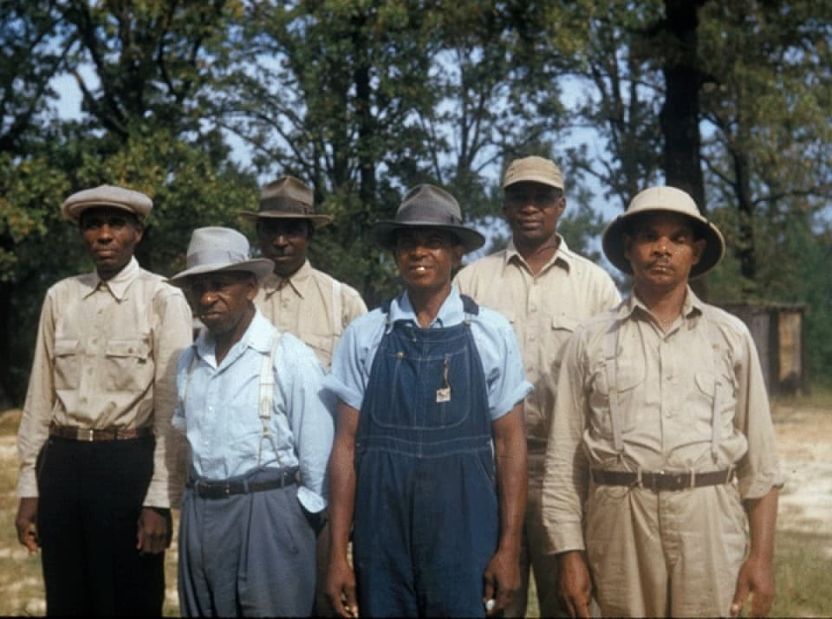
Tuskegee Syphilis Study
Performed from 1932-1972, by the US Public Health Service.
Purpose of the study was to observe the natural progression of untreated syphilis in rural African-American men in Alabama, while making the promise to participants of receiving free health care from the US government.
Enrolled total of 600 impoverished, African-American sharecroppers from Macon County.
None of the 399 infected, were ever told they had the disease and never given penicillin, even after it was proven to effectively treat syphilis (1945). They were only told they had “bad blood”.
This study eventually led to The Belmont Report (1979), the creation of the Office for Human Research Protections (OHRP) and federal laws requiring IRB’s for the protection of Human subjects (The Common Rule).

Slide 8
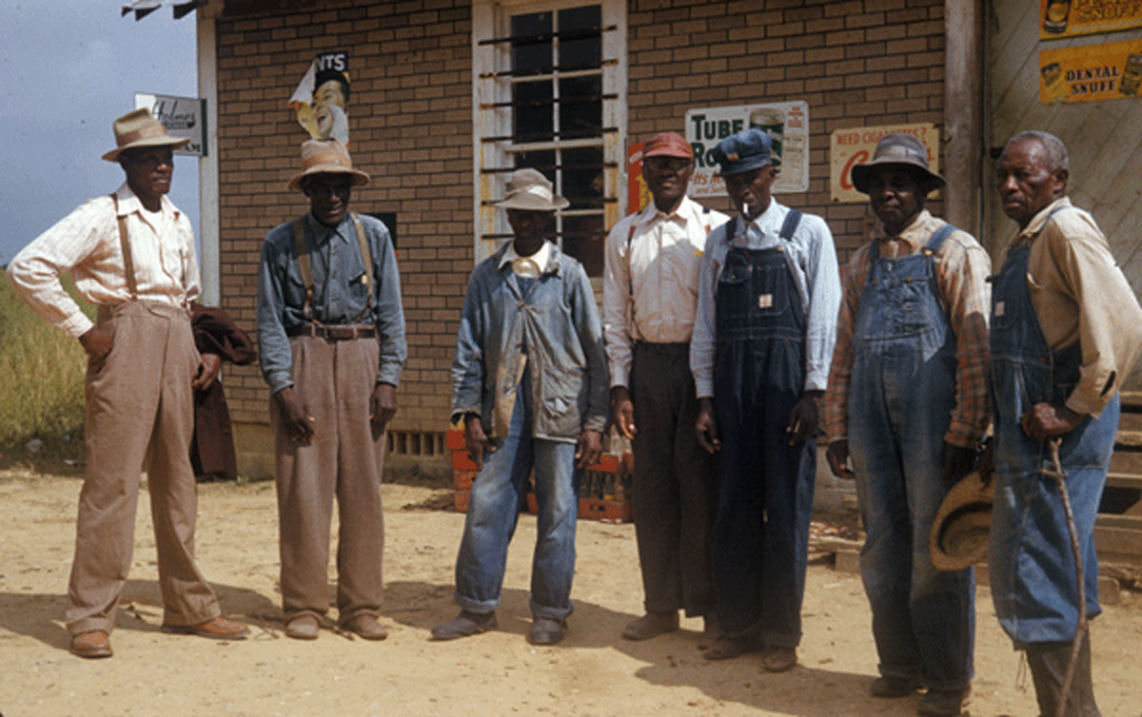
Pillars of research protections The Belmont report & The Nuremberg code
The Belmont Report
Respect for Persons
Individuals should be treated as autonomous agents & persons with diminished autonomy are entitled to protection.
Beneficence
Research should maximize possible benefits and minimize possible harms.
Justice
The benefits and risks of research must be distributed fairly.
The Nuremberg Code
Established 10 principles pertaining to the rights and protections of Human Subjects.
Voluntary Informed Consent is Essential.

Slide 9
The Belmont Report also established a list of vulnerable populations:
Students and employees
Minorities
Children
Economically and/or educationally disadvantaged
Prisoners
Cognitively impaired persons
AIDS/HIV
Human fetuses and neonates
Terminally Ill
Pregnant women*
*recently removed from list of vulnerable populations

Slide 10
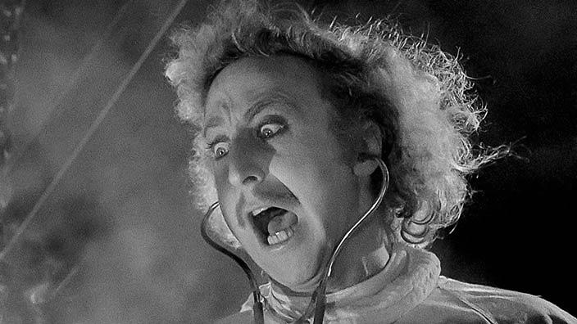
Is my project considered “research” & do I need IRB approval??
Does this activity involve a systematic investigation?
Does this research involve human subjects?
Does this research intend to contribute to generalizable knowledge?

Slide 11
My project is “research” and requires IRB approval…now what?
Complete your CITI certification – Citiprogram.org
Everyone on the research team will need to complete the “Social & Behavioral Research – Basic/Refresher” course or the “Biomedical” course; based on field of study. This course typically takes 3-4 hours to complete and expires after 3 years.
Create your protocol & submit via Cayuse
Links to Cayuse and templates to aid with your submission are available on the MSU IRB webpage.
When using online survey instruments, MSU requires the use of Qualtrics.
Obtain any letters of support, if necessary.

Slide 12
levels of review
Exempt – usually anonymous survey, with no identifying information collected. Minimal risk.
Takes approximately a week to obtain approval.
Expedited – collecting some identifying information, video/audio recording; could be asking sensitive information. Still considered minimal risk, but higher level of review than exempt.
Can take 2-3 weeks to obtain approval.
Full Board – collecting identifiable information, sensitive information, participants/researchers at higher than minimal risk. Involves a vulnerable population.
May take 2-3 months to obtain approval.
Submit asap.

Slide 13
Resources
MSU IRB Webpage
Office for Human Research Protections
www.hhs.gov/ohrp/
ME!!! Mike Heathcote
(303) 605-5282 or hspp@msudenver.edu

