Slide 1
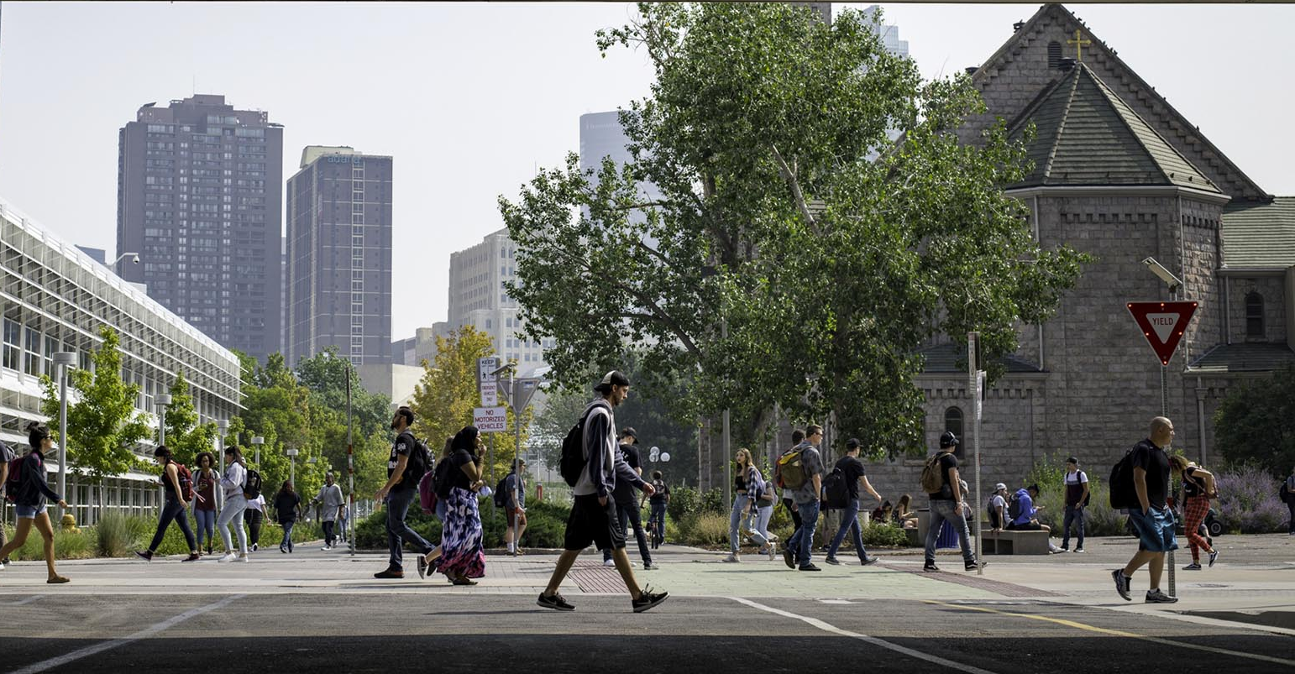

LEADERSHIP ACADEMY
PARTNERING WITH UNIVERSITY ADVANCEMENT
MARCH 4, 2022

Slide 2

LEARNING OUTCOMES
Determine the ways University Advancement can be a resource for your department
Understand what University Advancement does
Learn how the donor cultivation process works and how you and your faculty can help
Find out how the solicitation process works

Slide 3
WHAT IS UNIVERSITY ADVANCEMENT?
MSU DENVER FOUNDATION
Asset Management
Financial Management
STRATEGIC ENGAGEMENT
Alumni Engagement
DEVELOPMENT
Major Gifts
Annual Giving
Donor Relations
ADVANCEMENT SERVICES
Gift Processing
Data Management
CORPORATIONS & FOUNDATIONS
Corporate Relations
Foundation Relations
University Events
Fund Management

Slide 4
WORKING WITH ADVANCEMENT
IDENTIFY YOUR PRIORITIES
COMMUNICATE WITH YOUR ADVANCEMENT PARTNER
HELP IDENTIFY, CULTIVATE AND SOLICIT DONORS
HELP STEWARD THE DONOR RELATIONSHIP

Slide 5

WHAT ARE MY PRIORITIES?
What investments would really move the needle in your department?
What would be the student outcomes if you received this investment?
How would this investment be sustained?
Is this an investment that might interest a philanthropic donor?

Slide 6
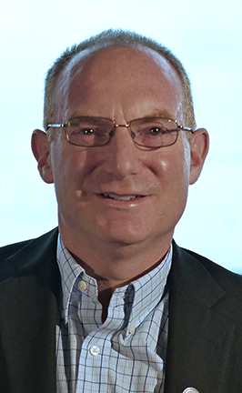
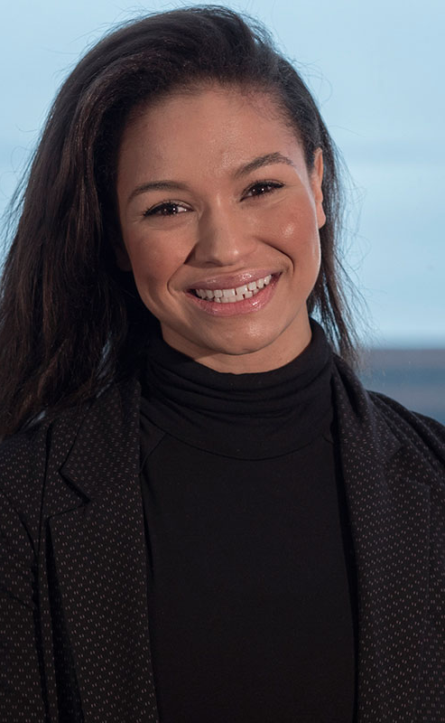
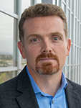
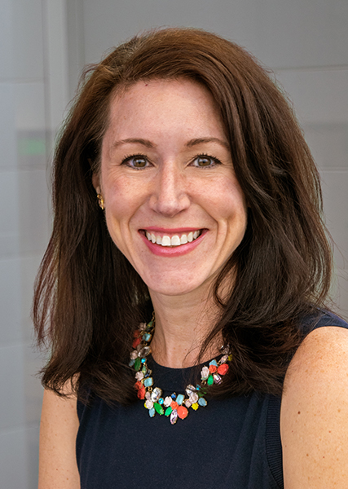
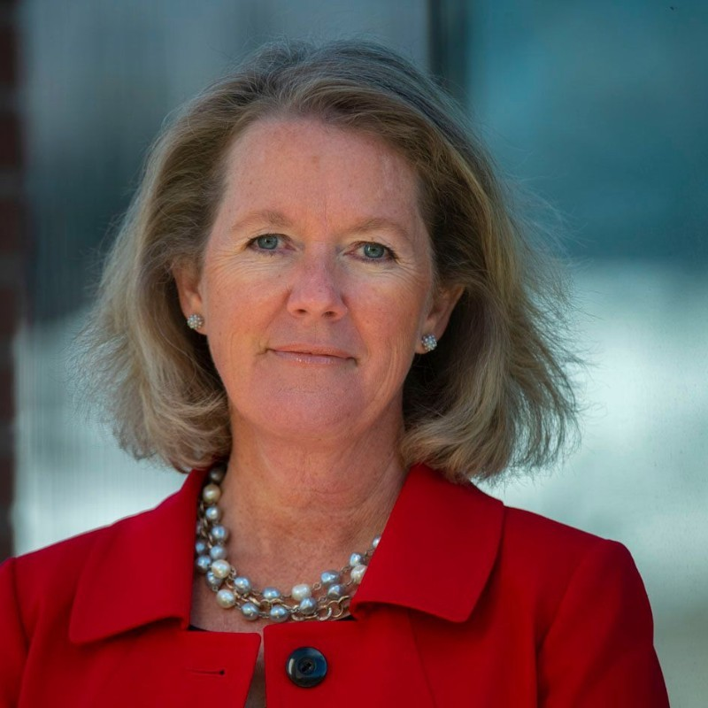

STEVE
GALPERN
ALLYSSA
JOSEPH
JACQUES
SWANEPOEL
KATIE
MNICHOWICZ
GWEN
THOMPSON
SENIOR DIRECTOR
OF DEVELOPMENT
ASSOCIATE DIRECTOR
OF DEVELOPMENT
DIRECTOR OF DEVELOPMENT
LEADERSHIP ANNUAL GIVING OFFICER
SENIOR DIRECTOR
OF DEVELOPMENT
ADVANCEMENT PARTNERS
SHELLEY
THOMPSON
AVP OF UNIVERSITY ADVANCEMENT

Slide 7
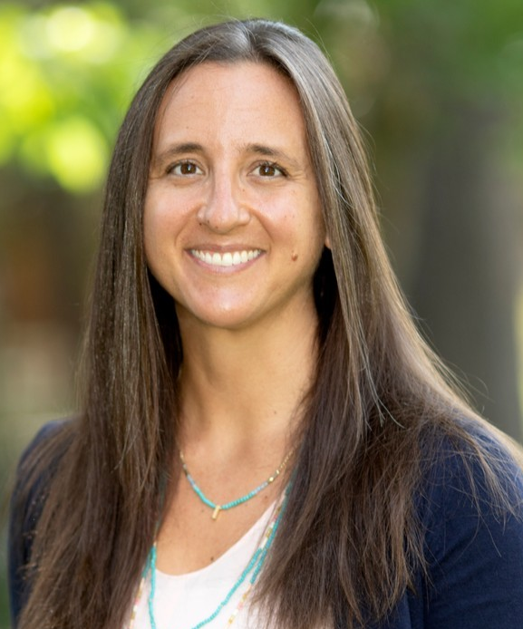
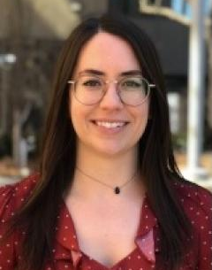
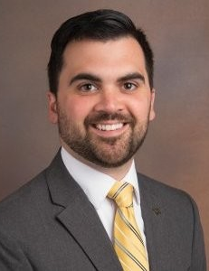
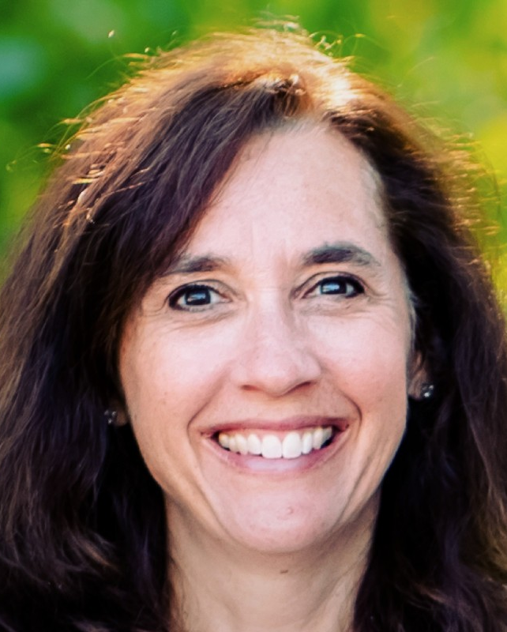
MEGAN CONKLIN
MANDY MALACHOWSKI
ZAC TARDIFF
TORI MEYERS
EXECUTIVE DIRECTOR OF CORPORATE AND FOUNDATION RELATIONS
DIRECTOR OF FOUNDATION RELATIONS
DIRECTOR OF CORPORATE RELATIONS
GRANT WRITER
CORPORATE AND FOUNDATION RELATIONS

Slide 8

IDENTIFY, CULTIVATE, SOLICIT AND STEWARD
QUALIFY
WHERE CAN I HELP?
IDENTIFY
CULTIVATE
Prospect Pipeline
SOLICIT
STEWARDSHIP
RECOGNIZE

Slide 9
IDENTIFY POSSIBLE DONORS
Are there people in your network who would be interested in giving to this project?
Grateful students, parents, alumni, former faculty?
Corporate partners?
Foundations?
Advisory council members?

Slide 10
CORPORATE AND FOUNDATION GRANTS
See the Grant Toolkit on MSU Denver website
Search centrally managed corporations and foundations or contact the CFR Team
    If you are seeking less than $15,000 from a source that is not centrally managed, use the fundraising toolkit
    If you are seeking more than $15,000, complete the Project Information Form and a member of the CFR team will contact you

Slide 11
CULTIVATE
Purpose
To engage and educate your next group of potential donors
Process
Tours, visits, lectures, receptions, or dinners with faculty and leadership; often accompanied by briefing materials and scripted talking points
Payoff
Moving donors closer to the ask; understanding more about the prospect

Slide 12
GETTING TO KNOW THE DONOR
Permission
Fact-Finding
Feeling-Finding
Tell me your story…
Paint me a picture…
Tell me more…
Importance/satisfaction
Best/least
Catch-all
Right prospect
Right time
Right offer

Slide 13
GETTING READY TO SOLICIT
A briefing meeting typically takes place in person with a prospective donor who is already familiar with MSU Denver and can take as little as 30 minutes or as much as an hour.
Meeting Goals:
Determine prospect’s area of interest
Determine prospect’s giving level or range
Determine recognition opportunities to present
Determine appropriate time frame for an ask

Slide 14
PRINCIPLES OF SUCCESSFUL BRIEFINGS
Successful prospective donor meetings have four essential components:
Preparation; knowing a donor’s background
Conducting the meeting, ideally in person
Thoughtful, personal follow-up
Timely scheduling
It is also important to remember the following principles of fundraising:
People give because….
They are asked—people give to people | They trust the person who asked them | They believe in the person who asked them | They are previous donors | People are generous | Giving back feels good | They are asked for a specific gift | The person who asked keeps sights high | The person who asked had a positive attitude

Slide 15
PREPARING FOR A SOLICITATION
Who?
Who is the “best” person to make the request?
Why?
Why is the donor interested in giving to MSU Denver?
What?
What will motivate the donor’s interest in making a gift?
How?
How is the ask going to be made, for what and how much, by whom, and when?
Who can influence the gift making decision?
What aspect of the case will most appeal to the donor?
Why is now the time to make the ask?

Slide 16
THE GIFT PROPOSAL
1. Executive Summary
Succinct overview
2. MSU Denver’s Story
History, mission, beneficiaries, milestones
4. Why Now?
Achievements, track record, unique approaches
6. Funding Needs
Description, should include impact on mission
8. Impact
7. Funding Status
9. The Ask
10. Supporting Information
Goals, progress, key donors, where gift “fits in”
What this gift will do
Clear and personalized request: state dollar figure and pledge period
Cover letter, naming opportunities, etc.
The need, current priorities
5. Why Us?
3. Thank Donor
Acknowledge previous giving and say thanks

Slide 17

ANATOMY OF A SUCCESSFUL ASK
4
Ask if there are any questions, use the memorized ask sentence, and ask for a specific gift for a specific purpose.
1
Meet in a quiet and private setting.
2
Set the table: recognize past generosity and ask them to consider your proposal.
5
Silence! Give the prospect time to process the request; wait for the response.
6
Understand the prospect’s reaction and handle responses or objections.
3
Present the case for support, funding needs, campaign status, and your personal motivations for giving.
7
Agree upon next steps and a specific time-frame for following up.

Slide 18
LEADING TO THE ASK
“Your investment in … ”
“Guarantee the sustainability of … “
“A transformational gift that will enable us to … “
“Your gift will demonstrate foresight … “
“Create exceptional awareness …”
“Provide critical funds for …”
“Inspire and motivate others to …”
“The impact of your gift will …”
“Your transformational gift will help us achieve…”
“Will establish a precedent for extraordinary generosity in this critical time …”

Slide 19


STEWARDSHIP
Thank the donor
Recognize the donor
Engage the donor
Report on impact

