Slide 1
Student Employment
February 11th, 2022
Human Resources – Student Employment Team

Slide 2
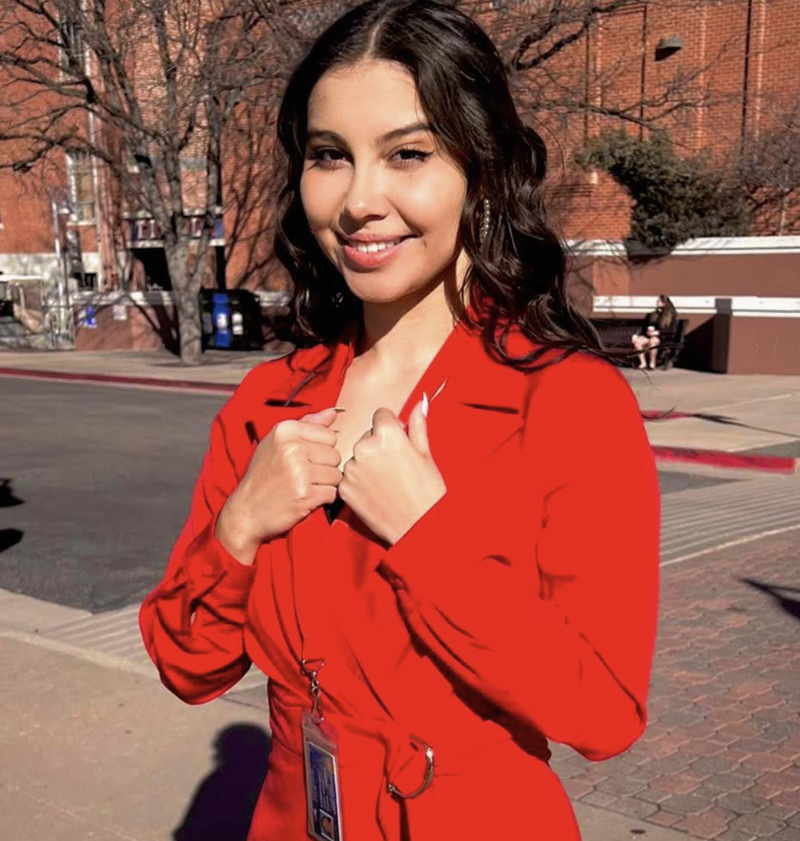
Who We Are
Ramona Morris
Jazmin Rodriguez Delariva
Sughra Ismaili
Zara Shafi
Jaqueline Cervantes
Joslyn Shelton
Notes:
Ramona- Introduction

Slide 3
All Things Student Employment
How to Hire a Student
Timesheet Approval Process
Offboarding process
Future of Student Employment
A little bit about ePAFs
Key Takeaways for Onboarding Students
Temporary Hourly Employee Process
Student Service Stipends
Requirements for Student Employees
Notes:
Zara – road map slide

Slide 4
Requirements for Student Employees
Must be enrolled in 6 credits or more for undergraduate students during the Fall and Spring semesters.
Summer credit requirements do vary if a student is being paid through non-workstudy funds (*departmental, grant, etc.)
Must maintain a 2.0 GPA.
Students who will be earning Work-Study must be awarded before starting their position.
Students must be at least 18 years or older. For anyone under 18, please contact HR for approval.
Notes:
Joslyn

Slide 5
How to Hire a Student
People Admin
Step 1
Job Opportunities – Should be posted in People Admin. These should be posted for both new and current student employees.
Hiring Proposal – Preferred Start Date should align with payroll schedule.
Training Materials available for People Admin
https://www.msudenver.edu/student-employment/peopleadmin/
Notes:
Joslyn

Slide 6
How to Hire a Student
Student Paperwork
Step 2
Background Checks through HireRight
After background check has been completed, Supervisors should submit student’s ePAF
i-9 documents and Authorization Form
Students are required to submit i-9 documents in-person
New Hire Paperwork
Payroll Documents (W4 Form and Direct Deposit forms)
Notes:
Joslyn

Slide 7
How to Hire a Student
ePAF Submission, Review, and Approvals
Step 3
ePAF must be submitted for all hiring actions (new, rehire, and other changes) prior to the ePAF deadline.
All additional approvals must be completed prior to the employees start date.
Once all paperwork has been received from the student and their i-9 has been processed, then the ePAF can be approved/applied for the student.
It is crucial that ePAFs are done correctly, otherwise this can delay a student’s hiring process.
Notes:
Jazmin

Slide 8
What is an ePAF?
an Electronic Personnel Action Form allows users to process job changes for their employees online, define, route and track actions as they move through the approval process, and it provides an electronic audit trail.
Step-by-Step guides available for ePAFs:
https://msudenver.sharepoint.com/sites/HR/SitePages/ePAF-step-by-step.aspx
Trainings are hosted monthly and ePAF Open Hours are also available for additional assistance.
Notes:
Jazmin
ePAF guides are in sharepoint

Slide 9
Timesheets and Payroll Schedules
Semi-Monthly Payroll Schedule
Calendar Reminders
https://www.msudenver.edu/student-employment/
Notes:
Jazmin

Slide 10
Late or Not Started Timesheets
Process for late or not started timesheets (Past-time Hours)
If the student misses the time sheet deadline, the hours will need to be entered as “Past Time Hours” on the next payroll cycle. If the delay was on the supervisor/department or HR’s behalf, then the supervisor may request a manual payment.
https://www.msudenver.edu/wp-content/uploads/2021/12/EnteringPastTimeHours.pdf
Manual Payment Requests**
Notes:
Zara

Slide 11
Access for Approvals of Timesheets
Supervisor Security Access for Approvals of Timesheets
https://www.msudenver.edu/wp-content/uploads/2021/12/WEBTIMEENTRYSecurityForm-3.pdf
In addition to this Webtime Security form, Supervisors do need access to a basic Banner user account. This access would need to be requested from IT prior to onboarding the student.
How to Guides for Approvals
https://www.msudenver.edu/wp-content/uploads/2021/12/WebTimeEntry_Supervisor.pdf
Notes:
Zara

Slide 12
Offboarding
IT Separation Requests – Supervisors must submit an Employee Separation Ticket and provide the separating employee’s NetID, University 900 number, date and time of separation.
https://www.msudenver.edu/wp-content/uploads/2021/12/EmployeeSeparationProcess-2.pdf
It is crucial that students are offboarded correctly, especially if these students have had access to confidential information, social media, IT Access...etc.
Notes:
Example of Security Issues that can arise if offboarding not done correctly *Student that worked in Advising, Separation wasn’t properly done and student was able to still have access to confidential information

Slide 13
Key Takeaways for Supervisors when Onboarding Students
To ensure that all steps are met within the onboarding process, it is important for supervisors to change the student's status in People Admin accordingly.
Supervisors need to ensure that they have proper access to approvals and Banner prior to onboarding students.
Make sure that Background check is complete prior to student starting
All paperwork needs to be submitted by student for their ePAF to be approved and applied
New Hire Packet, i-9 Documents, Payroll Packet
Notes:
Jackie

Slide 14
Student Service Stipends
Students who receive a Stipend are providing a service and not performing work.
There is an approval process through HR and the Office of the Controller for Departments wanting to provide a student(s) a stipend.
The stipend positions are under the Semi-Monthly Payroll even though it is for a flat rate and not an hourly rate of pay.
Notes:
Ramona

Slide 15
Future of Student Employment
HR Partner Model
Student Affairs
Academic Affairs
Administrative Branch
President's Office, Strategy, and External Affairs
In-Person Orientation's are coming back!
Notes:
Angela

Slide 16
Temporary Hourly Process
Temporary Hourly Checklist: https://www.msudenver.edu/wp-content/uploads/2021/12/TemporaryHourlyChecklist-NewEmployee.pdf
Supervisor Checklist: https://www.msudenver.edu/wp-content/uploads/2021/12/SupervisorTemporaryHourlyChecklist-NewEmployee.pdf
As a friendly reminder, until HR receives all necessary paperwork from both the Supervisor and Employee, the employee will not be authorized to start working
Contact Sughra Ismaili - sismaili@msudenver.edu
Notes:
Onboarding/Offboarding for Temporary Hourlies is currently in a transition phase for student employment. Sughra will be our point of contact in the meantime.

Slide 17
Notes:
Zara asks if there are any questions

