Slide 1
Welcome!
Braelin Pantel, Ph.D., AVP for Student Engagement & Wellness/Dean of Students

Slide 2
Student Engagement
Student Wellness
Notes:
As the name implies- this is what we are talking about- students' wellness and their engagement within the context of the University.

Slide 3
Our Why…. Why we do what we do
Notes:
May be stating the obvious but want to share a bit about why we do what we do... we are driving towards student success.
There's a reason why Universities invest in student affairs programs and services, along with the explicit academic pursuits.
We know that students' wellness (broadly defined-- including but not limited to their physical health, psychological and emotional wellbeing, social wellbeing, financial health, even spiritual wellbeing) matters. It matters to students' success in college-- there's ample evidence to support this from diverse scholars and disciplines.
And, related to this, we know that students' engagement also matters to their success. This is, the investment that students make-- their time/energy that they put into their University experience is also correlated strongly with their success. Clearly their engagement in the classroom is central to this, but research indicates that students who are engaged with communities of peers are more successful than those who are not. Students who spent time on campus outside of class, who are connected to the University in holistic ways are more likely to graduate than those who do not, and so we are committed to creating relevant and meaningful opportunities for students to engage, find their community, find friends (that matters a lot too!) within our broad and diverse MSU Denver community and so will talk about how we do that today!

Slide 4
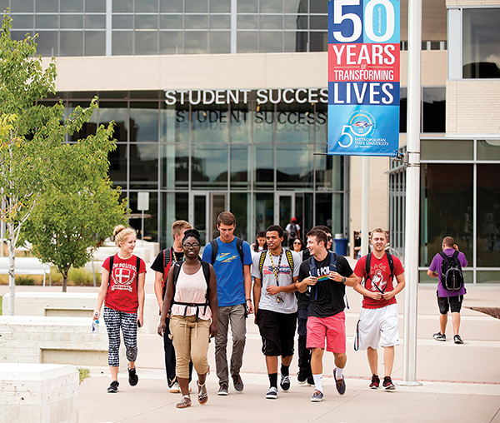
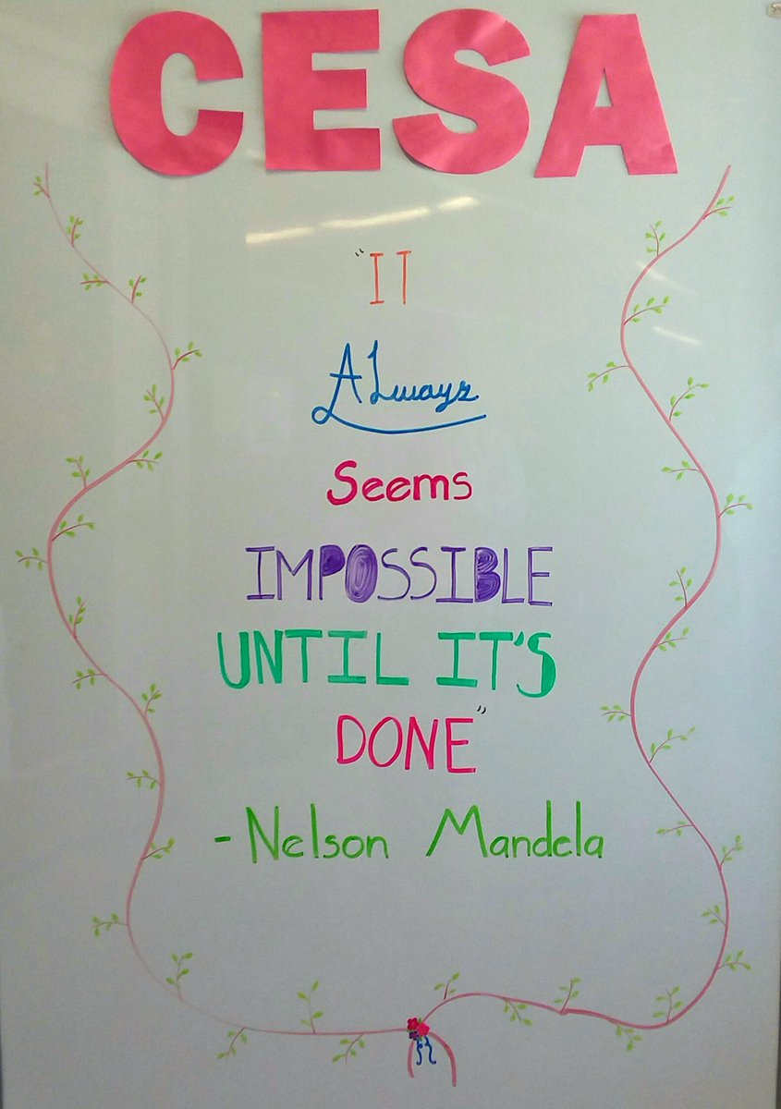
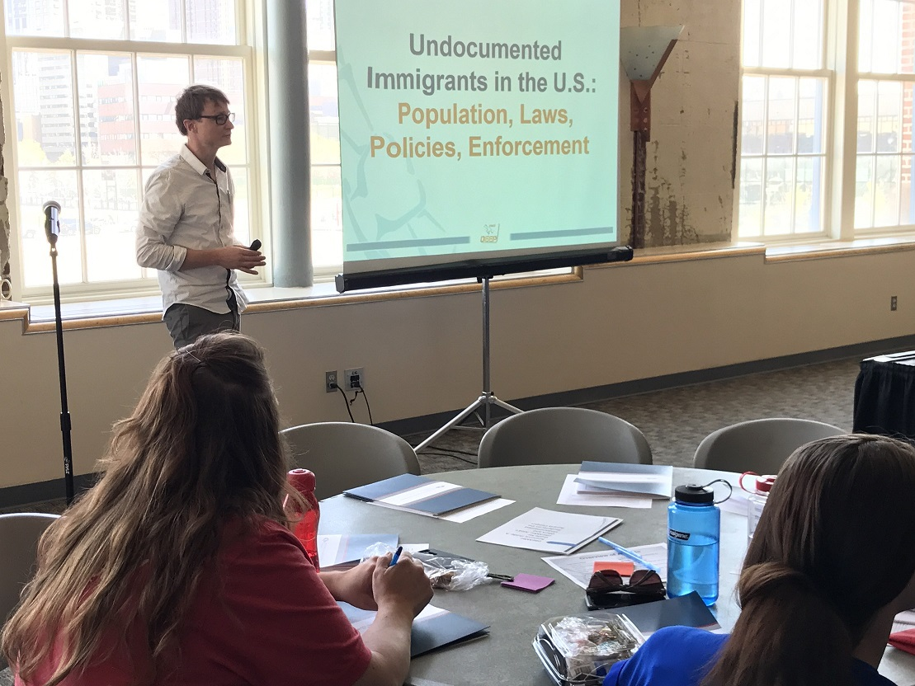
CENTER FOR EQUITY & STUDENT ACHIEVEMENT

Slide 5
Center for Multicultural Excellence & Inclusion (CMEI)
Student organizations, leadership programming, student media, community space for students of color, resources, events, leadership development, fraternity & sorority life, more…

Slide 6
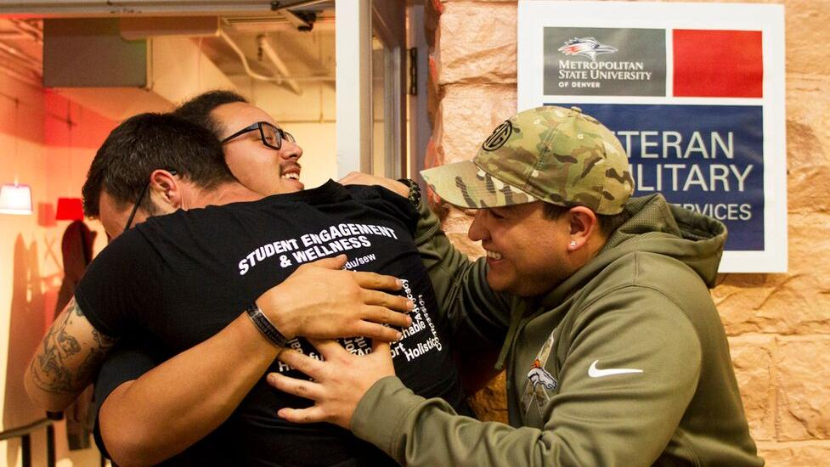
Veteran/Military Student Services
Ccamaraderie, VA referrals, GI bill benefits, peer support, civilian transition support…

Slide 7
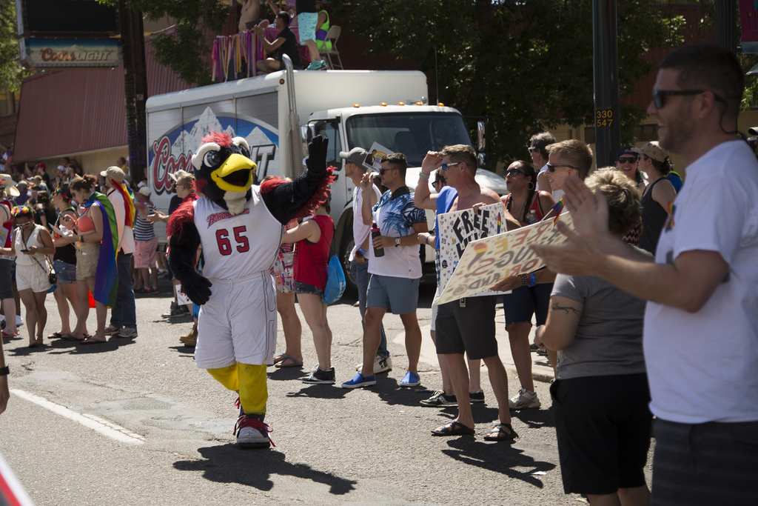
LGBTQ Student Resource Center
Advocacy, community, resources, peer support, education, training…

Slide 8
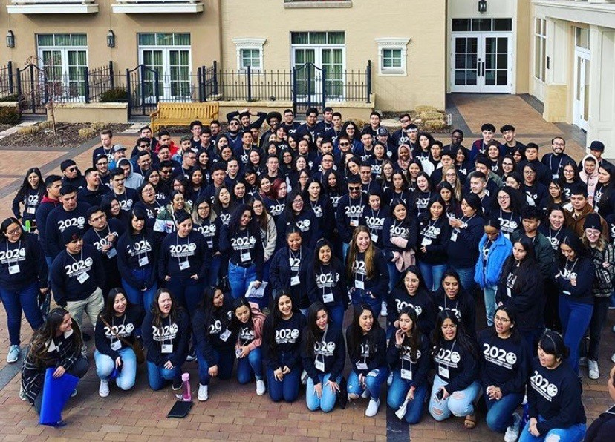
TRIO SSS & CAMP
TRIO offers academic guidance, tutoring, workshops, peer mentoring, financial literacy, grad school prep…
CAMP offers academic support, financial aid, social supports for eligible migrant/seasonal farmworkers and their children…

Slide 9
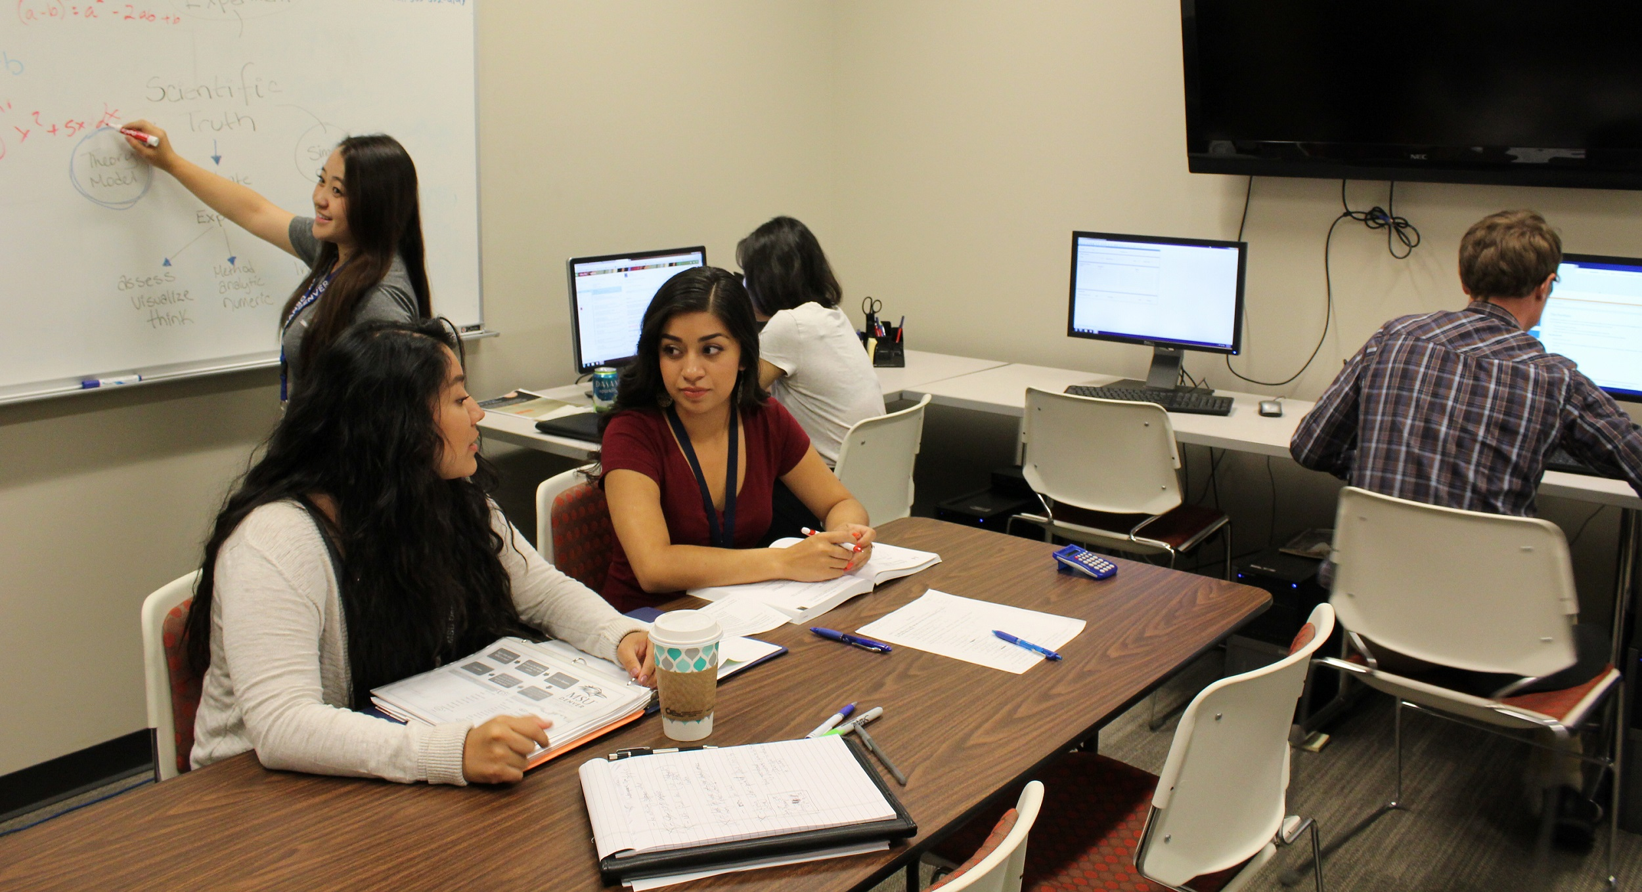
Immigrant Student Program
Academic and social support, degree & career planning, peer mentoring, resources…

Slide 10
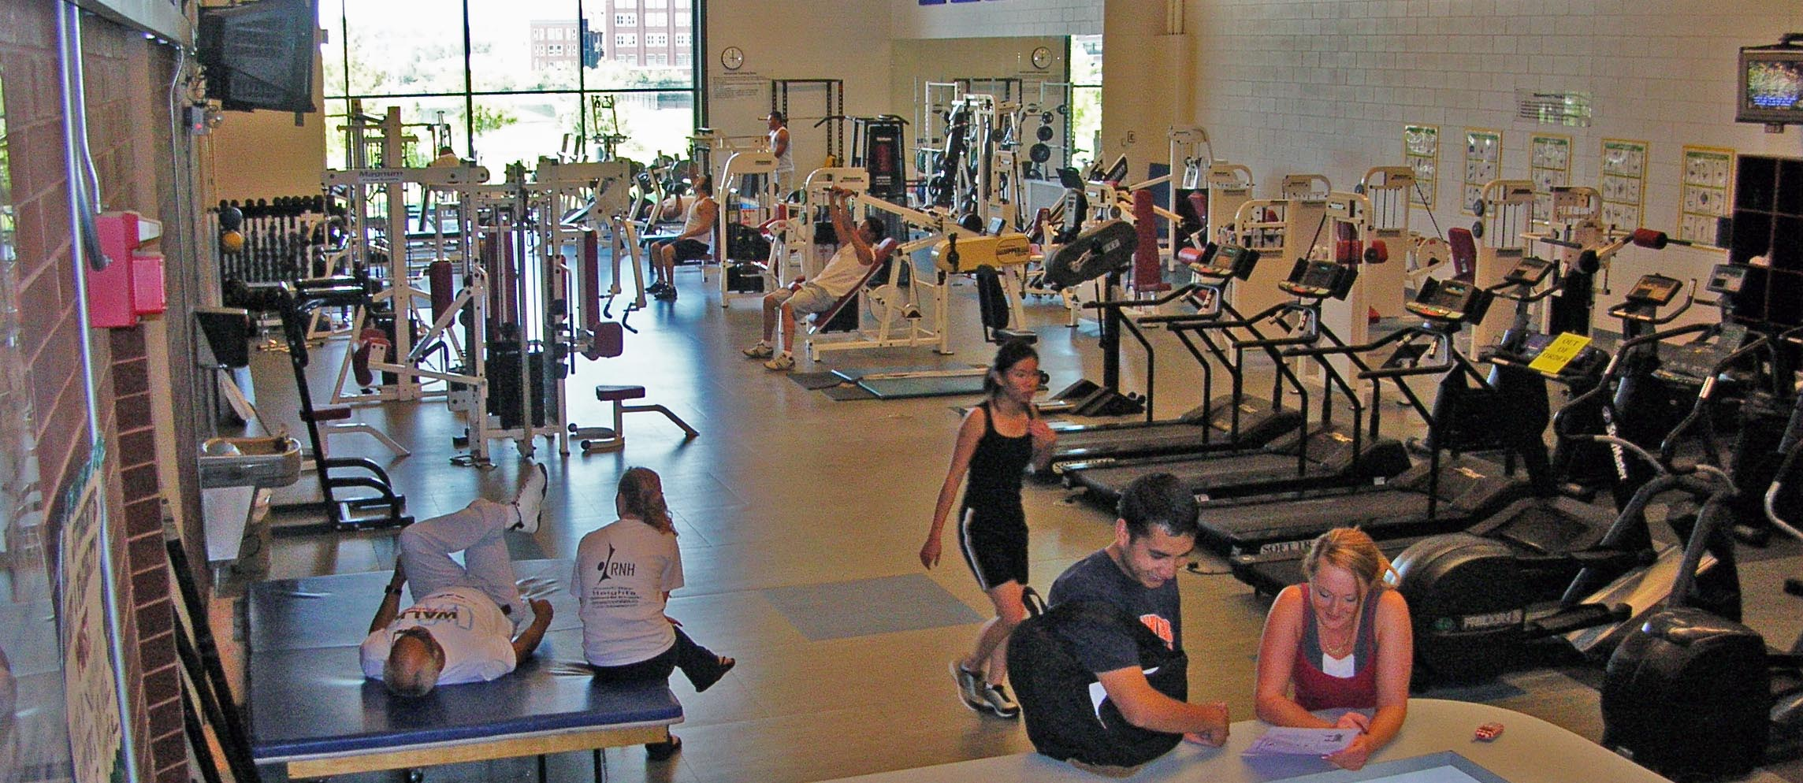
Campus Recreation
Fitness center, classes, outdoor adventures, gear rental…

Slide 11
Counseling Center
Psychotherapy, groups, workshops, referrals, consultation…

Slide 12
Health Center
Clinical services, immunizations, insurance, smoking cessation…

Slide 13
Student Care Center
Food pantry, Emergency Funds, Public benefit assistance, case management support…

Slide 14
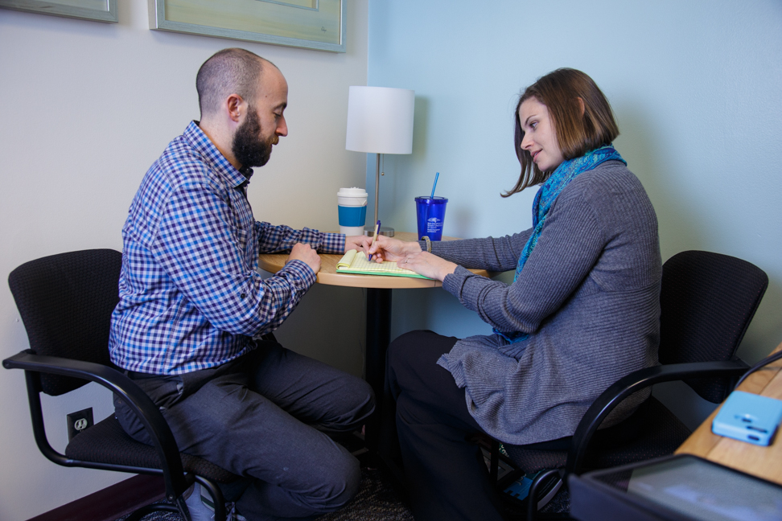
Dean of Students Office
Conflict resolution services, student code of conduct, CARE Team coordination…

Slide 15
Information Overload???
Are you there yet?

Slide 16
Case: Alexia recently got out of an abusive relationship. She shared with you that she and her 9 month old son are now temporarily staying at a friend’s place but you sense it isn’t a great environment for them. You know she doesn’t have financial means to secure better housing right now. She’s asked for some flexibility with turning in her assignments due to her situation. What do you do?

Slide 17
If you refer Alexia to the Student Care Center/file a CARE referral she might…
Receive emergency fund dollars to help get her and her son into safe/secure housing;
Receive direct assistance applying to WIC and/or other public benefits including affordable housing programs for which she may qualify to help her bottom line from our capable and compassionate case managers;
Receive a warm hand-off/referral to the Phoenix Center at Auraria which may assist her with the impact of Domestic Violence, including any applicable advocacy with protection orders or similar;
Be directly referred into mental health support through the University (this must be stressful for her)!
Receive more- based on her wants/needs. Our case managers will listen to her and support her in relevant ways, based on her unique circumstances.

Slide 18
Case: John has been a bit of an enigma to you all semester. He’s present but oftentimes seems distracted or distant from the class. Recently he failed a major assignment. You provided standard feedback to him when you returned the assignment. The next day in class he sat with a maniacal grin on his face-– staring directly at you all class. That evening he sent you a 14 paragraph email that was fairly non-sensical but you were able to make out that he intends to sue you and expose you as an awful teacher in the media. A colleague shares that he has posted to a departmental social media page that you are an idiot and shouldn’t be teaching. What do you do?

Slide 19
If you file a CARE referral about John the following might occur…
The CARE Team will review his situation, using the expertise of the group’s members including mental health, law enforcement, ADA, legal, student conduct lenses– what more do we know/can we learn to inform our approach;
A staff member will engage with you first, and then John, to dig further into what might be going on with him.
From there, the following options may be actualized:
Threat/risk assessment;
Metal health referral(s);
Academic support (i.e. to withdraw from the class, as/if applicable);
Conflict resolution (mediation-like) for you and John;
Possible student conduct action (i.e. restriction from the University or no-contact with you), pending his response/further engagement.*

Slide 20
If you file a CARE referral about John you might…
Get support from staff in the Dean of Students Office and others regarding him in your class;
Strategize on a plan to to move forward in a safe and productive manner (possibly without him!);
Minimize responsibility or potential liability if the student engages further in a problematic way (you’ve done your part to engage the appropriate University officials).

Slide 21
Case: Sheena is a bright student who has performed very well on written assignments. In class however, she seems to be isolated. Recently you assigned a group project and encouraged students to form their own groups. You noticed that she was disconnected from her peers and didn’t end up in a group. When you checked in with her at the next class she shared that she doesn’t fit in at MSU Denver and that she is having a difficult time finding friends. She told you she would probably not enroll for the following semester since she doesn’t really feel as though she belongs here. What do you do (beyond addressing the class specific issues with the group project)?

Slide 22
If you refer Sheena to student engagement programs, the following might occur…
She could join a student organization (perhaps using her strong academic interests as an ‘in’) and find her community within our broader community;
She could attend an event or program- such as a student leadership training or a speaker of interest to her and find her people that way;
She might find connection with other students who have similar lived experiences or identities and, through these connections, find that she does belong in college;
She might discover how her talents and skills are valuable and gain confidence in herself in new ways.
More…?

Slide 23
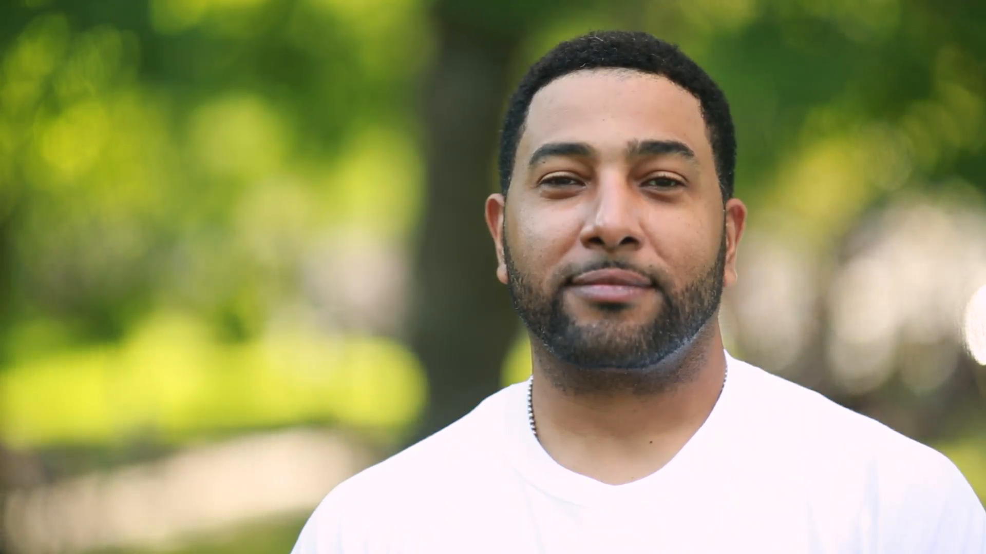
“I have something to tell you …

Slide 24
… but you have to promise not to tell anyone.”

Slide 25
Your answer?
“I’m sorry but I cannot make that promise.”
“I want to ensure that you are connected to the right person to help, and that may not be me.”
“I have responsibilities as an employee of the university that may preclude me from keeping your information secret.”
“I will only tell others who have an absolute need to know and be respectful of you in the process.”

Slide 26
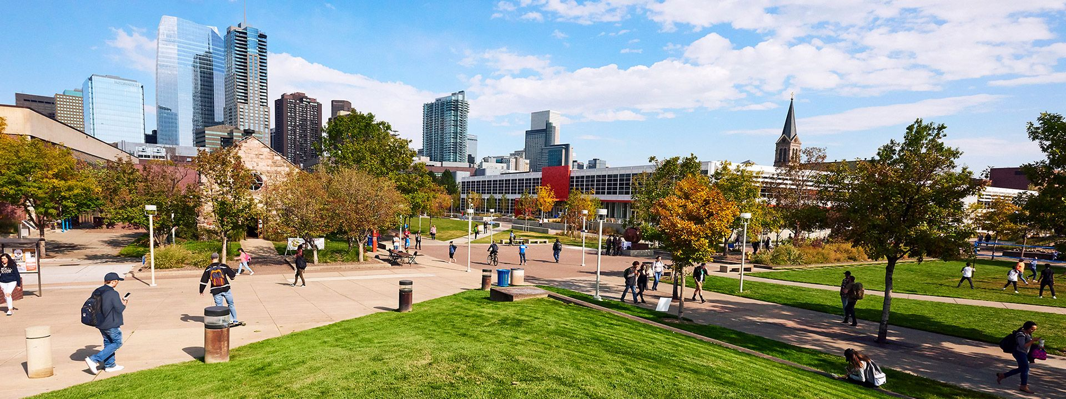
Referrals 101 – get ‘em to connect

Slide 27
We are people who work with people. Tip: Call us or swing by along with the student!

Slide 28
Follow up.
Let the student know you’ll check in later. (Then do!)

Slide 29
Don’t let uncertainty stand in the way.
Let us determine if we can help with on- and/or off-campus resources and referrals.

Slide 30
Final thoughts….
Faculty perspective is INVALUABLE to our teams’ ability to effectively program to support and serve our students.
We welcome feedback. We have work to do. We want to hear from you related to ways that we can evolve and advance our efforts to be as relevant and effective as they can be.

Slide 31
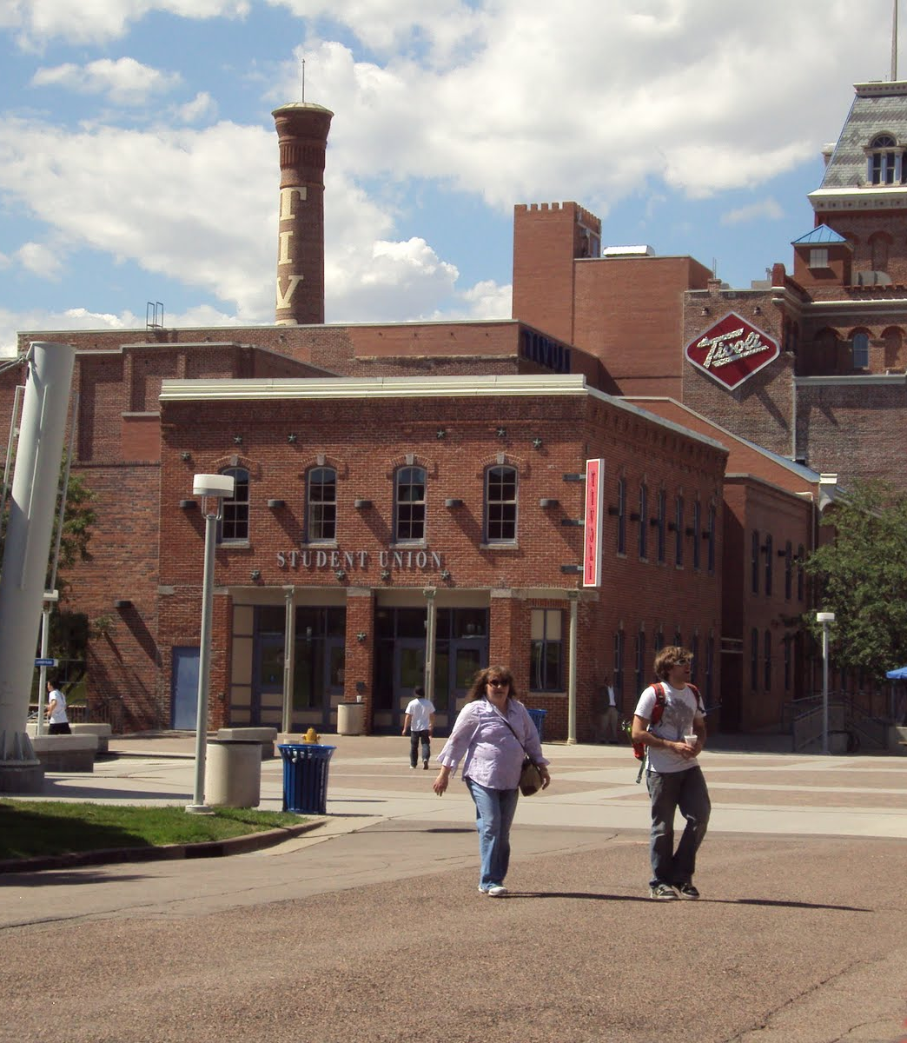
Student Engagement & Wellness/ Dean of Students Office Tivoli 343 303-615-0220 bpantel@msudenver.edu deanofstudents@msudenver.edu

