Slide 1
MONEY MATTERS Wednesday, October 31, 2018

Slide 2
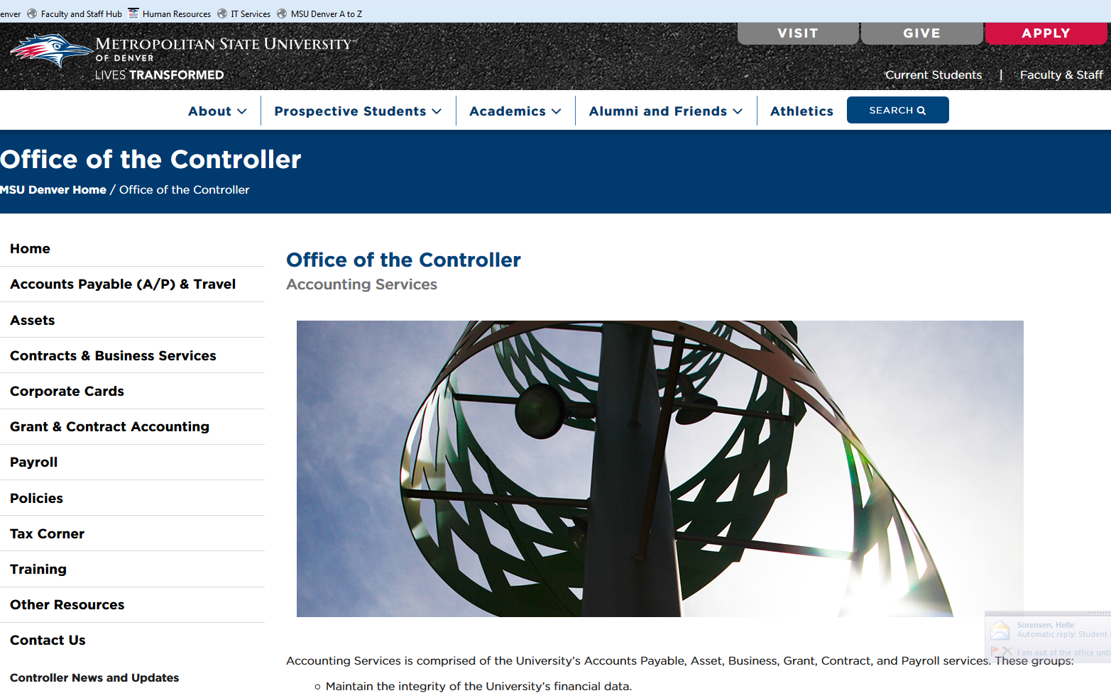
Introduction:
Liza Larsen: Controller
Webpage: https://www.msudenver.edu/controller/

Slide 3
Agenda:
-Changes to Banner Pay ID’s: What it means and doesn’t mean.
-New Honorarium Form- Fast tracking honorarium payments.
-Corporate Card Points- Follow up on the points system.
-Change in Backup Requirements for Ricoh payments on the C-card
-Chrome River- Update and timing of roll out.
-New Thoughts on How to Process a Purchase- Brainstorming new processes to make purchasing easier: one suggestion from Accounting.
-Banner Finance 9- Not the same ol’ Banner!
-Signatory Log and Related Materials– Where the log and other materials are going.
-Agency Fund Reports- Why are they being sent out anymore?
-Update on Accounting Services Action Plan- How your suggestions are turning into action.
-Housekeeping- Misc reminders.

Slide 4
Changes to Banner Pay ID’s: What it is and what it means.
Each time there is a payroll processed several jobs and processes are completed. Most of our employees are paid monthly but some are paid bi-weekly, so that means we have to run those jobs and processes 36 times a year (12 monthly plus 24 bi-weekly).
However, when we brought Banner up in 1999 we separated employee types out into 6 separate Pay ID’s.
MX- Monthly Exempt
MD- Monthly Deferred
MM- Monthly Misc
BW- Bi-Weekly (now SM- Semi Monthly)
MC- Monthly Classified
PF- Part Time Faculty
These Pay ID’s were nothing more than a way to separate the significant amount of employees into manageable batches so errors would be easier to find.

Slide 5
Changes to Banner Pay ID’s: What it is and what it means.
So instead of running the payroll jobs and processed 36 times a year we have to run them 96 times (6 pay ID’s times 12 months plus 24 bi-weekly).
We’ve been in Banner for almost 20 years now and the separate Pay ID’s are no longer helping us save time, in fact, those extra processes are slowing things down.
In an effort to fix this Payroll and Human Resources have been working together to reduce the number of Pay ID’s…

Slide 6
Changes to Banner Pay ID’s: What it is and what it means.
Beginning with the Sept. 2018 payroll Banner Finance Payroll ID’s are separated as follows:
MC- All Classified Employees
MD- All Full Time Faculty and Chairs
MX- All Administrative Staff
PF- All Part Time Faculty
SM- All Hourly Staff (The MM payroll was incorporated here in Aug 2017)
(Prior to this change Faculty and Chairs were in the MX Pay ID)
We are hoping to continue to streamline the Pay ID’s to the following:
MC- All Classified Employees
MD- All Administrators, All Faculty and Chairs
SM- All Hourly Staff

Slide 7
Changes to Banner Pay ID’s: What it is and what it means.
What these changes mean:
-If you used the Pay ID’s to run reports in Banner you may need to update those reports to ensure you are getting the correct payroll expense.
-If you looked for a Chair’s time sheet in the MX pay ID under web time entry you must now look for their timesheet under MD.

Slide 8
Changes to Banner Pay ID’s: What it is and what it means.
What these changes DO NOT mean:
-There is NO impact to employee
Classification
Pay amount or timing
Benefits
Tenure
Status
Contract terms or dates

Slide 9
New Honorarium Form: Fast tracking honorarium payments
Problem: We received some concerns over how much paperwork there is for paying an honorarium.
ICPS packet= 12 pages (5 pages of forms if you sign up for ACH, 7 pages of instructions)
What is an “Honorarium”? An honorarium is a gratuitous payment to an individual for “usual academic activity”, i.e. lecturing.

Slide 10
New Honorarium Form: Fast tracking honorarium payments
What an honorarium isn’t?
Payments to or for:
-Employees
-Companies
-Goods
-Goods or Services submitted on an invoice
-Scholarships

Slide 11
Honorarium Classification Flow Chart
START
Is the recipient a business, corporation, or partnership?
YES
Not an Honorarium. This is payment for services.
Not an Honorarium. This is payment for services.
NO
Is the recipient an employee of the University?
NO
Is this payment for “usual academic activity?”¹
YES
Is this payment a contractual arrangement or did the recipient invoice or negotiate payment with the University?
Is the recipient an international visitor?
YES
NO
YES
Has this recipient accepted payments from more than 5 institutions in the last 6 months? ²
NO
Does the activity or event last longer than 9 days? ³
YES
NO
NO
NO
Not an honorarium.
This is a salary supplement to be handled by Human Resources.
Not an Honorarium.
This is payment for services.
Does the recipient perform this service for a living? ⁴
YES
This qualifies as an honorarium.
YES
Not an Honorarium. This is payment for services.
Not an honorarium. This is payment for services. ⁵
YES
NO
Not an Honorarium.
This is payment for services.
This qualifies as an honorarium.

Slide 12
Corporate Card Points: Follow up to the points system
We’re 7 months post C-Card points implementation. How is it going?

Slide 13
Change in Ricoh Backup Requirements for the Corporate Card:
You can’t provide what you don’t have.
There is still risk so we need to start a tag team approach:
Departments Accounting Services
You still must verify if they We need to hold the vendor accountable
are billing you the correct to doing what they said they would do.
Amount.

Slide 14
Chrome River Update
What is Chrome River?
Chrome River is an integrated system that will work with Banner to replace the old paper Travel Authorization (TA) forms as well as the Wells Fargo Portal for C-Card re-allocations, to provide a streamlined approach to expense reports.
Who will use it?
Anyone who submits a travel authorization form or uses a C-card will need to know how to use this system.
When can we start using it?

Slide 15
Chrome River Update
Information Technology continues to work on this implementation but we’re still…
However…

Slide 16
Chrome River Update
We have a test environment in which a pilot group is working and that environment allows us to also provide demos.
Interested in a demo for your office or do you want to become part of the pilot group?
Contact Simone Chavous at: Schavous@msudenver.edu

Slide 17
New Thoughts on How to Process a Purchase
MSU Denver is governed by a lot of rules while can create complexities in our processes.
We understand that a lot of people are impacted by our purchasing process and we want to make it as simple as possible.

Slide 18
New Thoughts on How to Process a Purchase
How do we simplify a process that has a lot of conditional rules, i.e. if the purchase is over $10K then do this, unless you buy item “Y” on the C-Card then do that?
We began brainstorming on pulling together a committee to “lean” up the process, when one option came to mind…
A central repository to submit purchasing requests.
What are your thoughts on this option or maybe others?

Slide 19
Banner 9 Not the same ol’ Banner
Banner 9 for Finance is scheduled to go live on December 4th 2018
-If you haven’t been in it please do so as soon as possible.
-Things look and feel different.
CNTL PG DOWN is no longer a command
-It is slower now, but should improve (hopefully)
Link to Banner 9
https://tb9nv01.msudenver.edu:8443/applicationNavigator

Slide 20
Banner 9 Not the same ol’ Banner
Don’t let frustrations keep you out of the system. We are offering Finance training in SSB304 on the following dates and times:
11/06 9:00-10:30
11/07 8:30-10:00
11/08 2:30-4:00
11/13 3:00-4:30
11/14 1:00-2:30
11/15 10:00-11:30
11/27 9:00-10:30
11/29 1:00-2:30
Link to sign up for training:
https://msudenver-my.sharepoint.com/:x:/r/personal/tclark58_msudenver_edu/_layouts/15/Doc.aspx?sourcedoc=%7B249b3158-d96f-4c57-ba0f-9e65a81767a2%7D&action=default
Please contact Troy Clark at TClark58@msudenver.edu if link isn’t working

Slide 21
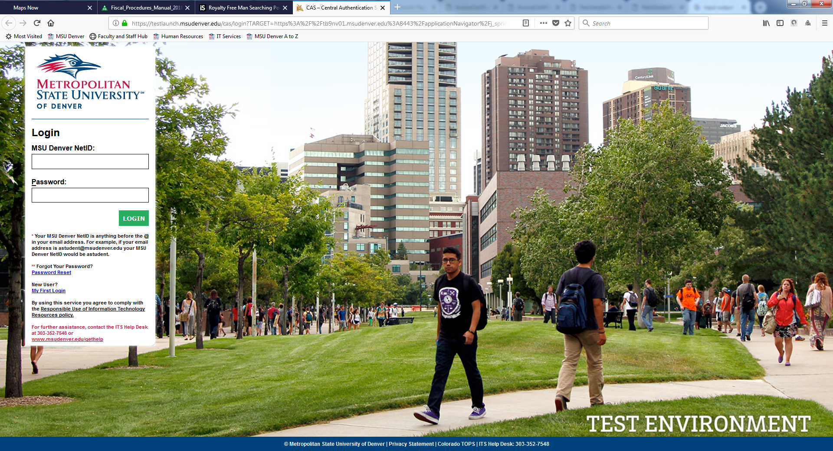
Banner 9 Not the same ol’ Banner
Banner 9 Link:
https://tb9nv01.msudenver.edu:8443/applicationNavigator

Slide 22
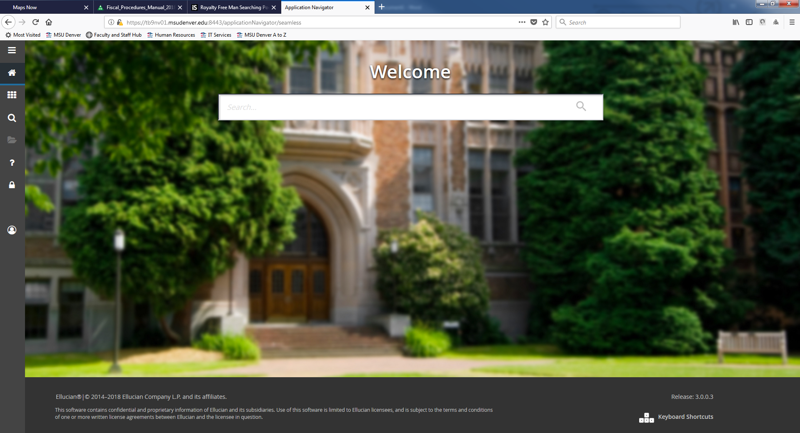
Banner 9 Not the same ol’ Banner
https://tb9nv01.msudenver.edu:8443/applicationNavigator

Slide 23
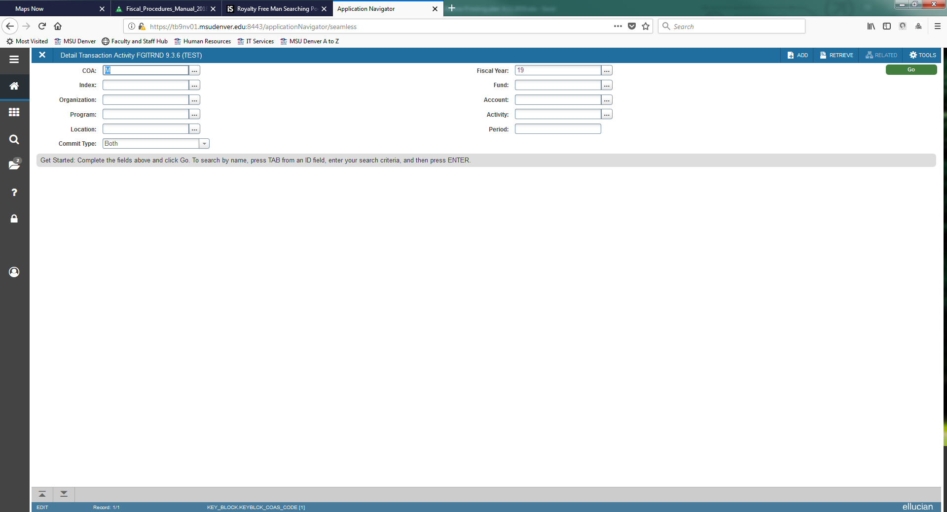
Banner 9 Not the same ol’ Banner
FGITRND

Slide 24
Banner 9 Not the same ol’ Banner
If you use Banner Finance now, please do not wait until December 4th to log into the system.
Questions on Banner Finance 9 please contact Troy Clark TClark58@musdenver.edu

Slide 25
Signatory Log and Related Materials
What is the Signatory Log?
A list of authorized signers, aka people who can financially commit the University.
Where is the Signatory Log?
It used to be on the Controller’s website and every year we asked you to verify the signers for your department. I removed it from the webpage for security concerns, and we are working to get it behind a layer of user authentication.
Other Materials that will be Removed from the Controller’s website:
Training materials, forms, policies and guidance. If the document helps you perform your job it will be moved.

Slide 26
Agency Fund Reports
Speadsheet Server was a new reporting tool that we used to build and automatically send reports to custodians of Student Clubs and Study Abroad Funds. The process was working pretty well until the reports stopped running.
We couldn’t get them working again so we had to work with Information Technology to find another solution. With their help these reports will start going out again on November 1, 2018. Then they will be sent automatically on the 1st and 15th of every month.

Slide 27
Agency Fund Reports
Because the recipients of these reports vary in financial background they are intended to be basic and only offer fundamental information. However, if you receive these reports and they are not providing the kind of information you’d like to see please let us know by simply replying to the e-mail you received that contained the report or e-mail MMarutl1@msudenver.edu

Slide 28
Agency Fund Reports
What are you supposed to do with these reports?
-Please look them over, and if the figures do not appear to be correct contact us and tell us your concerns.
-If the balance is negative please contact us immediately and we’ll work together to find a solution.
-If it’s a Study Abroad course that has been completed and there is any balance at all, contact us right away and we’ll help you close out the fund.
-If it’s a zero balance or you won’t be using the Fund any longer please contact us and we’ll help close it out.
-If you don’t know why you’re getting this report, contact us and we’ll get the report to the right person or help you understand why you are getting them.

Slide 29
Accounting Services Action Plan
Response to Feedback:
Back in June 2018 we solicited your feedback for areas we needed to work on.
Two over arching themes were:
- Simplify the purchasing process (which includes items from purchase orders to contracts, to invoices, to C-card and approvals, etc)
-Better Communication

Slide 30
Accounting Services Action Plan
We Listened:
We’re creating a customer service training for all Accounting Services employees.
We recently sent out a survey specifically asking about our customer service and we received some responses about what you’d like to see. We’ll use that feedback as we build our customer service training program.
We’re creating a contracts training that will allow departments to do their own reviews of vendor agreements which will speed up the time to complete a contract.
If you don’t want to do these types of reviews, no problem, we’ll continue to do them in house as well. The training is currently under review and will be shared once it’s completed.

Slide 31
Accounting Services Action Plan
We Listened:
We’re creating a management training program for all the Accounting Services managers.
We want to make sure our managers are more than just good accountants. We want them to be able to successfully engage the Accounting staff to ensure they are getting the support and guidance they need. Happy employees helps make happy customers.
We’re creating a formal communication plan that helps ensure we are offering timely, inclusive and helpful information.
We’ve double the Money Matter’s meetings from one to two, we’re working with Marketing and Communications to have a regular voice in the Early Bird, we’re working on a Tax Forum that will outline MSU Denver’s responsibility on taxes and how departments play an important role, and we’re brainstorming the idea of regular meetings with the Deans, Chairs, fiscal managers and others.

Slide 32
Accounting Services Action Plan
We Listened:
We’ve already reviewed Chrome River, and our initial thought about a purchasing repository, which we hope will create a more efficient expense reporting process.
We’re working to create “3 minute expert” videos that will help break down the “hows” and “whys” of Accounting. We have a few ideas to start with like Banner 9, how to buy something, the financial side of Study Abroad Funds, but if you have something you’d like to see please let us know.
These are just a few of the plans we’ve put into place to help support you in your role. But we always want to hear your thoughts on process improvement.

Slide 33
Housekeeping: Misc reminders
-Easy to do business with:
We’re here to make things easier. If we’re not please let me know at:
https://www.msudenver.edu/controller/contactus/questionorconcern/

Slide 34
Housekeeping: Misc reminders
Accounting Services has several E-Mail addresses to better support your questions.
CorporateCard@msudenver.edu- Anything related to C-Cards, including statement submission.
AcctSvcs@msudenver.edu- Requests for wire payments, Banner Finance security and FOAPAL setups/changes.
Grants@msudenver.edu- Anything related to Grants.
Payroll@msudenver.edu- Anything related to Payroll, including moving expense requests.
AccountsPayable@msudenver.edu- Payment requests and SPO submission.

Slide 35
THANK YOU!

