Slide 1
MONEY MATTERS Monday, November 18, 2019

Slide 2
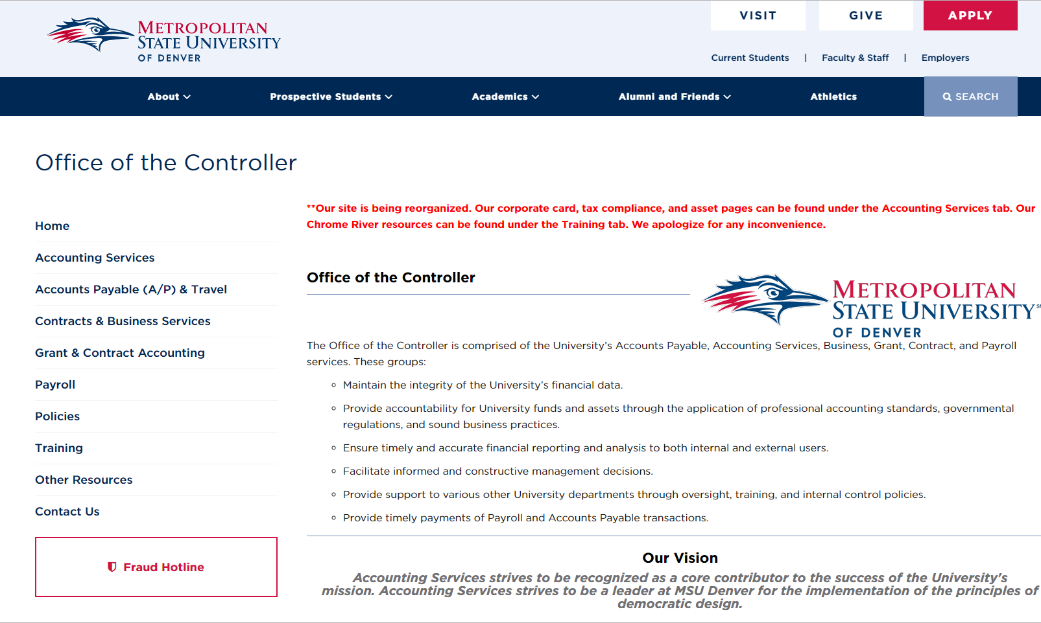
Introduction:
Liza Larsen: Controller
Webpage: https://www.msudenver.edu/controller/

Slide 3
Agenda:
-Fed up with Ricoh? Here’s what we’re doing.
-NPO/NPS: Updates and Improvements.
-Fiscal Year 2019 Re-Cap and What We Need to Change for FY20.
-Safe File Transmission: How to get sensitive information to the Controller’s Office, including Purchase Requisitions.
-Auxiliary Overhead Fees: What are they and what is changing?
-Credit Card Rebates: Vote on how they are spent.
-Fraud: Where, what and how to report suspicions of fraud.
-Donations vs. Sales: What is the difference and why does it matter?
-Amazon: To Prime or not to Prime?
-Rental Car Insurance: You may need to buy it.
-IT related purchases: What approvals are necessary.
-Moving expenses: Reminder on how they are paid.
-Bulk mail permit: Mail services you didn’t know you had.
-AP direct deposit on line- removal: Change to the webpage.
-Touching Base on Chrome River: Travel preapprovals, training, and reminders about routing.
-Housekeeping- Misc reminders.

Slide 4
Fed up with Ricoh?
After considerable billing problems we’re looking for a new partner.
We’ll be doing an RFP in January, 2020
What does that mean?
If a new vendor is selected
- Hopefully, billing will improve,
- There may be new kinds of problems,
- You will need to finish your existing Ricoh contract*
* If your existing contract expires between now and a new vendor, you can go month to month. If you sign another contract with Ricoh you’ll need to allow that to expire before changing vendors.

Slide 5
Fed up with Ricoh?
Why do we have to work with only one vendor?
-Bulk Savings,
-Improved Service,
-Efficiencies in getting connected to the network.
What will the new contract cover?
-Networked printers with a focus on:
-prompt, accurate billing,
-a dedicated customer service rep,
-competitive price,
-high quality and varied products.

Slide 6
NPS/NPO (updates and improvements):
What is an NPS and how is that different than an NPO?
First some history:
- We are a state agency and must follow state rules unless specifically exempted from them. We are also subject to federal rules.
- The state says if you’re going to hire someone to do something for you, you cannot displace a state employee. Additionally, the IRS says if certain conditions exist someone may qualify as an employee and not a contractor.
In order to determine if you are hiring an employee or a contractor, and therefore to determine if you may be displacing a state employee, the state requires you to fill out a CPS form and get it approved, by an authorized delegate BEFORE agreeing to any work.
So we had to build a process to get information submitted beforehand…
Notes:
Originally we had an ICPS form, which as you can imagine was often confused with the CPS.

Slide 7
NPS/NPO (updates and improvements):
What is an NPS and how is that different than an NPO?
NPS-A form to be used when you want to pay someone (less than $10K) who isn’t an employee for doing services. It stands for “Non Employee Personal Services”
NPO- A number that was originally intended to eliminate the need for an Special Purchase Order (SPO), and would allow departments to only submit the NPS once if multiple payments were necessary.
Notes:
The NPO was never intended to be a replacement for the SPO, it was supposed to eliminate the need for an SPO.

Slide 8
NPS/NPO (updates and improvements):

Slide 9
NPS/NPO (updates and improvements):
Proposal:
Services UNDER $10K
Eliminate the NPO.
No CPS needs to be submitted.
Use the SPO if you want, but it is not required.
If you don’t use the SPO then you must use the NPS, BUT
Nothing needs to be submitted before the services are rendered, only submit the NPS/invoice when you want to make a payment.
NPS SPO CPS
OR

Slide 10
NPS/NPO (updates and improvements):
Clarification:
Services OVER $10K
Submit a PR (purchase requisition) WITH a CPS BEFORE services are performed.
PR CPS
AND
Needed when working with a company OR a person.

Slide 11
FY19 Re-Cap
Year-end and why it matters:
-An audit with many comments can:
-Negatively affect bond ratings and bond sales,
-Result in higher interest rates on borrowed funds,
-Limit industry leaders who want to partner with us,
-Result in more audits,
-Affect the general public opinion of the University as a whole,
-Limit the number and types of grants the University is eligible for.

Slide 12
FY19 Re-Cap
Year-end and why it matters:
-Issues that can cause audit comments:
-Missed accruals (not recording all current year expenses OR revenues),
-Error in prepayments (not calculating the correct portion of an expense for the year),
-Delays in providing information.
Things the Office of the Controller does to help ensure correct/timely information:
-Send the year end e-mail showing your outstanding encumbrances,
-Send e-mail reminders to approve payments,
-Send e-mail reminders to submit Chrome River transactions.
-Send a year end calendar with all due dates.

Slide 13
FY19 Re-Cap
Year-end and why it matters:
Things you can do to help ensure correct/timely information:
-Reviewing and replying to encumbrance balance e-mail (which includes creating encumbrances in the fiscal year you expect to receive the goods/services- not when you want to pay for them).
-Approving payment (regardless of how much money you have).
-Submitting Chrome River transactions and transfer requests by the deadline.
-Meeting all the year-end deadlines and responding to e- mails from the Office of the Controller timely.
-Keeping open communication and asking for help if something doesn’t make sense.
-Reviewing and Updating the Signatory Log.

Slide 14
Safe File Transmission
Documents with sensitive information must be protected!
Please use the Secure drop box on the Controller’s website when you are submitting sensitive information.
Examples of some documents:
NPS
SPO
New Vendors (W9’s ACH, etc.)
Any personal information.

Slide 15
Safe File Transmission
Purchase Requisition Submission
Current: Dept
Dept AHEC MSU Denver AHEC
Not secure Vendor
Proposed: Dept
Dept MSU Denver AHEC
Vendor
Starting today please submit all PR’s to the drop box.
https://www.msudenver.edu/controller/
secure

Slide 16
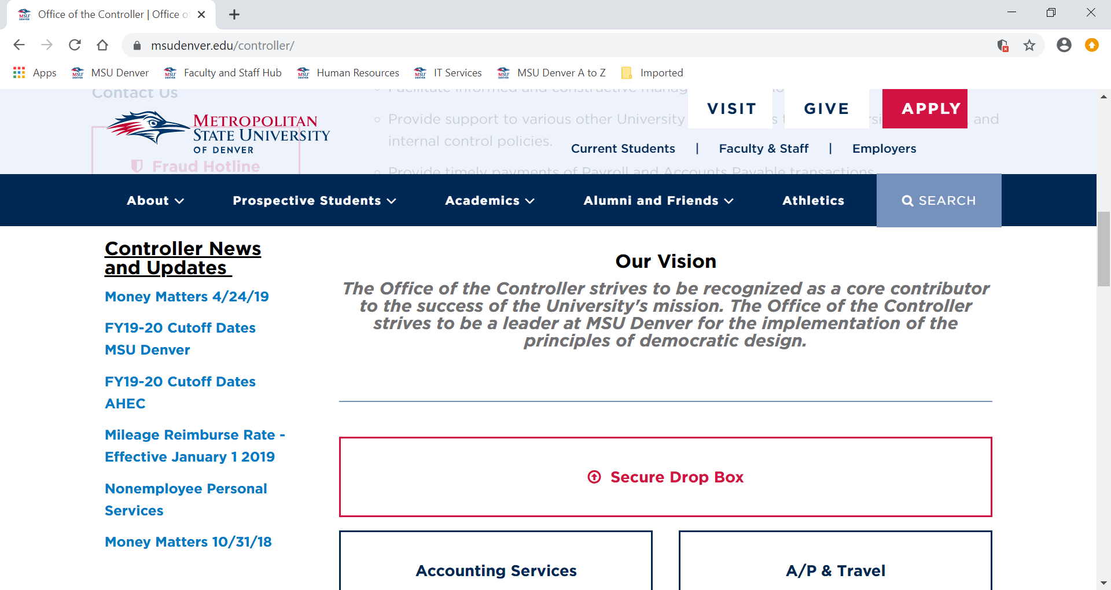
Safe File Transmission

Slide 17
Aux Overhead Fees
What is an Auxiliary Overhead Fee?
Let’s first start with defining an Auxiliary:
FUND TYPES
General AUXILIARY Loan Grant Plant Presentation

Slide 18
Aux Overhead Fees
What is an Auxiliary Overhead Fee?
AUXILIARY- Are mini businesses that must be self supporting.
Like any successful business Revenues must be larger than Expenses.

Slide 19
Aux Overhead Fees
What is an Auxiliary Overhead Fee?
When you operate an Auxiliary there are some bills you don’t pay directly i.e.:
- Electricity
- Water
- Rent
- Insurance
- Custodial Services
- Bank fees (merchant fees for credit cards)
- Salaries and benefits of staff who do administrative work like:
-Hiring/paying employees
-Paying your vendors
-Maintain your financial data
So in order to ensure the Auxiliaries pay their fair share of these services they pay “overhead fees”…

Slide 20
Aux Overhead Fees
What is an Auxiliary Overhead Fee?
Overhead fees come in the form of:
ASR: Administrative Service Recharge - 10% fee on all revenues
Bad Debt - 2% fee on all revenues (only accounts 51XX)
Unemployment, Workers Comp and Risk - 0.75% on all payroll (except 619X accounts)
Are you really charging me only for what I am using?

Slide 21
Aux Overhead Fees
Are you really charging me only for what I am using?
ASR-10% fee on all revenues
There is a student audit going on now to look into this rate to see if it is appropriate. A report is expected in mid-December.
Bad Debt-2% fee on all revenues (only accounts 51XX and 52XX)
Bad debt is reviewed by the Bursar’s office every year and we hover around 2%.
Unemployment, Workers Comp, and Risk- 0.75% on all payroll (except 619X accounts)
The Controller’s office looked into this at the end of FY19 and found that the rate appears to be too high. We worked with the Budget Office and have lowered this rate to 0.65%. We will continue to monitor and recommend changes if necessary.

Slide 22
Credit Card Rebate
Let’s grow our Credit Card Rebate to help our students!
Any growth up to $25K will go
to a program to help students
FY19 $168K
FY18 $153K
FY17 $120K
Notes:
Any growth we realize in FY20 over FY19 (up to $25K) can be redirected to a student program in FY21. No growth no money. We’ll need to spend approximately $XM more in FY20 to get the full $25K which is only about $X per month which is certainly doable. What would you like to see that money spent on?

Slide 23
Fraud Reporting
IF YOU SEE SOMETHING SAY SOMETHING!!
But what if:
-You’re not certain of all the facts,
-You don’t know if it’s actually fraud,
-It was only one time or not really a big deal
-You don’t want to get anyone in trouble,
-You like the person you think is being dishonest,
-You’re scared about retaliation,
-You don’t want to get involved,
-You don’t know who to tell.
https://www.msudenver.edu/controller/
Notes:
We serve a distinct mission in our community and our ability to be successful depends in large part to how we use our resources.

Slide 24
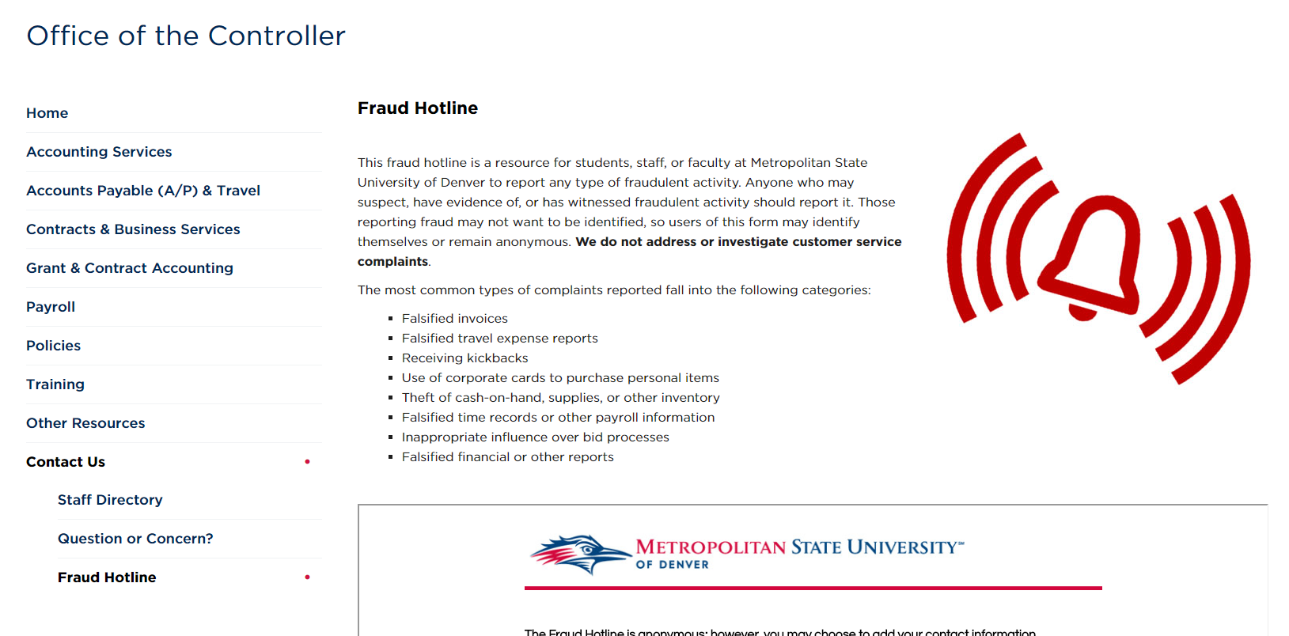
Fraud Reporting
Internal Reporting
https://www.msudenver.edu/controller/

Slide 25
Fraud Reporting
External Reporting
https://leg.colorado.gov/agencies/office-state-auditor/report-fraud-concern

Slide 26
Bulk Mail Permits
-Do you mail at least 200 items or more at a time?
-Can you easily sort them by zip code?
-Do you want to save money on postage?
If you answered “yes” to all these questions we may be able to save you money!
BULK MAIL PERMIT
Code = 973
Please call 6-0039 if you would like to use the permit.

Slide 27
Donations vs. Sales
What’s the difference?
Donation Sale
value value
General Examples
Gift Bake Sale
Go Fund Me Ticket Sales to an Event
Sponsorship with no exchange Sponsorship with Ads
Auction

Slide 28
Donations vs. Sales
Why does it matter?
Foundation University
Donation Sale
value value
Mission Option
Infrastructure Infrastructure
Audit Comment

Slide 29
Amazon
Yay Boo, Yay Boo, it’s lots of fun to do, if you like it holler YAY, if you don’t you holler BOO!
We have Amazon accounts here at the University- YAY!
They don’t come with Amazon Prime- BOO!
People can still ship things via Prime- YAY!
But they pay for it- BOO!
We can change our current University Amazon accounts to include Prime, but it comes at an extra cost. We’re looking into centralizing the Prime membership and related costs. We’ll keep you posted on any changes.
Please remember:
-Not every shipment is eligible for Prime
-Accounts must be University accounts- tied to a University e-mail

Slide 30
Rental Car Insurance
No car rental insurance is necessary.
You are covered if:
1) You use the state of Colorado price agreement CDP#s
State: 65579 MSU Denver: 1946331
2) You are on official University business

Slide 31
Rental Car Insurance
Any other car company you MUST purchase rental car liability insurance in the amount of $1M.
The C-card only covers property damage to items inside the car as well as the car itself, but does not cover damage to other cars, property or people. So you are not properly covered if you do not purchase the car insurance.

Slide 32
IT Related Purchases
IT must approve IT related purchases to make sure:
- they can support it,
- that we don’t already have it,
- that the department even needs to pay for it.
Over the past several years some software has been purchased without IT’s approval and it’s causing some problems.
IT is looking into centralizing these purchases, via MCC control. What are your thoughts?

Slide 33
Moving Expense Reimbursements
As part of some employment negotiations some new employees are offered reimbursements for moving expenses.
Before the Tax Cuts and Jobs Act (Trump’s tax reform) moving expenses that met certain criteria were tax free; however, now all these types of reimbursements are taxable.
What does that mean?
- Don’t submit moving expense reimbursements on a check request or otherwise to Accounts Payable.
-These negotiations must be a part of the employee’s offer letter and will be paid in the employees first payroll and counted as wages.
- Receipts are only necessary if it is part of the employment agreement.

Slide 34
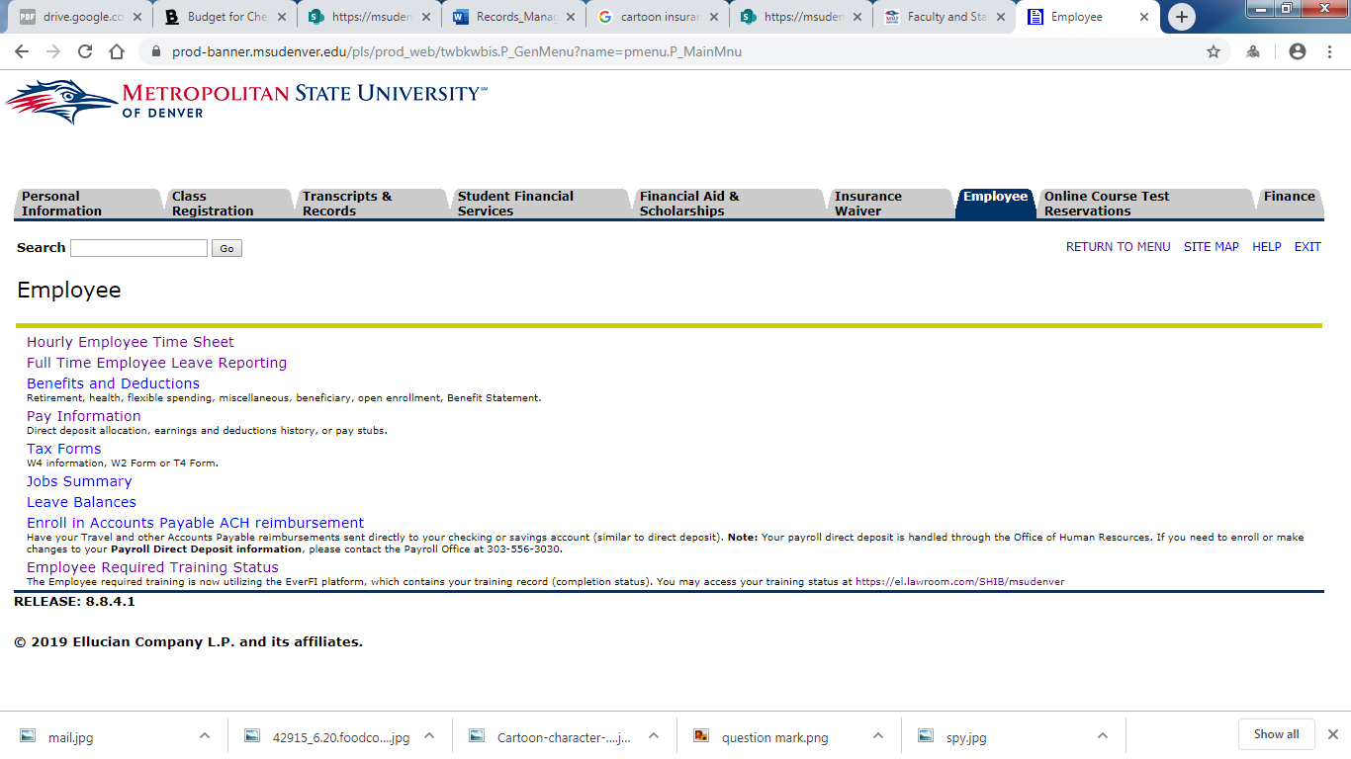
A/P Direct Deposit Link

Slide 35
Chrome River
-Training is still available
-In class training,
-In person training,
-Training from your liaison.
https://www.msudenver.edu/controller/training/chromeriver/
-Chrome River App (CR SNAP)
-You can upload images of receipts but you can’t process reports.
-Pain points with Pre-Approvals
-Pre-approvals and advance requests are different,
-Pre-approvals when you’re not filing your final TA
PREAPPROVALS ARE ONLY REQUIRED TO BE ATTACHED TO THE FINAL TRAVEL REPORT*
*Departments may still require it

Slide 36
Chrome River
-Submitting a final TA when an advance was received
-Don’t click on “university paid” for items you paid for with advance dollars.
-If you owe advance money back you pay it back at the Cashier’s office but you have to indicate that in Chrome River.
-Approvals
-Who approves what?
Travel Credit Card
- You (if a delegate submitted -Signatory
it on your behalf)
- Supervisor
- Signatory
- Dean (international travel)
- Dean of Students (internat’l student travel)
- VP (international travel)

Slide 37
Misc Housekeeping
OFFICE OF THE CONTROLLER
ACCOUNTING ACCOUNTS BUSINESS GRANTS AND PAYROLL
SERVICES PAYABLE SERVICES CONTRACTS
-Cash Mgt -A/P -Contracts -Grants
-Financial Rpt’g -Travel -Fee for Service
-Fixed Assets -Corporate Contracts
-Systems Card -Compliance (tax)
-Training

Slide 38
Housekeeping: Misc reminders
The Office of the Controller has several E-Mail addresses to better support your questions.
CorporateCard@msudenver.edu- Anything related to C-Cards, including Chrome River questions.
AcctSvcs@msudenver.edu- Requests for wire payments, Banner Finance security and FOAPAL setups/changes.
Grants@msudenver.edu- Anything related to Grants.
Payroll@msudenver.edu- Anything related to Payroll.
AccountsPayable@msudenver.edu- Payment requests and SPO submission.

Slide 39
THANK YOU! Calc-u-later

