Slide 1
MONEY MATTERS Wednesday, April 24, 2019

Slide 2
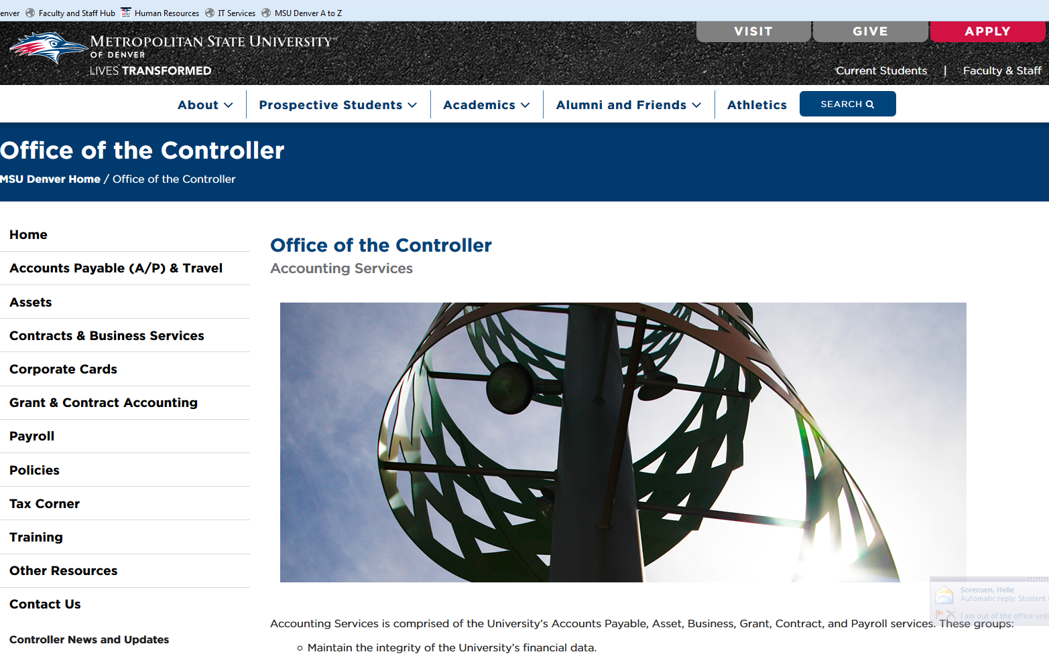
Introduction:
Liza Larsen: Controller
Webpage: https://www.msudenver.edu/controller/

Slide 3
Agenda:
-Fiscal Year End Deadlines: Dates to watch out for.
-Chrome River: Smooth Sailing.
-Corporate Card Points: A thing of the past.
-Sales Tax on the C-Card: Is it allowed?
-SPO or NPS: What’s the difference?
-Ricoh Update: Update on invoices and payments.
-Food and Beverage: What information needs to be submitted for a list of attendees? Help with policy.
-Last Invoice on Encumbrances: Help with request.
-When to Create a FOAPAL: Help with timing.
-Insurance Coverage on Travel Status: What’s covered and what isn’t.
-Mail Slips for Mail: What are they and do you need them?
-Action Plan Update- What has Accounting Services been doing?
-Staffing Updates- Who’s who in the zoo.
-Housekeeping- Misc reminders.

Slide 4
Fiscal Year End Deadlines:
Dates to Remember:
- April 26th : Transfer requests due for all items from 07/01/18 – 03/31/19
- May 14th : Transfer requests due for all items from 04/01/19 - 04/30/19
- June 7th : Finalize all completed travel with an advance
- June 14th : Transfer requests due for all items from 05/01/19 - 05/31/19
Review Signatory log
- June 27th : Last check/ACH run for FY19
Last day to make deposits at the Cashiers Office- Noon
(PLEASE CONTACT QUYNH NGUYEN IF YOU ARE OWED MONEY THAT YOU HAVEN’T RECEIVED BY THIS DATE)
Approval of time entry closes for SM13

Slide 5
Fiscal Year End Deadlines (con’t):
Dates to Remember:
- July 3rd : Last day to submit C-Card expense reports in Chrome River.
- July 5th : Last day to approve a C-Card expense report in Chrome River.
- July 9th : Transfer requests and accruals for 4* Funds due.
- July 11th : Transfer requests and accruals for all other Funds due. Noon

Slide 6
Chrome River
Chrome River is the University’s new cloud based travel and expense module.
Quick Facts: -The project started 2 years ago in April, 2017.
- It went live on 4/22/19
- A pilot group of campus users helped create the system.
- You no longer have to submit backup on the C-Card statement AND the TA form, it only needs to go once in an expense report.
- Per Diem is preloaded, no more checking webpages for correct rates.
- No more attaching mapquest maps to mileage forms.
- Receipts can be attached and approvals can be done from your cell phone.

Slide 7
Chrome River (con’t)
Corporate Card Transactions:
Any C-Card transaction with a posting date of April 21st or later must be submitted via an expense report in Chrome River.
There are no more “statement dates”. You can take up to 30 days to submit a C-card transaction in Chrome River.
Automated reminders will be sent from Chrome River, which you can opt out of.
Questions on how to submit an expense report? Contact Troy Clark Tclark58@msudenver.edu
Travel Transactions:
Any travel started under the old paper system can be finalized the old way.
New travel requests must be initiated via Chrome River.
Travel documents must have a preapproval. This is not a new requirement.

Slide 8
Corporate Card Points
In February, 2019 we reviewed the C-Card point system and sent communication out to the campus asking for feedback.
Most people were in favor of moving towards dedicated efforts targeted at specific cardholders, so we adopted that new process starting on March 5.
Any concerns or questions about that change?

Slide 9
Sales Tax on the C-Card
MSU Denver is tax exempt and when you use the C-Card
you should not be paying tax*.
What happens when you do pay tax?
- your department wastes limited resources.
- we reach out to you to have you get a refund from the vendor.
- you have to work with the vendors to get the refunds.
- you have to submit extra documents to support the refund on your card.
* There are some exceptions to our tax exempt status that would require you to pay sales tax, such as buying items for the purpose of resale

Slide 10
Sales Tax on the C-Card (con’t)
Proposal
Sales Tax Amount: Action
< = $5.00 No action taken
> $5.00 Vendor refund of tax required

Slide 11
SPO or NPO
What is an SPO and an NPO?
An SPO (Special Purchase Order) is
- a document that serves as a promise to pay for goods,
- encumbers (earmarks) funds for a particular purpose,
- contains terms and conditions surrounding the purchase,
- Is only for purchases of goods under $10K.
An NPO (Non-Employee Purchase Order) is
- a number that alleviates the need to resubmit NPS packets when you are simply making multiple payments on a previously approved NPS form,
- encumbers (earmarks) funds for a particular purpose,
- does not contain terms or conditions,
- Is only for use on the NPS (i.e. services under $10K).

Slide 12
SPO or NPO (con’t)
When do I need an SPO vs an NPO?
 | SPO | NPO | CPS | Comment
Goods < $10K | Yes | No | No
Goods > $10K | No | No | No | PO required
Service < $10K | No | Maybe | Yes | NPO only needed if making multiple payments
Service > $10 | No | No | Yes | PO required

Slide 13
Ricoh Update:
Some problems we’ve heard: Hopefully some resolutions:
- I’m not getting charged the base rent -Accounts Payable pays the base rent outside of your C-Card. You should be able to see these payments in Banner.
- I’m not getting charged the usage fee -Contact Heather R Monacchio at Ricoh. This should be charged to your C-Card automatically each month.
- My copier isn’t working - Contact Heather R Monacchio at Ricoh. You are under contact and it should be serviced and operational.
- I’m not getting base rent invoices -These are paid by AP and invoices are not scheduled to come to your department. We’re working on a pilot group to get these charges on your C-Card eventually.
- I’m not getting usage fee invoices -Contact Heather R Monacchio at Ricoh. They will get you set up with an account at MyRicoh.com where you can get your invoices on-line.

Slide 14
Ricoh Update (con’t):
A suggestion we’ve received: Some Challenges we see:
- Pay costs for the whole year- up front - If something is missed it’s missed for an entire year.
- Risk of double paying.
- Everyone has a different cycle start and end date so it would be difficult for us to know which payments are missing.
- Time value of money.
What are your thoughts on annual payments and do you have other suggestions or concerns?

Slide 15
Food and Beverage List of Attendees
There is a Food and Beverage Policy (link below) that says a list of attendees must accompany official functions.
We need help with the wording of the policy:
Current Wording
“…a list of attendees must be obtained and remitted to Accounts Payable”.
Proposed Wording:
“…a list of attendees and/or a general description of invited guests must be obtained and remitted to Accounts Payable.”
https://msudenver.edu/media/content/officeofthecontroller/documents/policies/FoodandBeveragePolicy08-05-15.pdf

Slide 16
Final Invoice on Encumbrances
We found a way to reduce some manual work, but we need your help.
If you set up an encumbrance and the amount of all the invoices is less than the total encumbrance we are looking for the best way to ask if it’s the last invoice…
Suggestion:
If this is your FINAL payment against your encumbrance, please let us know to close the encumbrance.

Slide 17
When to Create FOAPAL components
Please help us reduce re-work and last minute rushes by requesting FOAPAL components well in advance of when you need them.
Best practice is to create new FOAPAL before the start of a fiscal year effective July 1st of that new fiscal year.
A
F
O
P
L
A

Slide 18
Insurance Coverage on Travel Status
Am I covered under MSU Denver’s insurance when I’m traveling*?
What is generally covered What generally isn’t covered
- (L) damage you caused to someone -damage to your property else's property while you were working. regardless of who causes the damage.
-(WC) personal injury you sustain while -personal injury you sustain while you are working you are not working, i.e. in transit.
-(L&WC)Employees -Students
- (L) Authorized Volunteer
-Lost or stolen belongings
*Insurance coverage is based on circumstances unique to each case and there is no expressed or implied coverage with the information presented on this slide.

Slide 19
Mail Slips for Mail
If you use AHEC mail services to mail something you must use a mail slip.

Slide 20
Action Plan Update
Some of Accounting Services Tasks for Fiscal year 2019 and 2020:
- Customer Service Improvements
Survey’s sent out in Sept last year,
Each area in Accounting Services developed a plan to improve customer service.
- Communication Plan
We’re developing a plan that will broaden our communication efforts with ideas such as:
-Early Bird Stories
-Meeting with Faculty Senate and Fiscal Managers on a regular basis
-Traveling Road Shows about specific topics to specific audiences
- Contact Training
Pilot group starting within the next month or so.
-Purchasing Review- Pending

Slide 21
Staffing Update
We currently have three vacancies
Payroll Manager - Should start on May 6th
Tax Compliance Accountant – Currently interviewing
Grant Compliance Accountant – Currently interviewing
Molly Dougherty New Admin who among other things assists with encumbrances.

Slide 22
Housekeeping: Misc reminders
Accounting Services has several E-Mail addresses to better support your questions.
CorporateCard@msudenver.edu- Anything related to C-Cards, including statement submission.
AcctSvcs@msudenver.edu- Requests for wire payments, Banner Finance security and FOAPAL setups/changes.
Grants@msudenver.edu- Anything related to Grants.
Payroll@msudenver.edu- Anything related to Payroll.
AccountsPayable@msudenver.edu- Payment requests and SPO submission.

Slide 23
Housekeeping (con’t):
Ricoh contact information:
New Copiers & changes to copiers:
Beverly Dinges
Major Accounts- Higher Education
Ricoh USA, INC
7245 S Havana St., Suite 300
Centennial, CO 80112
Phone: 970-310-3838
beverly.dinges@ricoh-usa.com
Monthly usage fee invoices and payments:
Heather R Monacchio
Area Customer Support Specialist - Rocky Mountain
RICOH USA
7360 S. Kyrene Rd. Suite 101
Tempe, AZ. 85283
Work Phone: 480-379-7024 (Office)
Phone: 480-547-0396 (Cell)
Heather.Monacchio@ricoh-usa.com
.

Slide 24
THANK YOU!

