Slide 1
CAVEA Theater Main Screen
Presentation Template
CAVEA Theater Front Screen Presentation Template

Slide 2
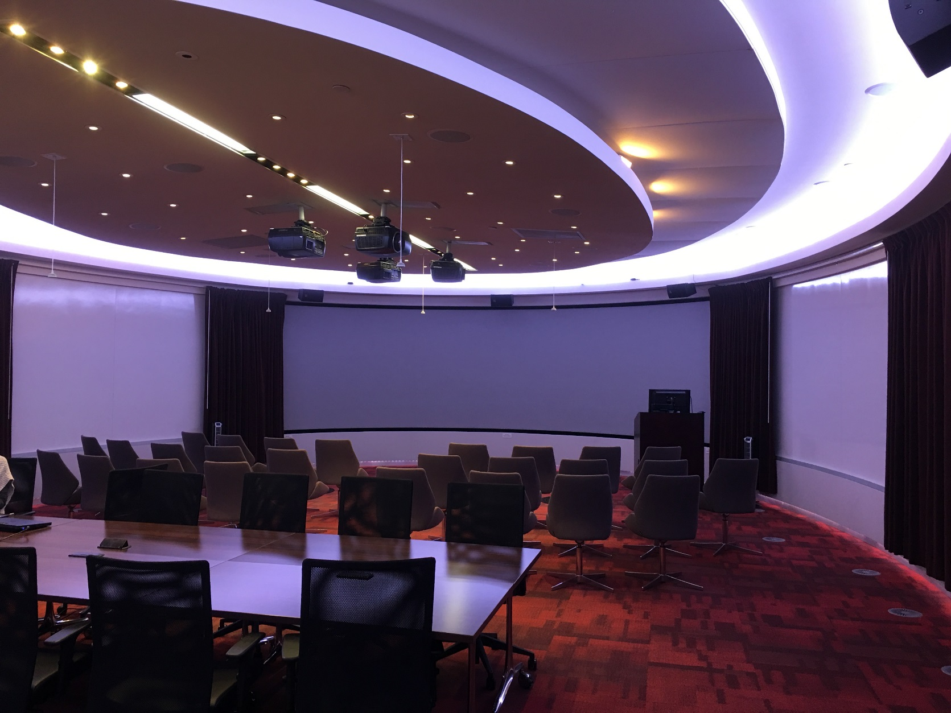
CAVEA Theater Main Screen
The CAVEA Theater Main Screen is a unique rear-projection display with a resolution of 3688 x 1050. This is much wider than typical presentation formats.
CAVEA can accommodate most presentations in most formats. However, using this template will enable you to maximize this unique screen for optimum projection.
CAVEA Theater Front Screen Presentation Template

Slide 3
CAVEA Theater Main Screen
Other features to be aware of while presenting:
Use of space (screen, room)
Acoustic environment
Clicker functions
Room layout
CAVEA Theater Front Screen Presentation Template

Slide 4
PowerPoint Settings for Best Outcomes
Set ‘Custom’ size
Width: 19.9 inches
Height: 5.7 inches
Select the ‘Design’ tab
Select ‘Slide Size’
Select ‘Custom Slide Size’
CAVEA Theater Front Screen Presentation Template

Slide 5
Other Presentation Formats
Slides.com – A theater template is available at: http://slides.com/cavea-msudenver/deck-36#/ NOTE: You must have a Slides.com subscription to use this method
Prezi – Prezi can be used however, it does not accommodate the 3688 x 1050 aspect ratio of the CAVEA main screen. Presentations using Prezi will have black bars on either side of your presentation.

Slide 6
Manual Resolution Settings for Video or Other Media
Display Resolution: 3688 x 1050
Effective for developing presentations in Adobe products (Illustrator, InDesign, etc)
Effective for encoding video where possible
CAVEA Theater Front Screen Presentation Template

Slide 7
Design Choices as Communication
Think about scale and proportion and font selection.
Consider color use: your intent and audience experience.
The bigger the image, the more important the image quality.
How will you balance text to image to your position as presenter?
Remember: all content must fit within the slide space available.
CAVEA Theater Front Screen Presentation Template

Slide 8
Background Color
Font: Arial
Size
20 25 30 35 40 45 50 55 60 65 70 75 80 85
Aa Aa Aa Aa Aa Aa Aa Aa Aa Aa Aa Aa Aa Aa
CAVEA Theater Front Screen Presentation Template

Slide 9
Embedded Material
If your presentation contains embedded materials such as YouTube video and audio, please be sure to have them embedded in a slide.
Test your settings to see if the material plays automatically once you advanced to that slide.
In case the material needs to be introduced before starting, please add an extra animation step in order to play the video or audio on the next click.
CAVEA Theater Front Screen Presentation Template

Slide 10
Content Coordination
Follow your instructor’s direction for content deadlines and delivery.
Rehearsal opportunity will be scheduled through the class.
What questions will help you maximize your time here today?
CAVEA Theater Front Screen Presentation Template

Slide 11
Background and Font
Font: Arial
Size
20 25 30 35 40 45 50 55 60 65 70 75 80 85
Aa Aa Aa Aa Aa Aa Aa Aa Aa Aa Aa Aa Aa Aa
CAVEA Theater Front Screen Presentation Template

