Slide 1

Strategic Plan Preview for the
MSU Denver Community Cabinet
DRAFT
DRAFT
DRAFT
DRAFT
Colleen Walker
AHEC Chief Executive Officer
__________________
In partnership with MSU Denver
Eric Mason
Interim Vice President Strategy, Marketing and Communications
Amy Kern
Associate Professor, Industrial Design Department
DRAFT
DRAFT
DRAFT
DRAFT
DRAFT
DRAFT

Slide 2
Our Goal for the Strategic Plan
Usher in a new era of collaboration and shared success for AHEC and campus partners
Elevate services
Activate campus
Create financial sustainability
Sustain the legacy of Auraria

Slide 3
Engagement and Process
Fall 2020
Workshops with leadership
Spring 2021
Community Engagement Days
Fall 2021
Socialization and re-engage the Community
Summer 2021
Strategic Plan Previews
January 2022
Strategic Plan implementation begins

Slide 4
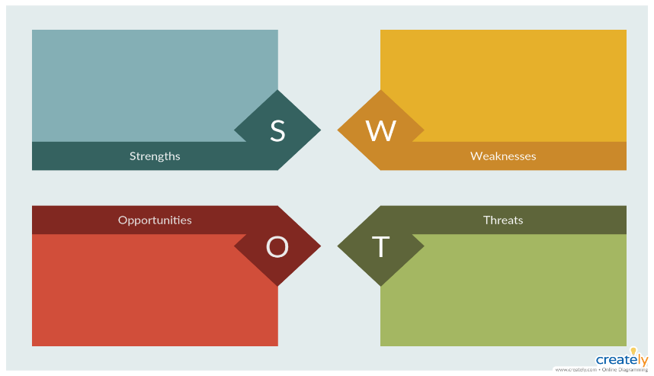
MSU Listening Sessions
What resonates as most important / relevant / proactive in this plan?
What is missing / under-valued in this plan?
How can MSU Denver work with AHEC to realize shared goals?
Are there potential problems or barriers to supporting this plan and its success?
Notes:
See you at the Board next week!

Slide 5
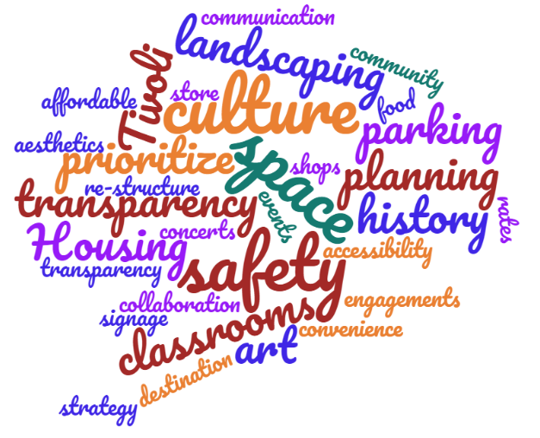
MSU Feedback

Slide 6
Inspiration
“Internationalism does not mean the end of individual nations.
Orchestras don't mean the end of violins.”
Golda Meir
Second Woman in World History to be Democratically Elected to Lead a Nation
Notes:
Internationalism is a political principle that advocates greater political or economic cooperation among states and nations.
Internationalism is a political principle that advocates greater political or economic cooperation among states and nations.^{[1]} It is associated with other political movements and ideologies, but can also reflect a doctrine, belief system, or movement in itself.^{[2]}
Supporters of internationalism are known as internationalists and generally believe that humans should unite across national, political, cultural, racial, or class boundaries to advance their common interests, or that governments should cooperate because their mutual long-term interests are of greater importance than their short-term disputes.^{[3]}
Internationalism has several interpretations and meanings, but is usually characterized by opposition to nationalism and isolationism; support for international institutions, such as the United Nations; and a cosmopolitan outlook that promotes and respects other cultures and customs.^{[2]}

Slide 7
Our Joint Commitment
Support student recruitment and retention
Respect the rights, differences, and dignity of all
Honor our past
Leverage our location
Be a desirable place to learn, work, and come together
Secure our financial future

Slide 8
Strategy Map
Experience Auraria
Expand Impact
Elevate Service
Vibrant Campus
Sustaining the Voice and Legacy of Auraria
Return to the Original Spirit of a Shared Campus
Vibrant Community
Creative and Flexible Funding
Maximize Campus Revenue
Increase Alternative Revenue
Structured for Success
Eliminate the Digital Divide
Community-Minded Mix-Use Development
Reclaiming our Identity
Advocate for Auraria Campus Partner Strategies

Slide 9
Strategy Map
Experience Auraria
Expand Impact
Elevate Service
Vibrant Campus
Sustaining the Voice and Legacy of Auraria
Return to the Original Spirit of a Shared Campus
Vibrant Community
Creative and Flexible Funding
Maximize Campus Revenue
Increase Alternative Revenue
Structured for Success
Eliminate the Digital Divide
Community-Minded Mix-Use Development
Reclaiming our Identity
Advocate for Auraria Campus Partner Strategies

Slide 10
Vibrant Campus
Theme
Experience Auraria
Initiatives
  Enhance student experience by improving common spaces
    Tivoli Student Union
  Improve amenities to increase engagement and utilization
    Hair and nail salons, shipping services, variety of food vendors, convenience store, etc.
Notes:
Create synergy for our students regardless of institution; Tivoli, AELC, Outdoor

Slide 11
Vibrant Community
Theme
Experience Auraria
Initiatives
  Actively foster a connected community
    Cultivate a common sense of belonging
  Create Auraria as a destination
    Community-oriented festivals and events that celebrate diversity
  Embrace our historical sense of place
Notes:
Cinco de Mayo, Jewish Colorado Walk-a-Thon, Pride Month, outdoor concerts/live music, etc.
Creation of a Director of All Campus Events

Slide 12
Increase Alternative Revenue
Theme
Experience Auraria
Initiatives
  Generate revenue sources that activate campus
    Host events, i.e. Farmers Market, Art Fair, Flea Market
  Explore viable, innovative funding models
    Social impact bonds
    Public-Private Partnerships
Notes:
Lease 5th Street Garage retail space

Slide 13
Community-Minded
Mixed-Use Development
Theme
Experience Auraria
Initiatives
  Research demand for and feasibility of expanding campus development in an efficient, effective way
  Partner with local experts to explore potential for housing development through P3 or other partnership opportunities
Notes:
Part of the statute is all about public-private partnerships

Slide 14
Strategy Map
Experience Auraria
Expand Impact
Elevate Service
Vibrant Campus
Sustaining the Voice and Legacy of Auraria
Return to the Original Spirit of a Shared Campus
Vibrant Community
Creative and Flexible Funding
Maximize Campus Revenue
Increase Alternative Revenue
Structured for Success
Eliminate the Digital Divide
Community-Minded Mix-Use Development
Reclaiming our Identity
Advocate for Auraria Campus Partner Strategies
Notes:
PUT ELEVATE SERVICE LAST

Slide 15
Sustaining the Voice and
Legacy of Auraria
Theme
Expand Impact
Initiatives
  Honor and celebrate our history
    Work with the Northern Arapahoe Tribe to construct a recognition garden in the Tivoli Quad
  Engage in reconciliation
    Adopt an Auraria land acknowledgement
    9th Street Park recognition of the Auraria neighborhood
  Build community through diversity, equity and inclusion
Notes:
Reinforce partner designations as Hispanic/Minority Serving Institutions

Slide 16
Creative and Flexible Funding
Theme
Expand Impact
Initiatives
  Re-establish the Auraria Foundation
    Increase grant and philanthropic funding
  Create a business development plan to explore enhancing partnerships with revenue potential

Slide 17
Structured for Success
Theme
Expand Impact
Initiatives
  Create a modern workforce to carry out the statutory duties, and guarantee the sustainability and financial security of the campus
    Adequate staffing and salary equity
    Hire dedicated professionals including a DEI Officer, Economic Development, and Philanthropy
    Ensure AHEC employees have access to higher education and professional development opportunities
  Prioritize diversity, equity and inclusion in all facets of our agency’s processes
Notes:
Elevate partner collaboration with a shared understanding of the strategy and vision for a healthy, vibrant campus

Slide 18
Reclaiming our Identity
Theme
Expand Impact
Initiatives
  Refine our identity and develop a brand that reflects our mission
    Embrace who we are and what we do
    Promote the use of a uniform reference to “Auraria” and the “Auraria Campus”

Slide 19
Strategy Map
Experience Auraria
Expand Impact
Elevate Service
Vibrant Campus
Sustaining the Voice and Legacy of Auraria
Return to the Original Spirit of a Shared Campus
Vibrant Community
Creative and Flexible Funding
Maximize Campus Revenue
Increase Alternative Revenue
Structured for Success
Eliminate the Digital Divide
Community-Minded Mix-Use Development
Reclaiming our Brand
Advocate for Auraria Campus Partner Strategies
Notes:
Switch order

Slide 20
Return to the
Original Spirit of a Shared Campus
Theme
Elevate Service
Initiatives
  Enhance stewardship of the campus
  Optimize space utilization on campus
    Conduct an annual space audit and report the results to partners and board
  Develop a shared commitment for the maintenance and modernization of the common spaces to benefit recruitment and retention of each institution
Notes:
Shared does not refer to classrooms – this can be lounges, hallways, corridors, outdoor areas, entrances and exits, etc.; Instead of “Reclaim” maybe “Return to”?

Slide 21
Maximize Campus Revenue
Theme
Elevate Service
Initiatives
  Improve common spaces through increased partner collaboration and support
    Tivoli Student Union
  Drive auxiliary revenue on campus
  Maximize the investment from the State of Colorado for the greater good of the campus
Notes:
Examples of investment being used for the greater good of the whole campus:
Auraria Library
Steam to Natural Gas

Slide 22
Eliminate the Digital Divide
Theme
Elevate Service
Initiatives
  Modernize technology infrastructure and processes
    Redesign WiFi in the Tivoli Student Union and Library for a differentiated student and visitor experience
  Design a solution that provides equitable service and access across common spaces
    West end of campus currently has inadequate service
Notes:
Third bullet – need equity among our operating systems; whether or not they are intended, there are consequences! All at fault because we have not been collaborative – the collaborative system was harder/required more effort…; we failed to provide a system for all – we recognize that and we want to fix it! CU is leading the charge but the digital divide remains – where can we be stronger together? Cybersecurity!! WiFi Platform!! EQUAL ACCESS TO TECH FOR ALL!!!!!!

Slide 23
Advocate for Auraria Campus
Partner Strategies
Theme
Elevate Service
Initiatives
  Increase collaborations between the institutions
    Future
      Reimagine the Tivoli Student Union
    Current
      Auraria Sustainable Campus Program is a successful student-supported collaboration
      Auraria Early Learning Center is a valuable childcare resource and teaching laboratory
Notes:
This last bullet previously read exactly the same as the first bullet on the Vibrant Campus slide – tried to differentiate to make it sounds like a “partner strategy” i.e. something we could do that would benefit their ultimate goal which is to strengthen student recruitment and retention

Slide 24

We are listening
What resonates with you?
What is missing?
How can we work together?
Are there barriers to success?
Email inquires or ideas to akern@msudenver.edu
Take the anonymous survey at https://qfreeaccountssjc1.az1.qualtrics.com/jfe/form/SV_3Cbz08YxsqsSmii
Notes:
See you at the Board next week!

Slide 25
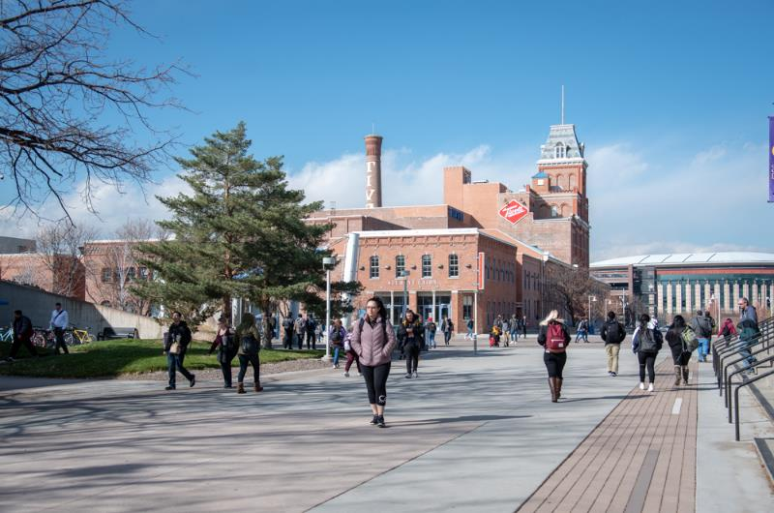
Thank you!
Notes:
See you at the Board next week!

